Slide 1

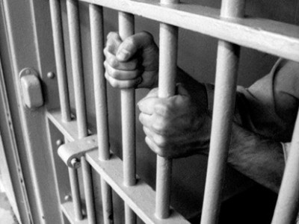

LAW
Mrs Taylor

Slide 2

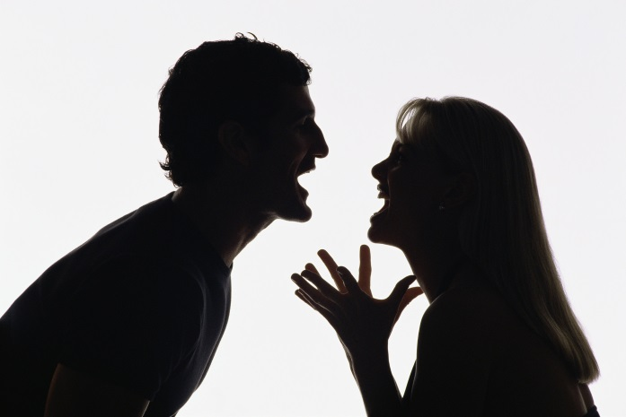
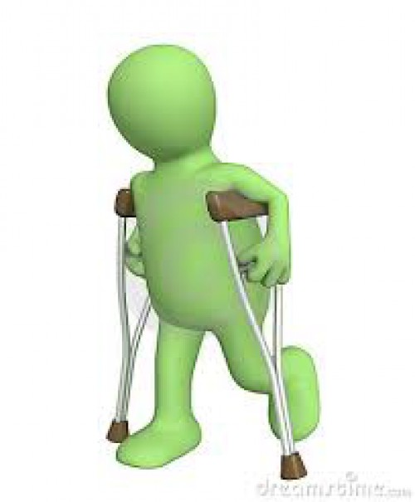


How the law effects us?
Witnessing/ Causing an accident
Road Traffic laws
Domestic abuse
Divorce
Assault
Fatal Offences
Wills
Consumer rights
Contracts
Accidents at work
Tripping/ slipping injuries

Slide 3


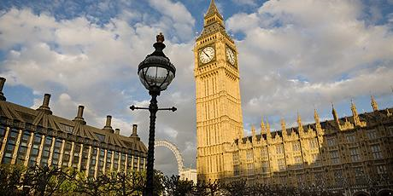
Why study Law?
The law is everywhere.
It helps you to understand how your country is run.
It is relevant to lots of university courses due to its academic rigour, skills and content.

Slide 4



Why study Law at BRGS?
Excellent Results
National Mock Trial Finalists
Specialist UCAS Support
Expert teaching – solicitor
Links with profession
Ofsted ‘Outstanding’
London Trip

Slide 5

How you will be assessed?
3 exams at the end of the course.
Exam Board = AQA for best results (much easier question styles)
Year One – The English Legal System & Criminal law
Year Two – Contract Law & Tort Law
  NO COURSEWORK

Slide 6

Exam Style
All exams have same format
Some multiple choice questions
Some short answer questions
Some scenarios
You will show your knowledge of the law.
You will apply the law to scenarios.
You will evaluate and criticise the law.

Slide 7
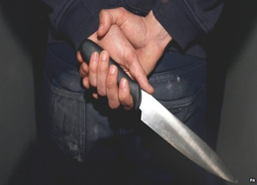

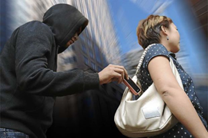

Paper 1: Criminal Law &
English Legal System
TOPICS WE STUDY
CASES WE STUDY
Murder, Manslaughter
Assault, Battery
ABH, GBH
Theft, Robbery
Attempted crimes
Defences used in court
Criminal courts, Juries
Prison sentences, Judges
Legal professionals
Man tries murdering mum with poison!
Son murders mum to inherit her money!
Man convicted of stealing his own car!
Body parts stolen!
Abortion cases
Rape cases
Man caught masturbating in public toilets!
Prostitutes approaching men in the street!

Slide 8
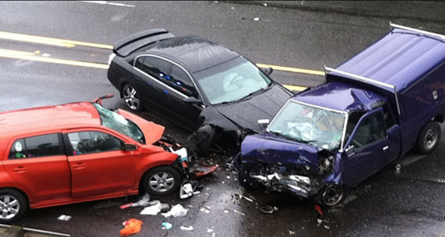



Paper 2: Tort Law
Injuries or financial loss sustained in a road traffic or other accident caused by someone's negligence.
Famous case created the law of negligence when a decomposed snail was found in a bottle of ginger beer.
How to claim compensation.
Why some people cannot claim compensation such as some affected by the Hillsborough disaster.

Slide 9


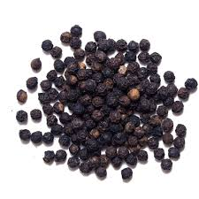

Paper 3: Contract Law
What are your rights when you buy something from Ebay or the internet?
Can you get your money back when that top you purchased shrinks in the wash?
Can your employer insist you work that shift?
What relevance do peppercorns have to the Law of Contract?

Slide 10


Grievous Bodily Harm
Can you inflict GBH on someone without violence?

Slide 11

Case 1:
The defendant was diagnosed as being HIV positive. Knowing of this he had unprotected sexual intercourse with two women.
Woman 1: Intercourse was without protection as he told her he had had a vasectomy.
Woman 2: He had used protection initially but later in the relationship had unprotected sex.
He claimed that both were aware of his condition and had consented to unprotected intercourse with full knowledge of the risk.
The women disputed this.

Slide 12

What did the court do?
Guilty
Biological GBH-HIV

Slide 13

Case:
D infected his girlfriend with incurable genital herpes virus (painful red blisters in the genital area, discomfort, itching, and flu-like symptoms such as headaches and fever. The virus can spread to other areas of the body, such as the face and hands, and can also increase the risk of spreading or contracting HIV).
He eventually admitted he had caught the virus from a previous partner, she contacted the police.
D’s doctor's records reported recurring genital herpes and referral to a special clinic several times. In a police interview, D admitted that he had infected her and that he should have informed her of his condition.
Was it serious enough to convict?

Slide 14

What did the court do?
Guilty
The symptoms were painful and effects were serious enough.

Slide 15
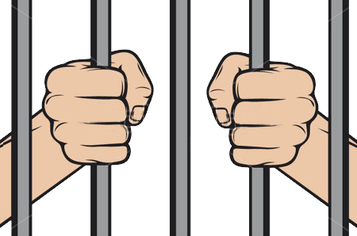
Guilty or Not Guilty?

Slide 16

Liable or Not Liable?

Slide 17

Liable or Not Liable?

