Slide 1
Welcome to Year One
Meet the Team

Slide 2
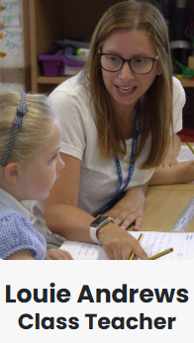
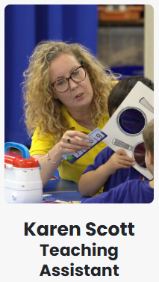
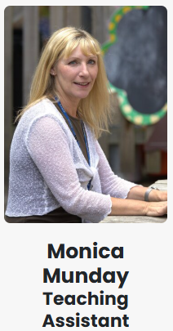
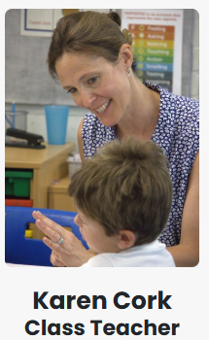
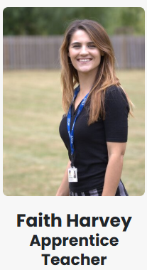
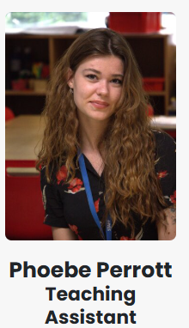
Who’s Who
Miss Andrews
Mrs Scott
Mrs Munday
Miss Cork - Tuesday to Friday
Miss Harvey – Monday to Thursday
Miss Perrott
Notes:
Please list not only class-based staff but also staff that they are likely to come across, i.e. PPA cover.

Slide 3
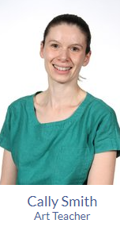

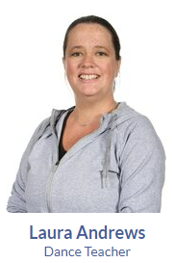
Who’s Who
Mr Miles, Thursday (Music)
Mrs Smith, Wednesday (Art)
Stewart Bristow Thursday (Tennis)
Laura Andrews (Dance)

Slide 4
Walk around village
Our walk around the village is on Tuesday 30th September.
If you are able to volunteer to help, please let us know!

Slide 5
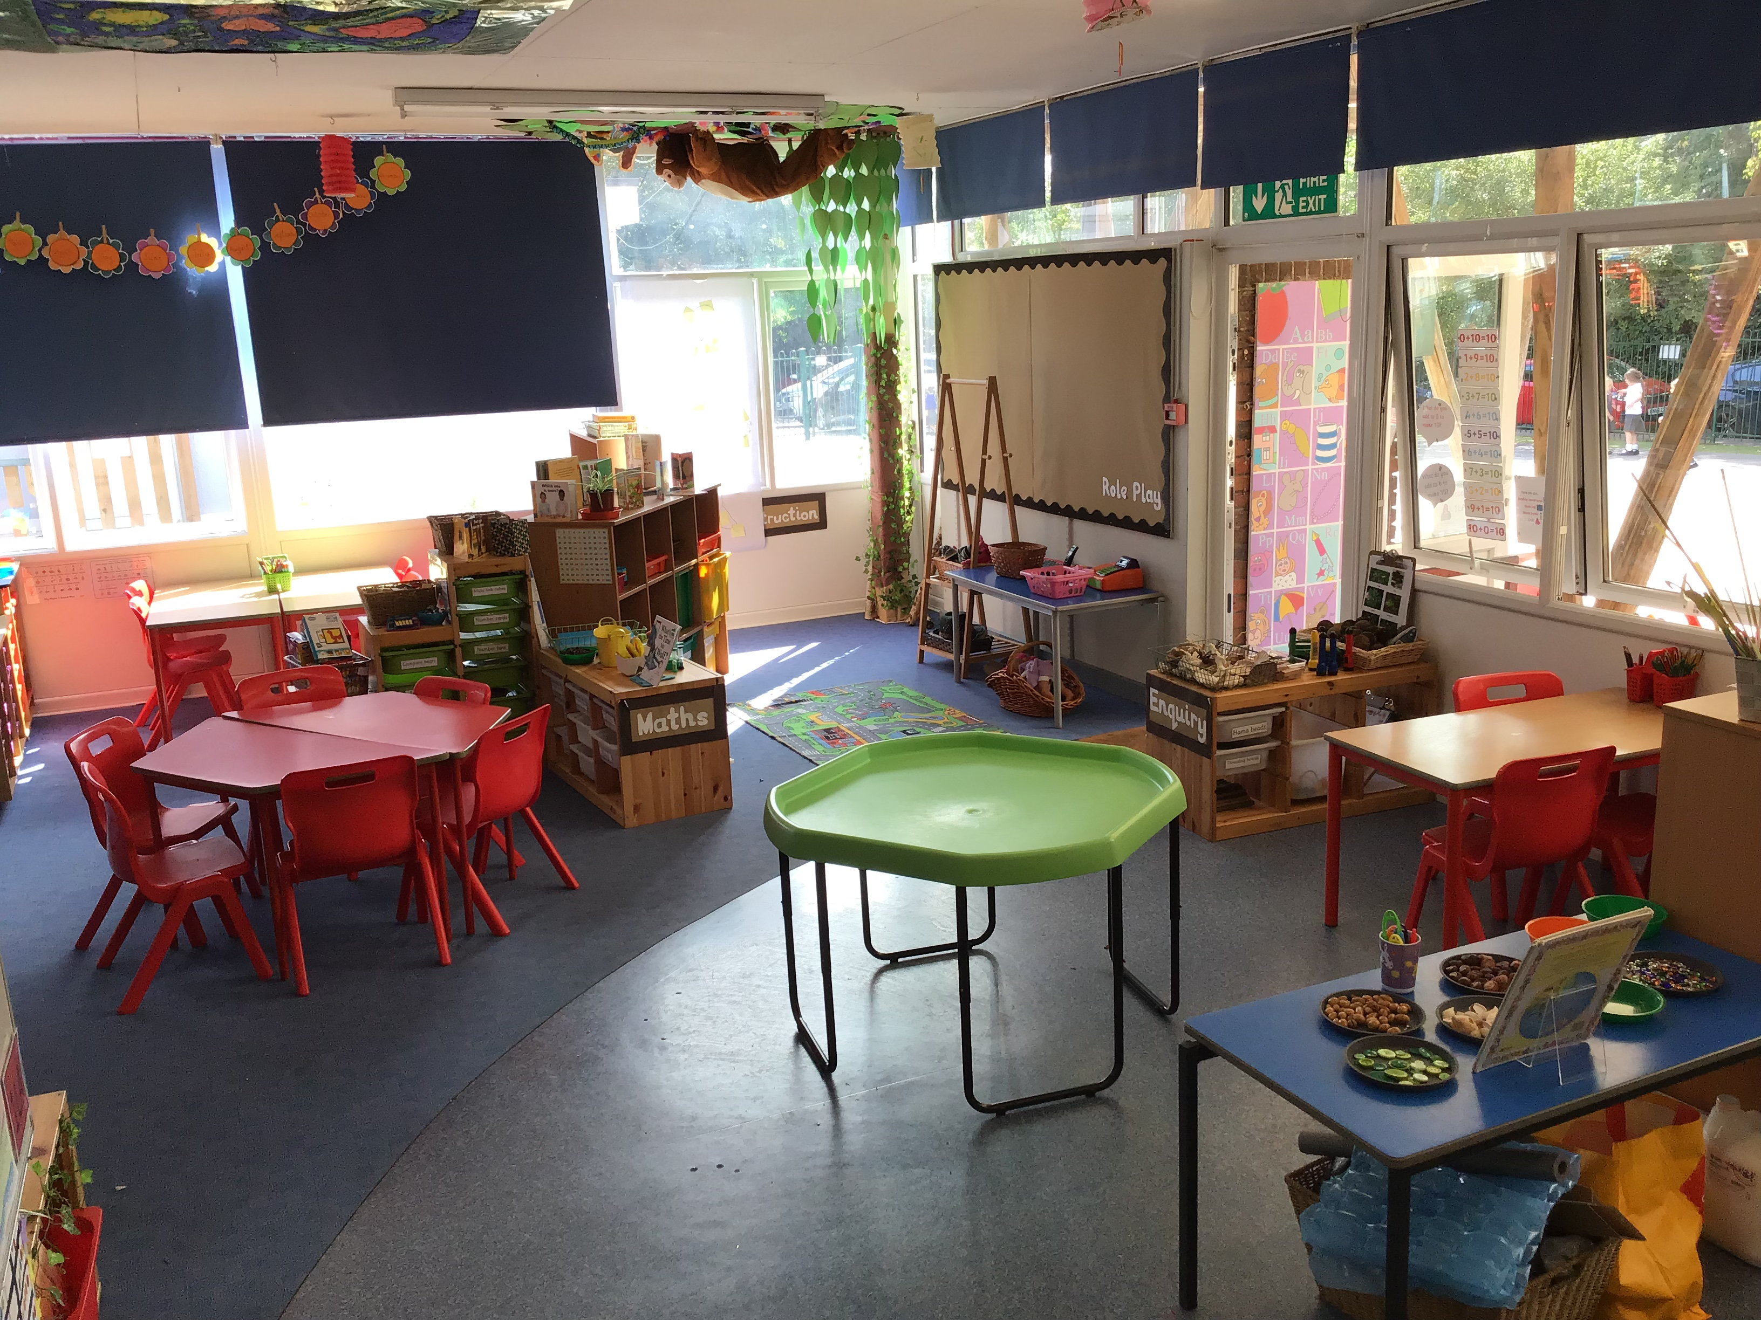
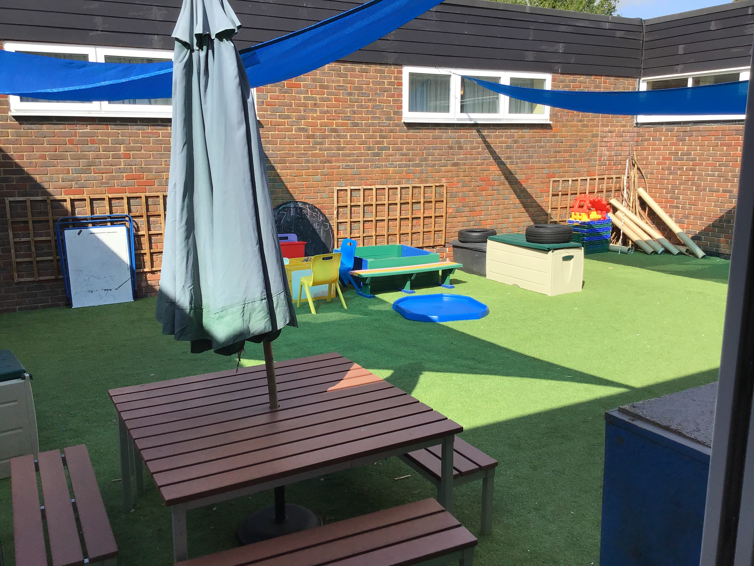
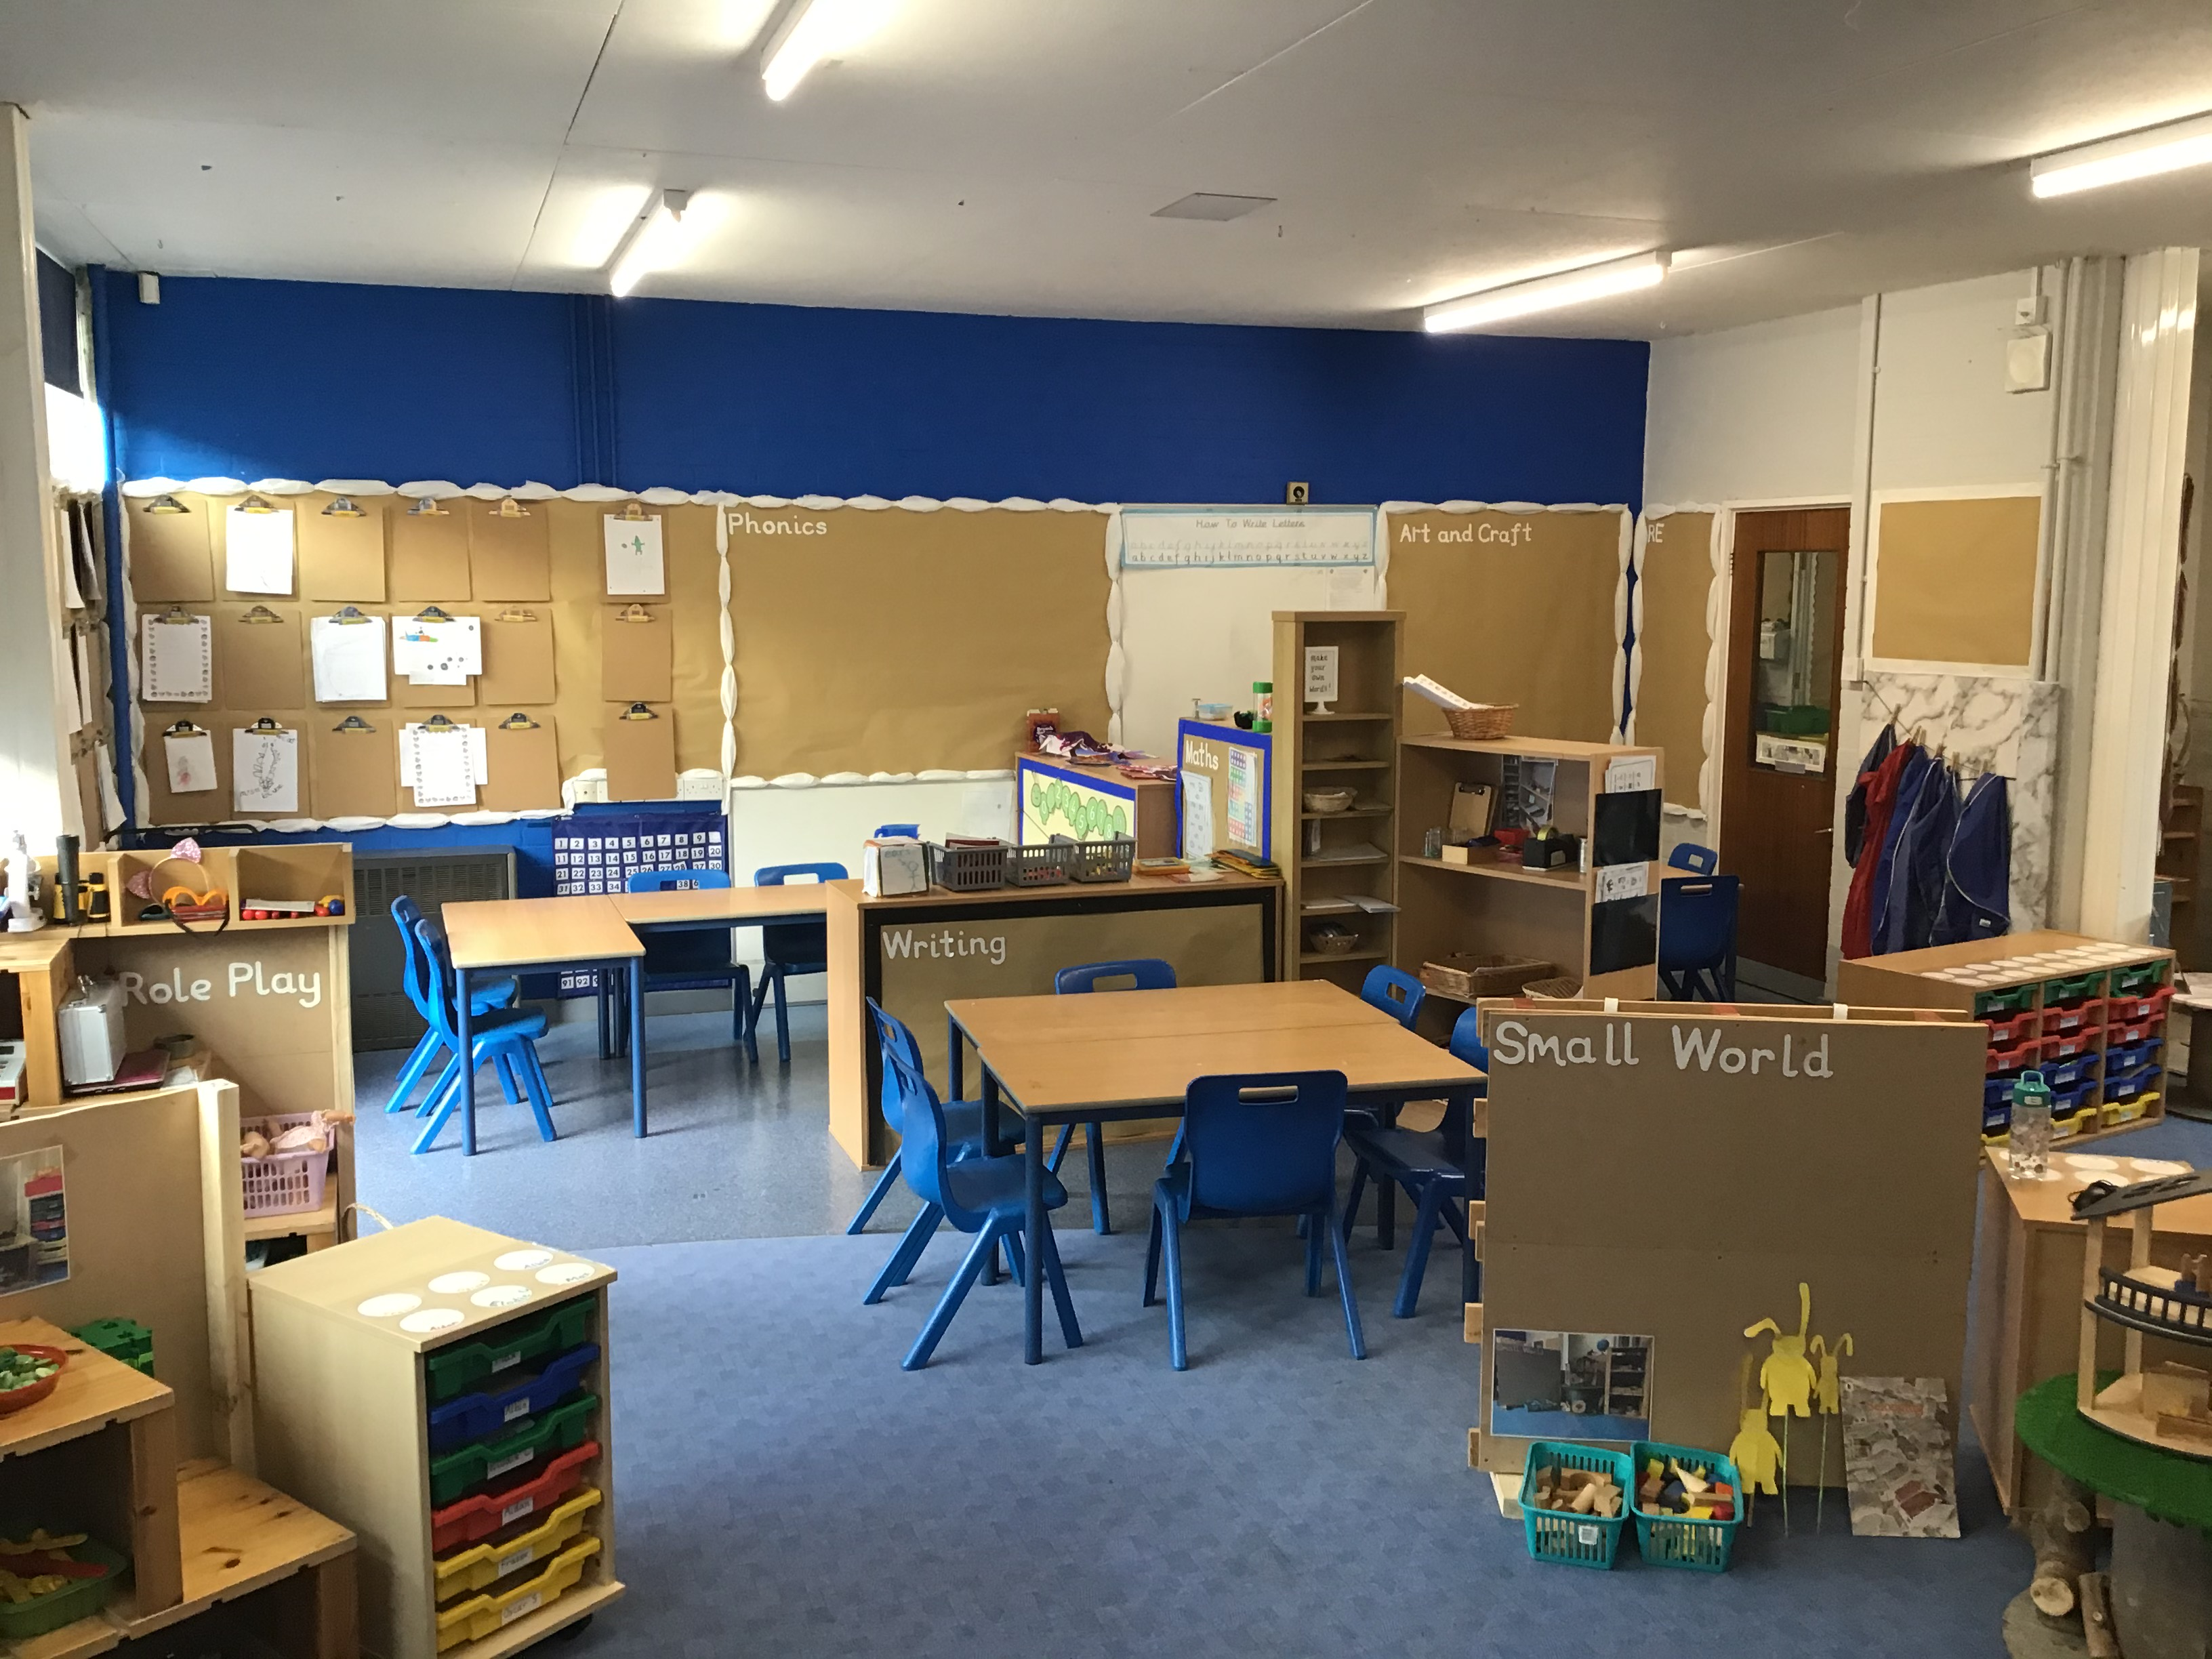
Year One
Classroom environments
Outdoor area
Continuous provision meets
National Curriculum
Notes:
What makes your year unique?
Swimming
Resi trips
Productions
SATS
Phonics
Etc.

Slide 6
Curriculum
How we teach in Year One: In Reception the children were receiving three adult inputs (plus a story and collective worship) each day and the rest of the day was exploring time. This is when the children access the indoor and outdoor environments and select their own activities. So this has been our starting point.
Topics which make our learning meaningful. Cross-Curricular lessons where relevant.
As the year progresses the adult directed activities will increase, however there will continue to be sessions of exploring time every week.
In addition we have music, tennis and art lessons. For Computing we will be the classroom this term and then we’ll be going up to the Computer room after October half term.

Slide 7
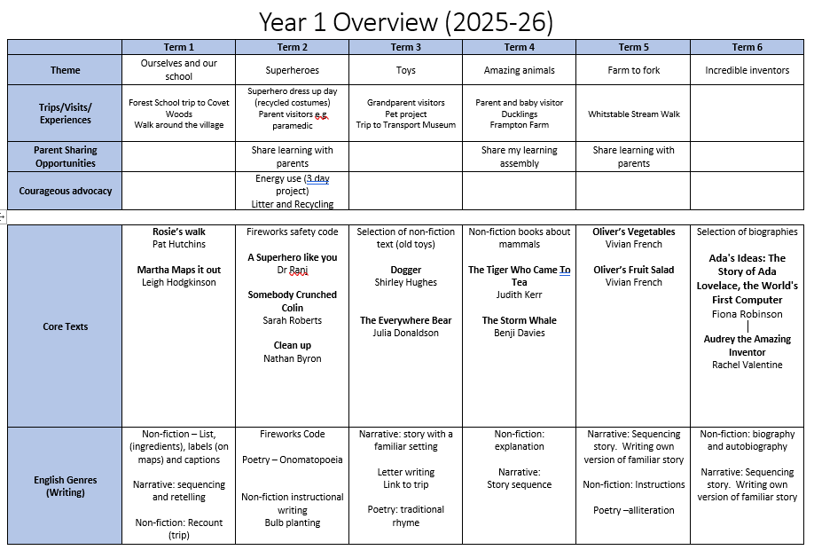

Slide 8
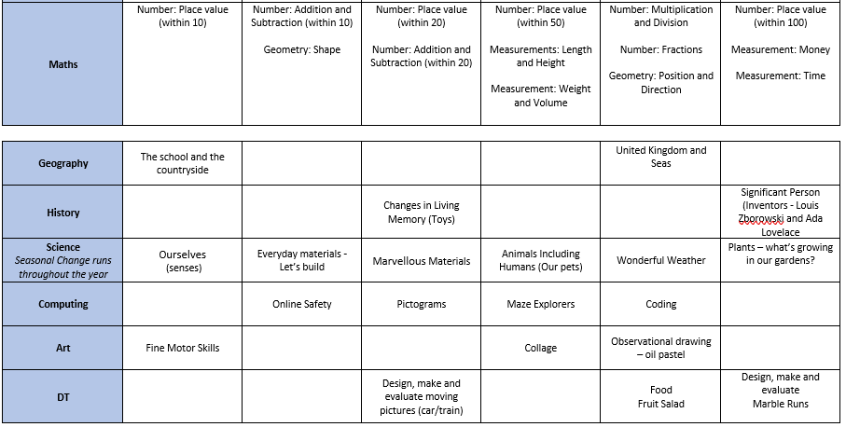

Slide 9
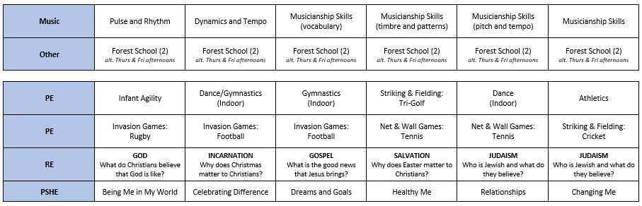

Slide 10
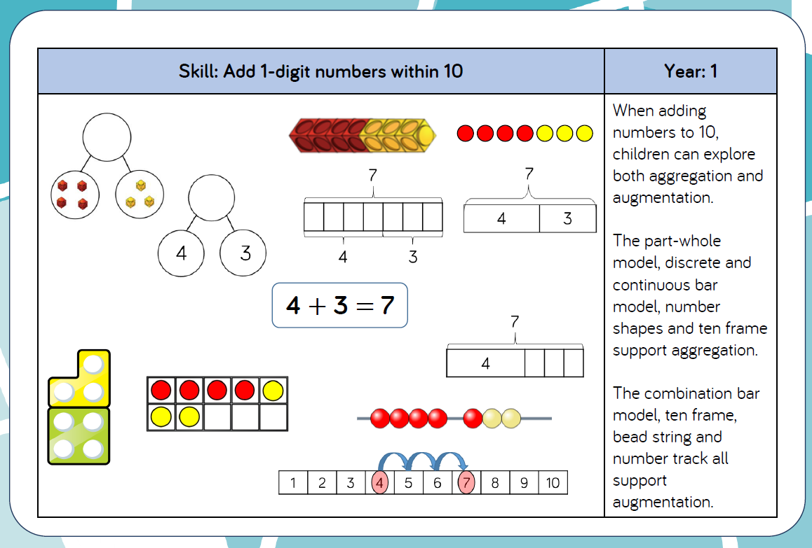

Slide 11
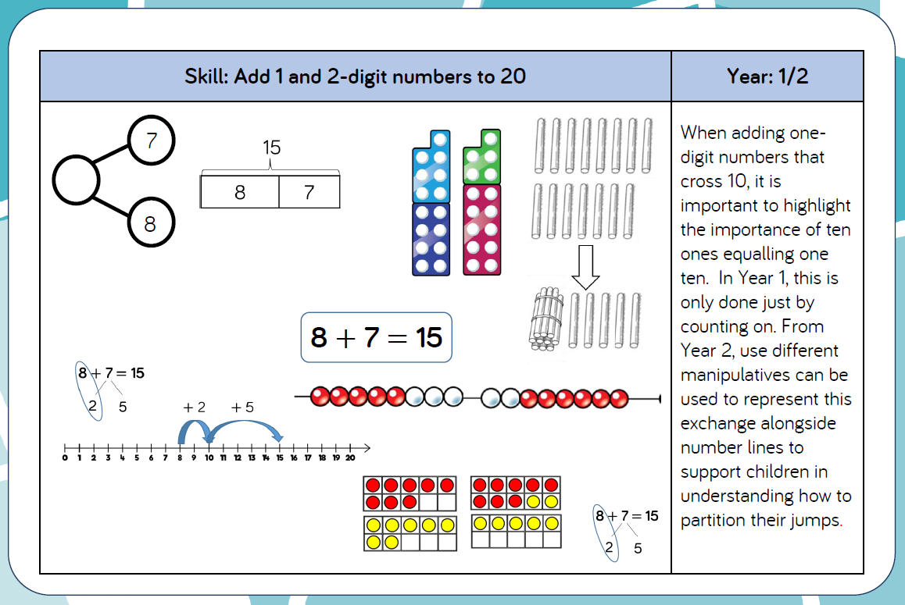

Slide 12
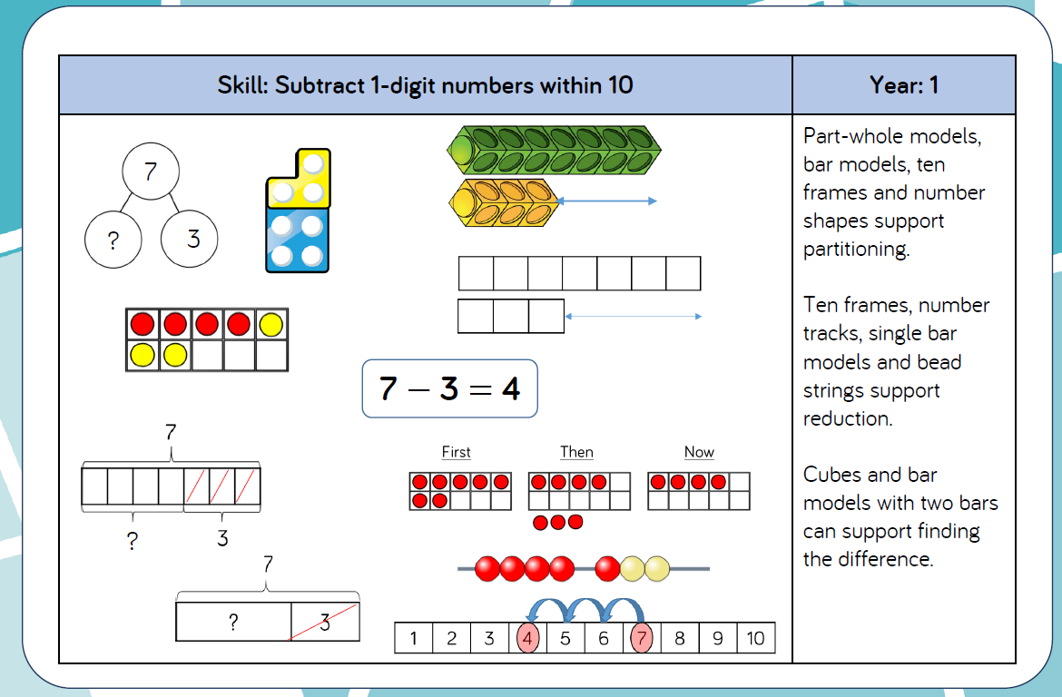

Slide 13
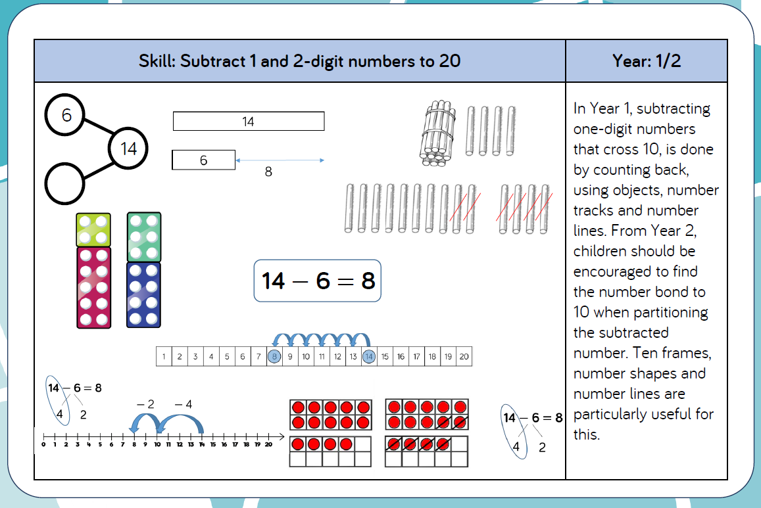

Slide 14



Slide 15


Slide 16
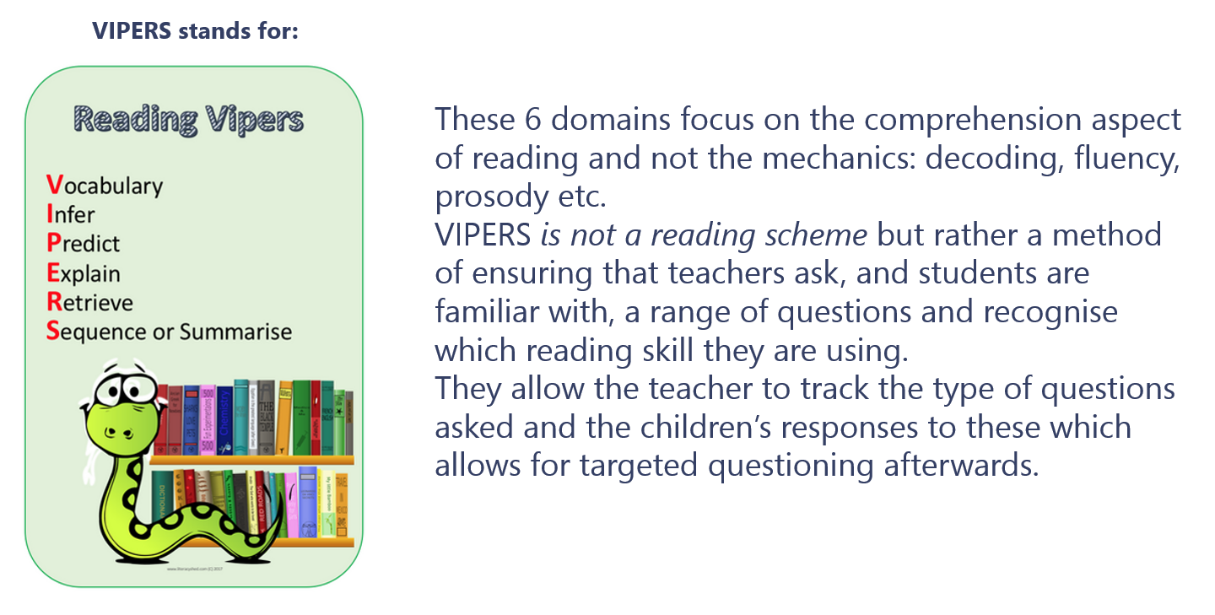

Slide 17
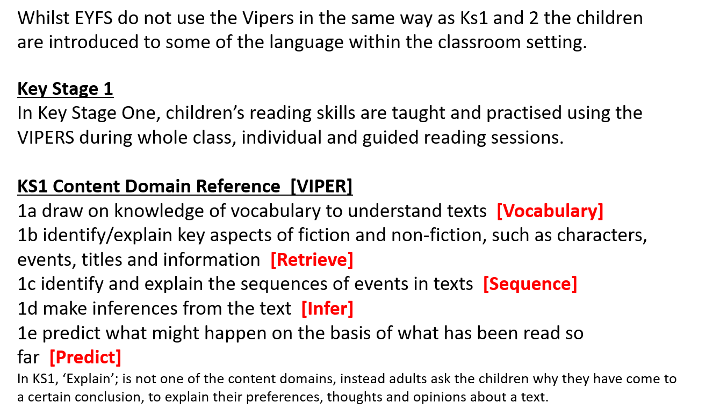

Slide 18


Home-Learning
Reading
We would encourage you to share books with your children daily. Three school reading books are being sent home each week and we would suggest that they are each read at least twice. We would encourage you to ask questions about the context of the story or information, ask them to recall details from the text and ask them how the characters might feel or what they found interesting.
READING STARS
Maths
Maths practise at home can be counting songs and rhymes, counting objects in everyday activities, board games and online activities.
ictgames || html5 Home Page
1-Minute Maths (whiteroseeducation.com)
Termly Key Knowledge & Skills
At the beginning of each term, teachers will send home a page of words for reading and spelling and recall facts for maths to support children’s learning at home. These can also be found on the Class Pages of our school website.
Notes:
Taken from school website

Slide 19
Behaviour & Expectations
Ready, Respectful, Safe
The Restorative Approach
Incidences of negative behaviour are dealt with in a fair, respectful and appropriate way, with the key focus on individuals taking responsibility for their behaviour, repairing any harm done, rebuilding and restoring relationships. The key principle when dealing with issues is to give all the people involved a chance to have their say and become actively involved in the process. All members of staff and children know that issues will be dealt with fairly with a ’no blame’ approach.

Slide 20
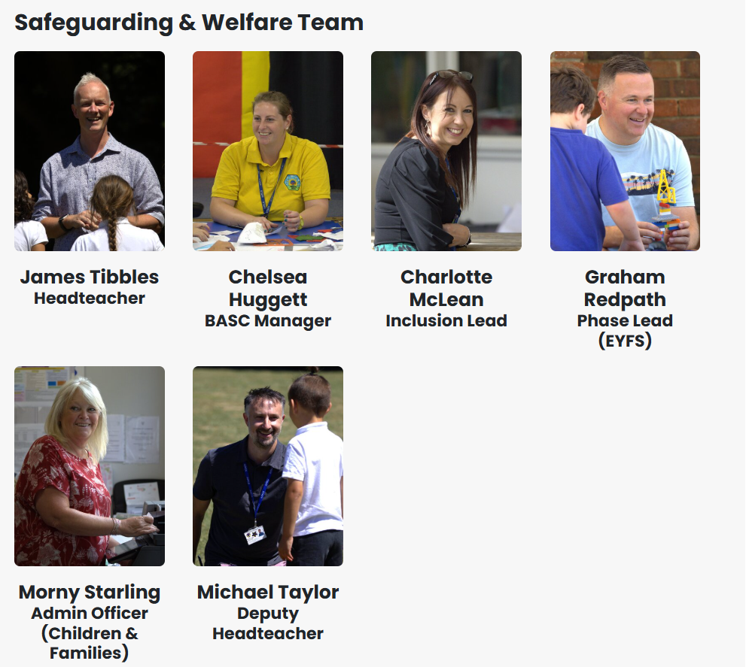
Please speak to any of Safeguarding Team with any concerns.
For more information about ways to stay safe online please look at the school website which includes lots of information and practical advice.

Slide 21
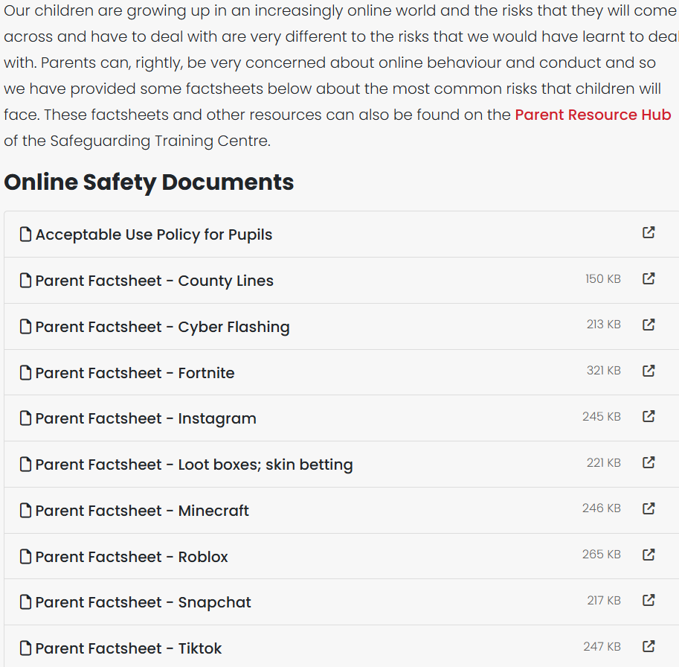
Safeguarding (Online Safety)
Notes:
highlight online safety pages and links to resources for parents

Slide 22
School/Parent Partnership
We pride ourselves on our open relationships with parents and together we:
Respect and support our school’s values
Encourage children to challenge themselves and provide the support and environment to maximize their academic potential
Encourage our child to take as full and active part in school life as possible
Support each other, especially regarding attendance, behaviour, online safety and home learning
Work together to safeguard pupils and support their physical, mental and emotional wellbeing.
Ensure that any concerns or issues are directly and promptly addressed through direct contact, telephone or email.

Slide 23
Key Information
PE is on Mondays and Tuesdays this term.
Reading books should be in the children’s book bags everyday. Please write in the record so that we know which books to change on their day.
Forest School is Thursday (Willow), Friday (Rowan) alternate weeks.
Children need to have water in a named water bottle everyday and are allowed to bring their own snack, but this should be fruit or vegetable.

