Slide 1
Welcome to Year 3
Meet the Team

Slide 2
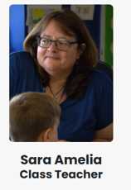
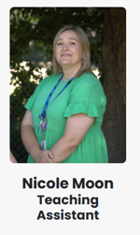
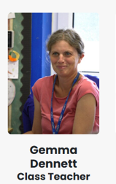
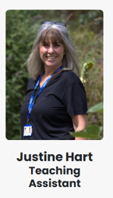
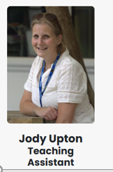
Who’s Who
CHESTNUT
BEECH
Mrs Gillane
Teaching Assistant
Thurs and Fri only
Notes:
Please list not only class-based staff but also staff that they are likely to come across, i.e. PPA cover.

Slide 3
Highlights of Year 3
Ancient Egypt
Samba drumming
Singing – Musical theatre and Opera
Stone Age – including a trip to Wildwood
Paddington
French
Trip to the Gurdwara
Notes:
What makes your year unique?
Swimming
Resi trips
Productions
SATS
Phonics
Etc.

Slide 4
Curriculum Highlights
Volcanoes
Egyptians
Stone Age
Investigating India
European Neighbours
Light and shadows
Animals including humans
Rocks
Forces and magnets
Plants
Music – samba, singing
Art and DT – sewing, clay flower tiles and observational drawing
French
Computing
Courageous Advocacy Project - Palm Oil

Slide 5
Curriculum
Ongoing informal assessments to analyse needs, identify gaps and accelerate learning.
In the foundation subjects, i.e. Geography, there will be greater emphasis on the enquiry skills.
Maths
Number & Place Value
Multiplication Tables (3, 4 and 8s)
Calculations
Fractions
Shape, space and measure
Geometry
Money
Time
Statistics
English
Handwriting
Reading
Phonics & Spellings
A range of fiction and non-fiction writing units linked to an array of texts.

Slide 6
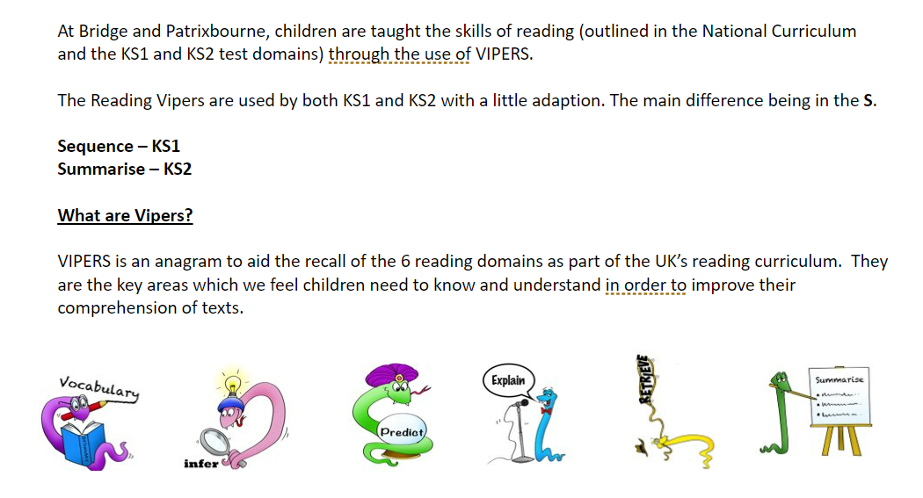
Reading

Slide 7
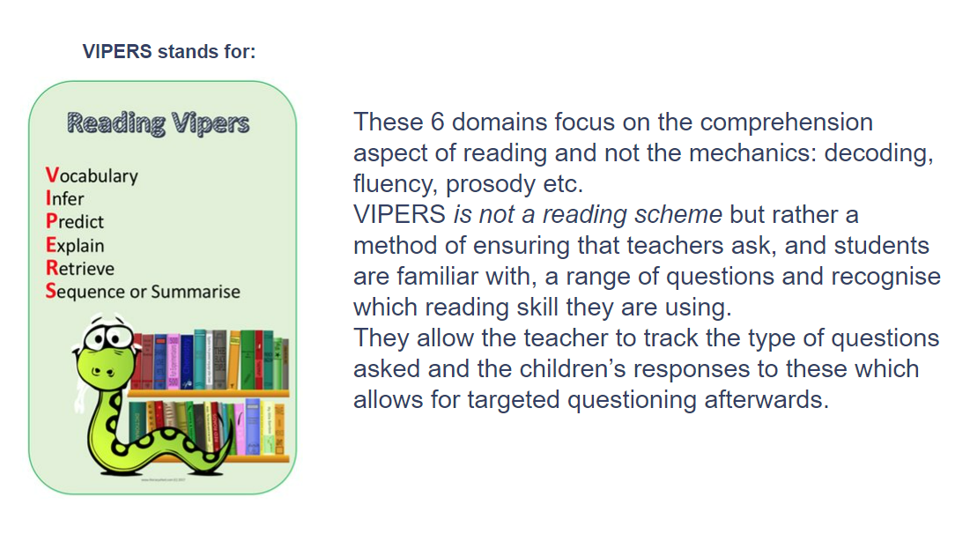

Slide 8
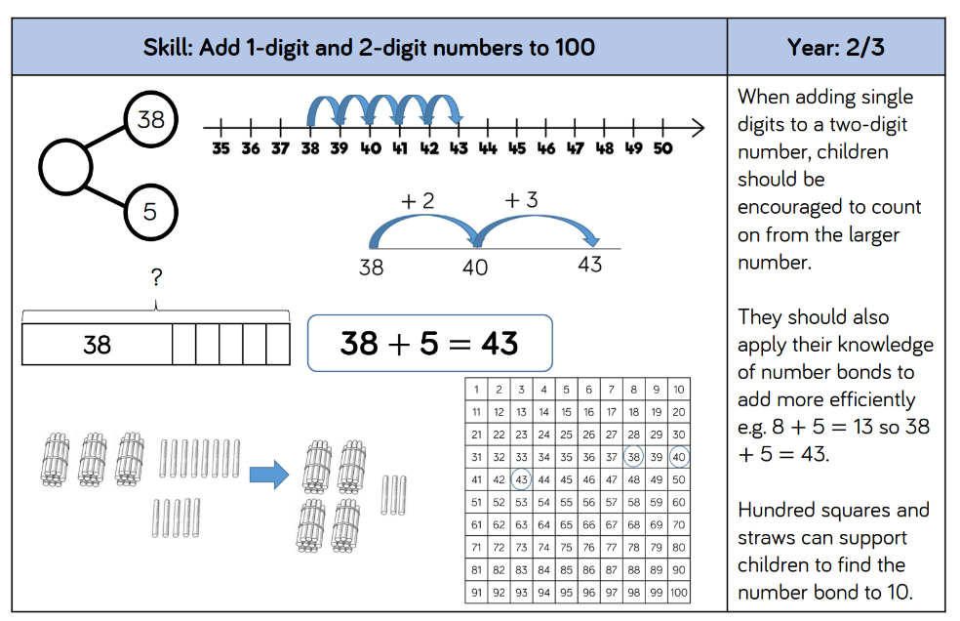
Maths - Addition

Slide 9
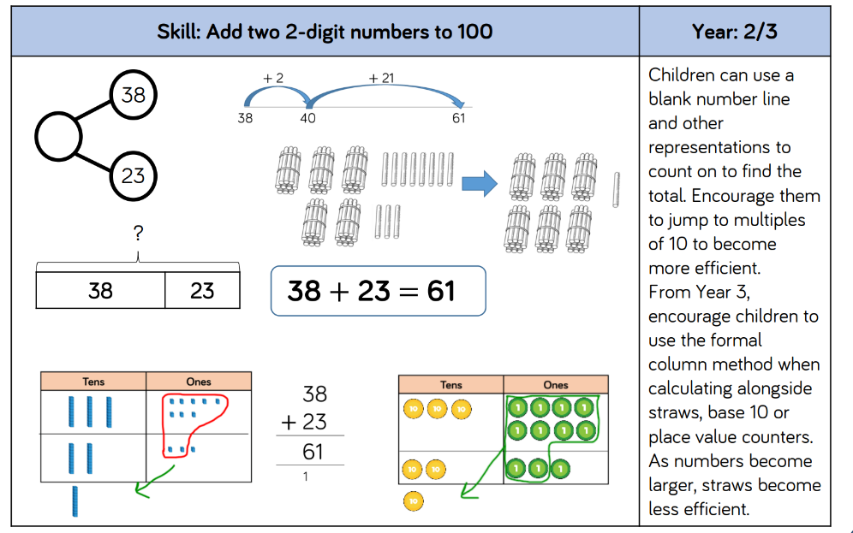

Slide 10
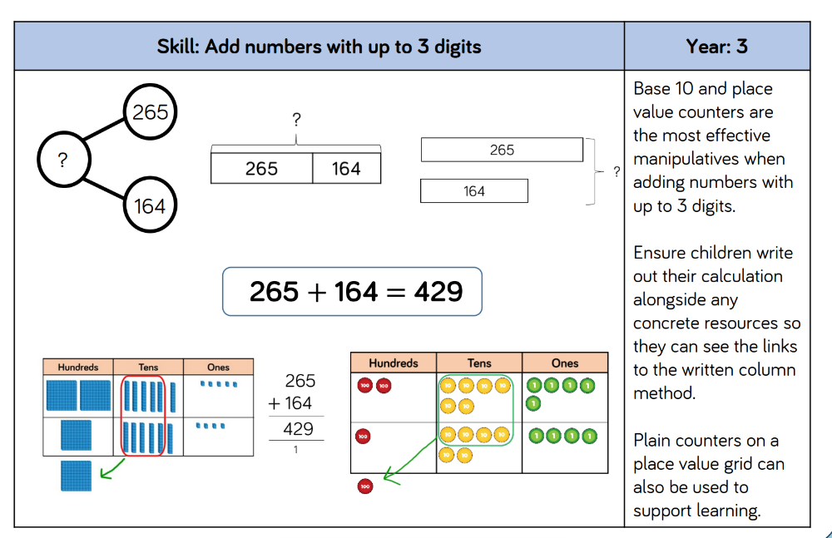

Slide 11
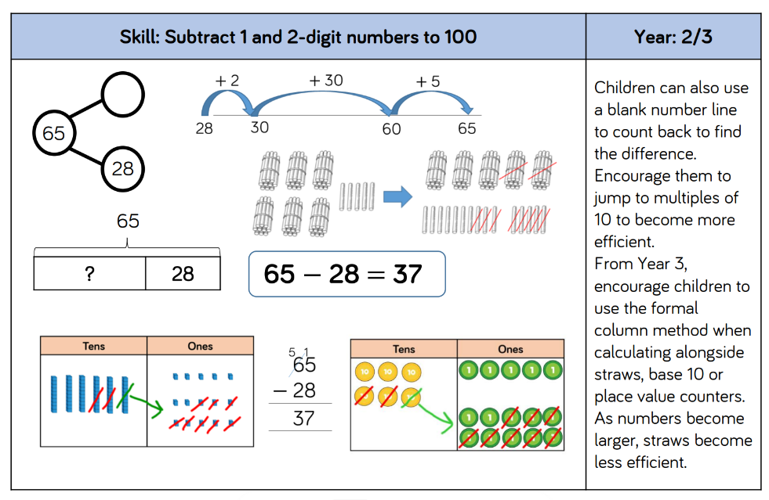
Maths - Subtraction

Slide 12
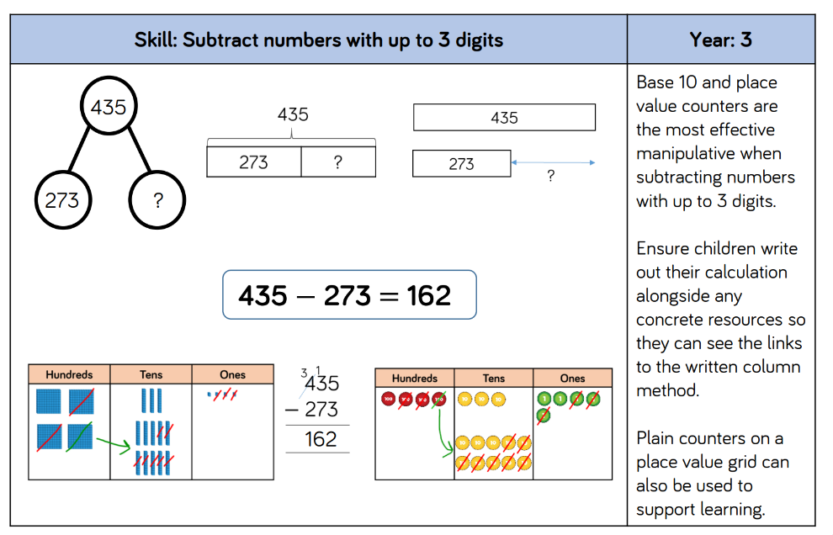

Slide 13
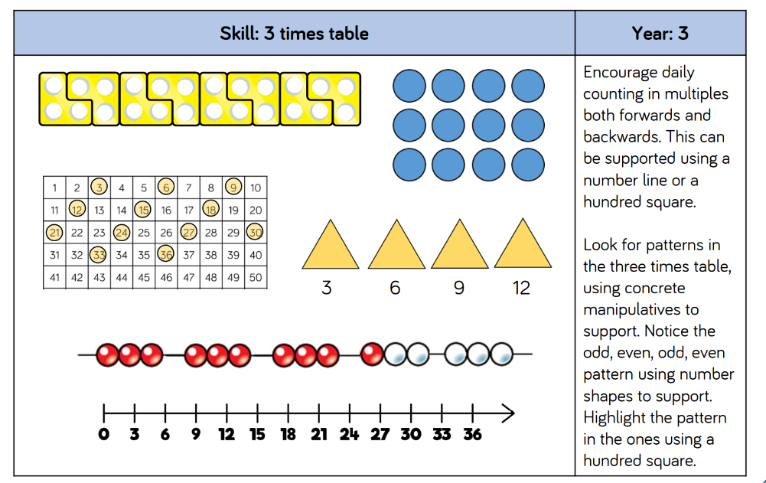
Maths - Multiplication

Slide 14
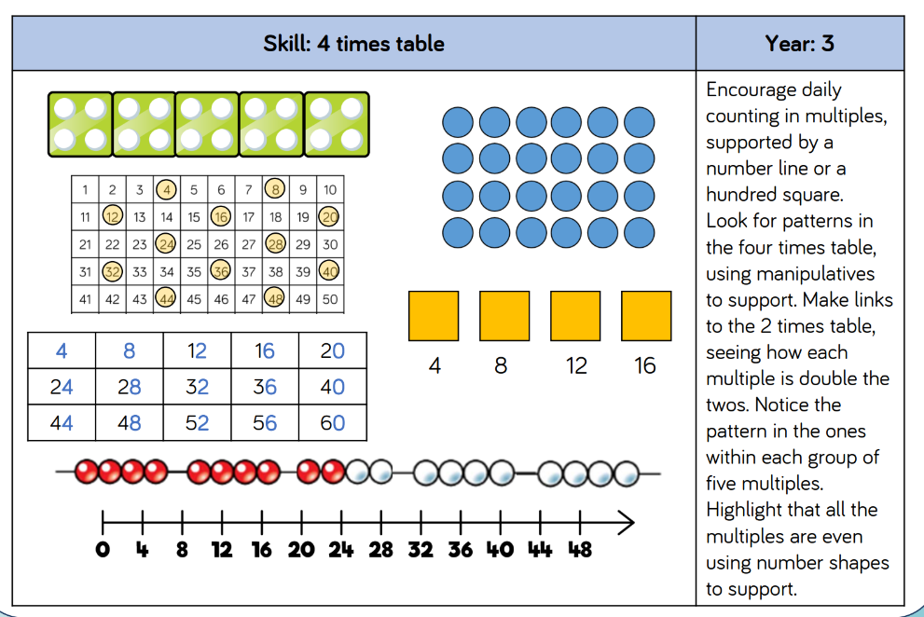

Slide 15
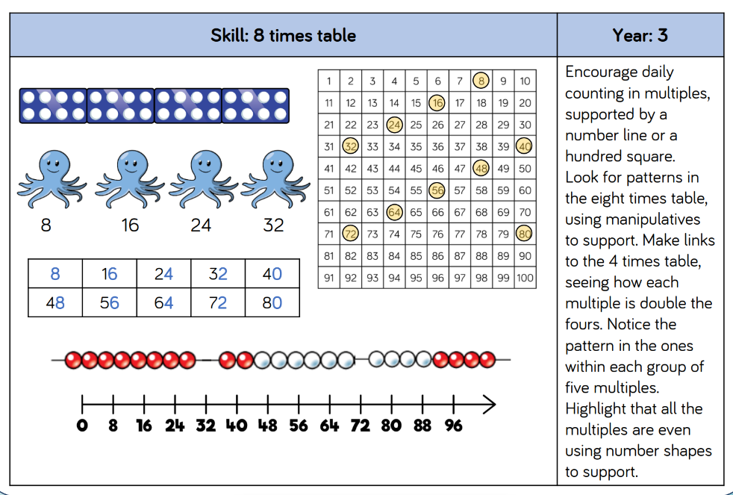

Slide 16
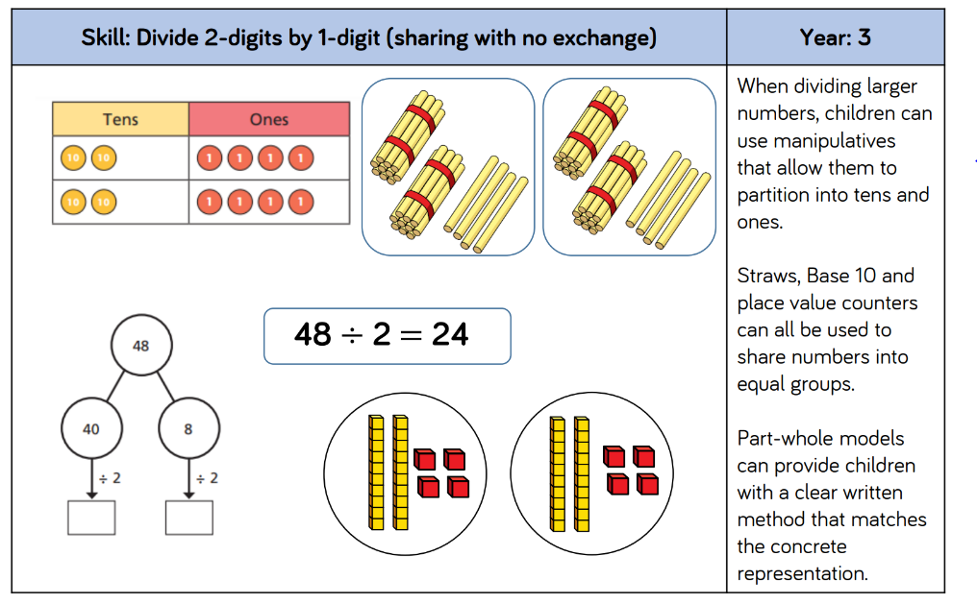
Maths - Division

Slide 17
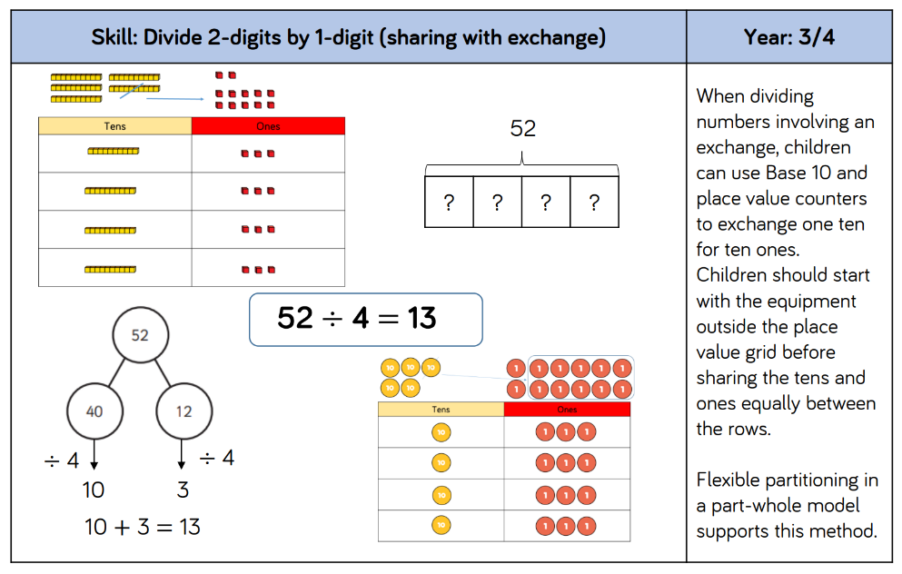

Slide 18
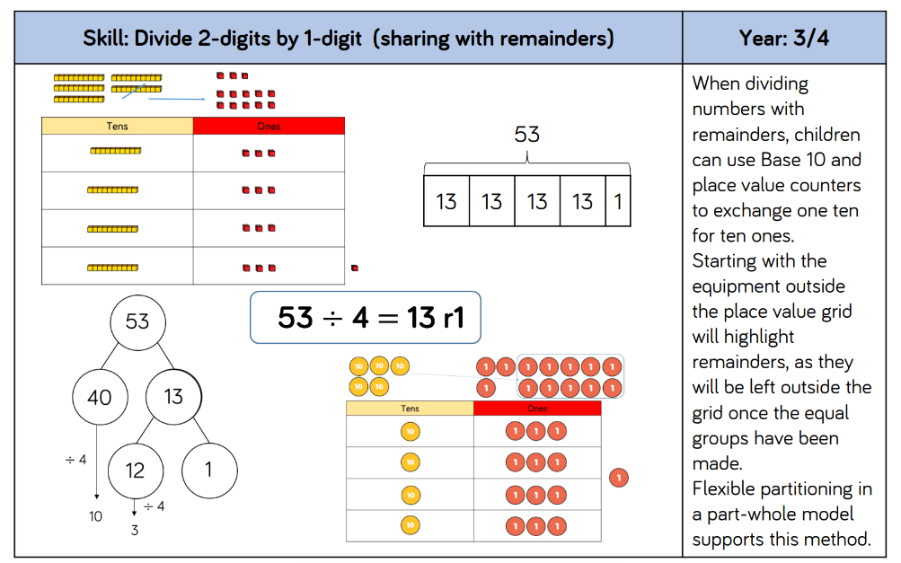

Slide 19
Home-Learning
Reading
Children may read to an adult, with an adult or read to themselves, in the presence of an adult. The story and characters should be talked about and new words discussed.
Termly Key Knowledge & Skills
At the beginning of each term, teachers send home an information leaflet detailing key mathematical and grammatical concepts as well as spellings that the parents could use to support their learning at home. These can also be found on the Class Pages of our school website.
Notes:
Taken from school website

Slide 20
Home Learning (Reading & Phonics)
It is an expectation that your child reads for a minimum of 20 minutes each night. This ideally would be to an adult so that you can support them not only with the decoding of words, pronunciation, clarification of unfamiliar words and expression but be able to check their understanding of what they have read. Reading is a core area of a child’s education which allows then to access all learning.
Regardless of whether you read with your child or they read alone, please sign their reading record so we can monitor the reading happening outside of the classroom.

Slide 21
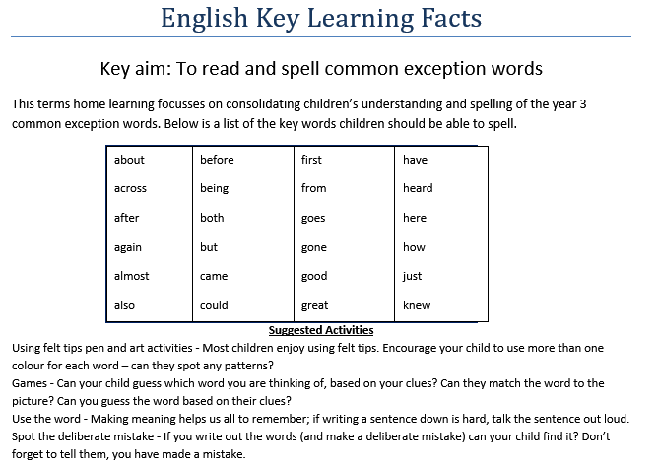

Home-Learning (Spellings)
We will be sending spellings home, each week on a Friday.
Notes:
Show examples of home learning sheet
Spelling Shed

Slide 22
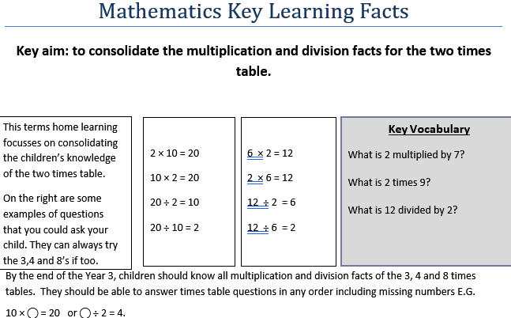
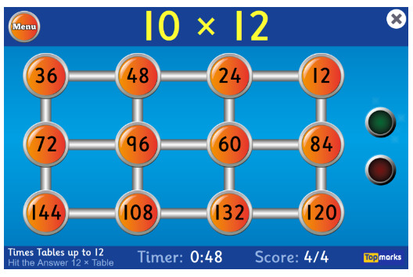

Home-Learning (Maths)
Notes:
Show examples of home learning sheet
Timestables Rockstars

Slide 23
Behaviour & Expectations
Ready, Respectful, Safe
The Restorative Approach
Incidences of negative behaviour are dealt with in a fair, respectful and appropriate way, with the key focus on individuals taking responsibility for their behaviour, repairing any harm done, rebuilding and restoring relationships. The key principle when dealing with issues is to give all the people involved a chance to have their say and become actively involved in the process. All members of staff and children know that issues will be dealt with fairly with a ’no blame’ approach.

Slide 24
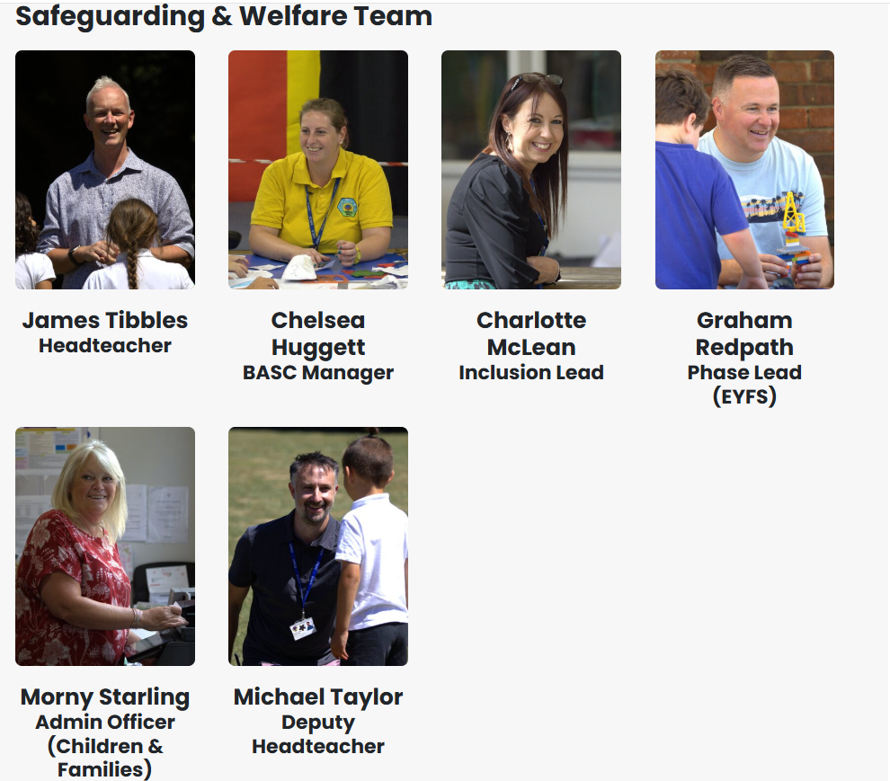
Safeguarding
Our Designated Safeguarding Leads:
James Tibbles
Michael Taylor
Charlotte McLean
Morny Starling
Chelsea Huggett
Graham Redpath
Please speak to any of Safeguarding Team with any concerns.
For more information about ways to stay safe online please look at the school website which includes lots of information and practical advice.

Slide 25
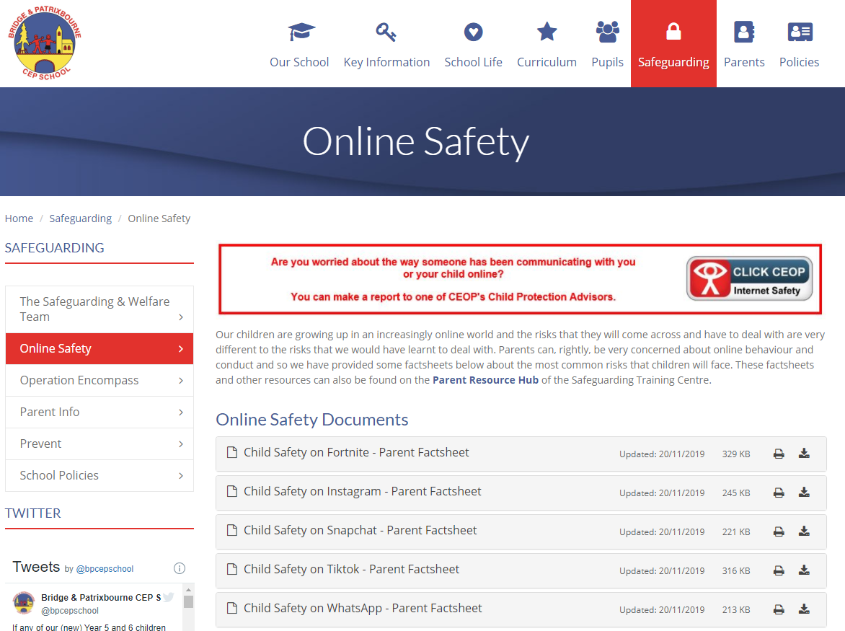
Safeguarding (Online Safety)
Notes:
highlight online safety pages and links to resources for parents

Slide 26
School/Parent Partnership
We pride ourselves on our open relationships with parents, and together we:
Respect and support our school’s values.
Encourage children to challenge themselves and provide the support and environment to maximize their academic potential.
Encourage our child to take as full and active part in school life as possible.
Support each other, especially regarding attendance, behaviour, online safety and home learning.
Work together to safeguard pupils and support their physical, mental and emotional wellbeing.
Ensure that any concerns or issues are directly and promptly addressed through direct contact, telephone or email.

Slide 27
Other Key Information
Forest School for both classes will be on a Friday in Term 1.
PE will be on a Tuesday this term.
Please remember to send your child in with a healthy snack and a water bottle.
Children aren’t allowed to bring toys in from home such as Pokemon Cards, etc.
Check that jumpers, coats, etc have names in.
Your child is now allowed to bring a small pencil case. It just needs to fit into their tray.

Slide 28

Any Questions

