Slide 1

Welcome to Year 6

Slide 2
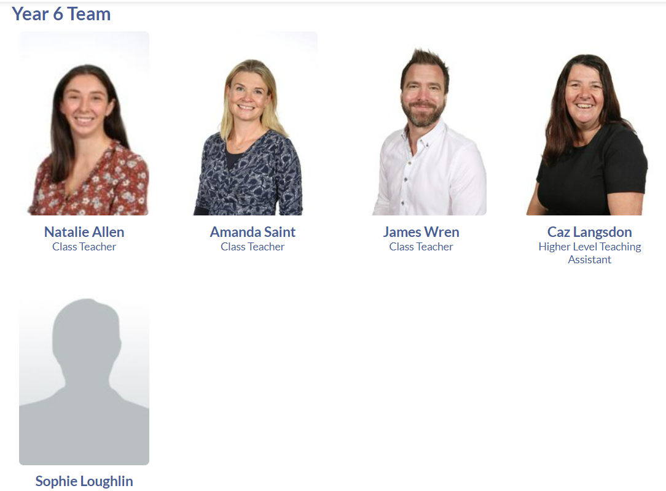
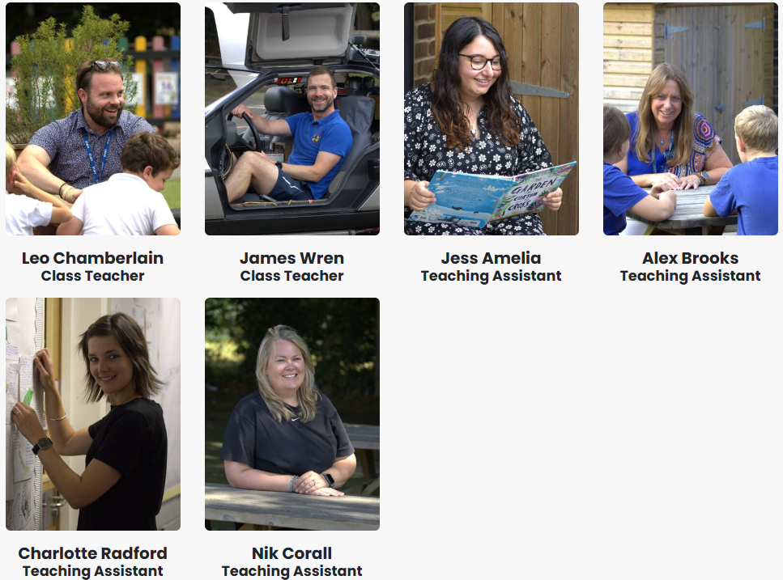
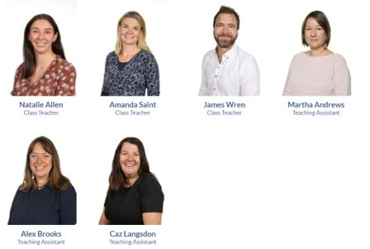
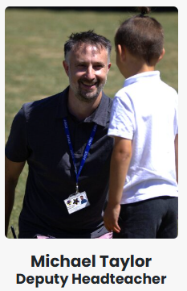
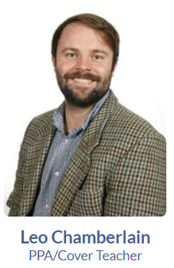
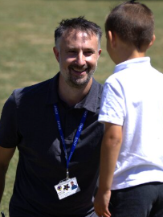
Who’s Who
Mr Chamberlain (Poplar)
Mrs Radford (Poplar)
Miss Amelia (Poplar)
Mr Wren (Sycamore)
Mrs Brooks (Sycamore)
Mrs Corall (Sycamore)
Mr Taylor (Sycamore Fridays)
Mr Miles (Music)
Mrs Smith (Art)
Notes:
Please list not only class-based staff but also staff that they are likely to come across, i.e. PPA cover.

Slide 3
Highlights of Year 6
Top of the school privileges – benches, monitor roles, house captains
Residential (PGL) - we hope they arrive back suitably tired
School Production (summer term)
Secondary transition
Bikeability
Notes:
What makes your year unique?
Swimming
Resi trips
Productions
SATS
Phonics
Etc.

Slide 4
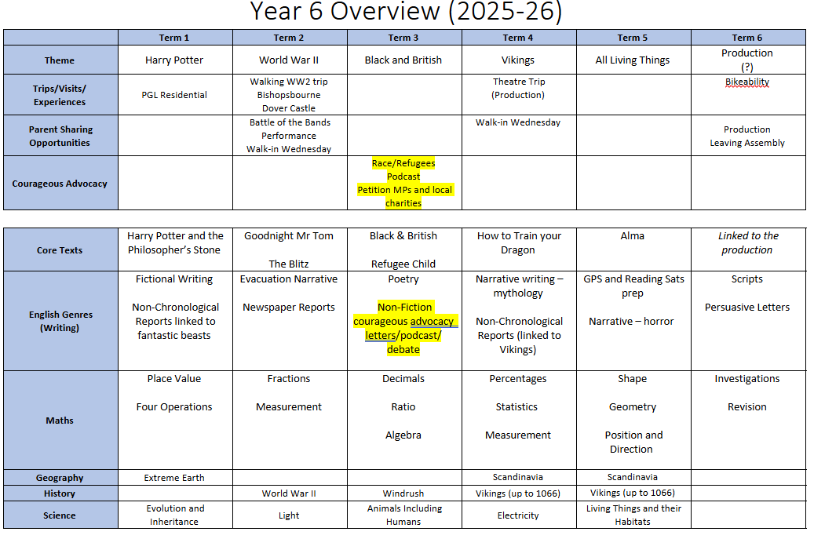

Slide 5
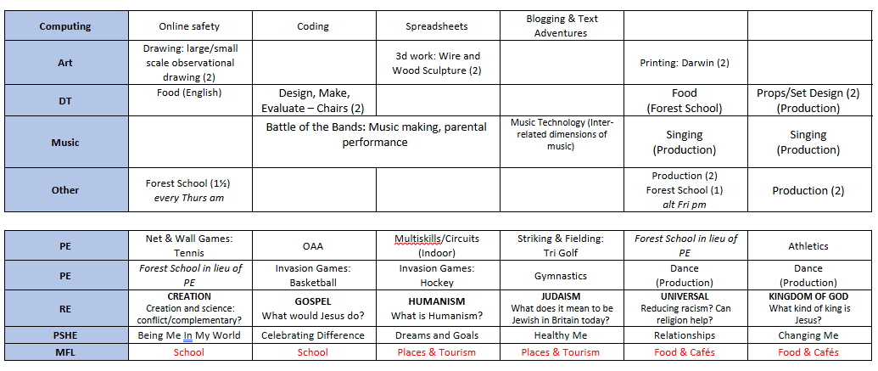

Slide 6

Home-Learning
Reading
Children may read to an adult, with an adult or read to themselves, in the presence of an adult. The story and characters should be talked about and new words discussed. Older children need a clear understanding of the text, and should use evidence from the text to justify their answers and opinions.
Termly Key Knowledge & Skills
At the beginning of each term, there will be a newsletter detailing key mathematical and grammatical concepts as well as spellings that the parents could use to support their learning at home. These can be found on the Class Pages of our school website.
Notes:
Taken from school website

Slide 7
Home Learning (Maths and English)
Children will soon receive their home learning books for English and Maths.
Each Friday, children will take these home and be expected to carry out one ‘workout’ from each.
The hand-in deadline is the following Wednesday.
Work will be marked in class with an opportunity for children to go through any concepts they are unsure of.
NB – The answers are in the back of each book respectively. Children are encouraged to avoid turning to this page before answering their questions independently. If you feel this is too tempting, please feel free to cut out the answers and keep them.

Slide 8
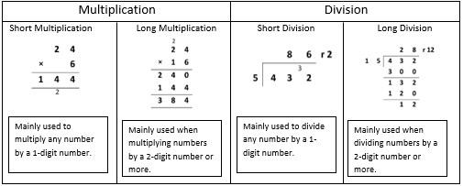

Home-Learning (Maths)
Notes:
Show examples of home learning sheet
Timestables Rockstars

Slide 9
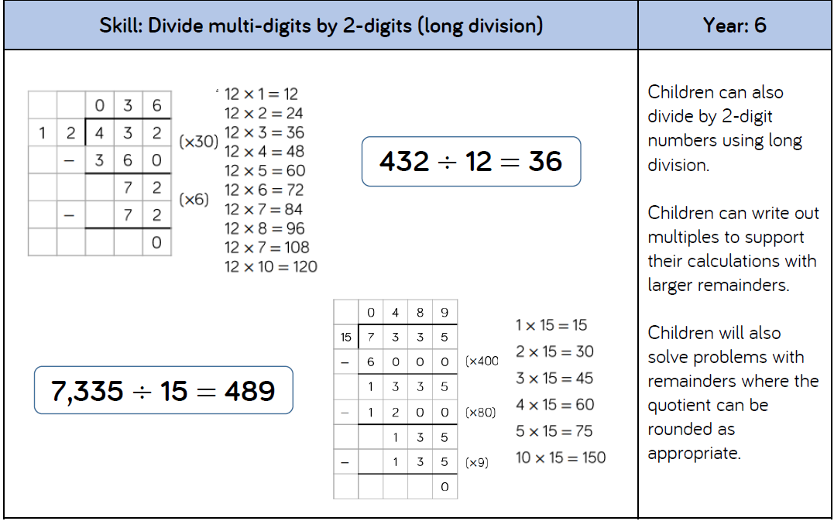
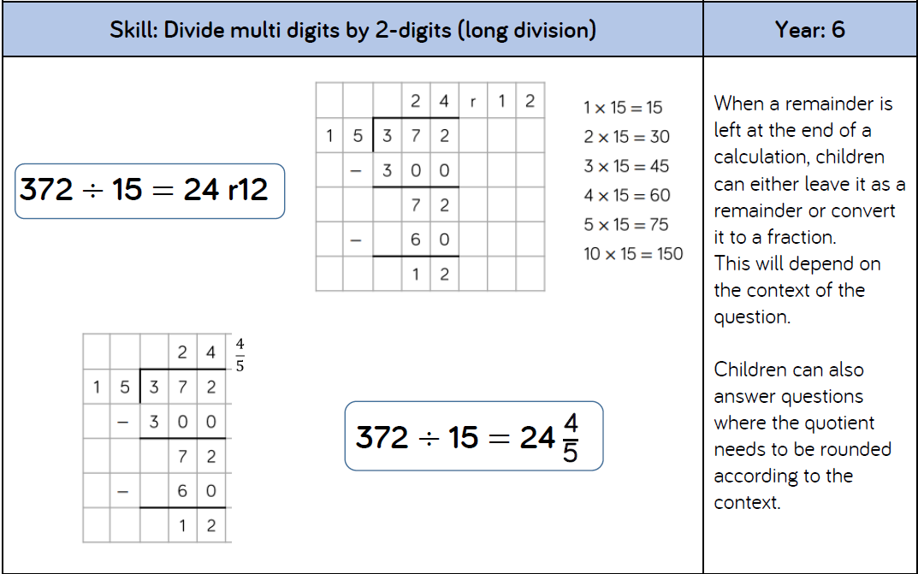
Home-Learning (Maths)
Notes:
Show examples of home learning sheet
Timestables Rockstars

Slide 10
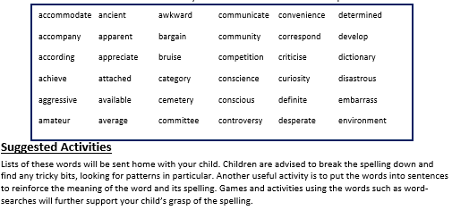

Home-Learning (Spellings)
Notes:
Show examples of home learning sheet
Spelling Shed

Slide 11

Behaviour & Expectations
Ready, Respectful, Safe
The Restorative Approach
Incidences of negative behaviour are dealt with in a fair, respectful and appropriate way, with the key focus on individuals taking responsibility for their behaviour, repairing any harm done, rebuilding and restoring relationships. The key principle when dealing with issues is to give all the people involved a chance to have their say and become actively involved in the process. All members of staff and children know that issues will be dealt with fairly with a ’no blame’ approach.

Slide 12
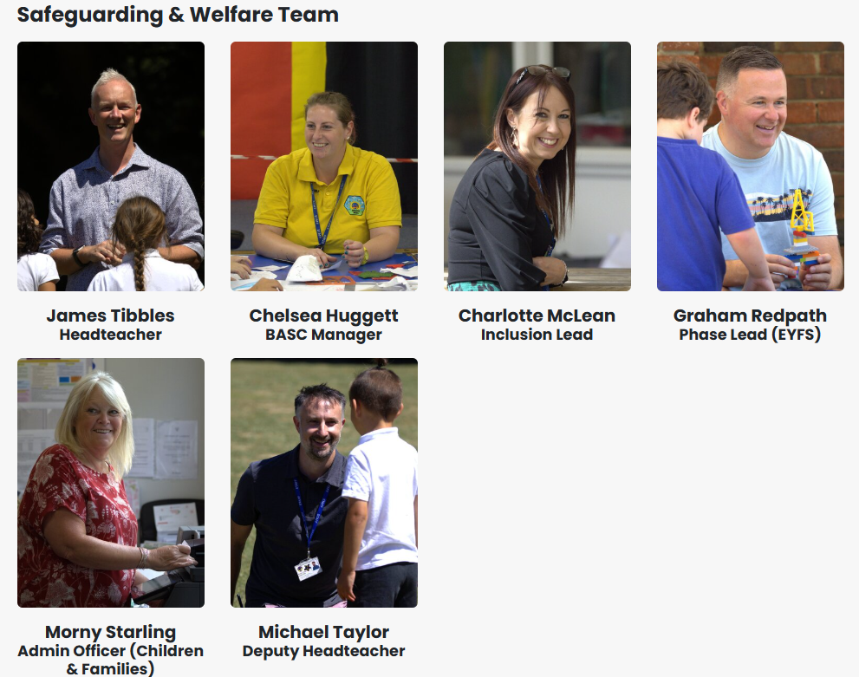
Safeguarding
Our Designated Safeguarding Leads:
  James Tibbles
  Michael Taylor
  Charlotte McLean
  Morny Starling
  Graham Redpath
  Chelsea Huggett
Please speak to any of Safeguarding Team with any concerns.
For more information about ways to stay safe online please look at the school website which includes lots of information and practical advice.

Slide 13
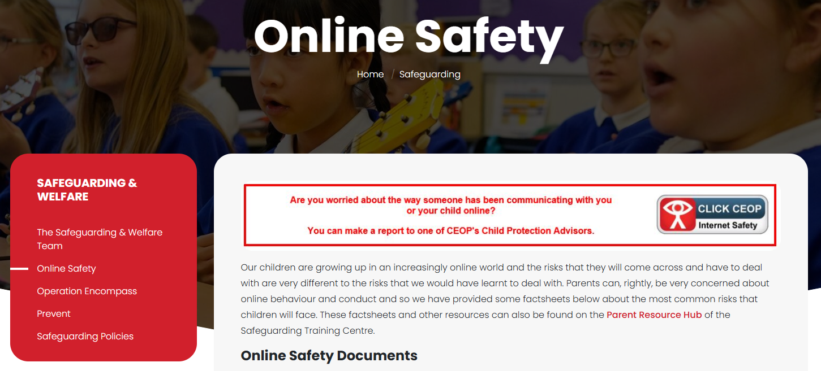
Safeguarding (Online Safety)
Notes:
highlight online safety pages and links to resources for parents

Slide 14
School/Parent Partnership
We pride ourselves on our open relationships with parents and together we:
Respect and support our school’s values
Encourage children to challenge themselves and provide the support and environment to maximize their academic potential
Encourage our child to take as full and active part in school life as possible
Support each other, especially regarding attendance, behaviour, online safety and home learning
Work together to safeguard pupils and support their physical, mental and emotional wellbeing.
Ensure that any concerns or issues are directly and promptly addressed through direct contact, telephone or email.

Slide 15

Key Information
PE days – Wednesday (Tennis) and Thursday (Forest School)
Please note this may change in future terms – PE will replace forest school in term 2.
School library – Friday is usually our slot to changes books as a class but this can also be done during lunchtimes
Parent Consultations will take place late September/early October. Dates TBC.
Walk-in Wednesdays: 12th November 14:45 / 25th February 14:45

Slide 16

PGL quick reminders
Bring a watch or clock for the room
Make sure they know how to change a duvet cover
No WATER ACTIVITIES?
No short shorts – should cover most of the thigh.
More long trousers/leggings
Long sleeves
PE Kit on Kent test day

Slide 17
Any Questions

