Slide 1
Carroty Wood
Monday 6th – Wednesday 8th October 2025

Slide 2
Staff
Miss Allison
Mr Perfect
Mrs Loughlin
Mrs McInnes
Mr Taylor
Other staff TBC

Slide 3
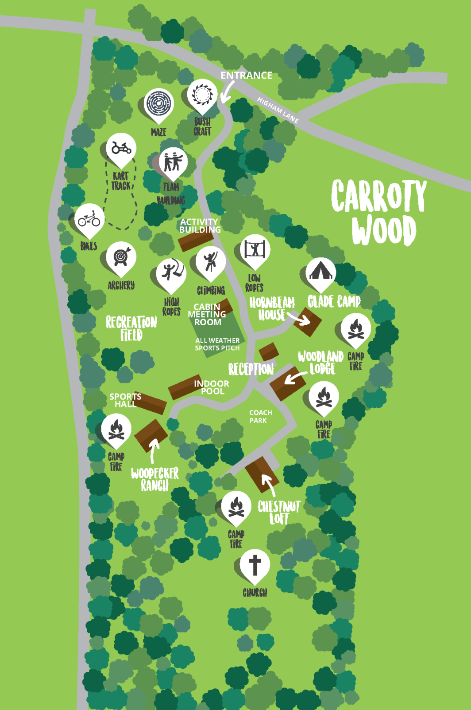
Where
CARROTY WOOD
Higham Lane,
Tonbridge, Kent
TN11 9QX

Slide 4
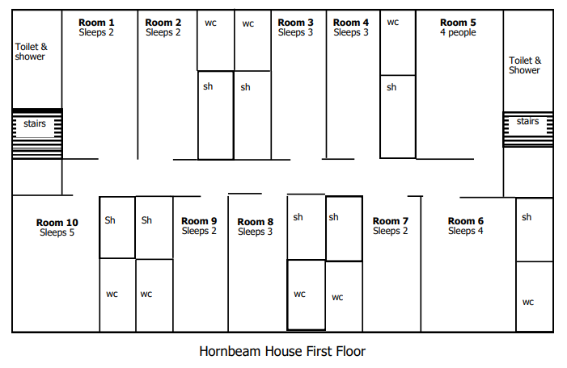
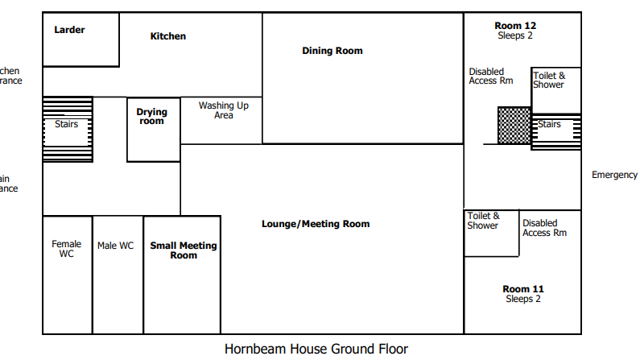
Accommodation – Hornbeam House

Slide 5
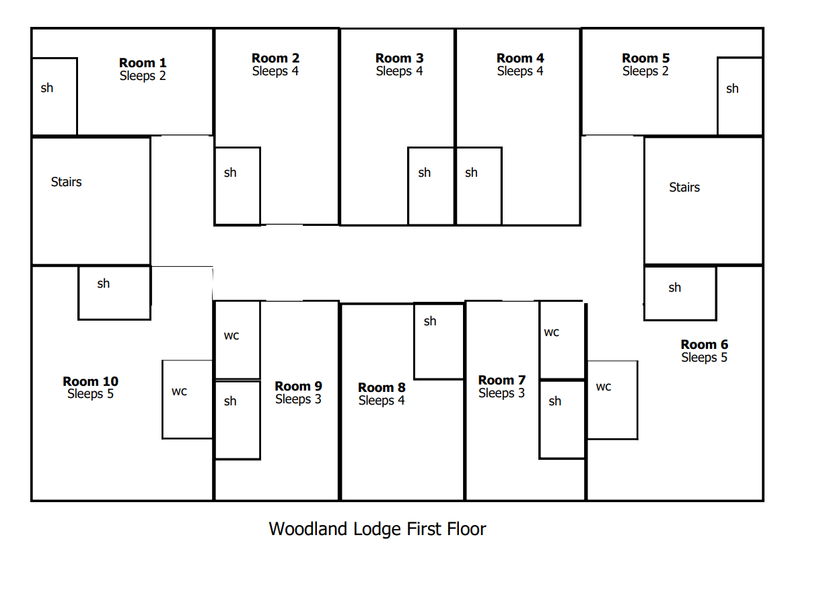
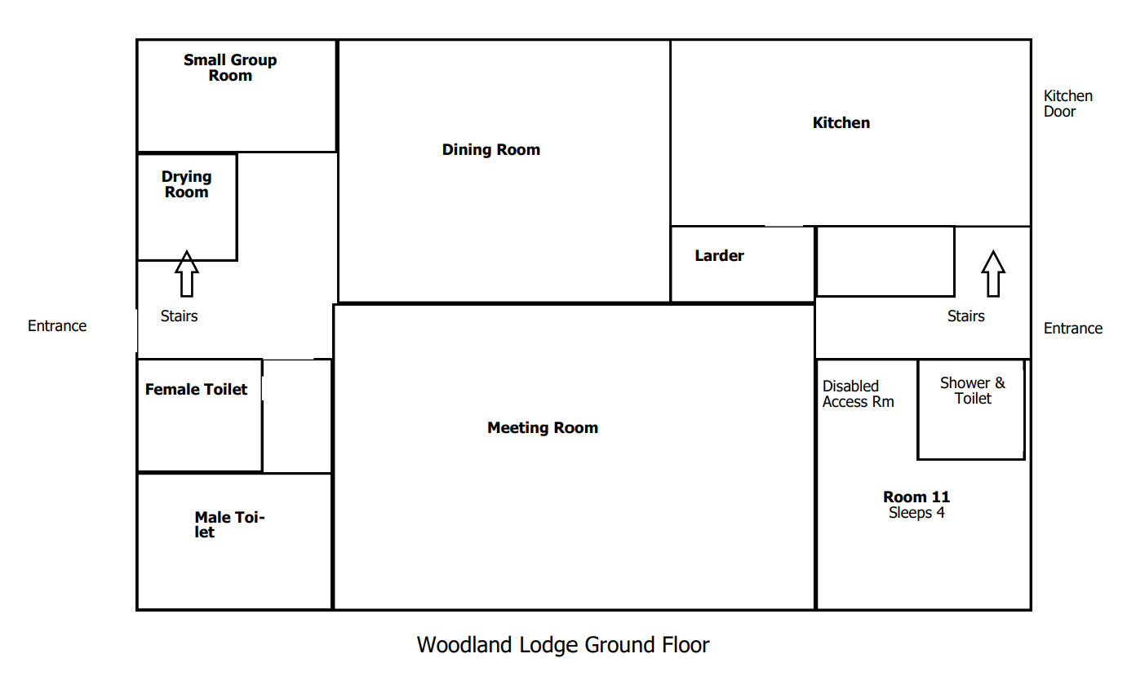
Accommodation – Woodland Lodge

Slide 6
Accommodation
All rooms sleep between two and five children.
Single-sex rooms.
Bedding is provided.
Separate toilets and showers (bring your own towel).
Children will be able to nominate up to 4 friends they would like to share a room with.
They will be in a room and an activity group with at least 1 friend on their list.
Arranging rooms is a very lengthy process that we take great care over.

Slide 7
Activities
Activities selected to promote communication and teamwork as well as the skills needed to overcome challenges.
All instructors are fully qualified and first aid trained.
Work in groups/as a team with others they may not usually work with.
We encourage the children to take part in the activities, but will obviously not be made to do anything that they feel uncomfortable with.

Slide 8
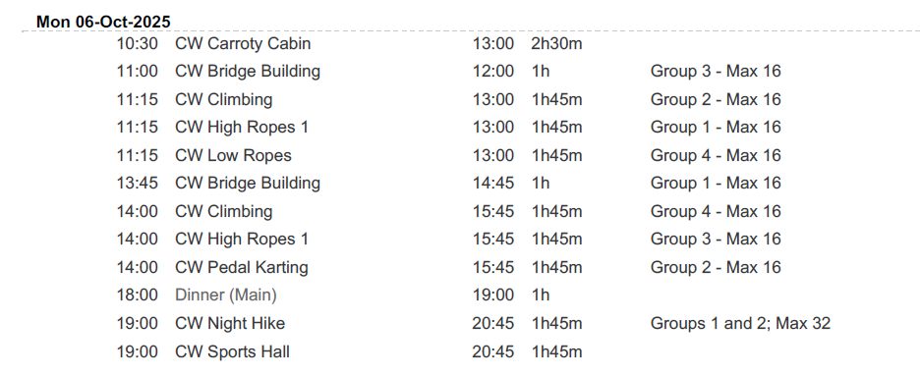
Activities – Provisional Draft Schedule

Slide 9
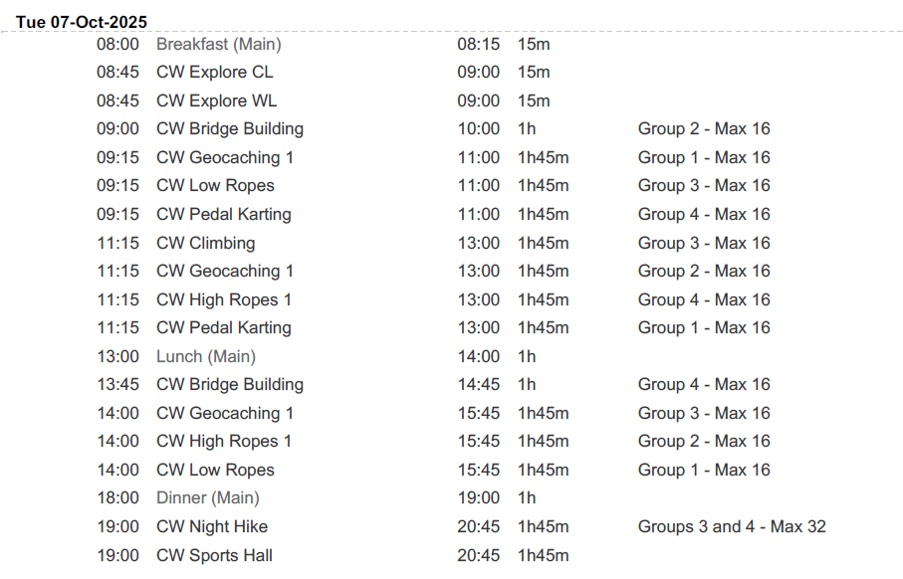
Activities – Provisional Draft Schedule

Slide 10
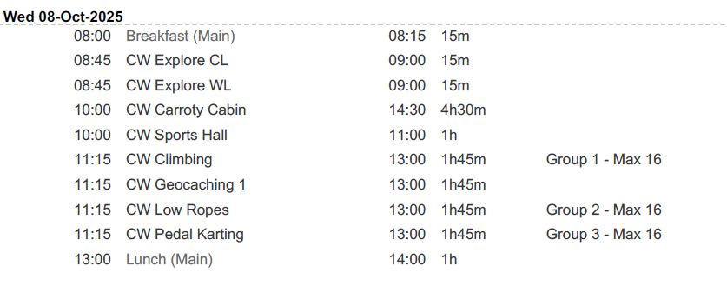
Activities – Provisional Draft Schedule

Slide 11
Food
All food will be provided apart from lunch on the first day.
Breakfast – toast and cereal.
Lunch – packed lunch.
Evening meal-
Snacks will be provided throughout the day.
If your child has any specific dietary needs/ medical form will be handed out for you to share this with us. Please return by the end of this academic year.

Slide 12
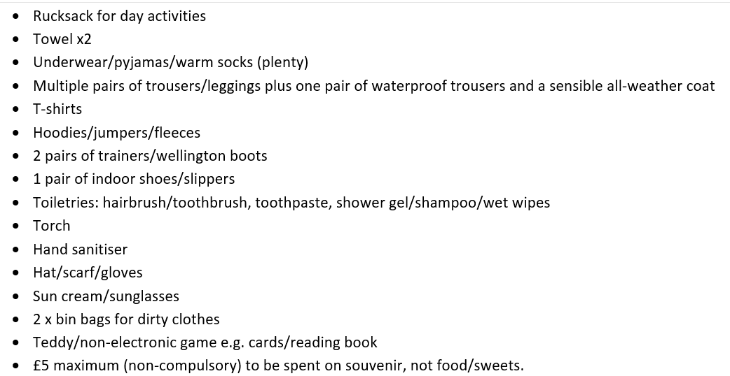
Kit, Money & Valuables
Please send your child with inexpensive clothes as there is a fair chance they may get ruined!
Please do not send your child with any electronic devices/hairdryers/straighteners etc.
Please do not pack any food/sweets.
Please name as much of your child’s kit as possible, including footwear.

Slide 13
Medication
Please encourage your child to take any travel sickness medication before arrival at school on Monday 6th October.
All medicines should be handed to Mrs McInnes on Monday morning.
Medicines must be in containers clearly labelled with the child’s name, the type of medicine and the dosage instructions.

Slide 14
Behaviour & Conduct
Exceptional behaviour is expected at all times and it is imperative in ensuring that we all have a happy and safe time.
The expectations we have for the children’s behaviour and conduct will be made very clear to the children before we leave.
We, and the staff of Carroty Wood, are able to remove children from activities if their behaviour is putting others at risk.
Serious incidents of misbehaviour may warrant contacting parents to arrange for their child to be collected from the premises and withdrawn from the trip.

Slide 15
Questions?

