Slide 1

YEAR 6 RESIDENTIAL – Marchant’s Hill Centre - Surrey
PARENTS’ MEETING

Slide 2


• Staff
• Who?
• Where?
• What?
• Accommodation & Facilities
• Catering and dietary requirements
• A Typical Day
• Travel Arrangements
• Kit/Money/Valuables
• Mobile Phones
• In Case of Emergency
• Medical Needs
• Questions
AGENDA

Slide 3
Staff
Mr Tibbles
Mr Chamberlain
Mr Wren
Mrs Corall
Mrs Brooks
Mrs Radford
Over the week each teacher will be assigned a group of children to support during activities.

Slide 4
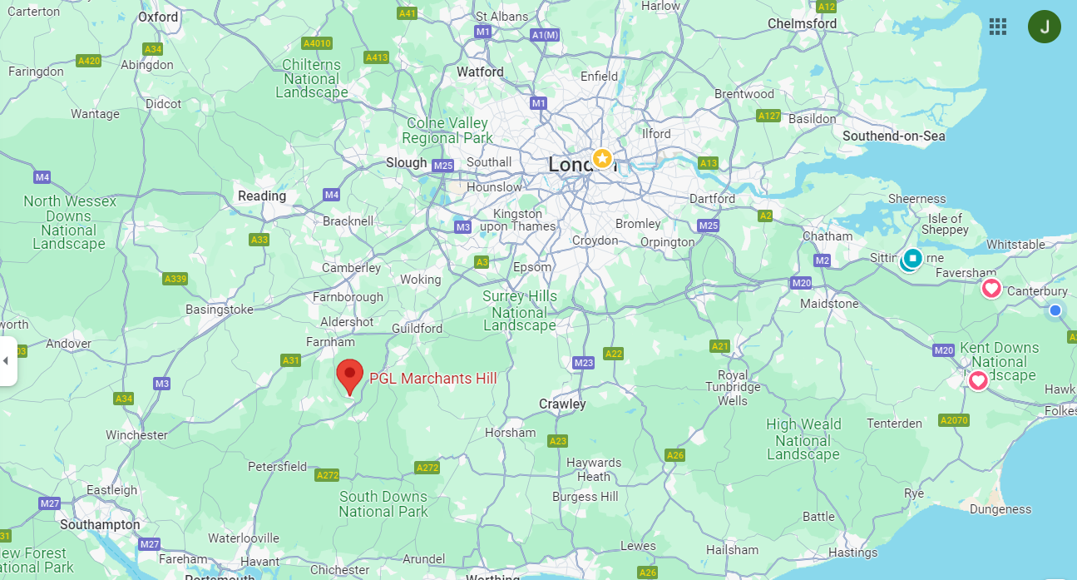
Where?
PGL Marchant’s Hill
Tilford Road
Hindhead
Surrey
GU26 6RF

Slide 5
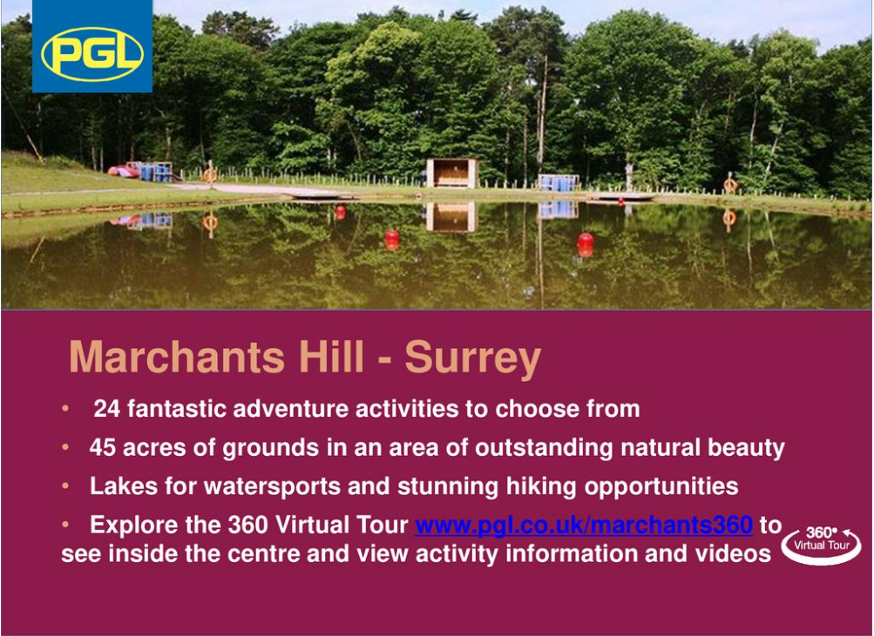

Slide 6
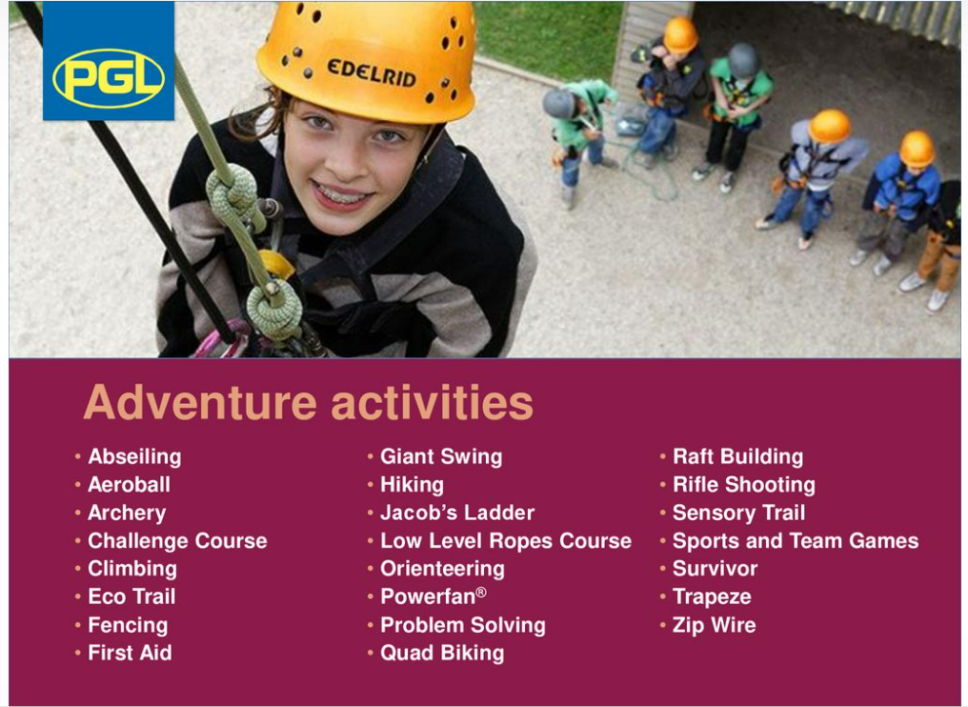

Slide 7
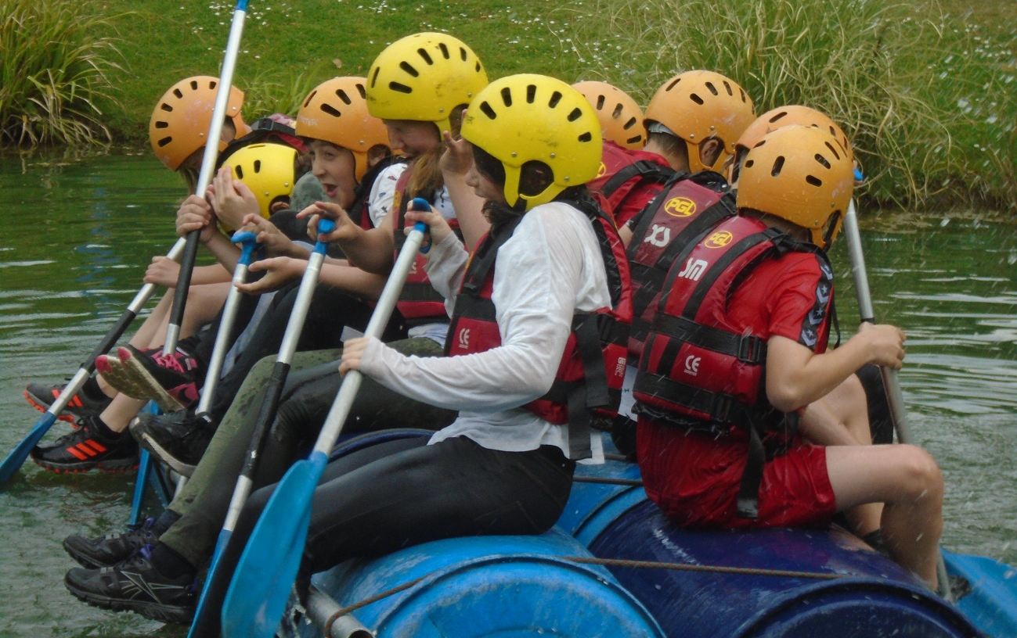
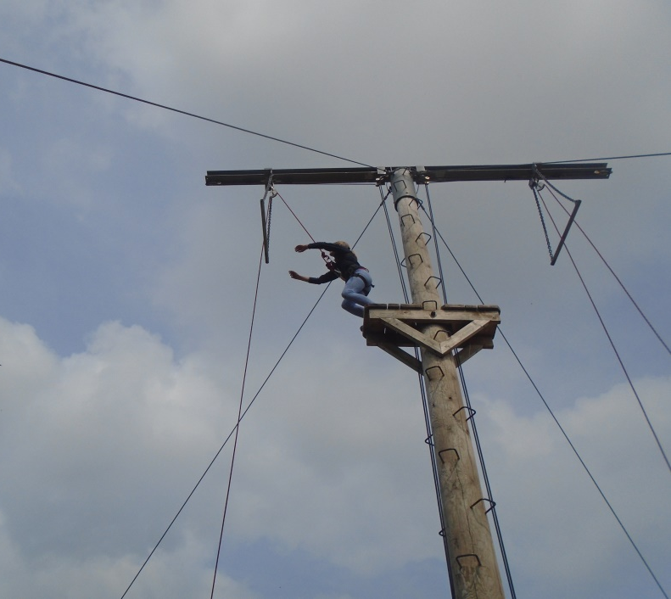
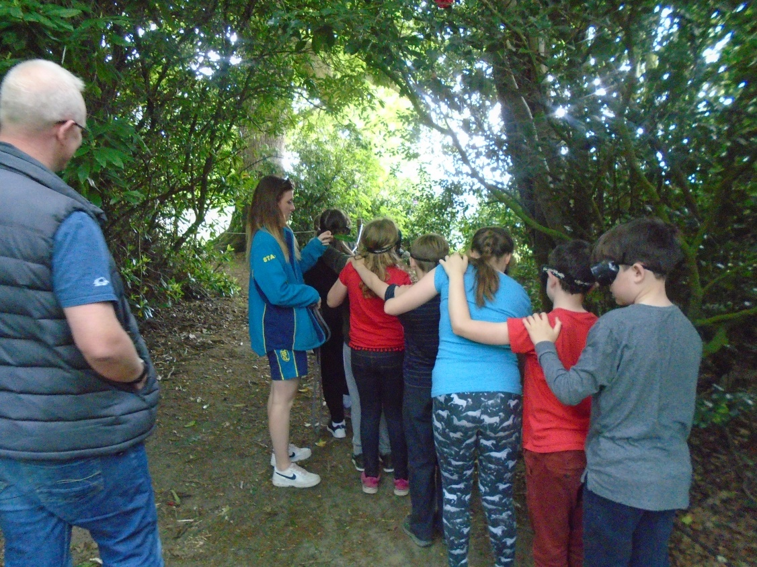
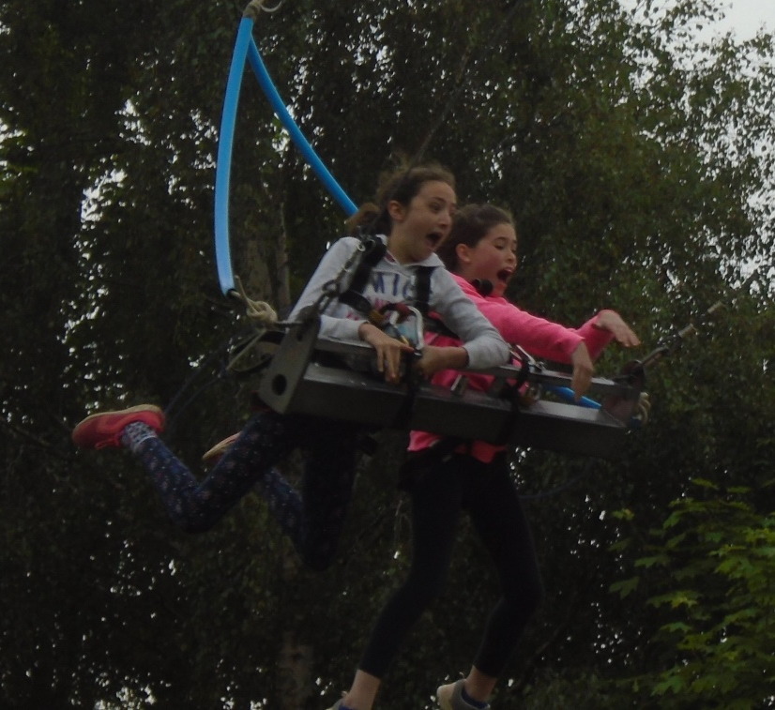

Slide 8
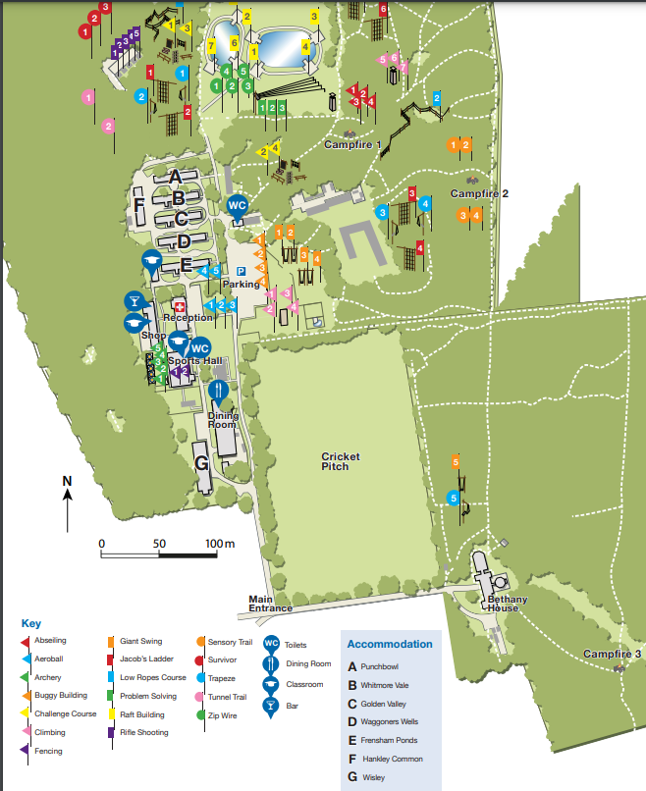

Slide 9

Activities
Selection of possible activities:
•Abseiling
•Archery
•Climbing
•And more…
Activities selected to promote communication and teamwork as well as the skills needed to overcome challenges.
All instructors are fully qualified
Work in groups/as a team with others they may not usually work with
Encouraged, not forced

Slide 10
Safety
Safety is the centre’s priority
Instructors trained to a very high standard
Staff available all of the time including school staff
All safety equipment is provided by PGL
Children are told how to use the equipment before they start the activity and centre leaders check it is fastened, fits etc
The site is very safe and secure. There is always a member of PGL staff on call over night
A master key for rooms will be held by school staff for the duration of the visit

Slide 11
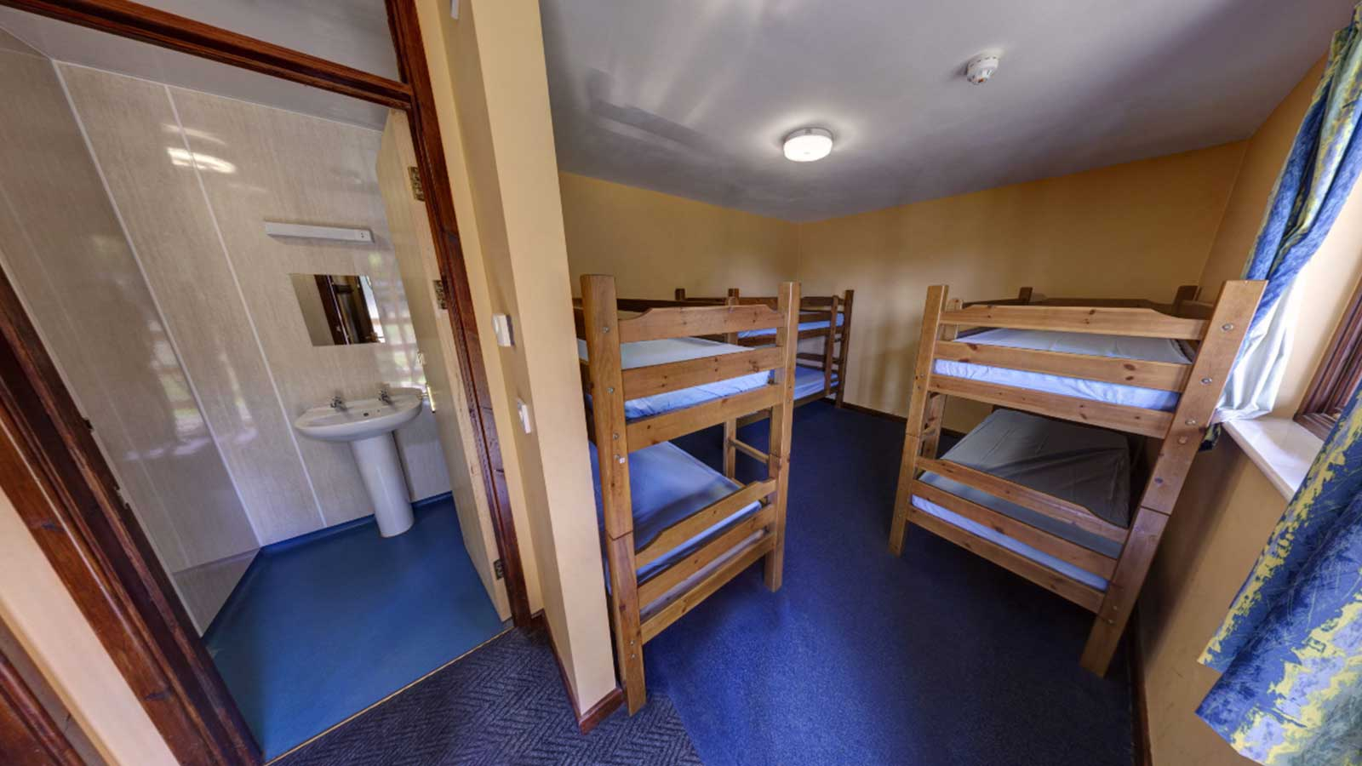
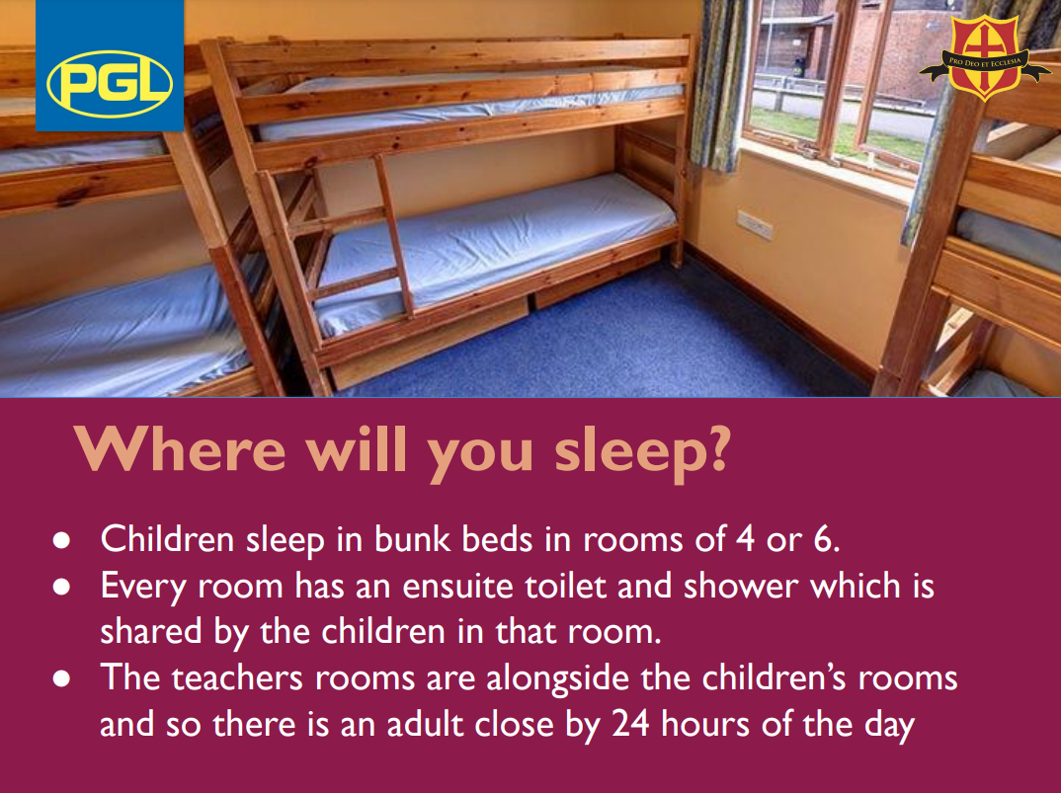
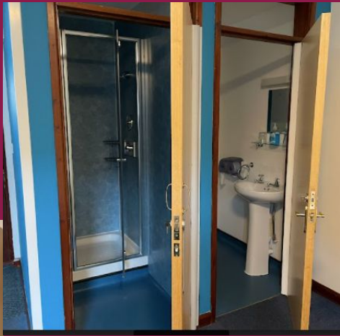
Accommodation

Slide 12
Rooming
  Rooms sleep 5 - 6
  Sleeping area & bathroom
  Single sex rooms
  Students will be able to nominate 4 friends they would like to share a room with
  They will be in a room and an activity group with at least 1 friend on their list
  Arranging rooms is a very lengthy process that we take great care over
  Kit List Ideas:
  Kit List -What does my child need to bring on a school trip? (pgl.co.uk)

Slide 13
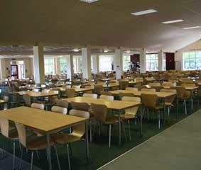
Catering and Dietary Needs
•There is a vegetarian option every meal time
•Special dietary requirements such as medical/religious needs can be catered for if we have been notified in advance
They are a nut free centre

Slide 14
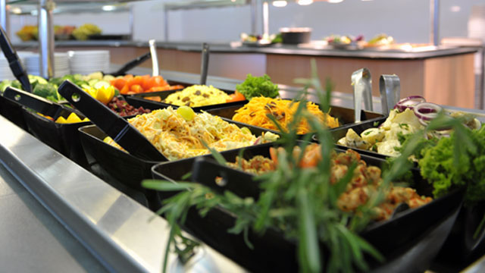
Breakfast
Lunch
Choice of Cereals
Natural & Fruit Yoghurts
White & Brown Toast with Preserves
Porridge Oats
Pork Sausages
(V) Vegetable Sausages
Scrambled Eggs
Baked Beans
Mushrooms
Seasonal Fresh Fruit
Cold Drinks
Homemade Soup of the Day
Choice of Breads
Jacket Potatoes or Rice
Choice of Meat & Vegetarian Fillings Seasonal Fresh Fruit & Salad Bar
Cold Drinks
Dinner
Homemade Soup of the Day
Chicken Chunks with Vegetables in Sweet and Sour Sauce
Pork Stew with Parsley and Thyme Dumplings
(V) Vegetable Enchiladas with Salsa
Braised Red Cabbage
Mixed Vegetables
Diced Potato or Rice
Seasonal Fresh Fruit & Salad Bar
Dutch Apple Tart with Cream
Cold Drinks

Slide 15
A Typical Day
• 07.15 Wake up, wash and brush teeth, make beds
• 08.00 Breakfast
• 09.00 Get ready for the day! (Remember your water bottles!)
• 09.15 Session 1 – Activity 1
• 10.45 Short break
• 11.00 Session 2 – Activity 2
• 12.30 Lunch
• 13.45 Free time
• 14.15 Session 3 – Activity 3
• 15.45 Break
• 16.00 Session 4 - Activity 4
• 17.30 Dinner
• 18.30 Shop is open and free time
• 19.15 Evening activity
• 21.00 Quiet time in rooms. Brush teeth, wash and get ready for bed
• 21.30 Lights out. Time to sleep!

Slide 16
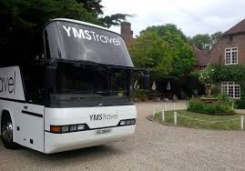
Travel
Wednesday 17th September 2025
Children are expected to arrive at school at the normal time. The coach will be departing at approximately 10am with an expected arrival time of 12:00pm.
Bring a bottle of water for the coach journey
All coaches have seat belts which must be worn at all times
Friday 19th September 2025
The coach will depart Marchant’s Hill at 1:30pm. Expected
arrival time back at school approximately 4pm.
Times may change slightly during the trip. Please look at the school website for details.

Slide 17
Kit, Money and Valuables
Please see the separate kit list
Send them with inexpensive clothes as there is a fair chance they may get ruined!
Money – There is a gift shop but children should only bring a small amount of money - maximum £5 for the week. It is their responsibility to keep this safe.
All valuables are brought at children’s own risk and no responsibility will be taken for loss or damage

Slide 18

Mobile Phones and Electronics
We kindly ask if you do not allow your child to bring any electronic devices.
We will be taking school tablets for children to use to take pictures and videos of their experience.

Slide 19
In Case of Emergency
If for any reason you need to contact us please phone the school office during school time.
If out of school hours please use the phone number of Marchant’s Hill 0333 321 2100.
You will be able to leave a message and they will get in contact with us. Please note this is for emergencies only.

Slide 20
Medication
Please encourage your child to take any travel sickness medication before arrival at school on Wednesday 18th September.
All medicines should be handed to Mrs Langsdon and on Monday morning.
Medicines must be in containers clearly labelled with the child’s name, the type of medicine and the dosage instructions.

Slide 21
Behaviour
Exceptional behaviour is expected at all times and it is imperative in ensuring that we all have a happy and safe time.
The expectations we have for the children’s behaviour and conduct will be made very clear to the children before we leave.
We and the PGL staff are able to remove children from activities if their behaviour is putting others at risk.
Serious incidents of misbehaviour may warrant contacting parents to arrange for their child to be collected from the premises and withdrawn from the trip.

Slide 22
Questions

