Slide 1
Maths Workshop
Reception
February 2024

Slide 2
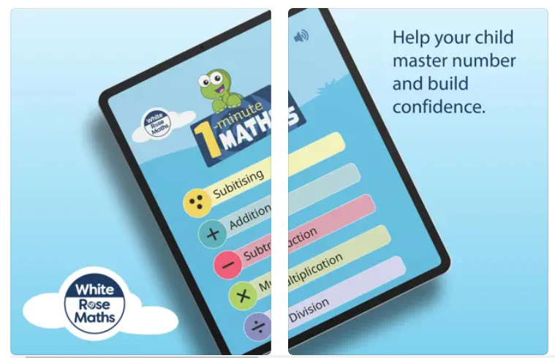
1 Minute Maths app
Download for free

Slide 3
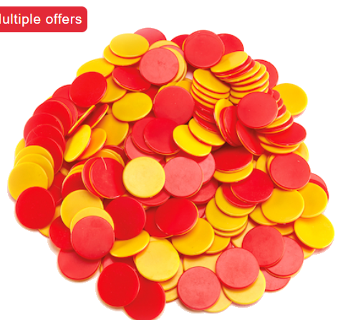
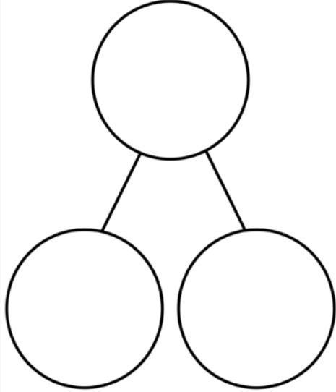
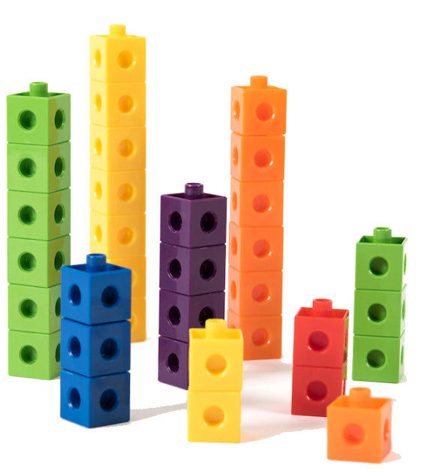
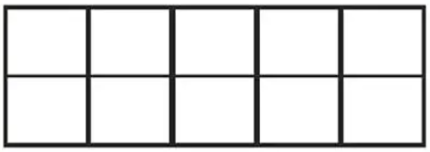
Different manipulatives used in EYFS

Slide 4
Objectives to be met at the end of Reception.

Slide 5
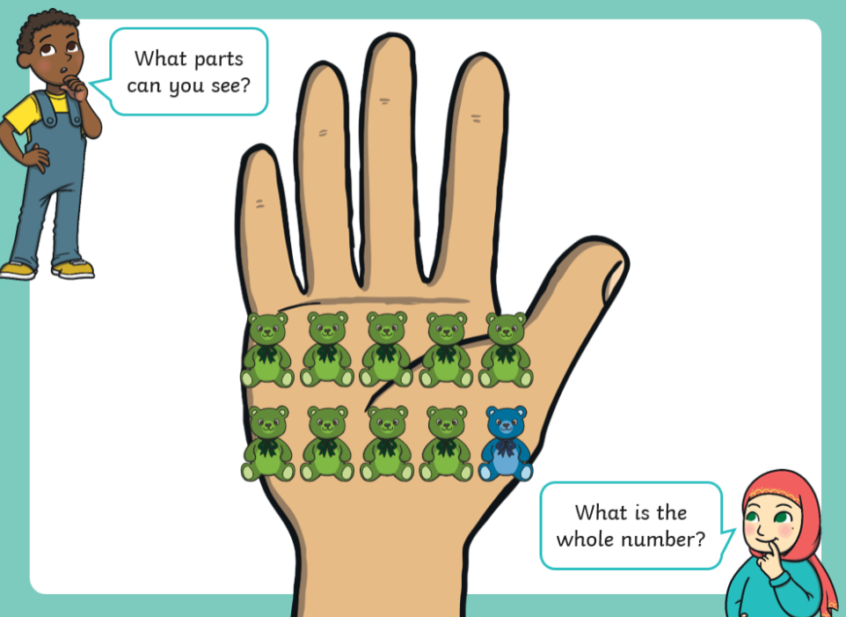
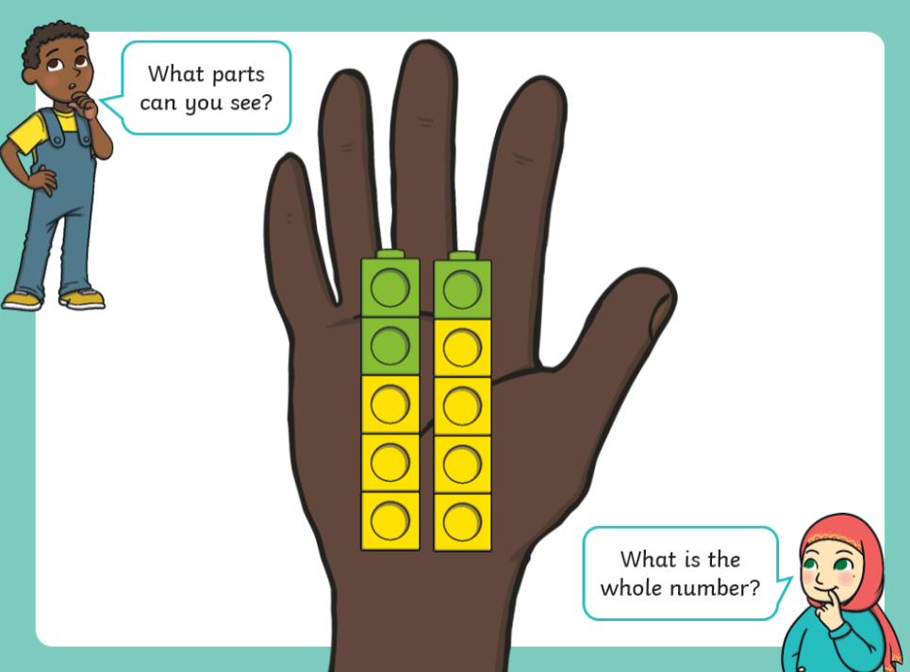
Have a deep understanding of number to 10,
including the composition of each number.

Slide 6
Can you talk about the way the apples are organised?
Part-part whole model
Number sentence
3 is a part 4 is a part the whole is 7
Can you find a different way to organise the seven apples? How could you organise nine apples? Is there more than one way to organise the apples?

Slide 7
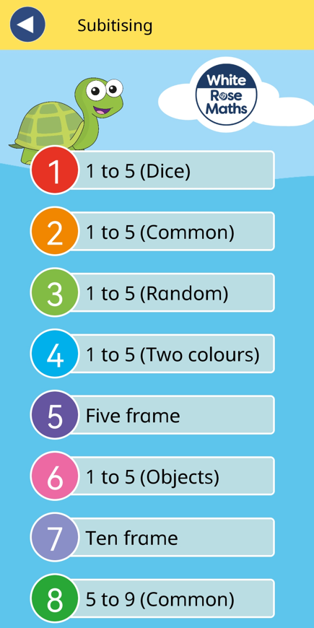
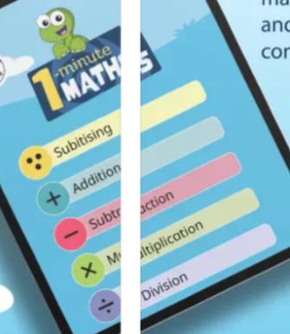
I can subitise up to five.
To see and know right away.
You subitise with your eyes.

Slide 8
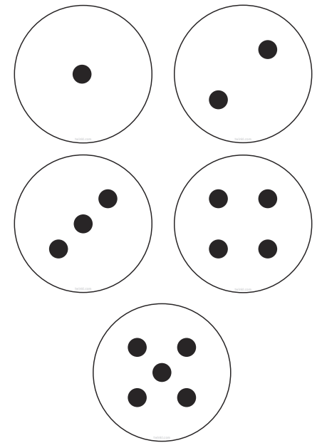
I can subitise up to five.

Slide 9
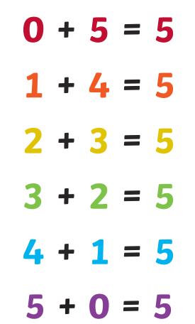
I can say number bonds up to five.
Begin to recognise some number bonds to ten.

Slide 10
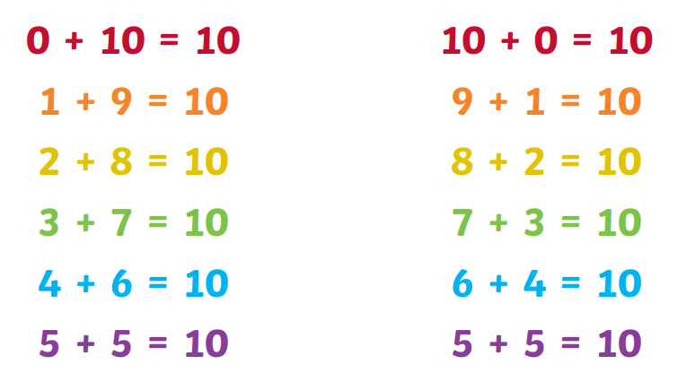

Slide 11
I can count beyond twenty.

Slide 12
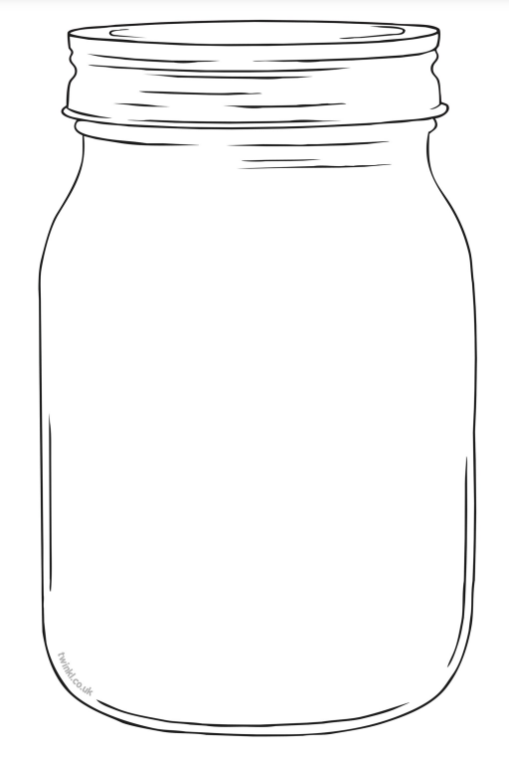
I can use vocabulary ‘greater than’, ‘less than’ or ‘the same as’ to compare quantities to ten.
Which jar has the greatest number of shells?
Which jar has the fewest number of shells?
Do any of the jars have the same number of shells?
Which jar would you choose? Why?
1
2
3

Slide 13
Helpful websites for your children.
https://www.topmarks.co.uk/
https://www.bbc.co.uk/bitesize/articles/zd4b382
https://www.tes.com/teaching-resources/shop/EYFSMathsGames (Register for free)
https://nrich.maths.org/9412

Slide 14
Activities
Make number bonds to 10 using the different manipulatives.
Find one more/one less on the number line.
Pick a number between 1-10 and count out that many objects.
Subitising – Recognise the number on the dice without counting.
Can you form the numbers correctly starting from the right place.
Using counters can you double the spots on the lady birds.

Slide 15
Thank you for coming!

