Slide 1

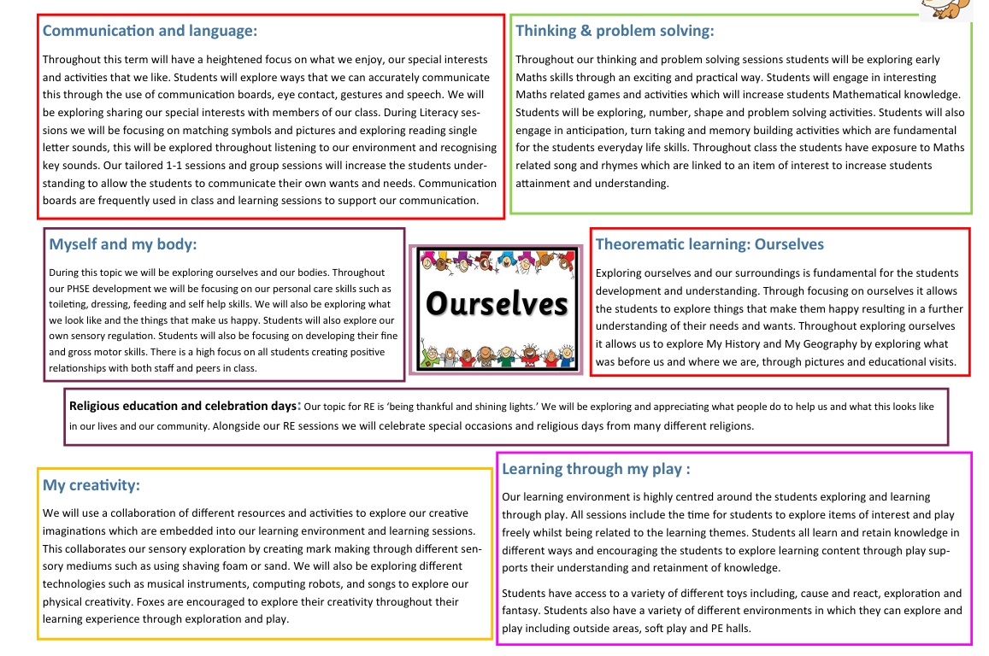
Class: Foxes Term: Autumn Pathway: Explorers Teacher: Niamh

