Slide 1


Welcome to Brookfields School

Slide 2
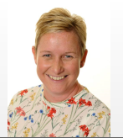
Welcome from Sara
Hello!
My name is Sara and I am the headteacher at Brookfields School.
I look forwards to you joining our fantastic school and getting to know you and your family as you start your learning journey with us.
I am here to make sure that you get the very best learning experience during your time at Brookfields School and that you are happy and grow and thrive with our care and support.

Slide 3
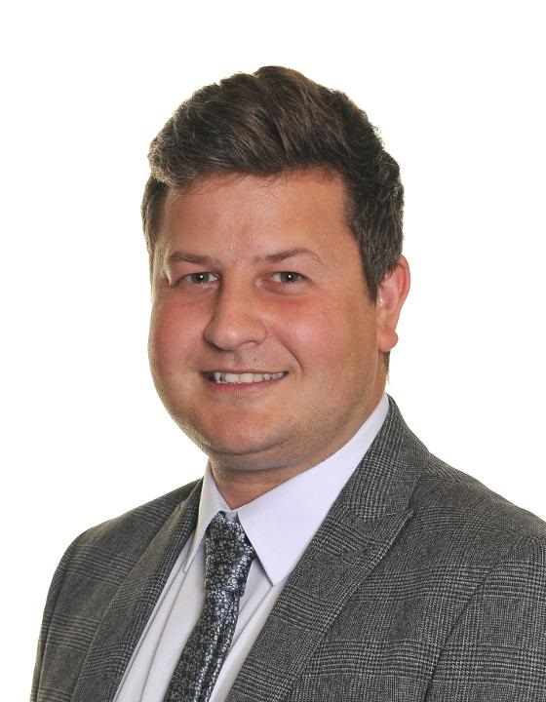
Welcome from Harry
Hello!
My name is Harry.
I am the Deputy Headteacher.
My job is to help Sara and to make sure you are happy and safe.
I am very excited to meet you!

Slide 4
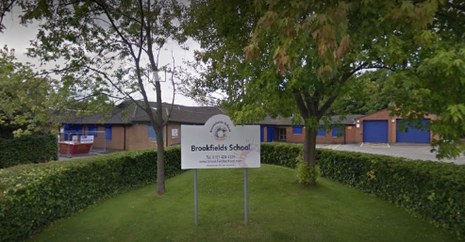
This is your new school

Slide 5
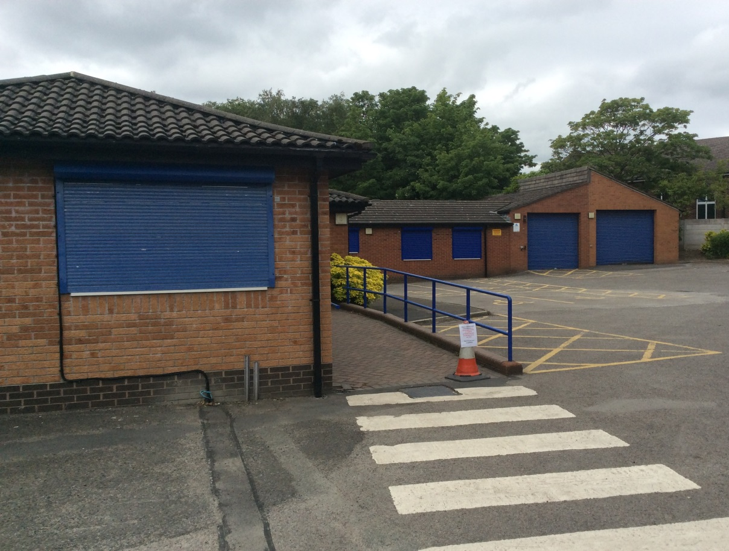
This is the ramp that leads into school.

Slide 6
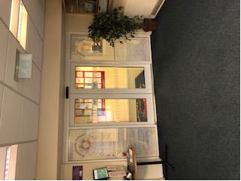
Welcome!
This is where you wait in the morning.

Slide 7
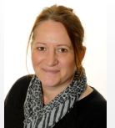
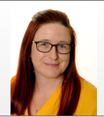
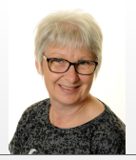
We have lots of people to help us in the school office.
Wendy Lynsey Nicola
Hello!

Slide 8
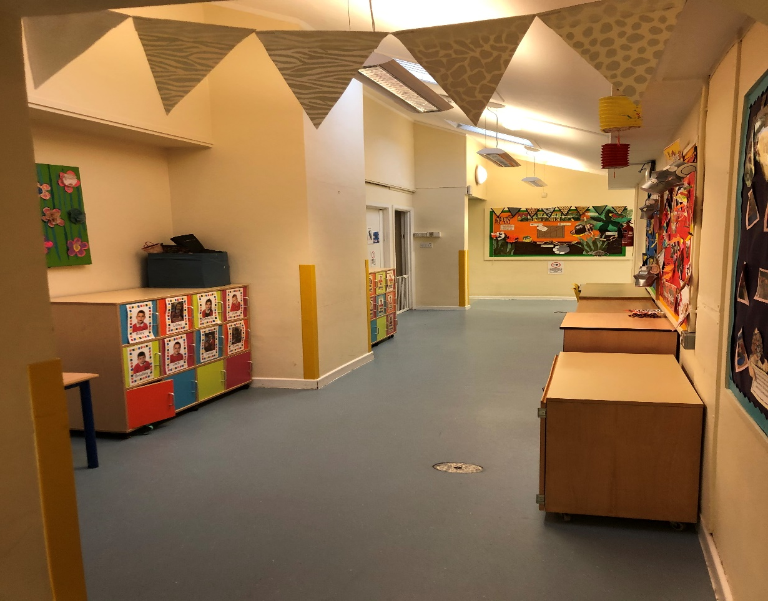
This is the corridor

Slide 9
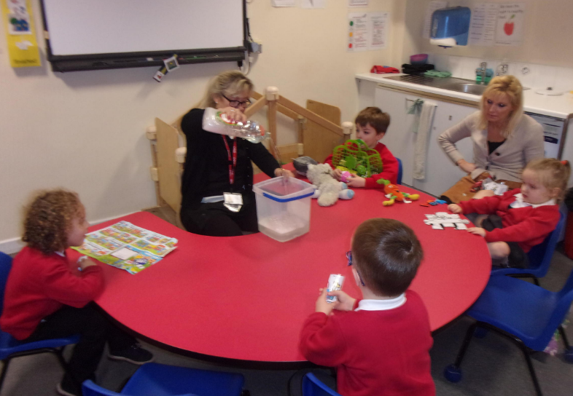
This is a classroom
This is where we learn.
This is where we play.
This is where we eat dinner with our friends

Slide 10
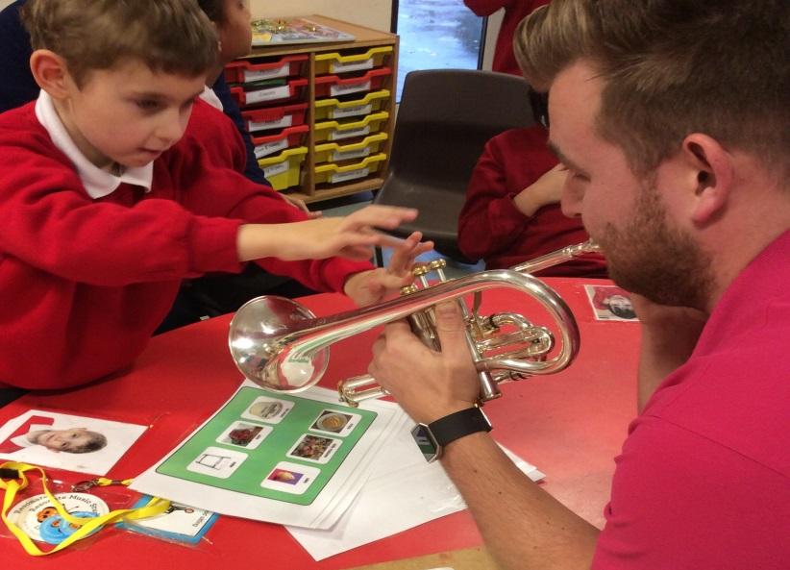
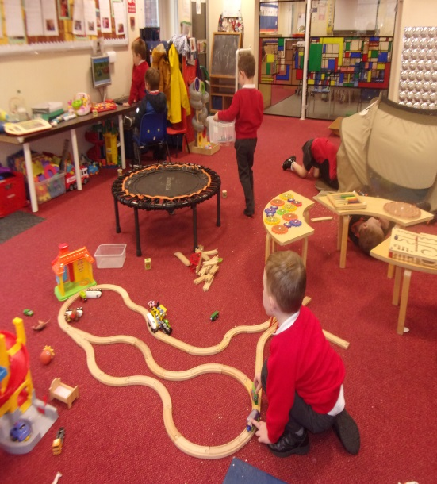
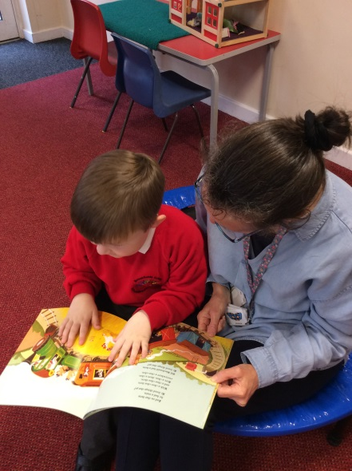
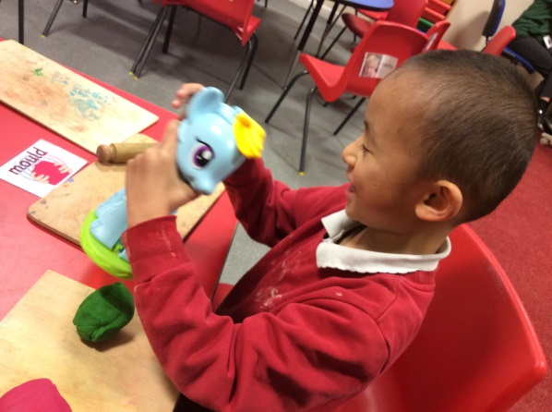
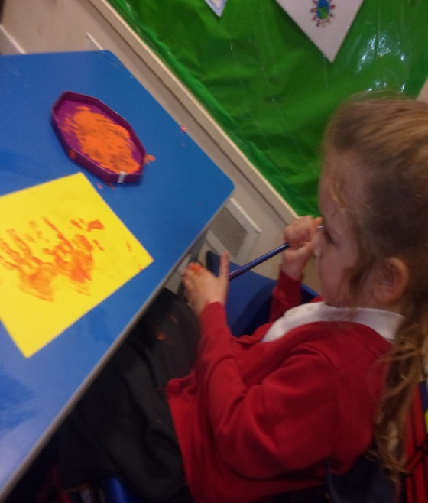

Slide 11
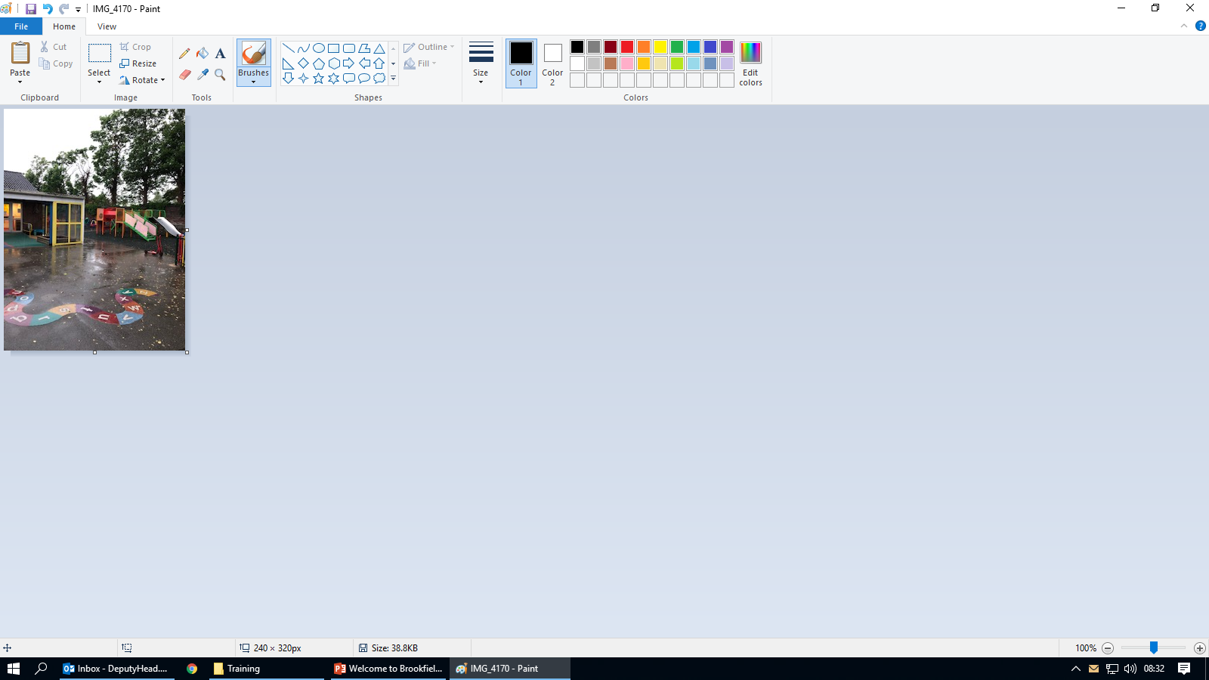
This is a playground
We like to be outside whatever the weather!

Slide 12
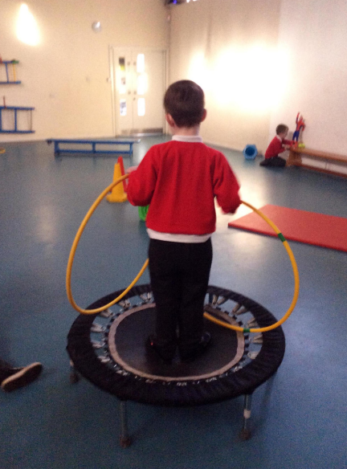
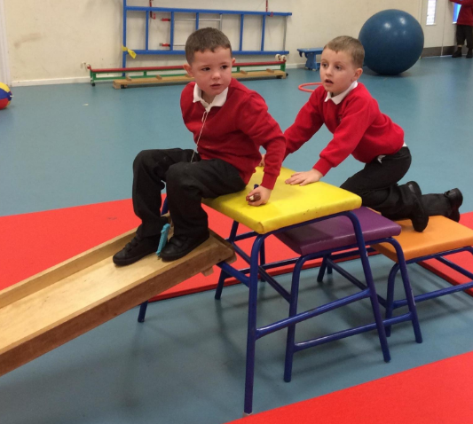
This is the hall
We like to run, jump, climb and dance!

Slide 13
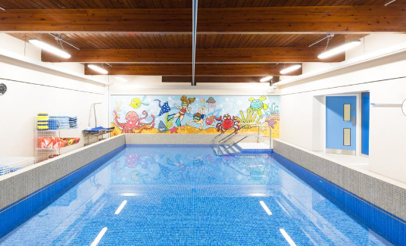
This is our swimming pool
We like to feel the warm water!

Slide 14
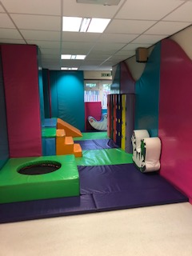
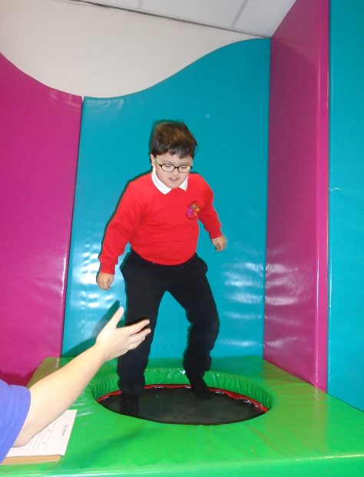
This is our soft play room
We like to bounce and jump!

Slide 15
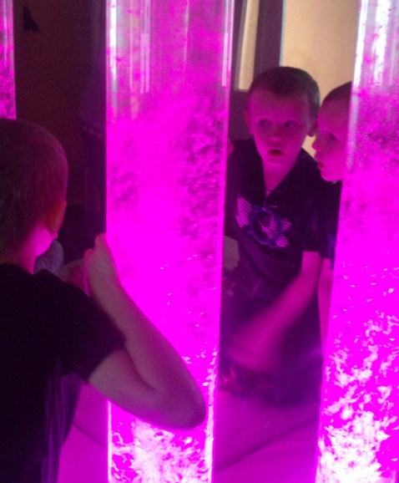
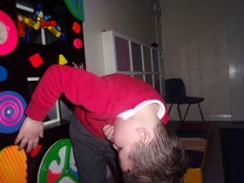
This is our light room
We like to watch the lights. We like to relax!

Slide 16
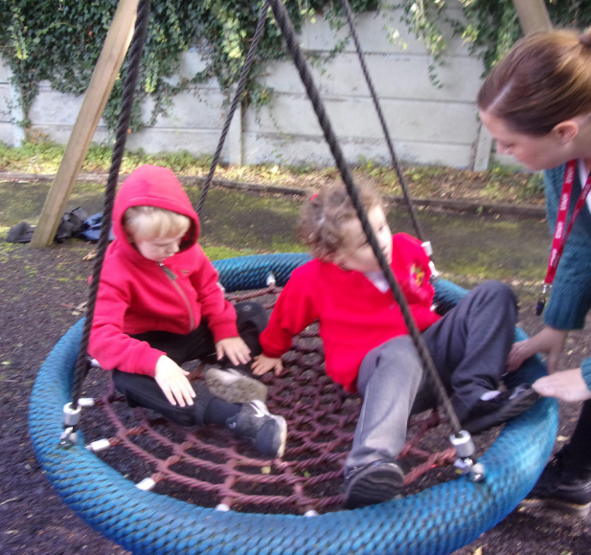
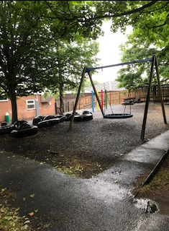
This is the ‘Tyre Park’
We like to swing!

Slide 17
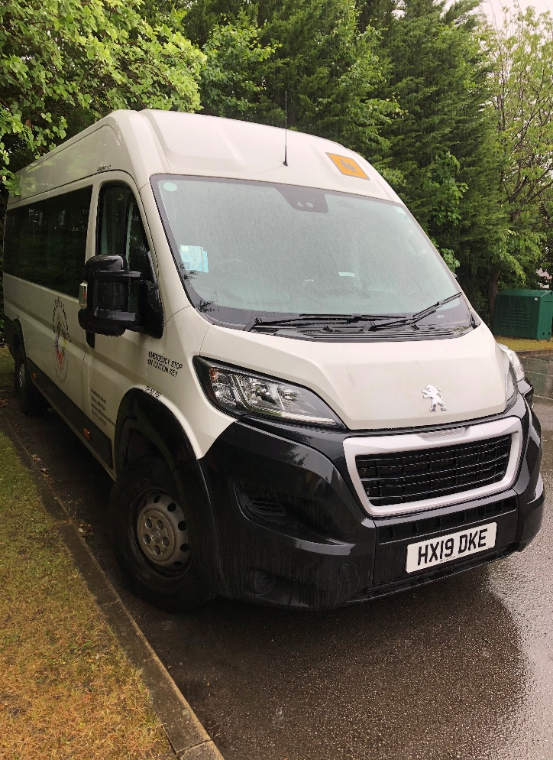
This is our school bus
Sometimes we go out on the bus.

Slide 18
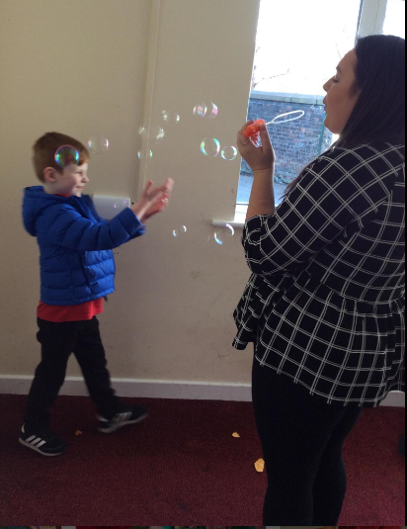
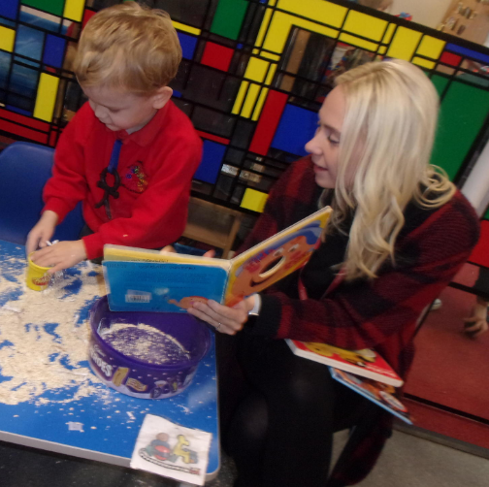
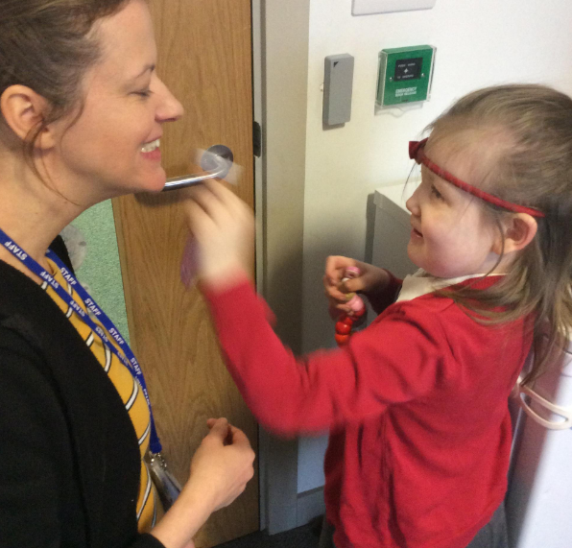
We have lots of staff to help you

Slide 19
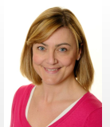
This is Louise, our Family Support Worker
She helps lots of children and their families.

Slide 20
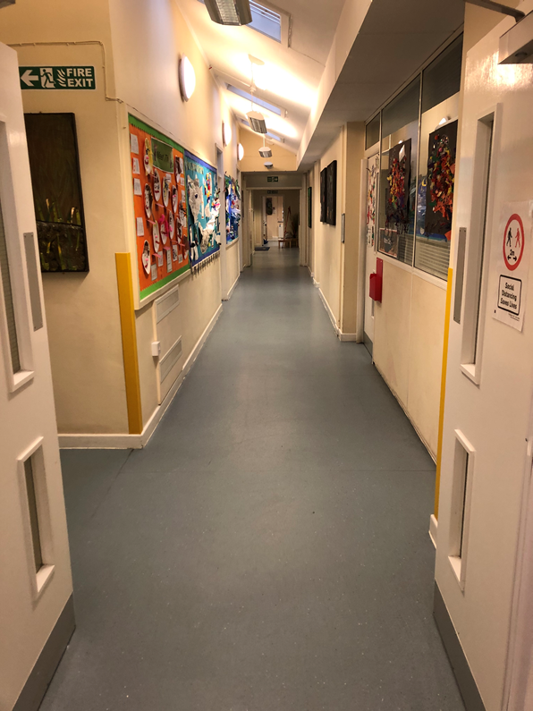
This is the corridor
This is the way we go home.
Some children go home in a taxi.
Some children go home on a bus.
Some children go home in their car.

Slide 21
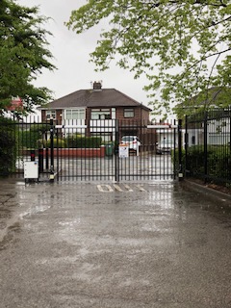
This is the way out.
This is the way we go home

Slide 22
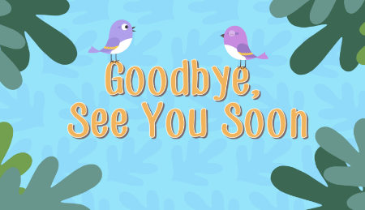
We hope you enjoyed looking around Brookfields school

