Slide 1


Special Educational Needs and Disability Information Parent Report
2024-2025
This report is written from the guidelines set out in Regulation 51 and schedule 1 of the Special Educational Needs and Disability Regulations 2014.
The report is reviewed at annually or when required.
Next review: October 2025

Slide 2
Contents
Different Kinds Of SEND
Glossary Of Terms
The SEND Team
Staff Development And Training
How Do We Identify Children With SEND?
What approaches do we use to teach children with SEND?

Slide 3
Special Educational Needs and Disability Information Parent Report
This document aims to provide information to enable parents and carers to make decisions about how best to support their child.

Slide 4
What are the different kinds of SEND that Broughton Primary School can provide support for?
At our school we pride ourselves on providing high quality teaching to all of our children. We understand the uniqueness in all of our children and in order for them to achieve their full potential they may need additional support to enable this to happen.
Often the different types of SEN can fall into the following categories, which are described in the Code of Practice (2014) as the broad areas of need: Communication and Interaction; Cognition and Learning; Social Emotional and Mental Health difficulties, and Sensory and/or Physical Difficulties.

Slide 5
Communication and Interaction
Some children have difficulty in communicating with others. This might be because they are still learning the correct speech sounds and/ or they don’t have the language to be able to communicate or understand others.
Cognition and Learning
Some children learn at a slower pace than their peers and their needs may fall into different learning difficulties such as:
- Moderate Learning Difficulties (MLD)
- Severe Learning difficulties (SLD)
- Profound and Multiple Learning Difficulties (PMLD)
- Specific Learning Difficulties (SpLD) such as dyslexia, dyscalculia and dyspraxia

Slide 6
Social, Emotional and Mental Health difficulties
Some children experience a wide range of social and emotional difficulties, which can impact on their behaviour. These conditions can include attachment disorder and Attention Deficit and Hyperactivity Disorder (ADHD).
Sensory and/or physical needs
Some children may have a hearing impairment (HI), a visual impairment (VI), a multi sensory impairment (MSI) or a physical difficulty (PD).
Please follow the link if you wish to access the full Code of Practice (2014) https://assets.publishing.service.gov.uk/government/uploads/system/uploads/attachment_data/file/398815/SEND_Code_of_Practice_January_2015.pdf

Slide 7
We recognise that there are several abbreviations linked to SEND and we have listed below a glossary to explain their meaning.
ADD - Attention Deficit Disorder
ADHD - Attention Deficit and Hyperactivity Disorder
ASD - Autism Spectrum Disorder
ASET - Autism Support Education Team
BESD - Behavioural, Emotional and Social Difficulties
CAMHS - Child and Adolescent Mental Health Service
COP - Code Of Practice
CP - Child Protection
DCD - Developmental Co-ordination Disorder
EAL - English as an Additional Language
EHA - Early Help Assessment
EHR - Early Help Review
EHCP - Education Health Care Plan
EP - Educational Psychologist
EWO - Educational Welfare Officer
FASST - Families are Safe, Supported and Transformed Team
FSM - Free School Meals

Slide 8
We recognise that there are several abbreviations linked to SEND and we have listed below a glossary to explain their meaning.
FSW - Family Support Worker
HI - Hearing Impairment
IBP - Individual Behaviour Plan
IEP - Individual Education Plan
KS - Key Stage
LAC - Looked After Children
LEA - Local Education Authority
LM - Learning Mentor
MLD - Moderate Learning Difficulty
NC - National Curriculum
OT- Occupational Therapist
PBST - Primary Behaviour Support Team
PSP - Pastoral Support Programme
SaLT - Speech and Language Therapy
SEN - Special Educational Needs
SEND - Special Educational Needs and Disability
SENCo - Special Educational Needs Co-ordinator
SpLD - Specific Learning Difficulty

Slide 9
We recognise that there are several abbreviations linked to SEND and we have listed below a glossary to explain their meaning.
TA - Teaching Assistant
VI - Visual Impairment

Slide 10
Meet the SEND Team
At Broughton Primary, every staff member in our school is a teacher of all of our children, including children with SEND. Some members of our staff play key roles in our SEND developments and are introduced below. They all work closely with children individually, in small groups and with their families.

Slide 11
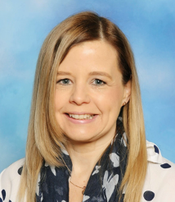
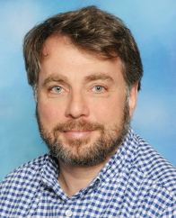
Mrs Wynne is the Vice Principal and one of the Mental Health Champions. Mrs Wynne holds the National award for SEN co-ordination. She oversees the provision for all our pupils.
If your child has a medical need, Mrs. Wynne will work closely with the family and Mr Clayton (Principal) to write a Health Care Plan to address the needs.
Mrs Wynne
Mr Clayton

Slide 12
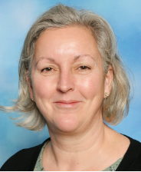
SENDCo
Mrs Smith
Mrs Smith is the SENDCo, one of our Mental Health Champions and Class Teacher and is passionate about supporting children with SEND. Mrs Smith is trained in Special Educational Needs and holds the National award for SEN co-ordination.
She is the first point of contact for all enquiries regarding SEND.

Slide 13
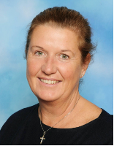
Learning Mentor
Mrs O’Shea
Mrs O’ Shea is an experienced Higher Level Teaching Assistant (HLTA) and she is also one of our Mental Health Champions.
If you have any concerns about the wellbeing of your child in school or at home, she provides a listening ear, alongside that of the teacher.

Slide 14
Designated Lead Teacher for Looked After Children and Pupil Premium
Mr Clayton
Mr Clayton is our Designated Lead Teacher for Looked After and Pupil Premium Children.
He is the advocate for these children in school to ensure their voice is heard.

Slide 15
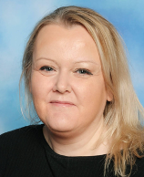
SEND Parent Advocate
Mrs Smithen
Mrs Smithen is our SEND Parent Advocate and works closely within our team. Mrs Smithen also monitors the provision for Looked after and Pupil Premium children.

Slide 16
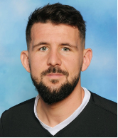
P.E Teacher
Mr McCarron
Mr McCarron is our PE teacher who also provides intervention for children who have difficulty with movement and co-ordination. He also works with children at playtime and lunchtime, who have social and emotional difficulties.

Slide 17
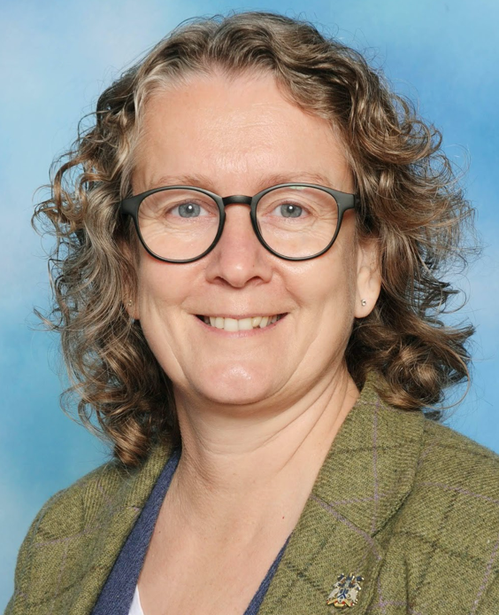
School Counsellor
Sarah Glover
Sarah is a trained counsellor who works 1:1 with children who require support with their social and emotional wellbeing and emotional intelligence.
Sarah uses play based techniques and works on developing children’s self-awareness and boosting self-esteem.
The SEND team is supported in School by a dedicated team of teachers and teaching assistants.

Slide 18
Staff Development and Training
We are committed to making sure our staff are fully trained and if we don’t know about something then we take the steps to learn and find out the information we need to support our children and families.
Our SENCo attends regular meetings to keep up to date with the latest SEND developments, which are shared with other staff members at staff meetings.
The SENCo and 2 other members of staff completed Dyslexia Profile training with the Local Authority SEND Team.
All of our staff are Emergency First Aid trained.
All the reception staff, Mr Clayton, Mrs Wynne, Mrs Marris, Mrs Ward and Mr Booker have completed paediatric first aid training.
In addition, staff have received asthma, epi-pen and epilepsy training.

Slide 19
Staff Development and Training
Other training, we have completed includes:
· Team Teach training to develop the skills for staff to use positive handling strategies if a child needs to be moved to safety.
· Training on the on the Whole School Approach to Mental Health with the team from With Me In Mind
· 5 of our staff have recently been trained on Speech and Language techniques to support children with communication and language difficulties.

Slide 20
Staff Development and Training
We work closely with the Educational Psychologist team, who have provided training to support children with social, emotional and mental health difficulties. This training has included:
· De-escalation strategies to support children with behavioural difficulties
· Attachment disorder to help staff understand how and why some children find it difficult to form attachments with others.
· Our previous Educational Psychologist, Karen Andrews-Longbone, trained our teachers and teaching assistants on precision teaching. This is a 1:1 evidence based intervention focusing on repeated learning and is tailored to a child’s individual needs. We have already seen the benefits of this programme on pupil progress.

Slide 21
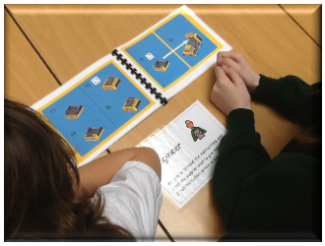
Staff Development and Training
9 of our staff members are trained on Lego Time by the ASET (Autistic Spectrum Education Team) to develop social relationships and team building skills.
8 staff members have also been trained on mindfulness and sensory awareness.
One staff member has been trained on supporting children with physical disabilities.
The ASET team have trained staff members on friendship intervention to develop social skills and relationships amongst children who have difficulty making new friendships.
One staff member has been trained on Emotional Literacy Support.
Children taking part in Lego intervention

Slide 22
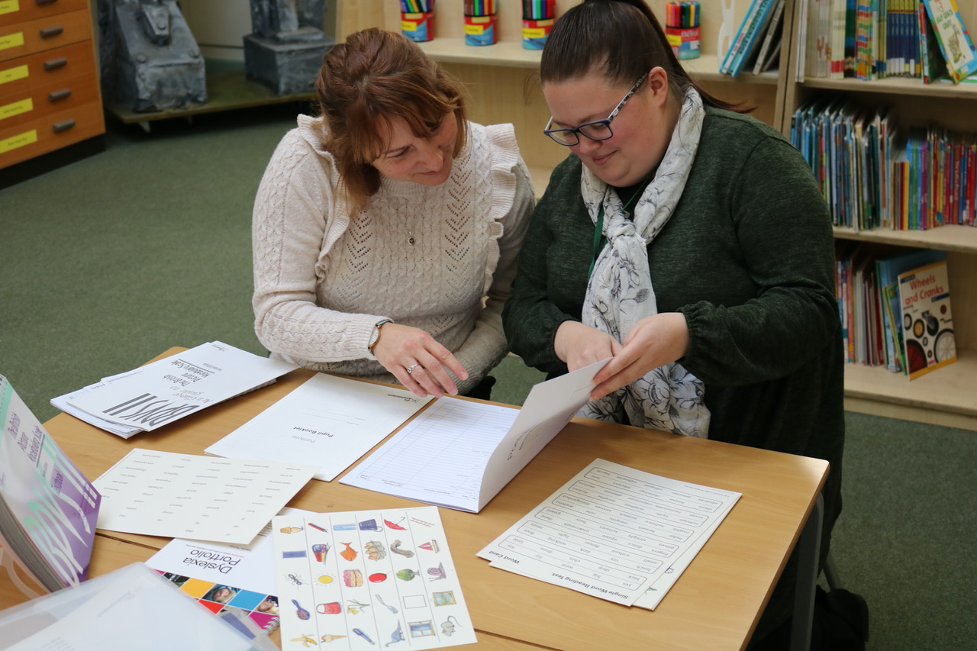
Dyslexia Profile Screener Training
Staff training
The SENCo and a selected staff have been trained on screening training using the Dyslexia Profile and British Picture Vocabulary Set toolkits.

Slide 23
How do we identify children and young people with SEND and how do we assess their needs?
The Code of practice (2014) refers to a child or young person has SEND:
· if they have a learning difficulty or disability which calls for special educational provision to be made for him or her.
· if they have a significantly greater difficulty in learning than the majority of others of the same age.
· If they have a disability which prevents or hinders him or her from making use of facilities.
At the time of writing this report we have 36 children on our SEND register which equates to 12.4% of the total number of children. Of this number, 8 of the children have an EHCP (Educational Health Care Plan) and 28 children are SEN support. These figures are currently below the national average of 18%.
If a teacher and/ or a parent has a concern about their child, the SEND team works closely with them. We will ask adults involved with the child to make close observations and record them. The SENCos will then observe the child and meet with the adults to assess the needs of the child together. We may decide to carry out some formal/ informal assessments/ tests. We will then plan interventions to address these needs, which may involve contacting outside agencies for specialist support. We refer to our Special Educational Needs Policy which can also be found on our website.

Slide 24
What approaches do we use to teach children with SEND?
Every staff member in our school is a teacher and every teacher is a teacher of a child with SEN. It is their responsibility to differentiate the children’s work according to their ability. This is the first step in the process and if necessary the child receives extra teaching in a focused group for a set time. Where there is need for an intervention programme to be implemented, this is identified on the Year Provision Map, which is reviewed to measure the impact and updated termly. Further training or advice might be necessary at this stage and the SENCo has responsibility for this.

Slide 25
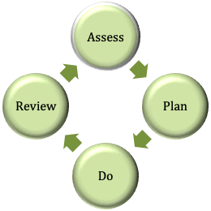
What approaches do we use to teach children with SEN?
Our school follows the Graduated approach, which is a cycle. Class teachers, parents, the SEND team and the child are involved, although specialist support from outside agencies might be needed at any point of the cycle. The approach also works towards the child achieving positive outcomes that are set from the beginning by people involved with the child. The child is firmly at the heart of the process.
Assess - Staff and parents work together to assess the child’s needs.
Plan - From these assessments a plan is formed.
Do -The plan is put in place with the child, parents and staff all working together
Review - The plan is reviewed and the cycle is repeated.

Slide 26
How do we adapt the curriculum and learning environment?
Our inclusive school recognises that at times the curriculum needs to be adapted to ensure all our children can access it. This may involve the SENCo, Learning Mentor or other staff members purchasing or creating resources to meet these needs. Also, with respect to those children who have behavioural difficulties, it may be necessary to complete some pre skills work before starting new topics, to allow the child to experience success, not failure.
The learning environment is bright and visual, and staff listen to expert advice to make adaptations. These may include using visual timetables or creating a tent area for children to access if they want some time alone. Areas outside the classrooms have been created for children, should they need some space or time out to reflect. Individual tables are used by some children, if the staff feel this is appropriate

Slide 27
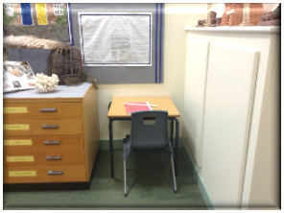
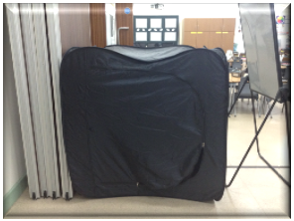
Quiet Areas
In classroom

Slide 28
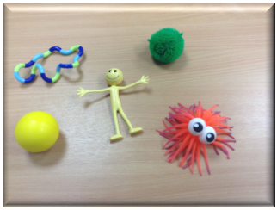
Resources
Resources are also purchased from the SEND budget to allow children to access the curriculum.
The ASET team completed a sensory audit and we have adapted the environment to support children with sensory difficulties. Staff have also been trained on how to use the sensory toolkit to identify any sensory needs children may have.
The Visual Impairment Team completed an environmental audit, and we have adapted the environment to support children with visual impairments.
If a child has a hearing impairment, staff ensures the seating arrangements are suitable at all times. The school building is a new build and is completely wheelchair accessible, with external ramps for each teaching unit and a canopy to shelter from inclement weather.
There is an automatically opening door at the main entrance for wheelchair access. Inside the school, walkways are clear and it is visually bright. Signage is clear and simple. The school has a modern purpose-built disabled toilet and washing area. Designated parking spaces are available in the car park.

Slide 29
How do we assess and review children with SEN?
The SENCo and Learning Mentor have open communication with all staff during the school year. The children on the SEN register are assessed and reviewed every term and outcome plans are reviewed and new ones are written. These outcome plans are completed and shared with the staff involved with the child, the child and the parents. This is in addition to the parent meetings, which take place twice a year and the annual report. If a child and family is part of the Early Help Process the reviews are more regular and tend to be every half term. During the termly reviews, progress towards outcomes is discussed.

Slide 30
How do we evaluate the effectiveness of our provision for our SEN children?
The SENCo and Learning Mentors undertake learning walks to ensure the inclusion of our SEN children. During progress meetings the impact of interventions is evaluated. Every term the SENCo analyses the assessment data to ensure that the children are making progress and the gaps between the SEN children and Non-SEN children are minimal. The SENCo and Learning Mentor regularly audit interventions on our new scholar pack system to ensure that the intervention the children receive is having an impact on their learning. The staff are given immediate feedback and can adapt the provision if necessary.
We know that our provision is effective because:
· Our SEND children enjoy coming to school. Our attendance figures reflect this and have been above national average for a number of years;
· Our SEND attainment in KS2 has been above national and local average for the last 3 years when data was published and has been above national and local average for the last 2 years in KS1.

Slide 31
Statements from our latest our latest OFSTED report
Extra funding for those pupils who have special educational needs (SEN) and/or disabilities is used very well. Leaders make sure that these pupils have good support in school and extra specialist support from a variety of external agencies to meet pupils’ needs;
Governors have a very detailed understanding of how the extra funding for those pupils who have SEN and/or disabilities is used and the good progress these pupils are making;
Teaching assistants help pupils who have SEN and/ or disabilities are making good progress, They are skilled and support small groups of other pupils outside the classroom, using work planned by teacher;
Pupils who have SEN and/or disabilities are making good progress, taking into account their complex needs. Leaders identify the needs of these pupils carefully and make sure that skilled teaching assistants support these pupils well. Teachers know the needs of these pupils and plan effectively to make sure the pupils can be fully included in all lessons.

Slide 32
The Parent’s Voice
Parent 1- EHCP Review Meeting:
As we are now in the final half term of the school year I wanted to express my gratitude to those involved with our daughter this year.
We can’t believe the progress she has made in just one year, both keyworker’s have worked so hard to know get to our daughter, to know her ways, how to manage her and to ensure she is enjoying school life. They are both an absolute credit to the school.
Parent 2 – SEND Support
Our child started Broughton Primary in the beginning of Y3, after a difficult time at the previous school. We found very quickly how different the teacher was. She listened to us straight away and built a good relationship which resulted in very honest discussions. This then also continued with the Y4 teacher. The SENDCo was then involved. During lockdown it was hard but the staff and SENDCo continued to support us since and made all of the steps that finally resulted in a referral to CAMHS.
Broughton recognised that behaviour can differ a lot between home and school and never doubted us. The school were quick to put strategies and tools in place to help our child.

Slide 33
The Parent’s Voice
Parent 3 – Early Help Review:
I feel that I need to express how absolutely over the moon I am that my child has had such a successful 1st half term. As a parent, I have worried for over a year about how my child would integrate with her peers and how staff within the class would manage her needs. I cannot give the staff enough praise for welcoming my child and her additional needs with such openness, she truly loves coming to school and literally skips in and out each day. Staff have tackled challenges with promptness and thought for my child and her peers. Her speech and social interaction are my main highlights. I can’t get over how much she has developed in such a short space of time. It's quite unbelievable to me. My child has been invited to birthday parties along with her peer, parents tell me that their children talk about my child at home and that means so much to me. I felt I needed to make you all aware of how grateful I am and how amazing your wonderful staff are in foundation.

Slide 34
Parent’s Voice
Parent 4 – LAC reviews:
My children started Broughton Primary School just over a year ago, one with an EHCP awarded by North Lincs council just before he commenced school in the foundation stage and the other with cognitive delay, a speech impediment and an ambivalent attachment difficulty. Therefore, neither child has been the easiest to settle and manage at times, with personal self-care required and additional emotional needs.
The SENCO, has been invaluably supportive, as have both boys’ previous teachers. Nothing has ever been too much trouble, especially during the Covid Pandemic. Both boys attended school throughout. The child in the Foundation Stage continued his valuable routine and 1:1 support. The other child in Year 2 made more progress because of the small classes.
The LAC and PEP reviews have always been attended. Staff have always listened to recommendations and given their own suggestions to make both the boys feel totally included and valued.
Their short time at Broughton (less than two years), has been very positive and they have been given every opportunity to thrive and meet their potential. Furthermore, their past adverse lives should not impact on the learning journey they have embarked on at Broughton. I have nothing but thankful praise to the SEN team and the boys’ teachers for going the extra mile for my special children.

Slide 35
The Children’s Voice
Our children are fully involved with their education. If a child has a personal plan they attend all meetings to review the plan with the SENCo and staff involved. If a child has an EHCP they attend their review. Before the meeting we gather the pupil’s views. We like the children to design invitations for this and organise the refreshments.
Through Showbie, all children have access to a “Don’t worry box!”. This allows their voice to be heard and share any worries they have.

Slide 36
The Children’s Voice
Child 1
“I like coming to school because I like P.E. especially cross -country and I love doing English because I like writing stories and I get help if I get stuck.”
Child 2
“I like coming to school because I enjoy Art, P.E. and Science. I really like doing the experiments especially the sand experiment.”

Slide 37
The Children’s Voice
Child 3
“I enjoy coming to school to see my friends are learn new things. I get to speak with Sarah the counsellor who helps me with my worries and gives me ways to cope with them and try new things. My teachers understand me and know that I like everything to be neat.”

Slide 38
How do we ensure that our children with SEN have the same opportunities as all of our children?
We strongly promote inclusion in our school. The class teacher and our support assistants teach all of our children either as part of the whole class in the classroom environment or in small groups in a quieter area if this is required. When it is appropriate, it is possible for a child to have some 1:1 support. All of our children participate in at least one extra curricular activity.
All educational trips and residential visits are an essential part of the curriculum and all children participate. Prior to the visit, the class teacher will discuss any mobility/medical/ behavioural needs with you and if appropriate, ensure there is extra adult support. It is important that School has the correct procedures and risk assessments are completed to ensure all pupils are safe and can be included.

Slide 39
How do we support our children with their emotional and social development and their mental health and wellbeing?
Mrs Smith, Mrs Wynne and Mrs O'Shea are our Mental Health Champions and hold the Mental Health First Aid certificate. They have also attended Mental Health conferences and relevant courses to ensure they have the skills to support children who may be experiencing mental health difficulties. We have recently joined forces with With Me In Mind, as part of the new government initiative for Healthy Minds in Schools. The team are currently working alongside Year 6 staff in supporting pupils with secondary transition. Our PSHE subject lead and staff ensure all of our children receive a curriculum that promotes the emotional wellbeing of our children and teaches them how to keep safe. Our school invests a lot of time and resources to support all of our children with their emotional and social development. We use some of our budget to pay for a private counsellor, Mrs Sarah Glover to work with children on a 1:1 basis. Sarah is also very happy to meet with parents to gain background information and update with progress.

Slide 40
How do we support our children with their emotional and social development and their mental health and wellbeing?
For some children who have emotional or behavioural needs, a room is available where they can choose to go and feel safe, with some oversight from an adult.
Our school works closely with carers and Children’s Services to ensure that our Looked After Children receive the support they require. Staff attend Looked After Children (LAC) reviews and chair (Personal Educational Plans) PEPs, focusing on positive outcomes. Some of our SEN budget or pupil premium money funds training for staff and resources including books on attachment difficulties.
The Learning Mentor, Mrs O’Shea plays a key role in supporting children with emotional needs and works closely with the children, parents and staff to work towards positive outcomes. We are currently involved with the 5 Pillars of Pivotal Practice and all of our staff have had training to develop a positive behavioural system in school. This will help to support children to develop their social and emotional skills.
Sometimes the family may require some support, which in turn supports the child. In this case, the SEND team meet with parents/carers and if appropriate an Early Help assessment will be completed to identify what support would best suit their needs. This support might be met by input from outside agencies, working alongside the School.

Slide 41
How do we work with other agencies to support our SEN children?
Speech and Language Therapy
Occupational Therapy
Physical needs and Disabilities Team
CAMHS
Children’s Services
FASST
Brigg Children’s Centre
Educational Psychology Service
Autism Spectrum Education Team
Primary Behaviour Support Team
Hearing Impaired Service
Education Preparation Unit
School Nurse Team
As a school, we realise that we don’t always have all of the answers and we are not frightened to ask for help. We strongly believe that to achieve positive outcomes for our children we need to collaborate with different agencies that can offer specialist help. We have strong links with many outside agencies and we have seen many successes amongst our children because of this fact. The ASET team has recognised this and have commented on our positive outcomes because we listen and follow their advice and work together as a strong team. Other links we have with other agencies are:

Slide 42
Admission Arrangements
This list is not exhaustive and if a child required a different specialist team we would make the relevant referral. We take the time to read specialist reports, which give valuable advice to support our children and answer questions raised by parents.
We still welcome advice and support from external agencies and have developed new online systems to allow us to meet virtually. This has proved to be a very effective way of communicating and our pupils who receive Speech and Language Therapy have responded very well to the online sessions.
All of our pupils, including children with additional needs are admitted to our school according to the Council’s admission arrangements. For further information, please follow the link on the school’s website.

Slide 43
How do we support children when they enter and leave our school?
Before children enter school in the Reception unit, they make regular visits with staff from their Early Years settings during the Summer term, prior to entry. After these visits, parents visit the school with their children. All parents are invited to attend an arranged meetings led by the Vice-Principal, Mrs Wynne, and the Early Years staff where they have the opportunity to talk to relevant staff to discuss concerns and needs. A separate meeting can be arranged if your child has very specific needs. The SENCo and Early Years Staff also meet with staff from pre-school settings to discuss individual needs of all children.
Pupils who transfer from another school, visit the school with their parent(s) before they start, and if appropriate and with parental consent, the SENCo attends this initial meeting.
When pupils with SEN transfer to the secondary school, the SENCO shares relevant information, arranges meetings between parents and the new SENCO if appropriate. Moving schools can be a difficult time for SEN children, so the SEND team and the receiving school will arrange extra visits to the secondary school. All children attend transition days at the Secondary school, starting in Year 5. Secondary school staff visit the school to meet the children before transition. Where necessary transition meetings will take place with parents, both schools and outside agencies involved to ensure the child’s needs are met.

Slide 44
How can we offer further support to parents?
The Local Authority has a SEND local offer website: http://www.northlincslocaloffer.com The website provides a wealth of further support for parents and can signpost you to further agencies.
If you have a concern about your child please contact your child’s Class Teacher. If you feel that you would like further support you can contact the SENDCo: Mrs Smith or the Learning Mentor: Mrs O’Shea using the details below.
School email: admin@broughtonprimary.net School Tel No: 01652 655711
We offer an open-door policy and pride ourselves on our close communication with parents. If at any time you do not feel satisfied with our provision please contact Mrs L Smith initially. For further information regarding a complaint please refer to our Complaints Procedures policy on our website.

