Slide 1

Parent Meeting
Set 2 and Set 3 Sounds
Notes:
Approximately 20 minutes is needed for this session.
Notes are provided to help you lead the presentation.
Notes in italics are for your attention only.
This bitesize parent session is best used alongside a demo of a Set 2 or Set 3 lesson in action with a group of children.
Alternatively, you may wish to use an in-action film from the Online Subscription.
Provide copies of ‘Reading at Home Booklet 2’ from Oxford Owl for each parent.

Slide 2
Reading changes everything
Teach a child to read and keep that child reading and we will change everything.
And I mean everything.
Jeanette Winterson
Notes:
Read quote.
Your children have worked hard to learn Set 1 sounds and read these sounds in words.
Today I will explain how your child will learn to read the Set 2 and Set 3 sounds.

Slide 3


What is phonics?
Sounds
Graphemes
demonstrate, containing, roamed, trivial, injured, whimper
Notes:
All words are made up of individual sounds. These sounds are blended together to form words.
e.g. in ‘mat’ we have the sounds ‘m’, ‘a’, ‘t’, ship – ‘sh’, ‘i’, ‘p’.
Click A grapheme is another name for the letters we use to write the sound. It’s spelling of a sound on the page.
Using phonics, children learn to read by saying each sound and blending them to read a word.
Children learn to spell by segmenting a word into sounds and writing the matching graphemes.
The National Curriculum ensures that all children are taught Phonics systematically.
This gives your children the tools to read any word, for example demonstrate, containing, roamed, trivial, injured, whimper.

Slide 4
English alphabetic code
44 sounds
26 letters
Over 150+ graphemes (letter combinations)
One of the most complex alphabetic codes in the world.
Notes:
We use 44 sounds to make all the words in the English language.
This means we’ve got a problem.
Click. We’ve got 44 sounds and only 26 letters.
The 26 letters work singly, in pairs and sometimes in threes to represent one sound.
We have to group letters together to write some sounds e.g. ‘igh’, ‘air’.
In English we have more than 150 ways to represent 44 sounds, using the 26 letters in the alphabet.
Click. This makes our language one of the most complex in the world!

Slide 5
Speed Sounds Set 2
Notes:
Set 2 sounds are shaded. They are long vowel sounds with 2 or more letters. We call these ‘Special Friends’ – two letters together that make one sound.
Let’s practise saying these sounds together.
Say each sound MTYT.
Once children know these Set 2 sounds, they know one way of reading and writing every sound.

Slide 6
Speed Sounds Set 3
Notes:
Once children know how to read Set 2 sounds, they start to learn Set 3 sounds.
These are different ways to read and spell Set 2 sounds.
We call these Set 3 sounds, but actually they are the same sounds as in Set 2 but with a different spelling.
We say "same sound, different spelling".
Point to the chart to show. For example, they know ‘ay’ and now learn a-e and ai as other spellings for the same sound.
Once they know all of these sounds, they will be able to read any unfamiliar word.

Slide 7

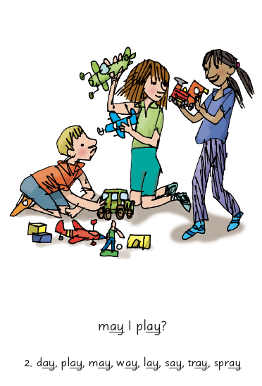

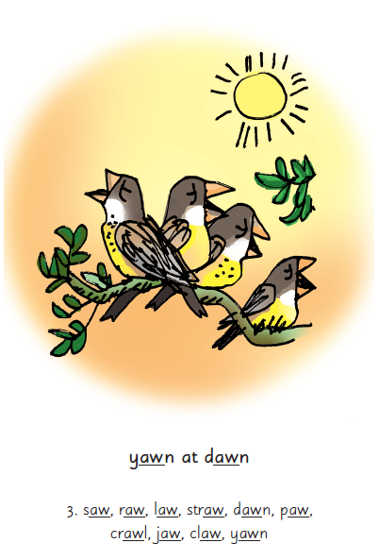
Picture Phrases
Notes:
We use a brief story and a picture phrase to help children to remember the Set 2 and Set 3 sounds.
For example, ay, may I play? aw, yawn at dawn.
We teach children to read and write three new Set 2 or 3 sounds each week.
We review the sounds we’ve taught before until they can read them speedily.

Slide 8


‘Special Friends’, ‘Fred Talk’
Notes:
Each day, children practise reading the sounds they know in words.
We use the routine ‘Special Friends’, ‘Fred Talk’.
They spot the ‘Special Friends’ first, then Fred Talk to read the word.
For example, ‘ay’, s-p-r-ay, spray.

Slide 9

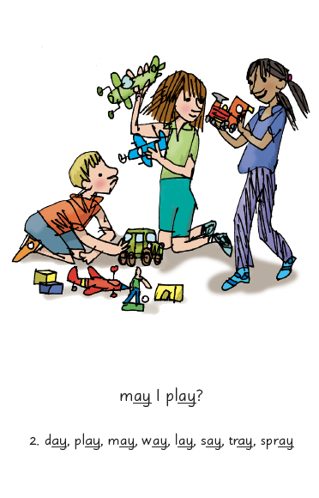

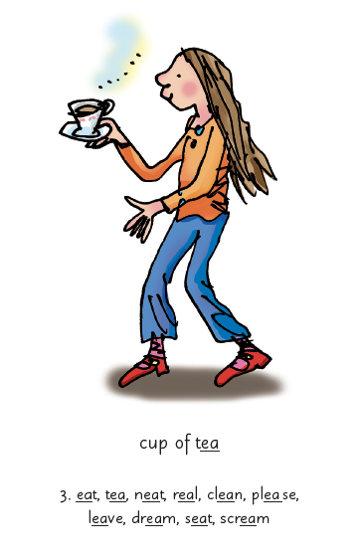
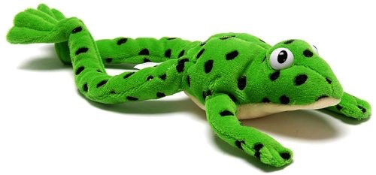
Sounds + blending = word reading
+
=
Notes:
When children can read sounds speedily, like this, (show how speedily this needs to be) and Fred Talk to read the word, they can decode words.

Slide 10
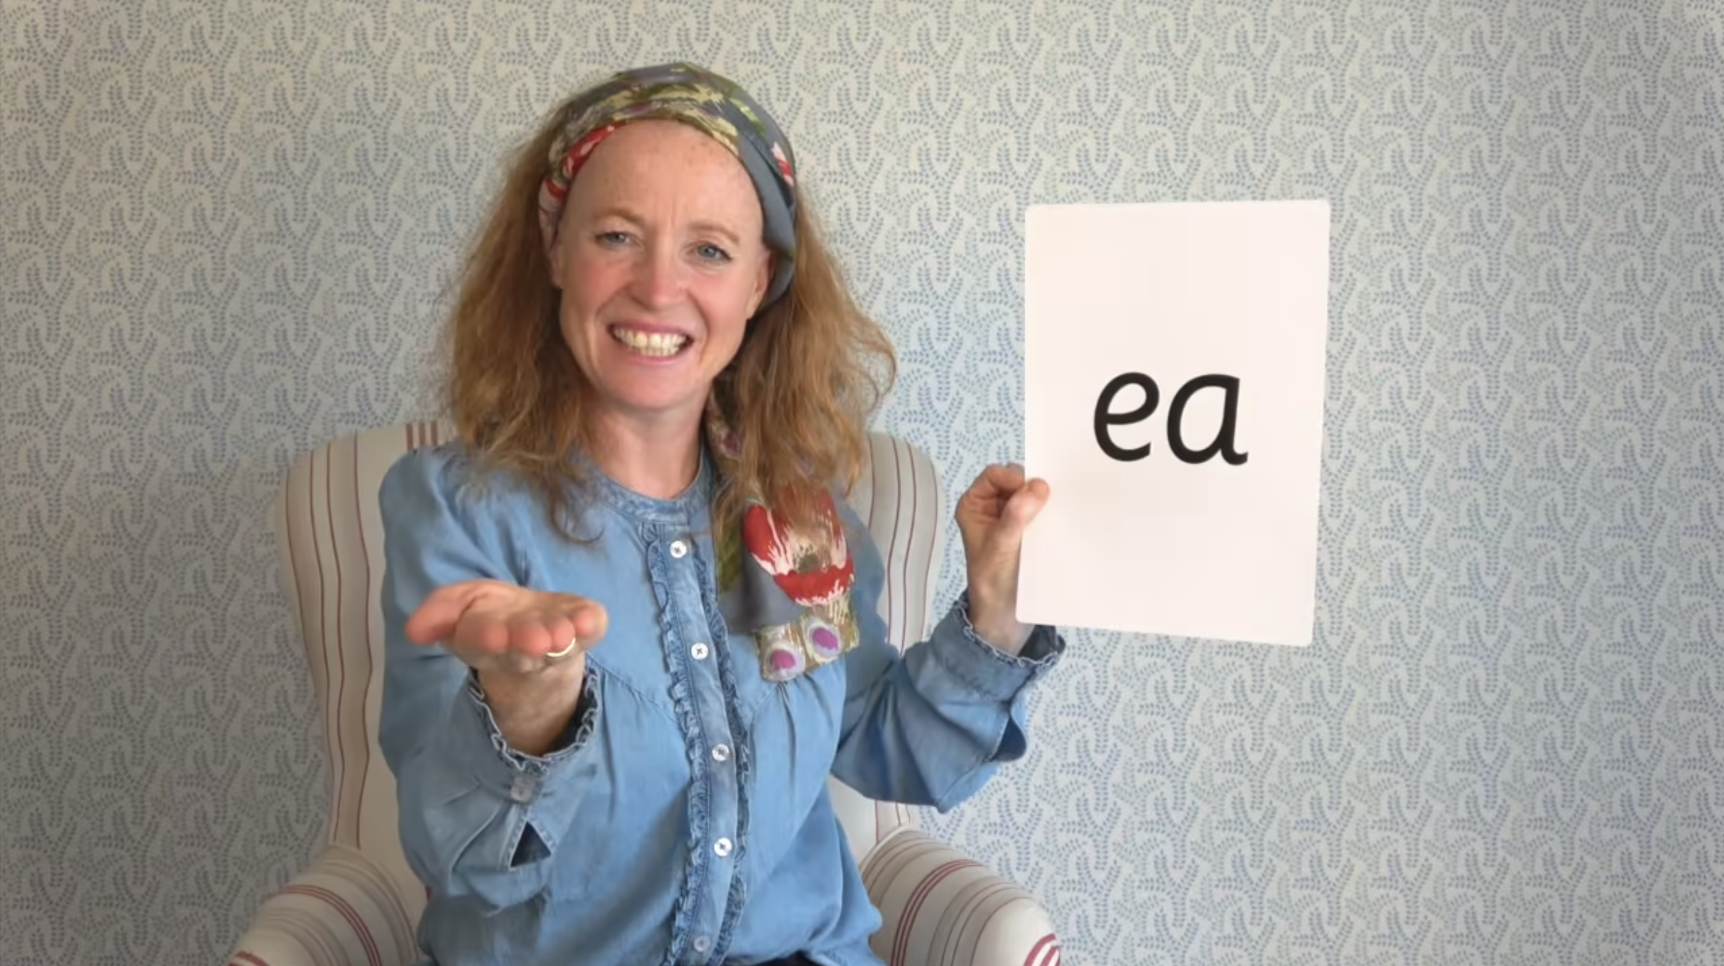
Virtual Classroom Set 2 and 3 sounds
Notes:
Each week, we will send home film links to lessons that match the sounds and words your child has been learning in school.
Your child uses the Virtual Classroom in school.
Children are familiar with the VC teachers – and interact with them as they would their own teacher.
Watch these films with your child to help them to practise reading the sounds and words until they can read them speedily.
Simply click the link and watch on a tablet or other device.
Let’s have a look at one of these films on the Virtual Classroom. Play a Set 2 or 3 at home film from the virtual classroom.

Slide 11
How do I use the Virtual Classroom?
Set aside 10 minutes to watch a film with your child each day.
Find a quiet space for your child to watch the film on a laptop or tablet.
Praise your child as they join in with the lesson – make it fun!
The more they practise using these films, the quicker they’ll learn to read.
Notes:
We will send you links to the films via email/ upload links to Google classroom/ Class Dojo etc.
When you receive the link, simply click on it . . . and press play.
Set aside 10 minutes to watch a film with your child each day.
Find a quiet space for your child to watch the film on a laptop or tablet.
Praise your child as they join in with the lesson – make it fun!
The more they practise using these films, the quicker they’ll learn to read.

Slide 12
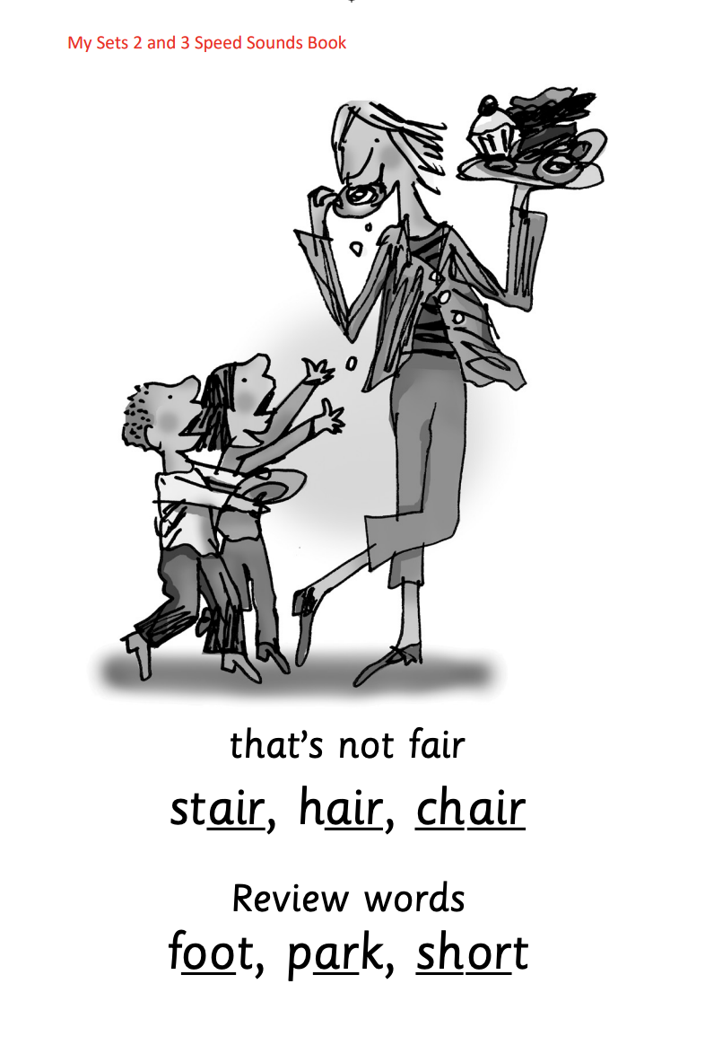
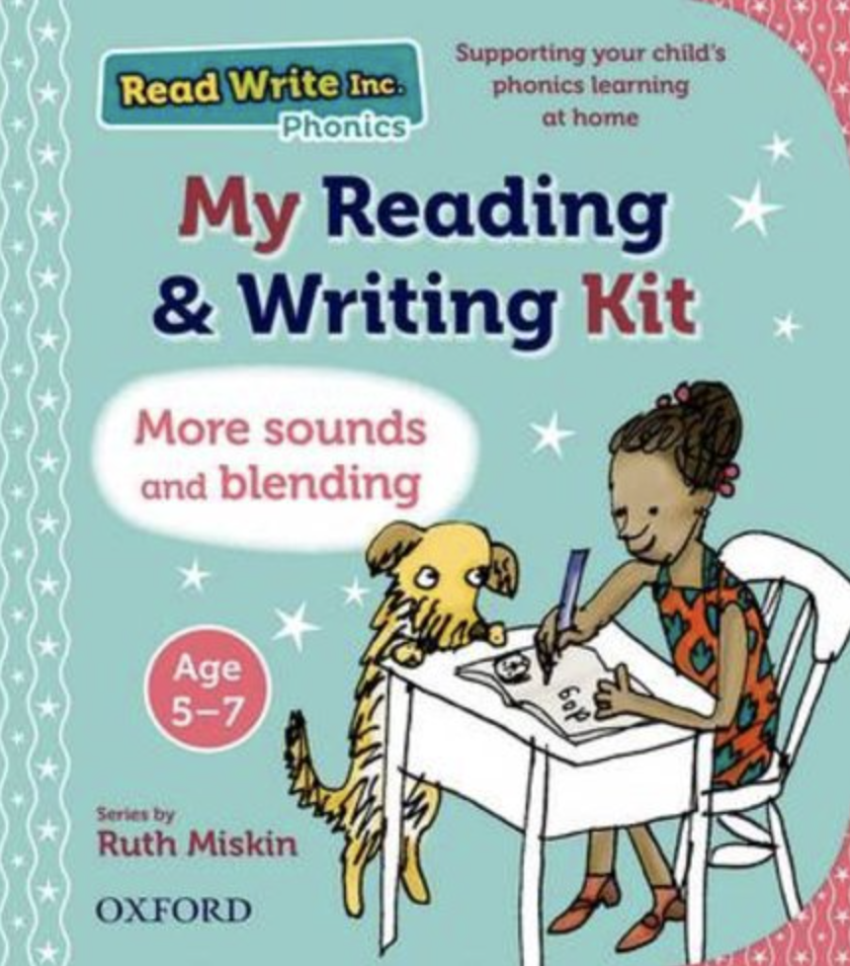





Practice at home
Notes:
Discuss the one that is applicable to your school:
Your child will also bring home a My Set 2 and 3 Speed Sounds books to practise reading and writing the Set 2 and 3 sounds and words.
There are instructions for you inside cover of the book.
Each week, your child will bring home the Speed Sounds cards they have been taught to practise reading sounds speedily.
You can purchase Set 2/3 flashcards or My Reading and Writing Kit ages 5-7 becoming a reader to support your child with Set 2 sounds at home if you wish.

Slide 13
What can I do?
Practise the sounds and phrases.
Practise reading sounds speedily.
Help your child use ‘Special Friends’, ‘Fred Talk’ to read words.
Watch the Virtual Classroom films together.
Notes:
Practise the sounds and phrases.
Practise reading sounds speedily.
Help your child use ‘Special Friends’, ‘Fred Talk’ to read words
Watch the Virtual Classroom films together.

Slide 14
Online resources available
Ruth Miskin Parents’ Page:
https://www.ruthmiskin.com/parents/
Ruth Miskin Facebook:
https://www.facebook.com/miskin.education
Free e-books for home reading:
http://www.oxfordowl.co.uk/Reading/

Slide 15
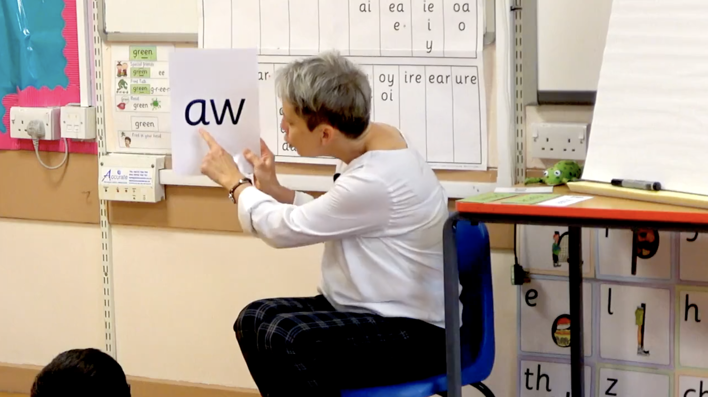
Teaching a Set 2/ 3 sound - in action
Notes:
Now let me show you this in action with a group.
Demonstrate teaching a Set 2/3 sound to a group.
Alternatively, you may wish to use an in-action film from the Online Subscription.

Slide 16
Reading changes everything
Teach a child to read and keep that child reading and we will change everything.
And I mean everything.
Jeanette Winterson
Notes:
Remember that all parents have the power to change outcomes for their children.

Slide 17

Any questions?

