Slide 1
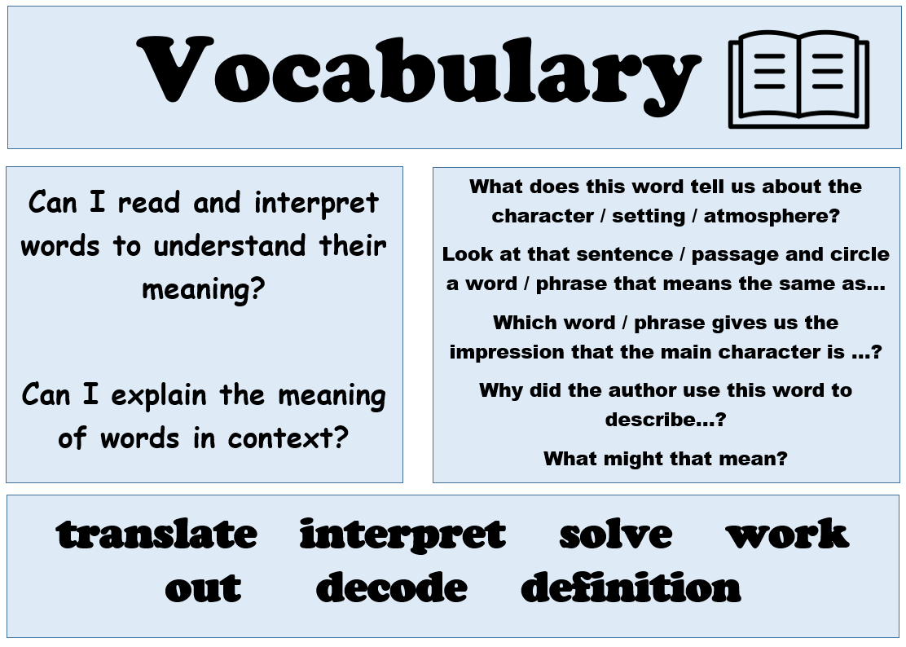
Today’s reading session is focusing on…

Slide 2
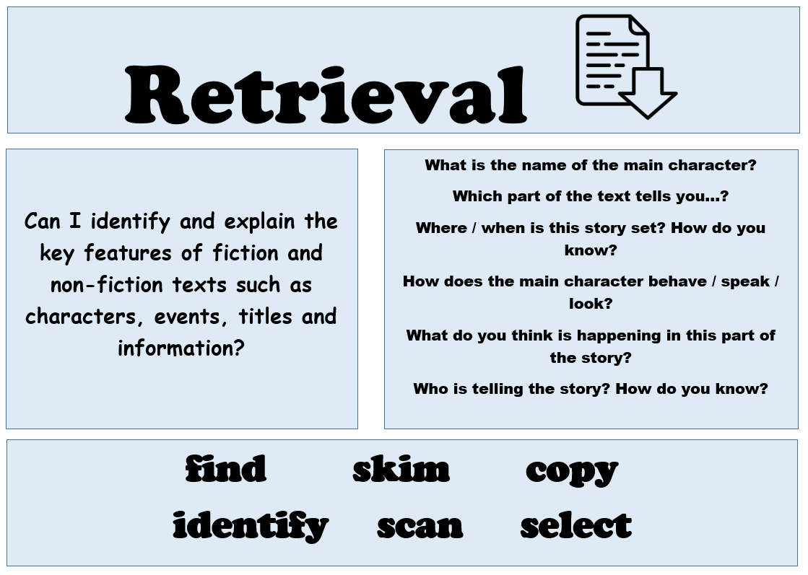
Today’s reading session is focusing on…

Slide 3
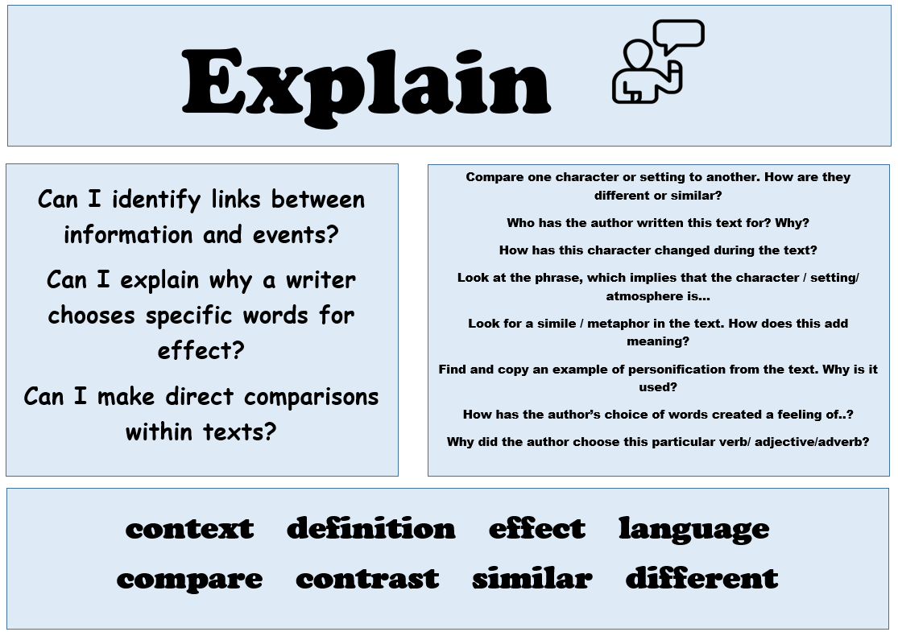
Today’s reading session is focusing on…

Slide 4
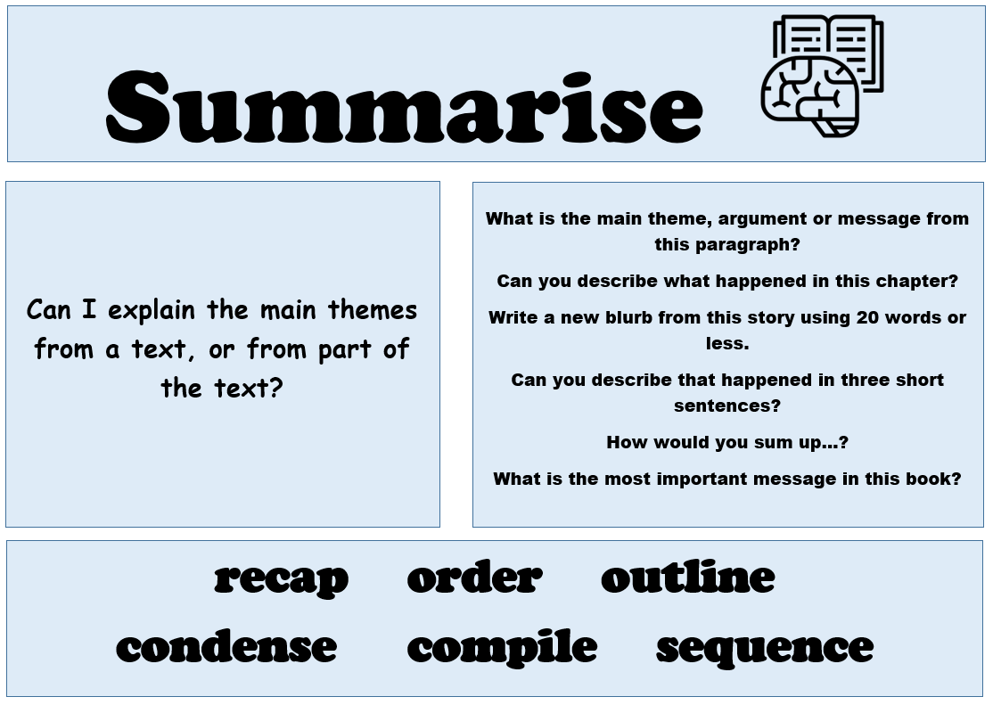
Today’s reading session is focusing on…

Slide 5
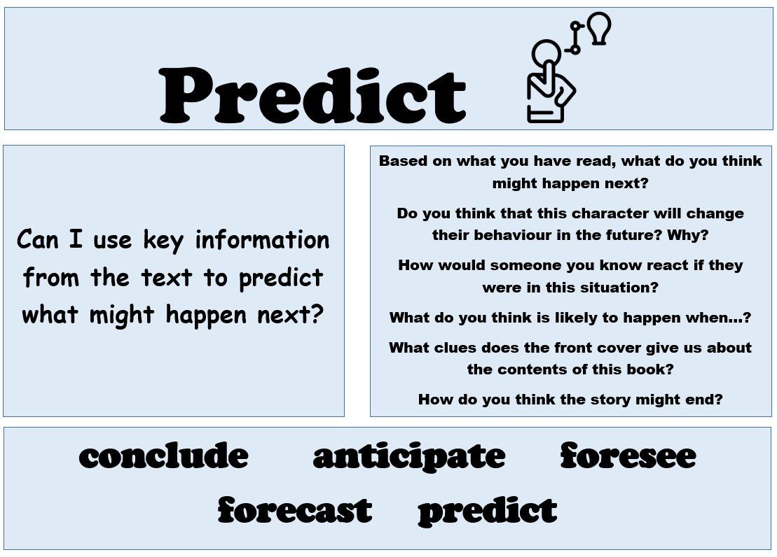
Today’s reading session is focusing on…

Slide 6
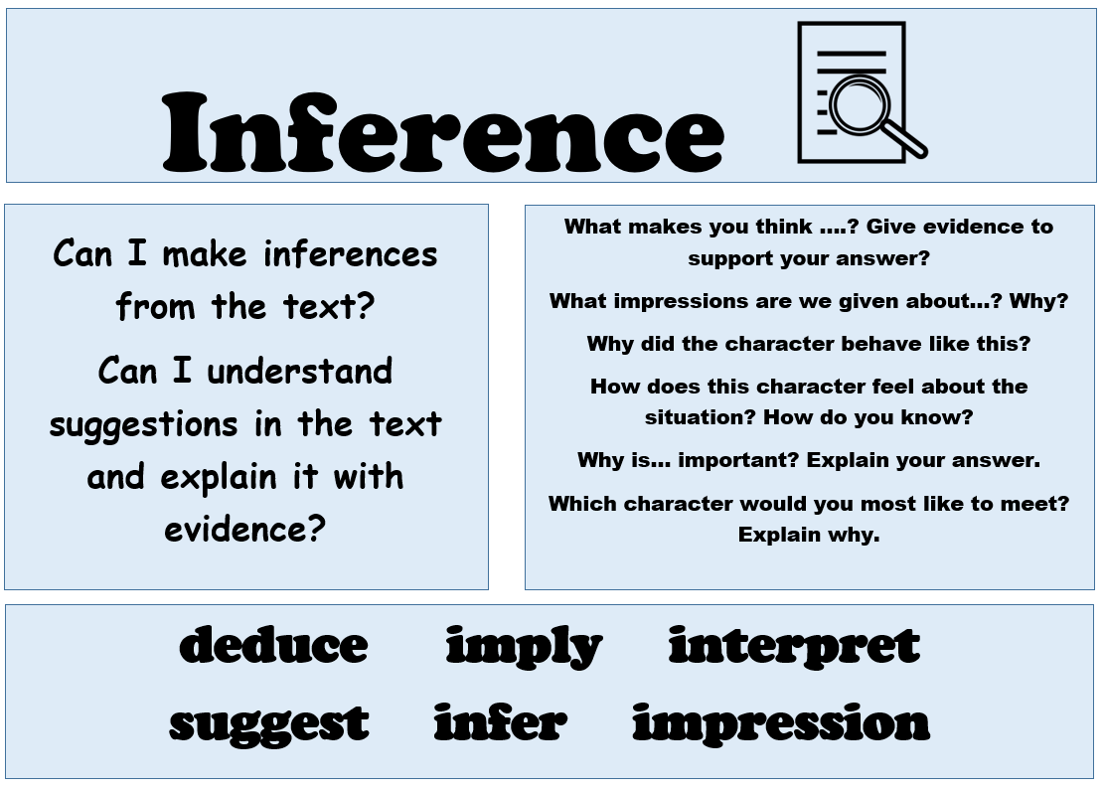
Today’s reading session is focusing on…

