Slide 1
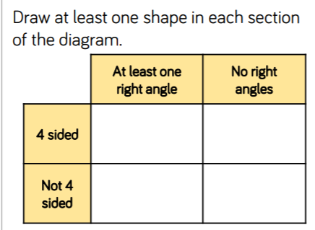
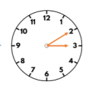
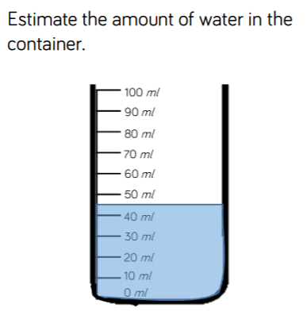
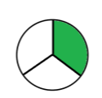
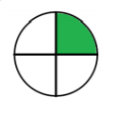
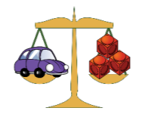
Number: Decimals
Number: Negative Number
Measurement: Converting Units
Number:
+ - x ÷
Measurement: Converting Units
Number: Algebra
Number: Fraction, Decimals and Percentage
Geometry (Shape:
Geometry Position and Direction
Geometry:
Shape
6
Measurement: Volume
Number: Place Value (
Number: Fractions (A+B)
Number: Ratio
Number: Decimals)
Statistics)
Geometry: Position and Direction
Statistics
Fractions A:
Number: Addition & Subtraction
Statistics
Measurement: Area and Perimeter
Geometry: Position and Direction
Number: Decimals and Percentages
Fractions B:
Number: Multiplication (B)
Number: Multiplication and Division (A)
Number: Place Value
Geometry: Shape
Geometry: (Shape)
Recap 2-3 lessons on properties of shape
Number: Place Value
Number: Multiplication and Division
Measurement: Area
Measurement Time:
Fractions B:
2
4
Fractions A:
Statistics
Fractions:
Number: Addition & Subtraction
Number: Decimals (A+B) (Week 14-17)
Measurement: Length and Perimeter (Week 19-20)
Measurement: Money
Measurement: Mass and Capacity
Multiplication and Division
(A + B)
eek
Measurement: Links to be made to money
Number: Place Value
Measurement: Time
1
Measurement: Length & Perimeter (Make reference to shape)
3
Number: Addition & Subtraction
Consolidation
5
Number: Multiplication and Division
Measurement: Time
Number: Place Value
Fractions:
Measurement: Length and Hei ght
Statistics:
Measurement: Money
Number: Place Value (within 100)
Number: Addition & Subtraction (Connection to be made to money)
Measurement: Time
Geometry: Properties of shape
Geometry: Position and Direction (
Measurement: Mass, Capacity and Temperature
Geometry Position and Direction
Number :Place Value (50)
Number: Place Value (20)
Geometry: Shape
Fractions:
Measurement: Length & Height
Number: Addition and Subtraction (20)
Number: Place Value (within 10)
Measurement: Mass & Volume
Number: Multiplication and Division
Number: Addition & Subtraction within 10

Slide 2
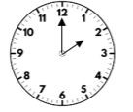
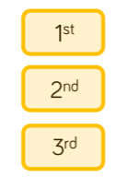
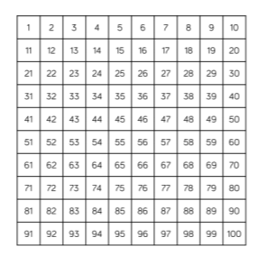
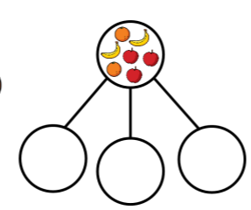
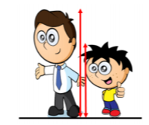
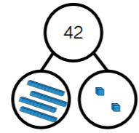
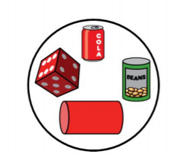
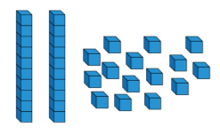
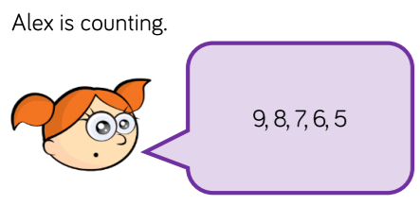
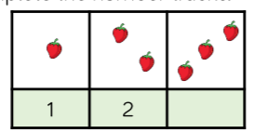
Measurement: Money (Week 31-32)
Recognising coins & notes
Counting coins
Measurement: Time
(Week 33-34)
Before & after
Dates
Time to the hour and half past..
Geometry: Position & Direction (Week 28)
Describe turns.
Describe position.
Geometry: Shape (Week 27)
Identify and sort 2D shapes
Identify and sort 3D shapes
Patterns
Sum 2
1.13 (EK) Know two more and two less than numbers up to 100
1.18 (EK) Recall number bonds to 10
Number: Place Value (within 100)
(Week 29-30)
Counting to 100
Partitioning numbers
Ordering numbers
One more, one less
Tens to 100
Compare numbers
Number: Fractions (Week 25-26)
Find a half.
Find a quarter.
Number: Multiplication & Division (Week 19-20)
Count in 10s
Make equal groups- sharing
Add equal groups
Make arrays
Make doubles
Count in 2’s, 10’s and 5’s
Make doubles
Measurement: Mass & Volume (23-24)
Introduce volume and mass.
Measure mass
Compare mass
Introduce capacity and volume
Compare and measure capacity.
Aut 2
Spr2
Measurement: Length & Height (Week 21-22)
Compare length and height
Measure length.
CM
Number: Place Value (within 50) (Week 17-18)
Numbers from 50
Tens and ones
Order numbers within 50
Compare numbers within 50
Compare objects within 50
Count in 2’s
Count in 5’s
Addition & Subtraction (within 20) (Week 14-16)
Number bonds to 20
Fact families
Subtraction crossing 10
Doubles
Missing number problems
Sum 1
Aut 1
Number: Place value (within 20) ( Week 11-13)
Numbers from 11-20
Count forwards and backwards to 20 in numerals and words.
Count one more and one less than
Compare groups of objects
Tens and ones
Order numbers
Numberline
Spr 1
1.16 (EK) Know half of 12, 14, 16, 18. 20
1.15 (EK) Know double 6, 7, 8, 9, 10
1.14 (EK) Know 10 more than a single digit number
Number: Addition & Subtraction (within 10) (Week 6-10)
+ and – symbol
Number bonds to 10
Fact families
Add and subtract
Find a part
Problem solving
Number: Place value
(within 10) (Week 1-5)
Sort and count objects
Introduce < > and =
Ordinal numbers
The number line
Ordinal numbers 2nd 3rd
1.17 (EK) Recall the odd and even numbers up to 10
1.18 (EK) Recall number bonds to 10

Slide 3
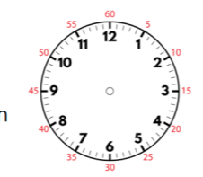
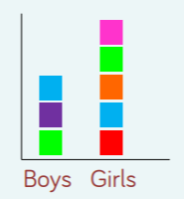
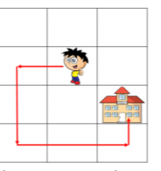
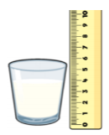
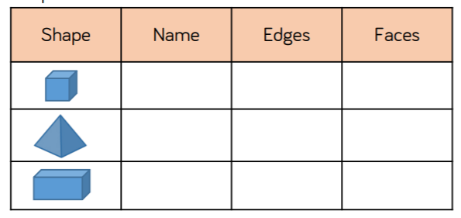
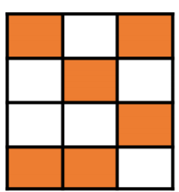
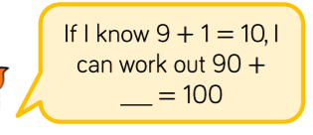
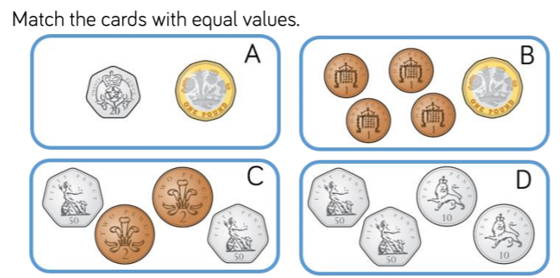
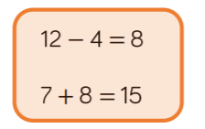
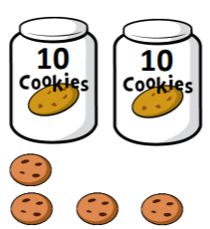
Statistics (Week 32-33)
Make tally charts.
Draw pictograms
Interpret pictograms
Block diagrams
Consolidation
Sum 2
Measurement: Mass, Capacity & Temperature (Week 29-31)
Compare mass & volume
Measure mass in gr & kg, capacity in ml & l
Temperature
Geometry: Position & Direction (Week 26-28)
Describing movement & turns
Making patterns with shape
Geometry: Properties of Shape
(Week 21-23)
Recognise and sort 2D & 3D shapes
Count vertices, faces & edges
Lines of symmetry
Week (24-25)
Aut 2
Spr2
Measurement: Time (Week 18-20)
O'clock and 1/2 past
¼ past and to
Telling time to 5 minutes
Durations of time
2.11 (EK) Know double 11-20
Number: Fractions (Week15-17)
Recognise ½ , ¼ and 1/3
Find a third
Equivalence 2/4 – ½
Find ¾
Equal and unequal
Unit fractions
Count in fractions up to 1 whole
Number: Multiplication & Division (Links made to Money) (Week 10-14)
Multiplication sentences using x symbol
2,5, 10 times tables
Divide by 2, 5 & 10
Odd and even numbers
Equal groups
Multiplication sentences
Double/half
Aut 1
Spr 1
Sum 1
2.14 (EK) Recall compositions of numbers within 20 (Make 15 etc)
Measurement: Money
Notes & coins
Find the amount
Find the total
Find the difference
Find change
2.14 (EK) Recall compositions of numbers within 20 (Make 15 etc)
Number: Addition & Subtraction (Week 5-9) Links made to money
Recap number bonds to 10
Bonds to 100- tens
Add and subtract 1’s
10 more & 10 less
Fact families
Add three 1 digit numbers
Across 10
Add the next 10
Subtract across 10
2.13 (EK) Recall number bonds to 20 (making 20)
Number: Place Value (Week 1-4)
Recap from year 1
Represent numbers to 100
Using a place value chart
Tens and ones addition
Order objects and numbers
Count in 5’s, 10’s and 3’s
Number line counting
Estimate a number line
2.12 (EK) Know double 10, 20, 30, 40, 502.13
(EK) Recall number bonds to 20 (making 20)
2.13 (EK) Know half of 10, 20, 40, 60, 80 and 100

Slide 4
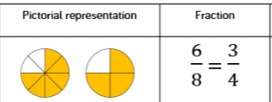
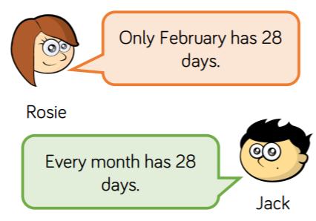
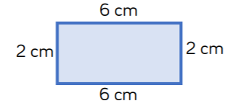
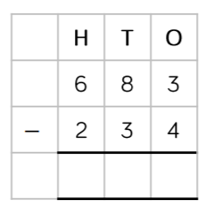
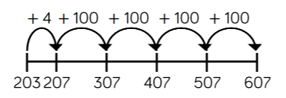
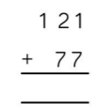
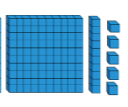
Geometry: Properties of Shape ( Week 28-29)
Right angles in shapes
Compare angles
Horizontal & vertical
Recognise and describe
Parallel and perpendicular
Draw polygons
Make 3D shapes
Statistics (Week 30)
Make tally charts.
Draw pictograms
Bar charts
Tables
Consolidation
Sum 2
Number: Fractions (B)
(Week 26-27)
Add and subtract fractions
Partition the whole
Unit fraction (objects)
Non Unit fraction (Object)
Reason fraction of an amount
Fractions A: Week (26-28
Understand the denominators
Compare and order
Fractions and scales
Equivalent fractions on a number line
Measurement: Mass & Capacity (Week 22-23)
Measure & compare mass
Measure & compare capacity
Grams/kilograms
Add and subtract mass
Equivalent
L and ml
Measurement: Length & Perimeter
(Week 18-19)
Measure length
Equivalent lengths m & cm, mm & cm
Measure & calculate perimeter
Add and subtract lengths
Measure perimeter
Aut 2
Spr2
3.16 (EK) Know double/half 100, 200, 300, 400, 500
Measurement: Time (Week 20-21)
Months and years
Hours in a day
Telling time to 5 and 1 minute
24hour clock
Use a.m. & p.m.
Start and end – duration
3.15 (EK) Know half of 30, 50, 70, and 90
3.14 (EK) Know double 60, 70, 80, 90 and 100
Aut 1
Number: Multiplication & Division (B) (Week 15-17)
Multiplies of 10
Related Calculations
2 x 1 digits no exchange
2 x 1 and exchange
Divide 2 by 1 no exchange
Divide 2 by 1 with exchange
Scaling
Spr 1
Sum 1
Number: Multiplication & Division (A) (Week 11-14)
Use arrays
Equal groups
2,5, 10
X by 3
Divide by 3
3,4,8 timestable
Measurement: Money (Week 8-10)
Count in £’s and pence
Convert between £’s and pence
Add & subtract money
Find Change
3.13 (EK) Recall number bonds to 100 in multiples of 5
Number: Addition & Subtraction (Week 4-8)
Add & subtract 2-digit and 1-digit numbers – crossing 10
Add & subtract 3-digit and 1-digit numbers – crossing 10
Add and subtract two 2-digit numbers – crossing 10
Add and subtract two 3-digit numbers – crossing 10
Estimate answers
Inverse Operations
Number: Addition & Subtraction (Week 4-8)
Add & subtract multiples of 100
Add & subtract 2-digit and 1-digit numbers – not crossing 10
Add & subtract 3-digit and 1-digit numbers – not crossing 10
Spot the Pattern
Add a1’S across 10
Add and subtract two 2-digit numbers – not crossing 10
Add and subtract two 3-digit numbers – not crossing 10
Number: Place Value (Week 1-3)
Represent numbers to 100 & 1000
Number line to 1000
Compare numbers to 1000
Order numbers to 1000
Flexible partitioning
100, 10, 1
Count in 50’s

Slide 5
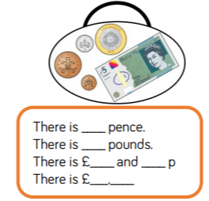
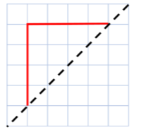
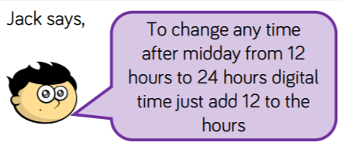
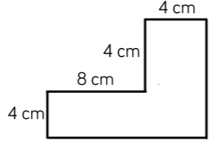
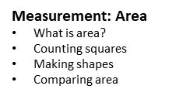
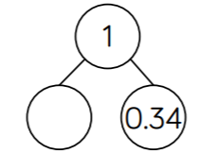
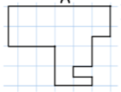
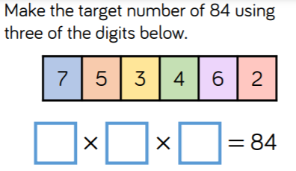
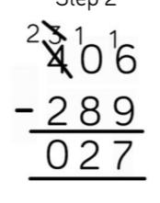
Geometry: Position & Direction (Week 33-34)
Describe position
Draw and move on a grid
Sum 2
Geometry: Properties of Shape (Week 30-31)
Identify angles
Triangles & quadrilaterals
Lines of symmetry
Statistics (Week 32)
Interpret charts – introduce line graphs
Comparison – sum and difference
Measurement: Time (Week 28-29)
Hours, minutes & seconds
Years, months, weeks & days
Analogue to digital – 12 & 24hr clocks
Measurement: Length & Perimeter (Week 20-21)
Equivalent lengths m & cm, mm & cm
Measure & calculate perimeter
Kilometres
Add & subtract lengths
Perimeter of rectangles and rectilinear shapes.
Number: Fractions (Week 24-28))
Understand the whole
Partition a mixed number
Number lines
Understand improper
Comapre and order mixed numbers
Conver improper to mixed number etc
Equivalent fractions
Add two or more fractions
Add fractions and mixed numbers
Aut 2
Spr2
Measurement: Money (Week 22-23)
Pounds and pence
Ordering money
Estimating money
Four operations with money
Write money as decimals
Number: Decimals (B) (Week 17-18)
Make a whole with tenths
Make a whole with Hundredths
Partition decimals
Compare decimals
Order decimals
Round to the nearest whole
Halves and quarters as decimals
4.17 (EK) Recall number bonds to 1000 in multiples of 50 (350 and 650)
Aut 1
Spr 1
Sum 1
Number: Decimals (A) (Week 15-16)
Tenths as fractions
Tenths as decimals
Tenths on a place value chart
Divide 1 digit by 10
Divide 2 digit by 10
Hundredths as fraction
Divide 1 or 2 digit by 100
Number: Multiplication & Division (A) Week 8-11)
Multiply & divide by 10 & 100
Multiply by 1 & 0
Multiply & divide by 3, 6 9 & 7
11 and 12 x tables and division facts
Multiply 3 numbers
Number: Multiplication & Division (B) Week (12-14)
Factors Pairs
Use factor pairs
Multiply by 10
Multiply by 100
Divide by 10
Divide by 100
Related facts
Informal written methods
2 x 1 digit
3 x 1 digit
4.16 (EK) Recall number bonds to 1000 in multiples of 100
4.14 (EK) Know half/double of 300, 500, 700, 900
Number: Addition & Subtraction (Week 5-7)
Add & subtract multiples of 100
Add/subtract 1’s, 10’, 100’s and 1000’s
Add & subtract two 3-digit numbers – not crossing 10 or 100
Add & subtract two 4-digit numbers – not crossing 10 or 100
Efficient subtraction
Add & subtract two 3-digit numbers – crossing 10 or 100
Add & subtract two 4-digit numbers – crossing 10 or 100
Estimate Answers
Checking strategies
Number: Place Value (Week 1-4)
Represent numbers to 1000
Partitioning to 1000
Number line to 1000
Round to the nearest 10, 100
Find 1, 10 100 more than/less than
Count in 25’s
Negative numbers
Estimate
Roman numerals to 100

Slide 6
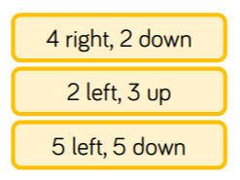
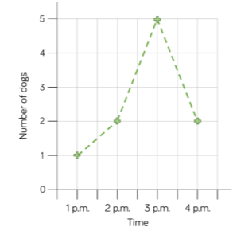
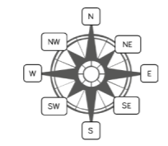
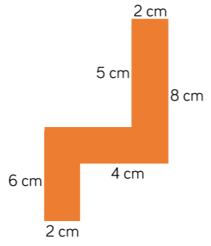
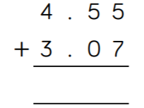
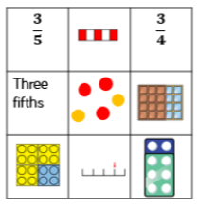
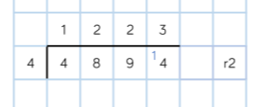
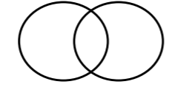
Negative Numbers (Week 32)
Understand negative numbers
Count through zero
Count through multiples
Find the difference
Measurement: Converting Units (Week 33-34)
Kg, km, mg, ml,
Metric & Imperial units
Timetables
Measurement: Volume (Week 35)
What is volume?
Compare & estimate volume & capacity
Number: Decimals (Week 29-31)
Multiply & divide by 10, 100, 1000
Add & subtract whole & decimals
Sum 2
Geometry: Position & Direction ( Week 27-28)
Position in first quadrant
Reflections
Translation
Read and plot coordinates
Statistics (Week 23)
Interpret charts
Read & interpret line graphs
Read & interpret tables
Two way tables
Timetables
Geometry: Properties of Shape (Week 24-26)
Measuring with a protractor
Using angles
Angles on a straight line
Angles around a point
regular & irregular polygons
Measurement: Perimeter & Area (Week 21-22)
Perimeter of rectangles and rectilinear shapes.
Area of compound shapes
Area of irregular shapes
Estimate Area
Aut 2
Spr2
5.14 (EK) Know decimal compliments to 10 to 1decimal place (3.4 and 6.6)
Number: Decimals & Percentages (Week 18-20)
Rounding decimals
Ordering & comparing decimals
Understand percentages
Percentages as fractions & decimals
Equivalent F.D.P
Rounding to the nearest whole
Percentages as fractions
Percentages as decimas
Number: Fractions (B) (Week 16-17))
Equivalent fractions
Fractions greater than 1
Add and subtract fractions
Improper fractions to mixed numbers
Mixed numbers to improper fractions
Add/subtract mixed umbers
Compare and order
5.15 (EK) Know decimal compliments to 1 to 2 decimal places (0.76 and 0.24)
5.11 (EK) Know double 0.5, 1.5, 2.5, 3.5, 4.5
5.12 (EK) Know double 5.5, 6.5, 7.5, 8.5, 9.5
5.13 (EK) Know half of 19, 17, 15, 13 and 11
Aut 1
Spr 1
Sum 1
Number: Multiplication & Division (B) (Week 13-15)
Multiply & divide 2, 3 & 4 -digit by 1-digit numbers
Multiply & divide 2, 3 & 4 -digit by 2-digit numbers
Divide with remainders
Solve problems with x and division
Number: Multiplication & Division (Week 6 -8)
Multiples & Factors
Common Factors
Prime numbers
Square & cube numbers
Multiply & divide by 10, 100 & 1000
Multiples of 10, 100 & 1000
Divide and multiply by 10,100,1000
Number: Fractions (A) (Week 9-12)
Equivalent fractions
Fractions greater than 1
Add and subtract fractions
Improper fractions to mixed numbers
Mixed numbers to improper fractions
Add/subtract mixed umbers
Compare and order
Number: Addition & Subtraction (Week 4-5)
Mental strategies
Add whole numbers with more than 4 digits
Subtract whole numbers with more than 4 digits
Multistep problems
5.10 (EK) count forwards or backwards in steps of powers of 10 for any given number up to 1,000,000
Number: Place Value (Week 1-3)
Roman numerals to 1,000
Numbers to 10,000, 100,000,1,000,000
Powers of 10
More or less up to 100,000
Number line
Compare and order
Round up to the nearest 1,000,000

Slide 7
SATs Prep & Consolidation
Sum 2
Consolidation of weak areas. investigations & preparing for Key Stage 3
Geometry: Position & Direction
(Week 27)
Recap first quadrant
All four quadrants
Translations
Reflections
Statistics (Week 23)
Read, interpret & draw line graphs
Circles
Read & interpret pie charts
Draw pie charts
The mean
Geometry: Properties of Shapes (Week 24-26)
Recap yr 5 angles
Vertically opposite angles
Angles in a triangle & quadrilaterals
Angles in regular polygons
Draw nets of 3D shapes
Number: Decimals (Week 17-18)
Round to 3 d.p.
Multiply & divide by 10, 100, 1 000
Multiply & divide decimals by integers
Decimals as fractions
Fractions as decimals
Number: Fractions, Decimals and Percentages (Week 19-20)
Decimal/Fraction Equivalents
Understanding Percentages
Fractions to percentages
Order FDP
Percentage of amounts
Measurement: Perimeter & Area and Volume (Week 21-22)
Area & perimeter
Area of a triangle & parallelogram
What is volume- counting cubes
Volume of a cuboid
Aut 2
Spr2
Algebra (Week 15-16)
One step & two step rules
Forming expressions & equations
Substitution
Find pairs of values
Number: Ratio (Week 13-14)
Introduce ratio symbol
Introduce scale factors
Calculate scale factors
Ratio & proportion problems
Aut 1
Number: Fractions (Week 8-9)
Equivalent fractions
Simplify fractions
Fractions on a number line
Mixed numbers to improper fractions
Compare/order fractions
Spr 1
Measurement: Converting Units (Week 12)
Know metric measures
Converting metric measure
Imperial measures
Miles & kilometres
Sum 1
Number: Fractions (Week 10-11)
Add & subtract fractions
Multiply & divide fractions
Multiply and divide fractions by integers
Four rules with fractions
Fractions of amount
Fractions of amount – find the whole
Number: Addition, Subtraction, Multiply & Divide (Week 3-7)
Primes to 100
Squares & cubes
Order of operations
Mental calculation
Estimation
Number: Addition, Subtraction, Multiplication and Division (Week 3-7)
As for year 5
Divide with remainders
Short & Long division
Factors 7 multiples
Common factors & common multiples
Number: Place Value (Week 1-2)
Numbers to 10 000, 100 000
Numbers to I million & 10 million
Compare & order any number
Round number to 10, 100, 1 000
Negative numbers

