Slide 1
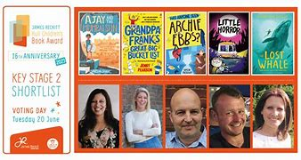
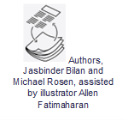
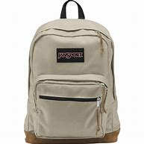
Personal Development
Year 6
Changing Me
Enquiry Question 4
Were the Maya Unique
Relationships
Healthy Me
Dreams and Goals
Enquiry Question 3
Is World Trade always fair?
Celebrating Difference
Enquiry Question 2
How are major conflicts viewed through the eyes of a child?
Overnight residential
Being Me
Enquiry Question 1
Will you ever see the water you
drink again?

Slide 2
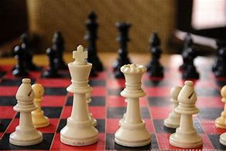
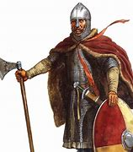
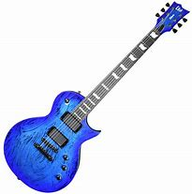
Personal Development
Year 5
Changing Me
Enquiry Question 4
Why should gunpowder, treason and plot never be forgotten?
Relationships
Healthy Me
Dreams and Goals
Enquiry Question 3
How has the fishing industry shaped Hull?
Celebrating Difference
Enquiry Question 2
Who were the Anglo Saxons?
Being Me
Enquiry Question 1
What is so special about the USA

Slide 3
Personal Development
Year 4
Changing Me
Enquiry Question 4
Why was Boudica so powerful and what did we learn from her?
Relationships
Healthy Me
Dreams and Goals
Enquiry Question 3
Would you prefer to live in London or Hull?
Celebrating Difference
Enquiry Question 2
Did the ancient Greeks do much for our modern world?
Being Me
Enquiry Question 1
Why are rainforests the oldest ecosystems?

Slide 4
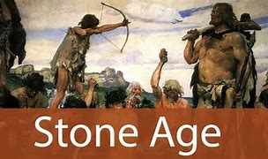
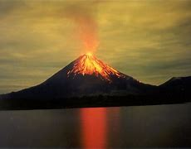
Personal Development
Year 3
Changing Me
Stone Age art
Enquiry Question 4
Who first lived in Britain?
Relationships
Healthy Me
Dreams and Goals
Enquiry Question 3
Why do so many people choose to go to the Mediterranean for their holidays?
Celebrating Difference
Enquiry Question 2
Do you think Mary Anning was a heroine or villain?
Build a volcano
Being Me
Enquiry Question 1
What makes the Earth angry
Learn to speak Spanish

Slide 5
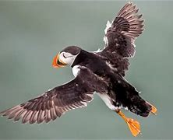
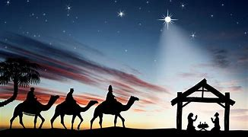
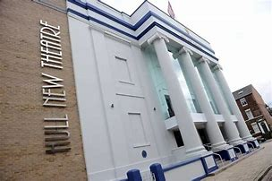
Personal Development
Year 2
Changing Me
Enquiry Question 4
Why was Neil Armstrong a brave person?
Relationships
Healthy Me
Dreams and Goals
Enquiry Question 3
Why do we love to be by the seaside?
Bempton Cliff experience
Celebrating Difference
Enquiry Question 2
Why was the Fire of London so Great?
Being Me
Perform the Nativity
Enquiry Question 1
Where would you prefer to live England or Africa?

Slide 6
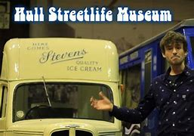
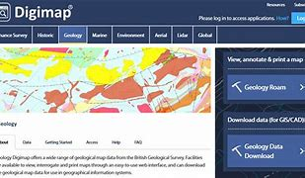
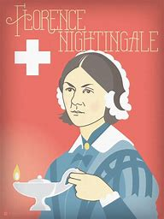
Personal Development
Year 1
Changing Me
Enquiry Question 4
What has changed over the last 100 years
Relationships
Healthy Me
Dreams and Goals
Enquiry Question 3
What will we see on our journey around the UK
Celebrating Difference
Enquiry Question 2
What impact did Florence Nightingale have?
Being Me
Perform as the
choir in the Nativity
Enquiry Question 1
Why can’t a Meerkat live in
the North Pole?

Slide 7
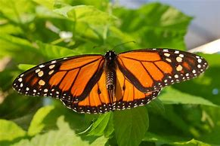
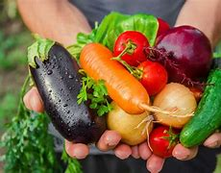
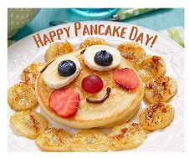
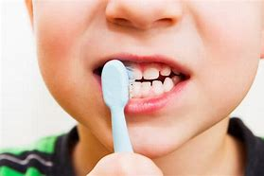
Personal Development
Year FS2
Changing Me
Enquiry Question 4
Who lives under our feet?
Relationships
Healthy Me
Dreams and Goals
Enquiry Question 3
What skills do you need to become an astronaut?
Celebrating Difference
Enquiry Question 2
Where do we fit in our world?
Being Me
Enquiry Question 1
Who am I?
Visit from Dental nurse

