Slide 1
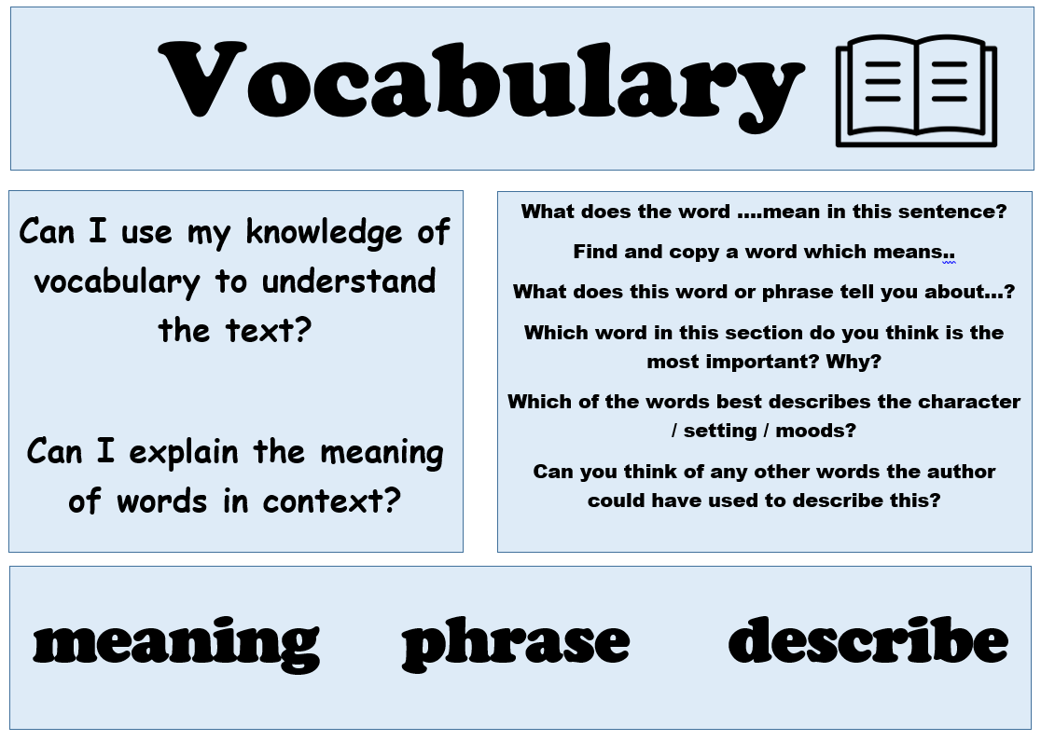
Today’s reading session is focusing on…

Slide 2
Today’s reading session is focusing on…

Slide 3
Today’s reading session is focusing on…

Slide 4
Today’s reading session is focusing on…

Slide 5
Today’s reading session is focusing on…

Slide 6
Today’s reading session is focusing on…

