Slide 1
Home Learning Challenge
Year 6 Week 4

Slide 2
During this weeks learning challenge, you are going to find out all about the Maya Pyramids and Architecture.
I would like you to read through the information and then I would like you to research about the different pyramids.
On the picture of the pyramid at the end of the PowerPoint, I would like you to annotate all of the different features and research you have found out. You could research the different pyramids and then choose a specific one to focus on e.g. Nohoch Mul Pyramid.
You could also design your own version of a Maya Pyramid and explain the different features you have included.

Slide 3
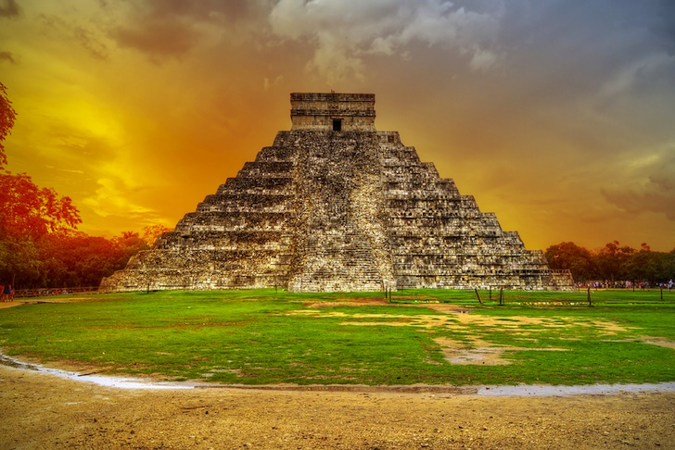
Maya Pyramids and Architecture

Slide 4
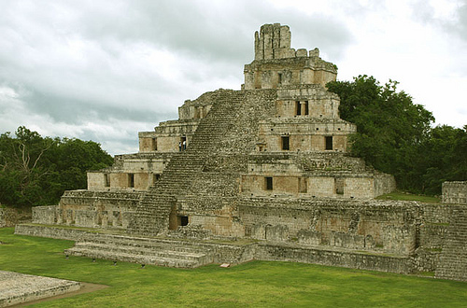
The Maya civilization is famous for its architecture. Many city-states built large palaces, pyramids, and other public buildings that are still standing today. The buildings were covered with carvings and statues to honour their gods as well as to commemorate their kings.

Slide 5
Pyramids The Maya are perhaps most known for their many majestic pyramids. They built two kinds of pyramids. Both types of pyramids were similar in many ways. They each had the familiar pyramid shape. They each had steep steps up the side that would allow someone to climb to the top. They each were built for religious purposes and for the gods. However, they had their differences as well. The first type of pyramid had a temple on the top and was meant to be climbed by the priests to make sacrifices to the gods. The stairs going up the sides of these pyramids were steep, but not too steep for the priests to climb. The most important religious ceremonies were held at the top of these pyramids. The second type of pyramid was a sacred pyramid built to a god. These pyramids were not to be climbed or touched by humans. There were still steps going up the sides of these pyramids, but they were often too steep to climb without a lot of effort. These pyramids were sometimes built with secret doors, tunnels, and traps.

Slide 6
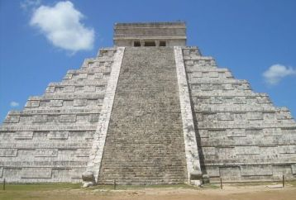
Famous Pyramids El Castillo - This pyramid was built as a temple to the god Kukulcan in the city of Chichen Itza. The total height of the pyramid is just under 100 feet. Each side of El Castillo has 91 steps. When you add up the steps on all four sides and then add in the top platform as a step, you get 365 steps, one for each day of the year.

Slide 7
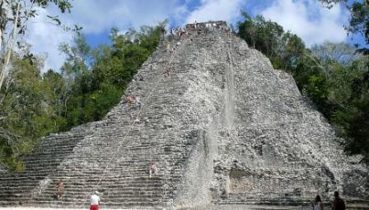
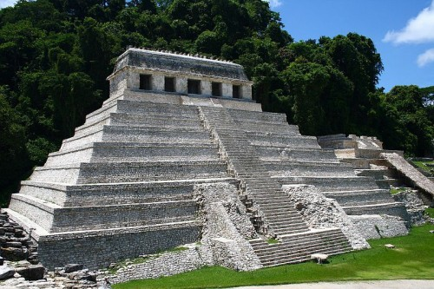
Nohoch Mul Pyramid
Temple IV at Tikal - Temple IV at Tikal is part of a number of very tall pyramids in the city of Tikal. It is 230 feet tall and was built to mark the reign of King Yik'in Chan K'awiil. La Danta - This pyramid is thought to be one of the largest pyramids in the world by total volume. It is 250 feet tall and has a volume of 2.8 million cubic meters. Nohoch Mul - A temple pyramid in the city of Coba, Nohoch Mul is one of the tallest pyramids on the Yucatan Peninsula at 138 feet high.

Slide 8
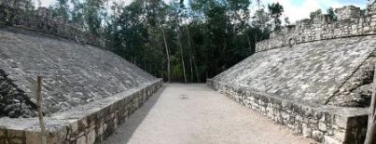
Palaces for the Kings Each Maya city-state would have a large palace inside the city for their king and the royal family. These palaces were sometimes large monuments to powerful kings. One of the most famous palaces is the palace at Palenque built by King Pakal. It was a large complex of many buildings and courtyards including a tall tower that looked over the city. It was covered with colourful hieroglyphics and carvings of the king and his family. Ball Courts The Maya also built giant ball courts where they would play their game with a rubber ball. Some major cities had multiple courts. Sometimes ball courts were attached to temples. The courts had two long stone walls, sometimes built with sloped sides.

Slide 9
Interesting Facts about Maya Pyramids and Architecture
Maya pyramids had a flat top.
The pyramids of the Aztecs were very similar to those of the Maya. The main difference was that the Aztec would sometimes build more than one temple on the top of a pyramid.
Many times new pyramids were built on top of old pyramids. Archeologists have found several more pyramids inside and under existing pyramids.
Some pyramids served as burial chambers for kings similar to the ancient Egyptians.
Many Maya buildings and temples were aligned with celestial events such as the path of the sun.

Slide 10
This Pyramid is located Mexico's Yucatan Peninsula
The height of this pyramid is 137-feet tall.
Nohoch Mul Pyramid

