Slide 1
Home Learning Challenge
Year 1 Week 5

Slide 2
What sort of clothes would your grandparents have worn?
/historical enquiry- Can they answer questions using an artefact/ photograph provided

Slide 3
What does fashion mean?
What do you think fashion was like in the 1960’s?
What do you think your Grandparents would have worn when they were your age?

Slide 4
We are going to be finding out about how clothes and hairstyles have changed over time.
Can you find a photo of a relative as a child or young adult (parent, grandparent or great-grandparent)?
Don’t worry if you have not got a photograph. I have one you can use.

Slide 5
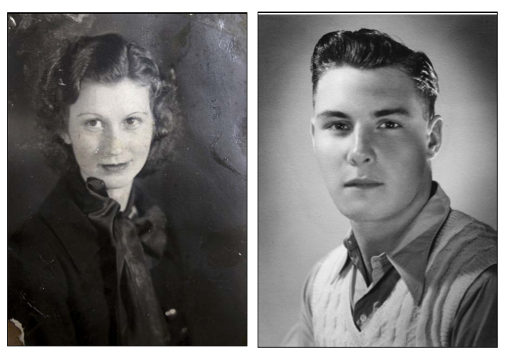

Slide 6
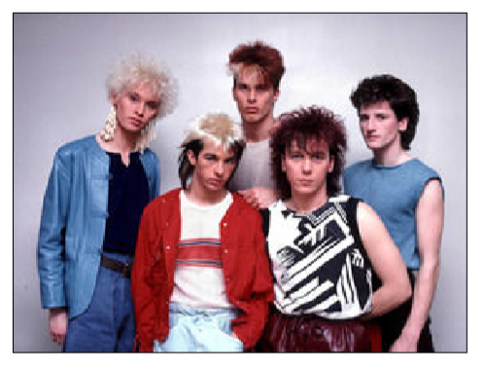
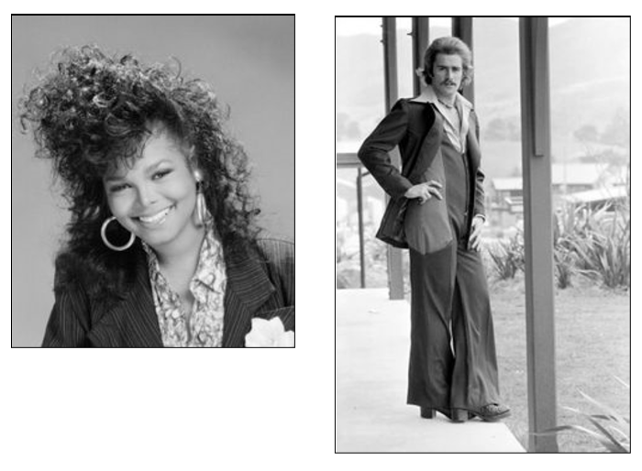
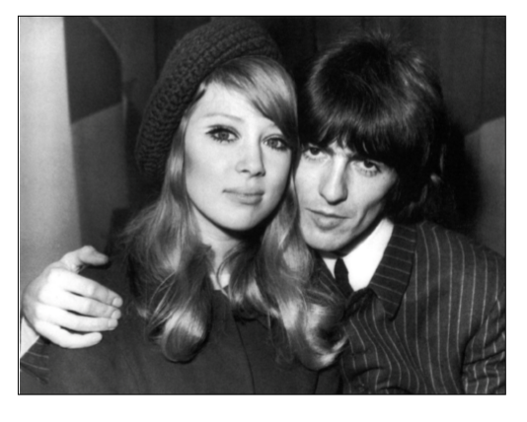
Look at the photographs on the next slides. They are photographs of people and fashions from different eras. Can you try to identify which fashions and trends come from which era? Watch this video to help you. https://www.youtube.com/watch?v=prDS8EdsOUA

Slide 7
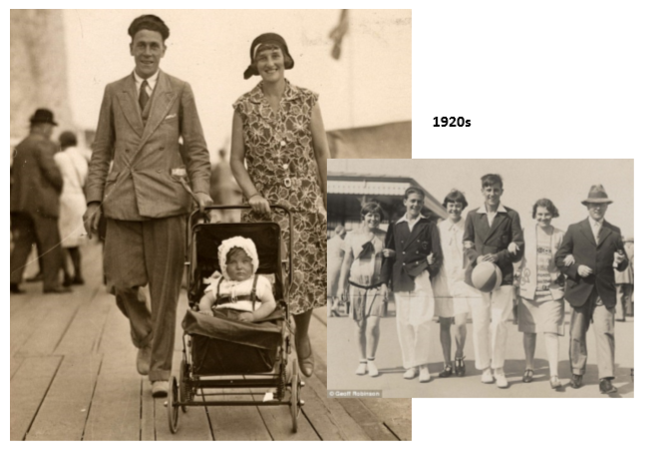
Which fashions and trends come from which era?

Slide 8
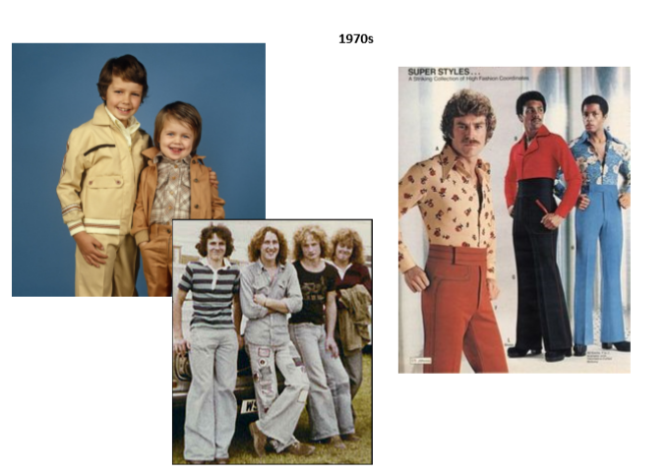
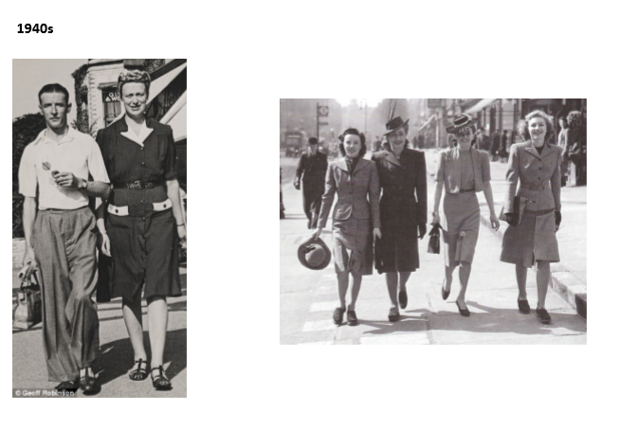
What impresses you?
Are there any fashions you like?

Slide 9
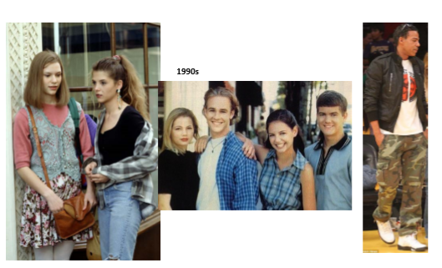
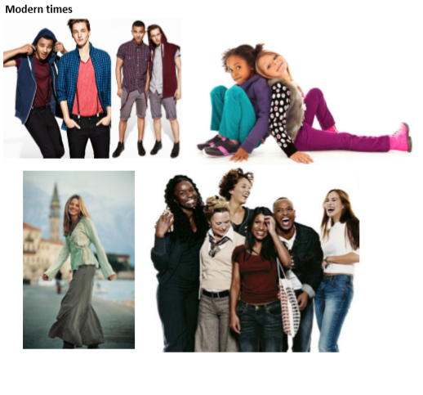
Do you think any of these clothes are from the modern era?

Slide 10
How did you do?
I hope that you managed to research the different clothes and find out the correct era
We are going to think about clothes your grandparents may have worn.

Slide 11
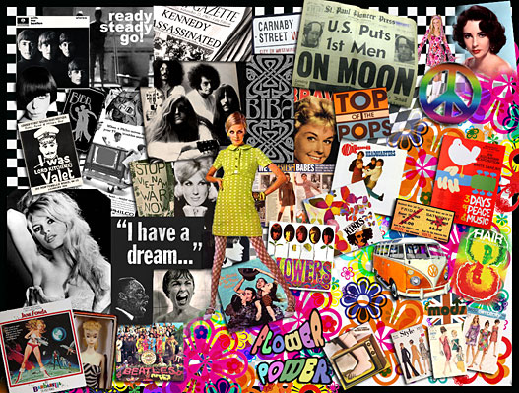
1960s Fashion

Slide 12
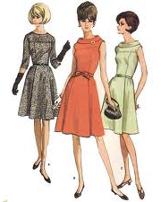
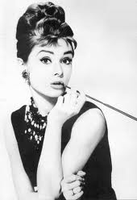
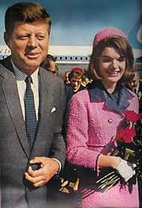
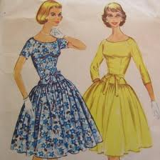
Prior to the British invasion on fashion in 1964, sixties fashion carried on from the late 1950s. Women usually wore very smart, feminine designs.
They were also heavily influenced by style icons such as the US President Kennedy's wife, Jackie and film actresses such as Audrey Hepburn.

Slide 13
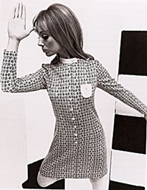
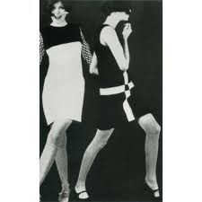
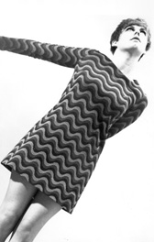
When The Beatles hit the scene in 1964 there was a new and very different fashion influence - not Paris or Milan but "swinging" London.
By the mid 1960s new colours, patterns and fabrics were being used to make clothes young, fresh and exciting.

Slide 14
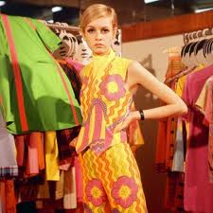
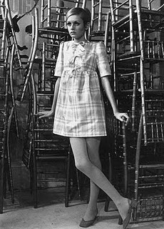
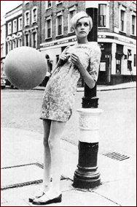
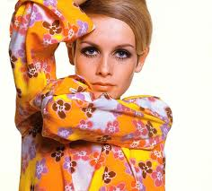
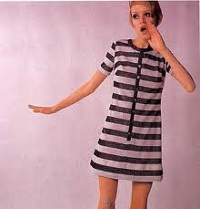
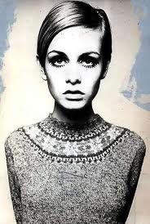
Twiggy was know as the first British Supermodel, as she was on the cover of every major fashion and teen magazine of the 1960s.

Slide 15
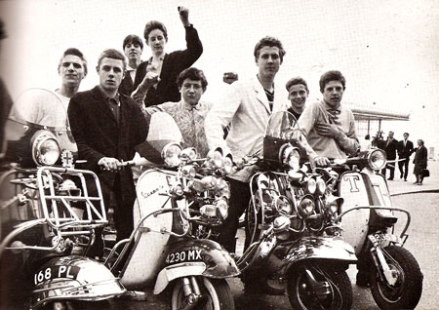
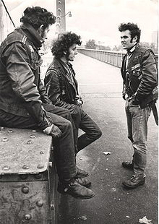
Mods and Rocker
The mods (modernists) and rockers were two rival 'tribes' who both existed in the sixties and believed in different values, music and fashion ideals.
Rockers tended to be more rebellious and wore scruffier clothes - black leather jackets and jeans with black leather boots. They rode around on motorbikes.
Mods were well dressed urban youngsters and portrayed a clean look. Twiggy was a mod icon. Teenager mods often rode scooters.

Slide 16
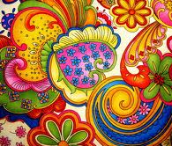
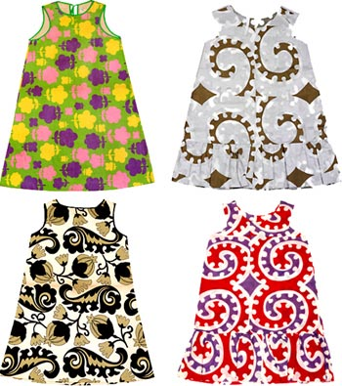
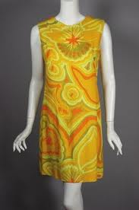
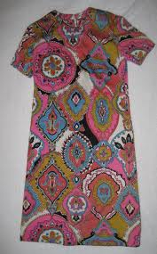
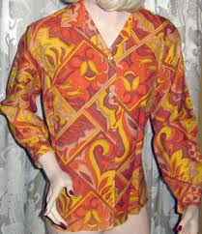
Fashion fully embraced all the bold and bright colourful patterns of the 1960s.

Slide 17
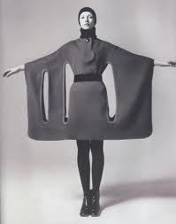
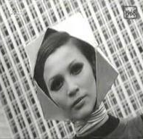
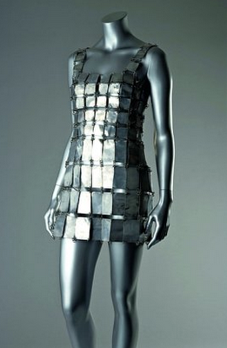
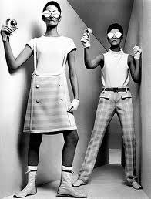
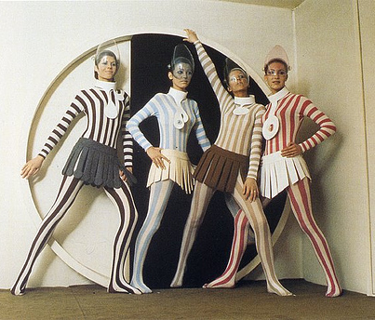
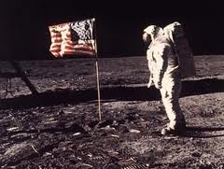
Space Age
In the 1960s the great race to become the first country to land on the moon began, this had an influence upon the fashion and films of the era. Different materials were used such as discs of metal or plastic linked together with wire.

Slide 18
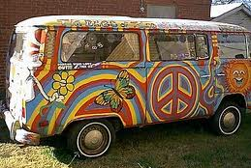
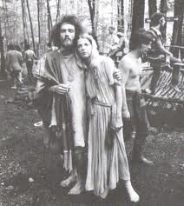
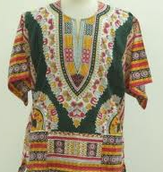
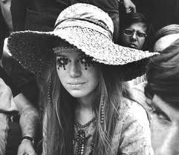
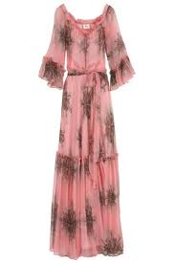
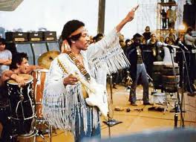
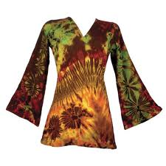
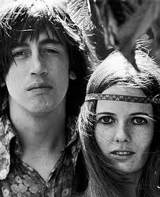
Hippie’s
Hippies were carefree and wore casual, loose clothing such as caftans, bell bottom trousers and long dresses. Many were decorated with tie dye.
The 1969 Woodstock musical festival in New York was at the height of the hippie fashion.

Slide 19
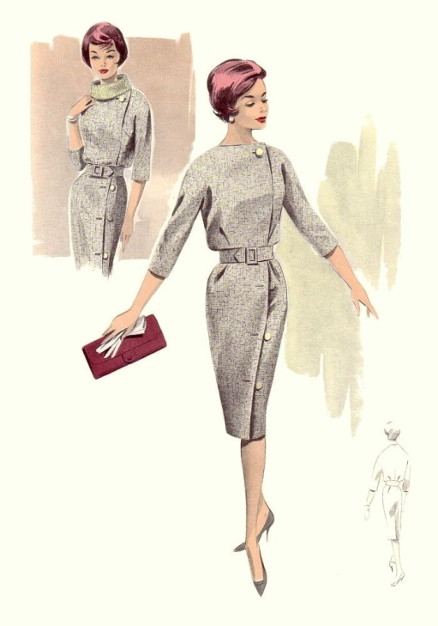
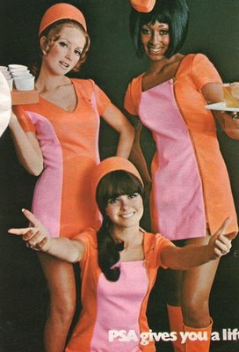
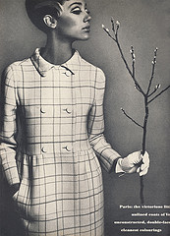
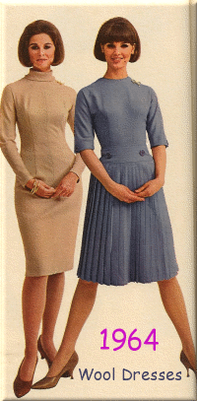
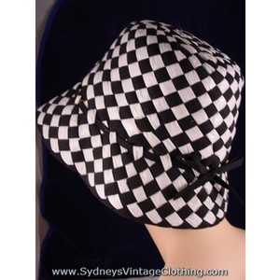
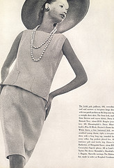
1960

Slide 20
You are going to think of some questions to ask a family members about the clothes they wore when they were a child and a young adult.
What is a question ?
something you ask when you want to find something out.
Where in the sentence do you use a question mark?

Slide 21
Activity 1
Write out the questions using the correct punctuation.
Is it a ? or a .

Slide 22
Can you write a list of questions to ask an older relative or grandparent about the clothes they wore when they were young. Remember a question will need a capital letter.

Slide 23
We are going to design a 1960’s inspired outfit.
What styles from the 60’s do you like and why?

Slide 24
We are going to design a 1960’s inspired outfit.

Slide 25
Can you use photos of outfits from the 1960’s to help you create your own outfit.

Slide 26
create a portrait of a parent, grandparent or great-grandparent, based on an old photograph

Slide 27
1961 Knickerbocker Dress 1965 Mondrian Dress
This 1961 dress is by British designer Mary Quant. This outfit represents a completely new, fun approach to dress.
Mary Quant had become an international star for her move towards youth fashion.
This 1965 dress was created by Yves Saint Laurent, a former designer at the House of Dior. This dress is from his ‘Mondrian’ collection that was inspired by the abstract paintings of Piet Mondrian, and the collection was featured on several covers of fashion magazines at the time.
.

Slide 28
What are the little trousers called on the 1961 dress?
What does the design of the 1965 dress remind you of?
Activity
The design on the 1965 Mondrian dress has the bold double cross motif based on the work of the Dutch abstract painter Piet Mondrian. Research Piet Mondrian. Use a simple drawn-out design of a dress or shirt, design your own dress or shirt based the Mondrian style.

Slide 29
Use a simple drawn-out design of a dress or shirt, design your own dress or shirt based the Mondrian style.

