Slide 1
Home Learning Challenge
Year 2 Week 1

Slide 2
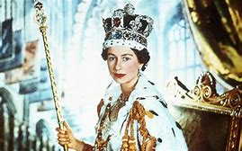
We are learning about what a coronation is and what one looks like.

Slide 3
Ask children the questions and discuss what they think. Look at the answer together – What was the same/different?
What is a coronation?

Slide 4
A coronation is the crowning of the Sovereign. It is an ancient ceremony. For the last 900 years, it has taken place at Westminster Abbey as the royal church for the Palace of Westminster. Before the Abbey was built, Coronations were carried out wherever was convenient, for example at Bath, Oxford and Canterbury.
Westminster Abbey
Vocabulary Check!
Sovereign – A supreme ruler
Ceremony – A public occasion, especially one celebrating a particular event, achievement, or anniversary.

Slide 5
Follow the link to watch the Queen’s coronation
https://www.youtube.com/watch?v=bTOXdND_Yoo

Slide 6
Ask children the questions and discuss what they think. Look at the answer together – What was the same/different?
Why did the coronation take place?

Slide 7
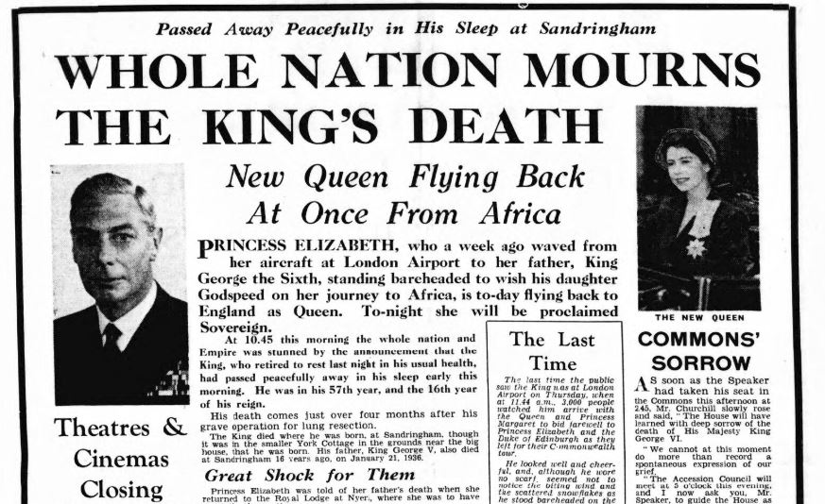
The Queen succeeded to the Throne on the 6th February, 1952 because of the death of King George VI.
She was in Kenya at the time and became the first Sovereign in over 200 years to accede while abroad.
Vocabulary Check!
Succeed – take over a throne
Accede – agree to a request

Slide 8
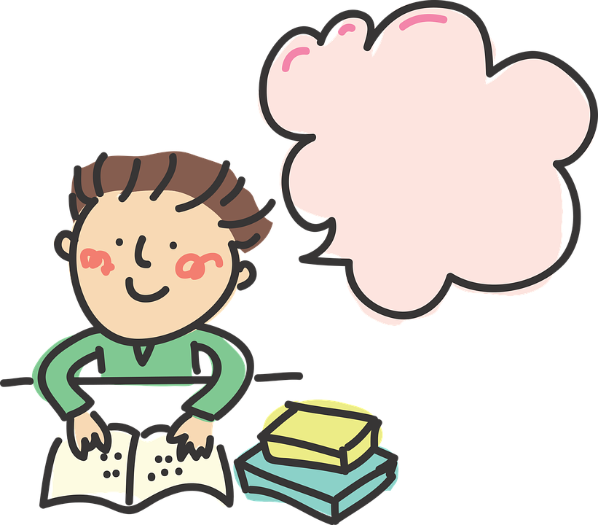
Thinking Time!
How do you think the Queen might have felt on the morning of her coronation?

Slide 9
Ask children the questions and discuss what they think. Look at the answer together – What was the same/different?
How did the Queen arrive at her coronation?

Slide 10
The Journey
The Queen, with The Duke of Edinburgh, was driven from Buckingham Palace to Westminster Abbey in the Gold State Coach, which was pulled by eight grey male horses: Cunningham, Tovey, Noah, Tedder, Eisenhower, Snow White, Tipperary and McCreery. The Gold State Coach has been used by The Queen twice since her Coronation - at the Silver and Golden Jubilees.
Gold State Coach
Vocabulary Check!
Jubilee – A special anniversary of an event, especially one celebrating twenty-five or fifty years of a reign or activity

Slide 11
Ask children the questions and discuss what they think. Look at the answer together – What was the same/different?
What did the Queen wear for her coronation?

Slide 12
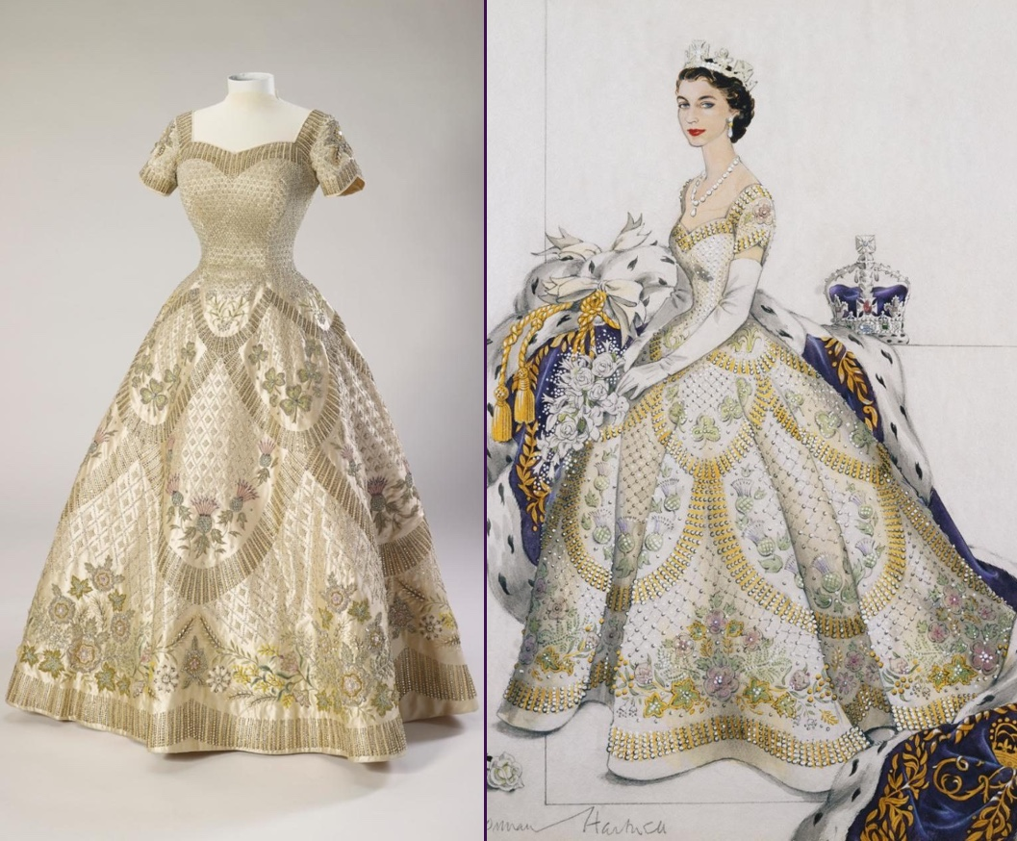
What the Queen wore
The Queen's Coronation dress was made by Mr Norman Hartnell. The dress was made of white satin and embroidered with the emblems of the United Kingdom and the Commonwealth. It had short sleeves with a full, flaring skirt. The neckline was cut square over the shoulders, before curving into a heart-shaped centre. The dress's exquisite embroidery in gold and silver thread and pastel-coloured silks was encrusted with seed pearls and crystals to create a lattice-work effect.
Vocabulary Check!
Satin – a smooth, glossy fabric
Embroidered – cloth decorated with patterns sewn on with thread
Emblems – a symbolic object as a distinctive badge of a nation, organisation, or family
Encrusted – decorated with a hard surface layer

Slide 13
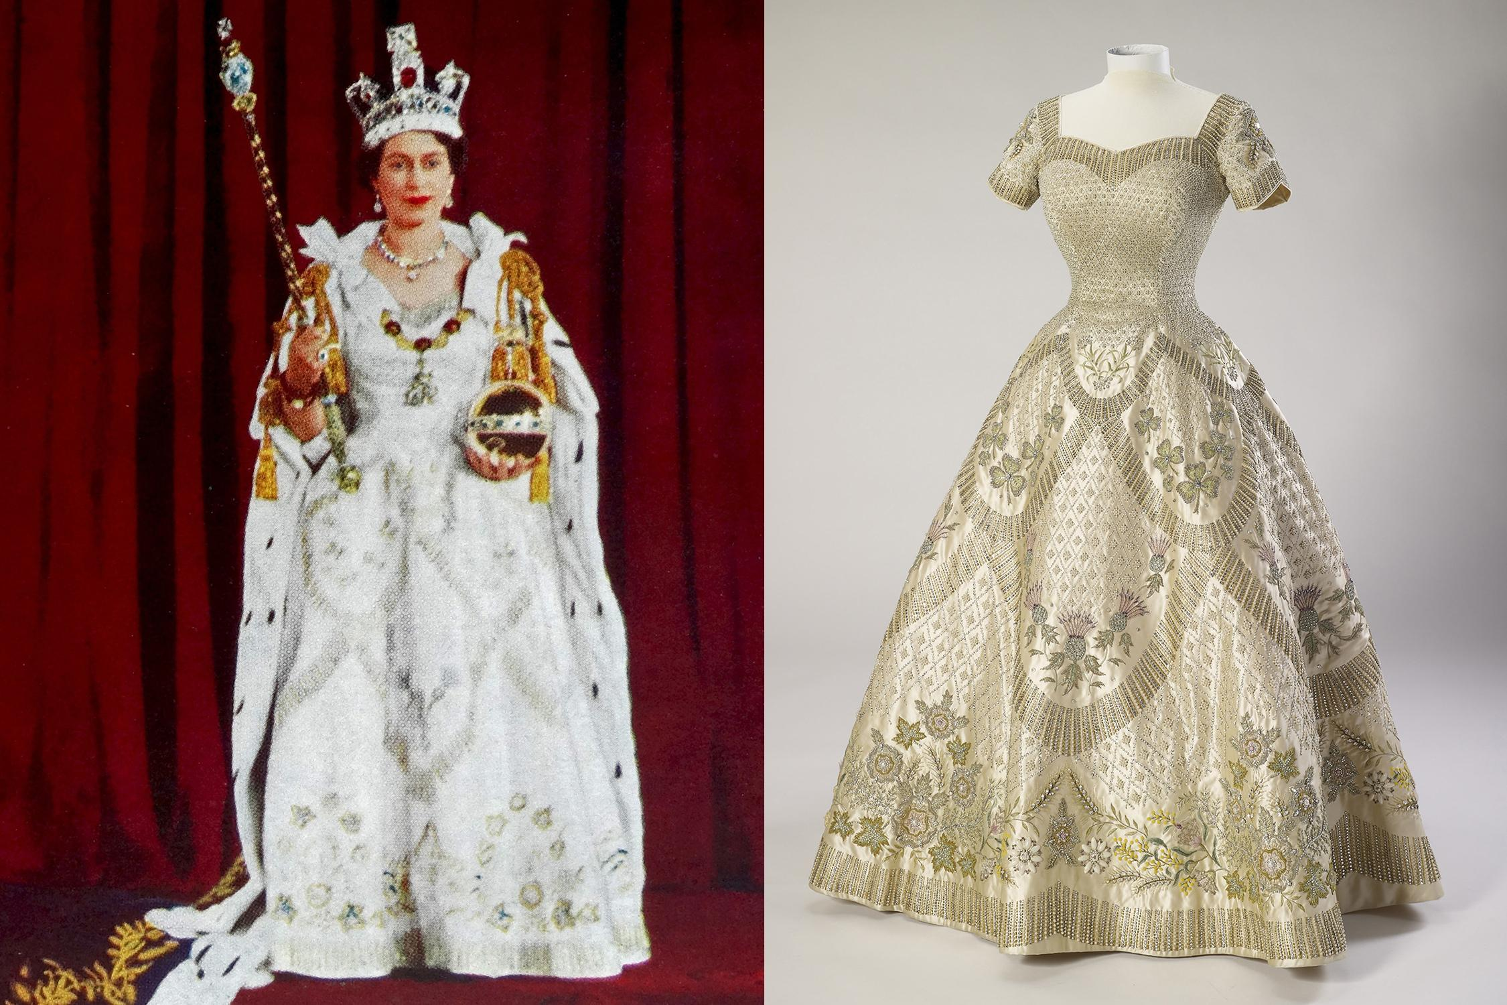
The Queen’s coronation dress

Slide 14
The Queen’s coronation

Slide 15
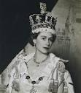
The Coronation
Queen Elizabeth II was crowned on 2 June, 1953 in Westminster Abbey. Her Majesty was the thirty-ninth Sovereign to be crowned at Westminster Abbey.
Queen Elizabeth II is the sixth Queen to have been crowned in Westminster Abbey in her own right. The first was Queen Mary I, who was crowned on 1 October, 1553.

Slide 16
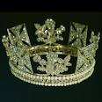
The Queen's Coronation service began at 11.15 am and lasted almost three hours, finishing at 2.00 pm.
On her way to the Coronation, Her Majesty wore the George IV State Diadem - the one she is depicted wearing on stamps. It was made in 1820 for George IV's Coronation. The Diadem incorporates national symbols: roses, shamrocks and thistles and features 1,333 diamonds and 169 pearls. It is on display at The Queen's Gallery, Buckingham Palace.
George IV State Diadem

Slide 17
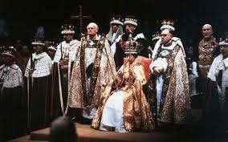
The Queen's Coronation service was taken by the Archbishop of Canterbury, whose duty this has usually been since the Conquest in 1066. For the first time at the 1953 Coronation, a representative of another Church, the Moderator of the Church of Scotland, also took part in the service. The Coronation service fell into six basic parts: the recognition, the oath, the anointing, the investiture, which includes the crowning, the enthronement and the homage.
Vocabulary Check!
Conquest in 1066 – Battle of Hasting
Representative – a person chosen to speak or act for others

Slide 18
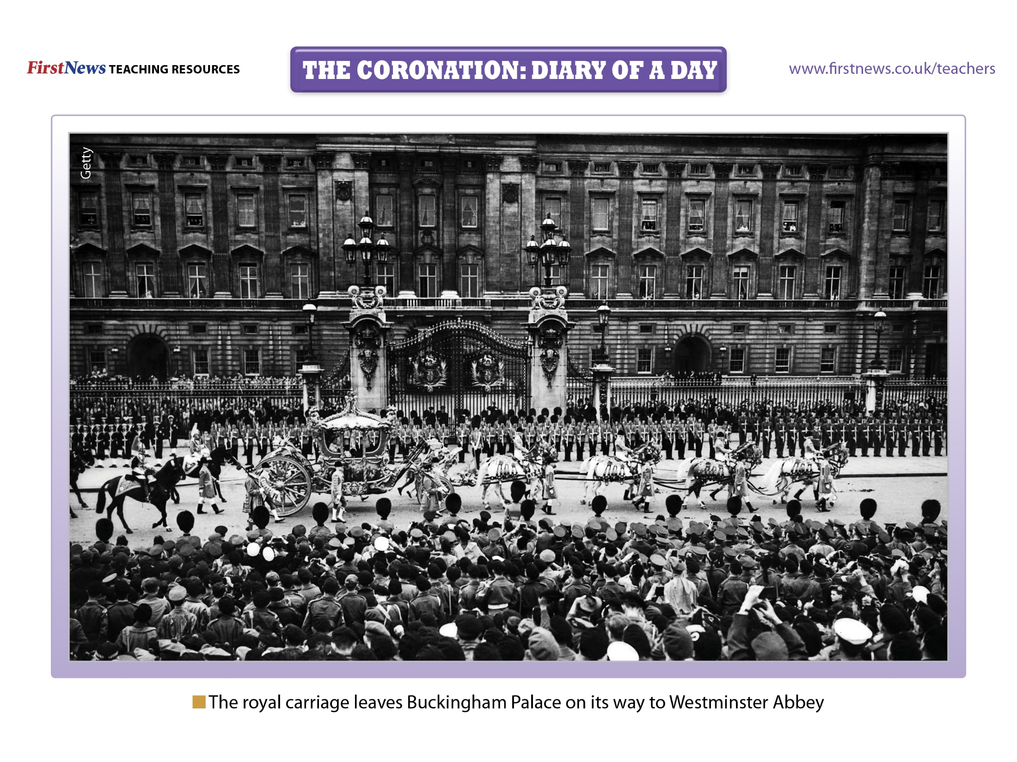
Notes:
The day: On 2 June 1953, the whole of Great Britain joined in a spectacular celebration. It was Queen Elizabeth’s Coronation – the day her title was officially recognised. There had been hopes that the weather would be glorious as it was summer but, unfortunately, it rained all day!

Slide 19
Notes:
Early morning: At 6am, the doors to Westminster Abbey opened to the 8,251 guests. Around three million people gathered in the streets of London around Westminster Abbey, to ensure they had a good view of the Queen as she arrived. The procession included foreign royalty and heads of state. In fact, there were so many guests, that volunteers were required to fill the ranks of regular footmen!

Slide 20
Notes:
Late morning: At 11am, people all over the world settled down in front of their television sets to watch the Coronation. More than 20 million people watched the ceremony in this way. The Queen agreed that the Coronation should be televised, so that as many people as possible could see this historic event.

Slide 21
Notes:
The ceremony begins: The Coronation service was broken into six parts: the recognition, the oath, the anointing, the investiture – which includes the crowning – the enthronement and the homage. St. Edward’s Crown was carried into the Abbey before the Queen arrived. When she arrived at around 11am, the friction between her robes and the carpet meant that she found it hard to move forward. So she asked the Archbishop of Canterbury to: “Get me started!” Once the Queen had moved forward, the procession moved inside the Abbey, up the central aisle and through the choir to the stage.

Slide 22
Notes:
The Coronation Service: After the Queen moved to stand in front of the Coronation Chair, she turned in each direction of the compass, as Lords asked the audience: “Sirs, I here present unto you Queen Elizabeth, your undoubted Queen: wherefore all you who are come this day to do your homage and service, are you willing to do the same?” The crowd replied: “God save Queen Elizabeth,” every time and the Queen curtsied in return. She then took the Coronation Oath, saying: “The things which I have here promised, I will perform, and keep. So help me God,” before she kissed the bible.

Slide 23
Notes:
Secret part of the ceremony: There was one part of the ceremony which was hidden from the TV cameras. The Queen’s jewellery and crimson cape were removed and she sat in the Coronation Chair. A cross was made on her forehead by the Archbishop of Canterbury, using the holy oil made from the same ingredient as was used in her father’s Coronation. This part of the ceremony was completely private and hidden from the TV cameras by a silk canopy held above the Queen.

Slide 24
What was missing?
https://www.bbc.co.uk/news/uk-22764987

Slide 25
Notes:
The crowning: It was then that the actual crowning took place. After being handed the four symbols of authority – the orb, the sceptre, the rod of mercy and the royal ring of sapphire and rubies – the Archbishop of Canterbury placed St Edward’s Crown (the official name for the Coronation Crown) on the Queen’s head, to finish the ceremony.

Slide 26
Notes:
Queen Elizabeth II poses with the royal sceptre after being crowned on 2 June 1953.

Slide 27
Notes:
The Queen celebrates: The newly crowned Queen appeared with her family on the balcony of the palace still wearing the Imperial State Crown and the Royal Robes to greet the cheering crowds. She appeared again on the balcony of Buckingham Palace at 9.45pm to turn on the ‘lights of London’. The whole of London was illuminated to celebrate the exciting event.

