Slide 1
Home Learning Challenge
Year 2 Week 2

Slide 2
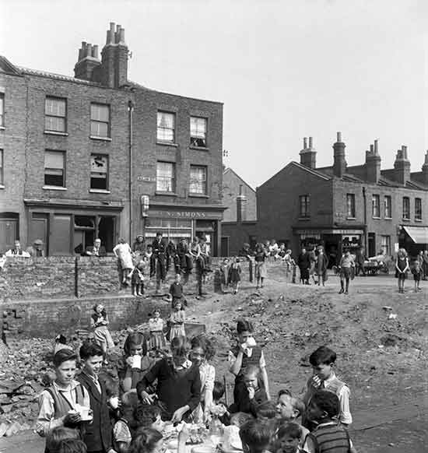
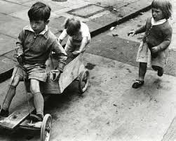
We are learning about what you would have done after school if you had lived in 1953.

Slide 3
Ask children the questions and discuss their answers
Thinking Time!
What do you do after school?
Make a list of things you do
after school now.

Slide 4
What is happening in these pictures?
Discuss what is happening in each picture. Discuss if they have ever played the game before, if they like or dislike the game, if they haven’t played it before would they like to or not? Ask children to explain their answers, why do they think that?

Slide 6
Cat’s Cradle

Slide 7
Hop Scotch/ chalk games

Slide 8
Skipping

Slide 12
Watch the video clip
This video shows street scenes in Hull from 1950.
It begins with children playing a variety of games in the street, including British Bull Dog and wrestling.
There are also shots of children playing hopscotch, pavement chalking, blind man's bluff, ring-a-ring-a-roses and swapping cigarette cards
https://www.mylearning.org/stories/family-life-in-the-1950s/203?

Slide 13
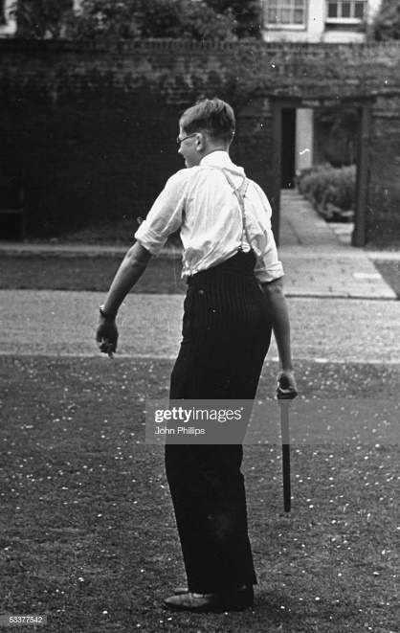
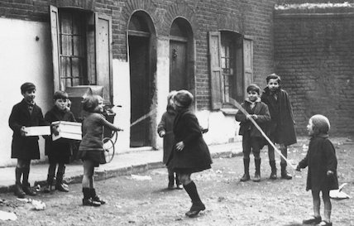
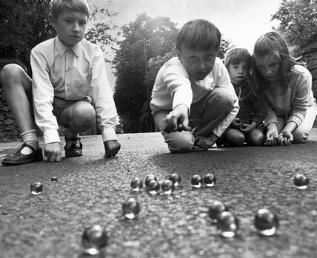
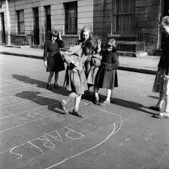
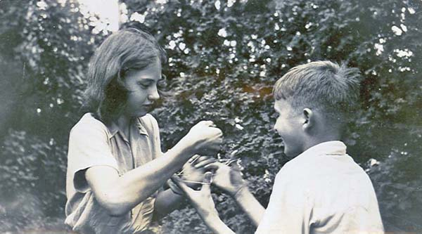
In the 1950s children often played games in the streets outside their houses. This was much safer, as fewer people owned cars and there was far less traffic.
Children also played different types of games, with more simple toys. Instead of computer games, they had footballs, chalk, hula hoops, skipping ropes and cards.

Slide 14
1950s games
Marbles
Cat’s Cradle
French Cricket
Eggity Budge
Hop Scotch
Skipping
Card games

Slide 15
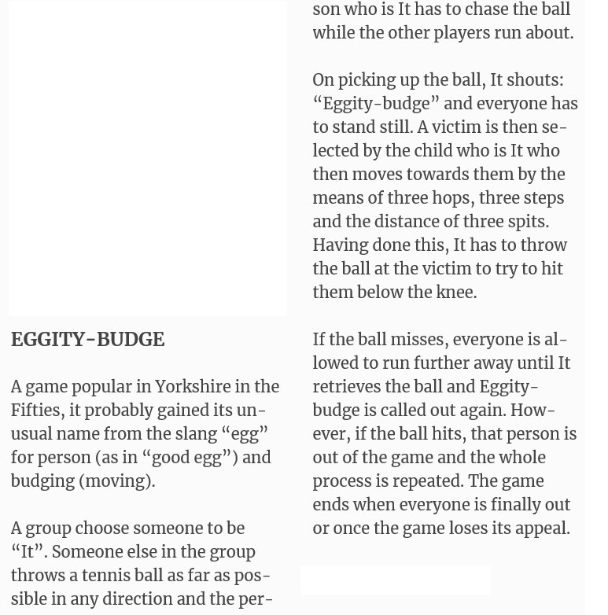
1950s games

Slide 16
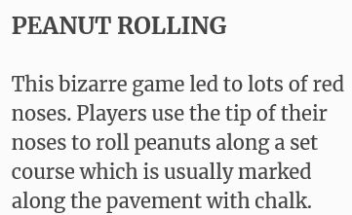
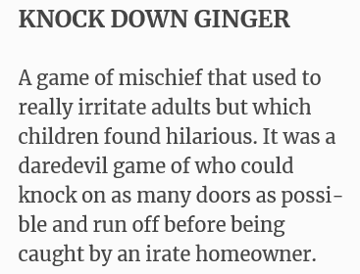
1950s games

Slide 17
Can you write up and answer the following questions?
What games did children play in the 1950s?
Where did they play?
Who did they play with?
Do we still play any of these games today?

Slide 18
Activity
Sort the following games into past and present.

Slide 19
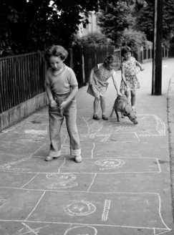

Slide 21
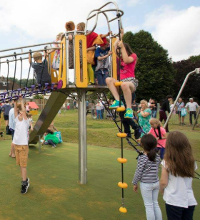

Slide 23
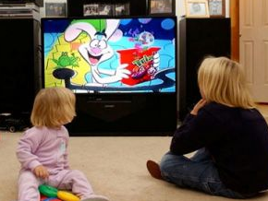

Slide 24
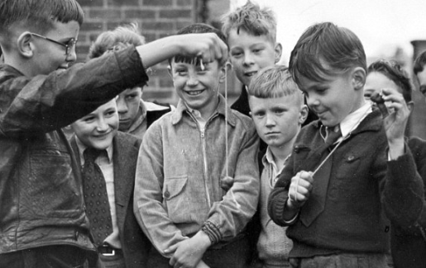

Slide 25
Sentence starters to help you.
In the past…
Today children play…
Something that is the same is…
Something that is different is…

