Slide 1
Home Learning Challenge
Year 2 Week 4

Slide 2
We are learning the British Empire.

Slide 3
What is the British Empire?
Watch the short video about the British Empire.
https://www.youtube.com/watch?v=hCERcnYzOTk

Slide 4
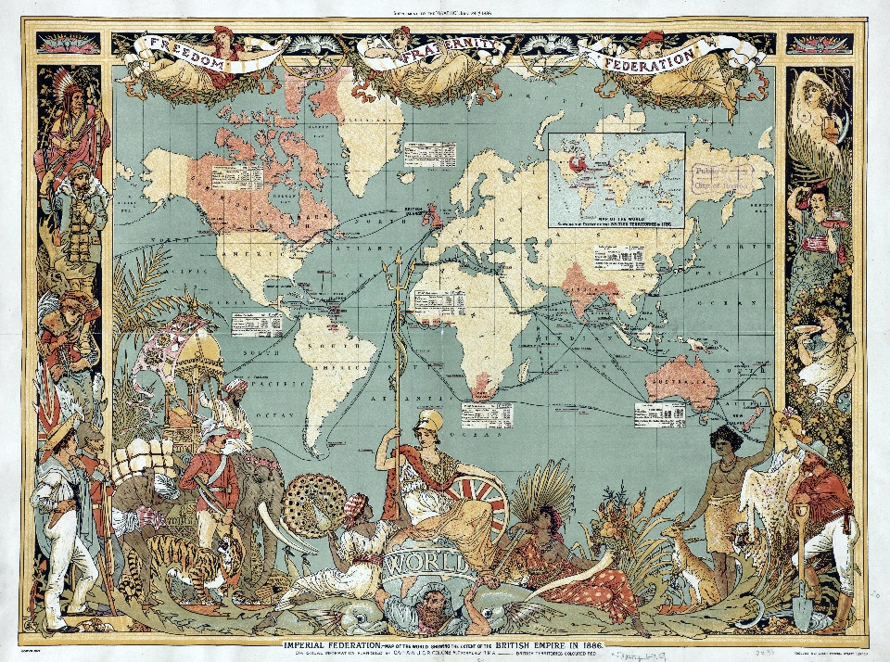
What Is The British Empire?
An ‘empire’ is a group of countries ruled over by a single monarch or ruling power. An empire doesn't need an ‘emperor’.
The British Empire comprised Britain: the ‘mother country’; and the colonies: countries ruled to some degree by and from Britain.

Slide 5
What Is The British Empire?
The British Empire was the greatest empire the world had ever seen, and for more than a century Britain was the foremost global power, ruling over a quarter of the world’s area and population.
Key Facts:
Lasted during 1497 – 1997.
Over 450 million people (more than a quarter of the world's population).
36,000,000 square miles of territory (more than a quarter of the world's area).
The years 1815 to 1914 are referred to as Britain's imperial century.
“The sun never sets on the British Empire.” - Scottish writer, John Wilson.

Slide 6
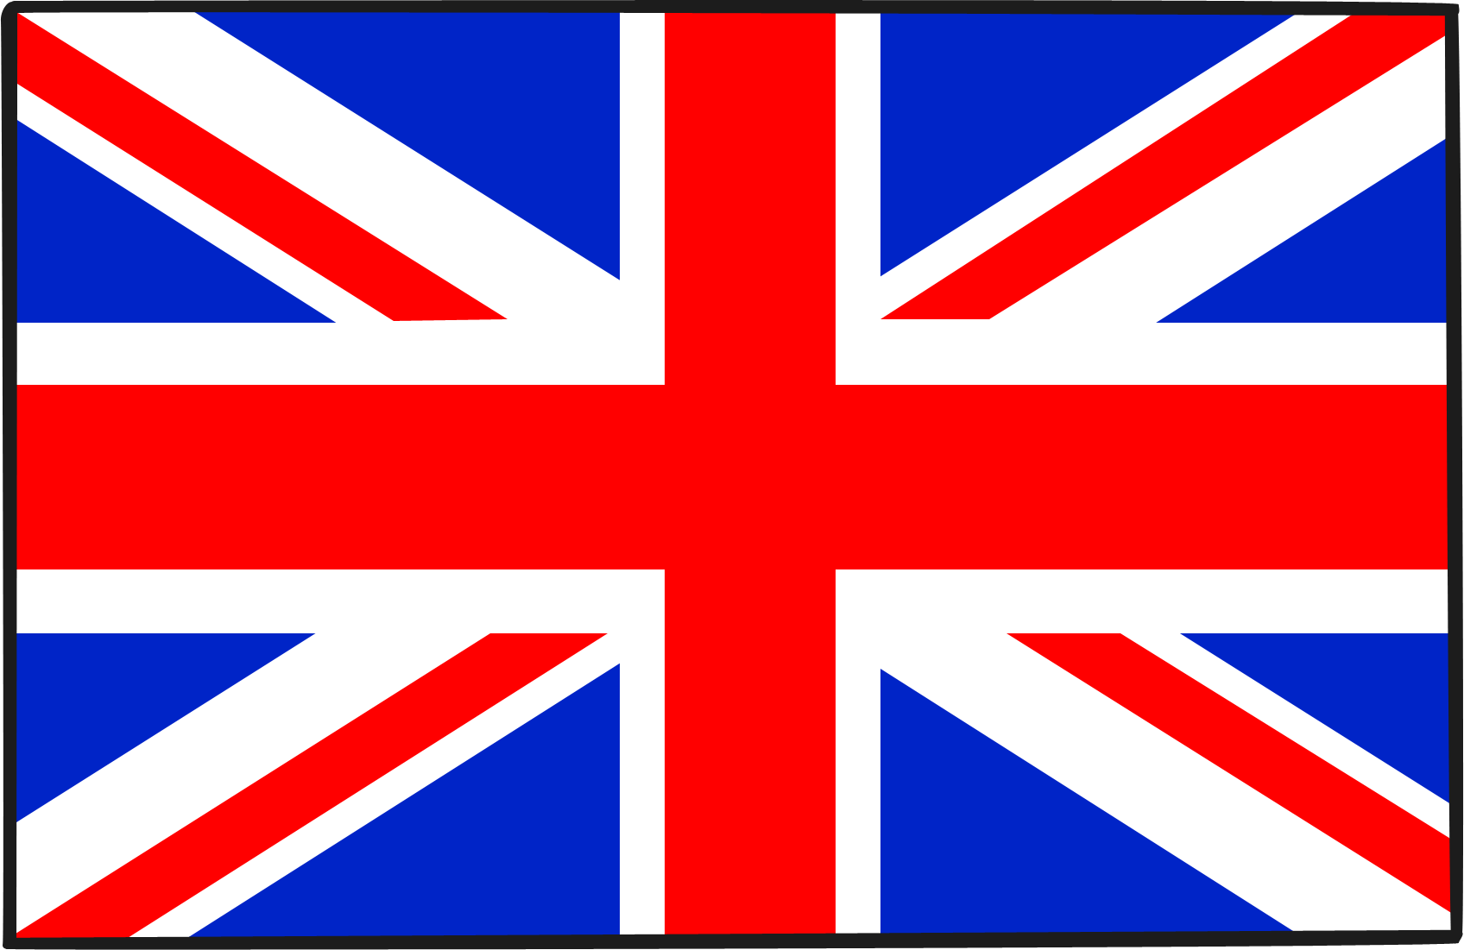
The British Flag
The Union Flag (sometimes called the Union Jack) dates from 1801.

Slide 7
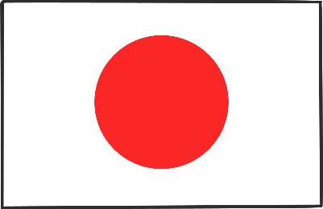
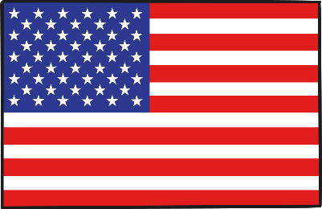
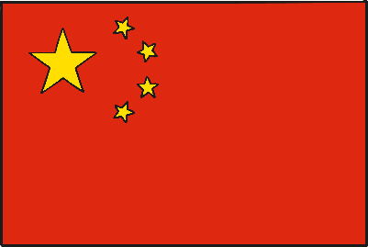
The Current Rich List
Which order do you think these countries would appear in?
Japan
Germany
USA
China
United Kingdom
France

Slide 8
The Current Rich List
Which order do you think these countries would appear in?
USA
China
Japan
Germany
France
United Kingdom
USA
China
Japan
Germany
France
United Kingdom

Slide 9
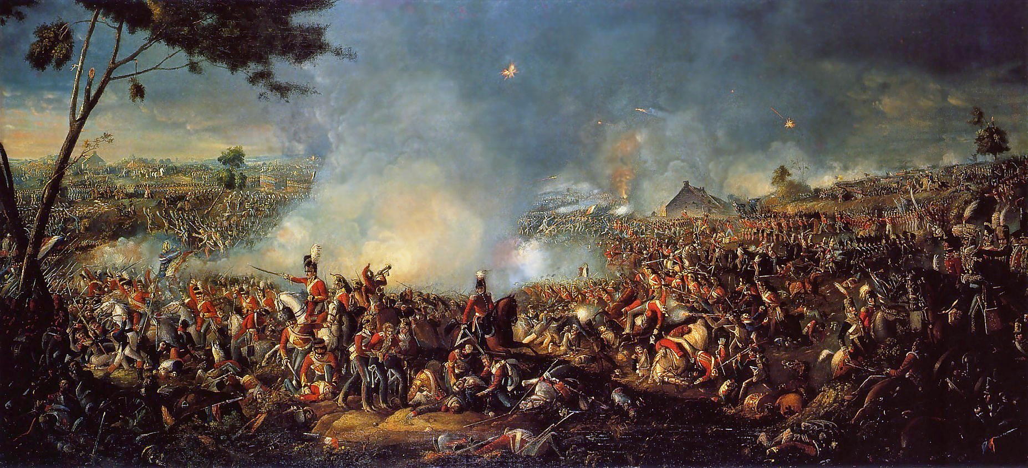
The 1850 Rich List
Britain = Number 1
Can you think of some reasons why?

Slide 10
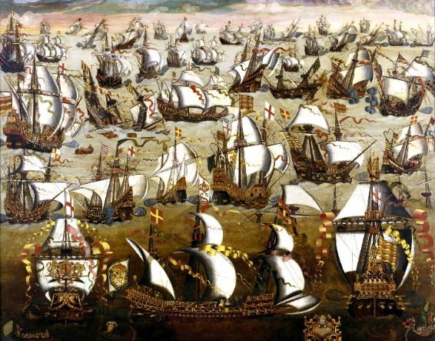
A History of The British Empire
The British Empire has its origins in the 16th century, during the reign of Queen Elizabeth I (1533 -1603).
After the victory of the English navy over the invincible Spanish Armada (1588), England increased its maritime power.
This led to overseas trade and the setting up of the first settlements in North America.
England imported luxury goods and re-exported them at higher prices to the European countries which didn’t have a direct overseas trade.

Slide 11
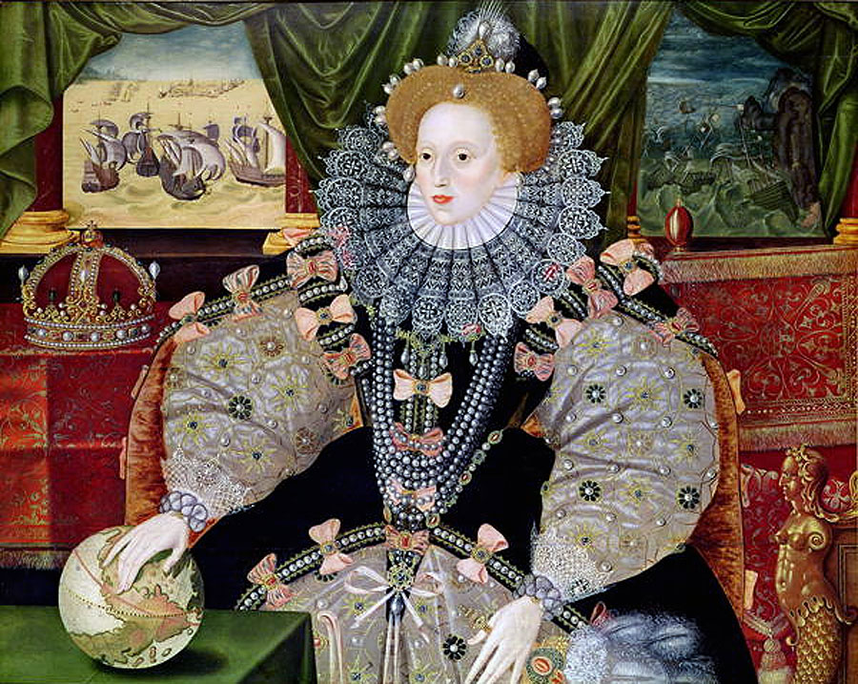
The Armada Portrait
Portrait of Elizabeth made to commemorate the defeat of the Spanish Armada (1588), shown in the background.
Elizabeth's international power is symbolized by the hand resting on
the globe.
The Imperial Crown to her right also indicated England's growth as an international power during her reign.

Slide 12
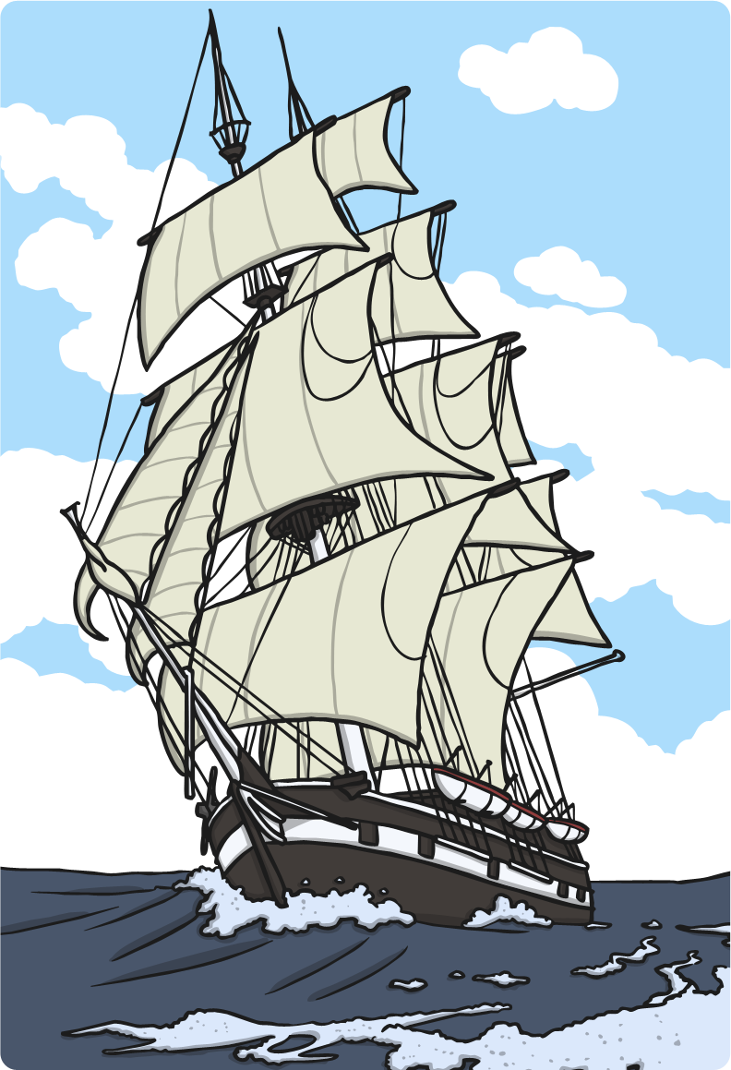
Why was The Empire so Successful?
Trade – to gain raw materials
Strong military/Army – seen as a ‘great power’
Spread of Christianity
The rise, and successive growth, of the British Empire was mainly due to economic reasons.
With the Industrial Revolution the need for new markets and new sources of raw materials accelerated the expansion of the Empire.

Slide 13
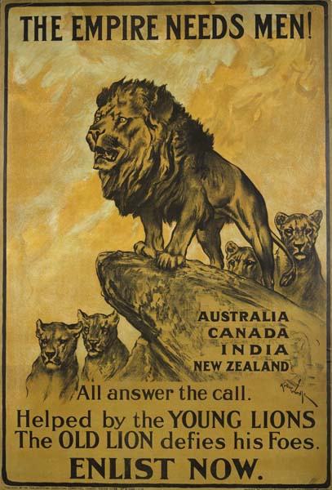
The British Empire – 1750 - 1900
The Brits marched into somebody’s country and said, ‘We’re in charge.’
Imagine: You have lived in your house all your life. You are happy with your home. Suddenly, some soldiers march in and say,‘this belongs to us now!’
Not only that - the soldiers then made the people work for them!

Slide 14
The British Empire in the 20th Century
During the first half of the 20th century almost all the colonies turned into dominions. This implied that they acquired political independence from England.
There have been many reasons suggested as to the decline:
Britain no longer had military and naval supremacy.
Following the Second World War, Britain was no longer able to financially support or afford an Empire.
The United States had grown in population and wealth.

Slide 15
