Slide 1
Home Learning Challenge
Year 4 Week 3

Slide 2
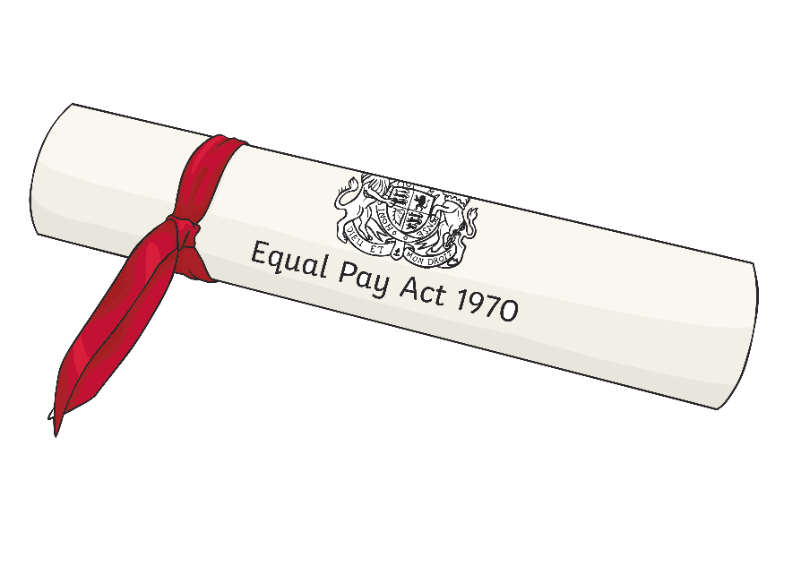
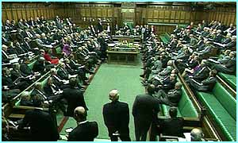
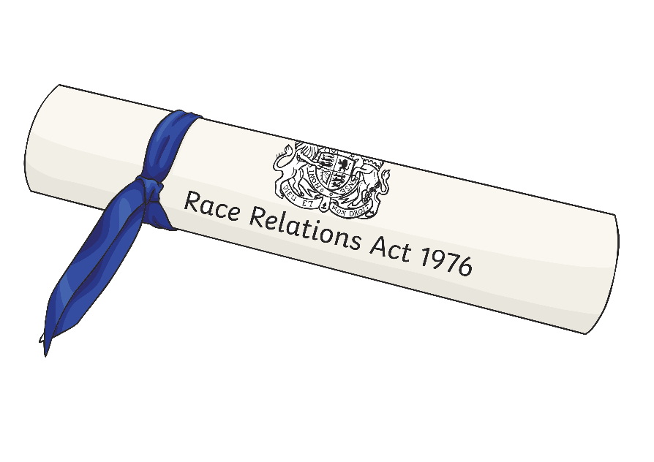
We are learning about how laws are created today.

Slide 3
What do we already know about laws?
Who do you think creates new laws?
Why do we need new laws?

Slide 4
What are laws?
Laws are based on the same ideas as rules – but they are different. We don’t make laws ourselves, they are made in Parliament. MPs and members of the House of Lords debate and vote on ideas for new laws to make sure they are the best they can be. If people break the law, then they are doing something illegal and they might have to pay a fine, or even go to prison.
Why do we have laws?
We have laws to:
Keep us safe and protect us.
Make sure people behave so they don’t hurt themselves or others.
Make sure everything is fair and people can access their rights.
Solve conflicts (fights and disagreements)
Key vocabulary:
MP - member of parliament. MPs are members of parliament.
House of Lords - The House of Lords is the part of the parliament in Britain whose members have not been elected. The building where they meet is also called the House of Lords.
Debate - A debate is a discussion about a subject on which people have different views

Slide 5
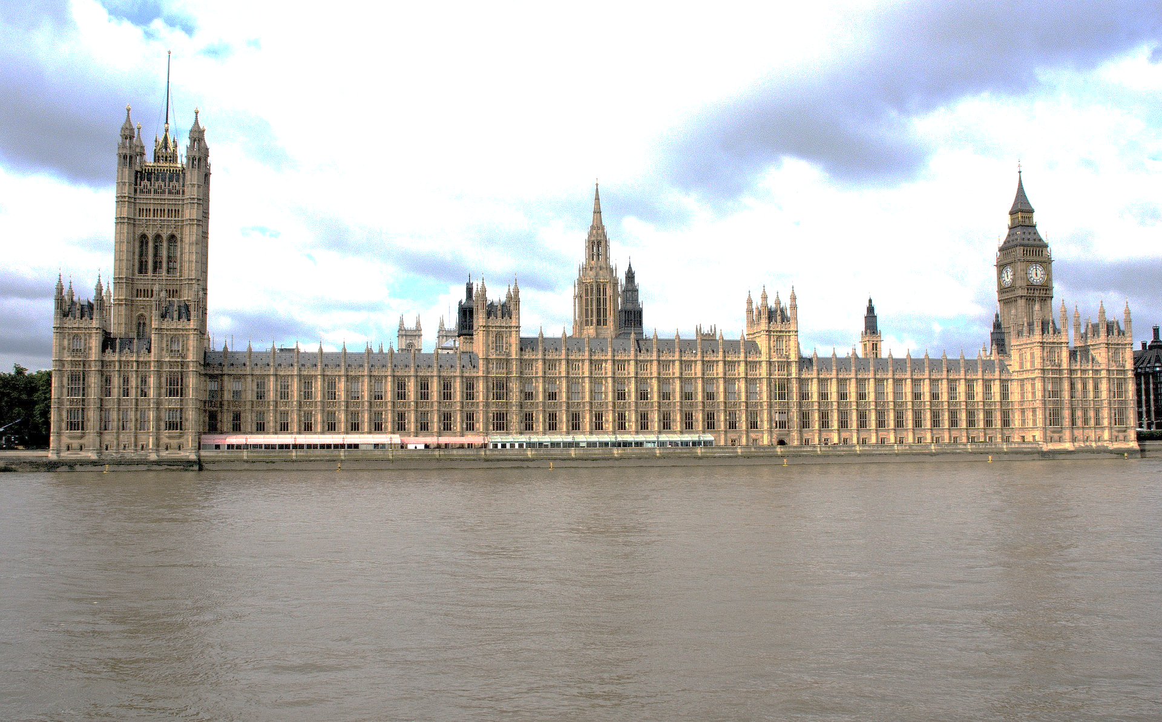
House of Lords
The Peers meet in the southern part of the Palace of Westminster.
The House of Lords is where peers meet. They check that new laws are fair.
Each member has either inherited a family title or has been given a title to recognise their good work in a certain area.

Slide 6
House of Commons
The Members meet in the northern part of the Palace of Westminster.
The House of Commons is where the Members of Parliament (MPs) meet.
Each MP has been elected by the people in their constituency (local area).
Most MPs belongs to a political party, although a very small number are independent.

Slide 7
How are laws made?
When somebody has an idea for a new law they create a bill. There are two different types of bills depending on who has had the idea for the law.
Government Sponsored Bill
The idea normally comes from the government. This is called a government sponsored bill.
Private Member's Bill
It can also come from an ordinary MP. If it does it is called a private member's bill.
In order for a bill to be turned into a law it needs to pass through three stages.

Slide 8
Stage one- The House of Commons
The first stage a bill must pass through is held in the House of Commons. Here is goes through this long process.
First reading
Second reading
Committee stage
Report stage
Third reading
First reading - Drafting Writing a Bill is called drafting. The bill must be written carefully as mistakes could produce a law that was unfair or had 'loopholes' that allowed people to ignore it.
Introducing a bill This is when you formally tell everyone that you are going to start the process of making the bill into a law. When you announce this in the Houses of Parliament it is called a first reading.

Slide 9
Stage one- The House of Commons
The first stage a bill must pass through is held in the House of Commons. Here is goes through this long process.
First reading
Second reading
Committee stage
Report stage
Third reading
At the second reading the bill is explained.
Debate
The reasons why the bill is needed are debated. Those people who want the bill to become law must convince others that it is worthwhile.
Vote
After the bill has been explained and debated there is a vote. The members of the House of Commons will decide if the bill should continue its journey towards law .
The bill must receive over half of the votes to get past the second reading.

Slide 10
Stage one- The House of Commons
The first stage a bill must pass through is held in the House of Commons. Here is goes through this long process.
First reading
Second reading
Committee stage
Report stage
Third reading
A committee is a group of members of either House (House of Commons or House of Lords) that examines the detail of a bill and proposes amendments (changes).
Standing Committee
A group of members that meet regularly and look at bills in a particular area of a government's work.
Committee of the whole House
If the detail of a bill is examined by all members of a House of Parliament is called a committee of the whole House.
Working like this is common in the House of Lords. In the Commons it is reserved for very important laws, such as those that prevent terrorism.
Proposing amendments
If the committee believes the bill needs to be altered in some way they will suggest changes called amendments.
Amendments must be voted for by both houses.

Slide 11
Stage one- The House of Commons
The first stage a bill must pass through is held in the House of Commons. Here is goes through this long process.
First reading
Second reading
Committee stage
Report stage
Third reading
Report stage
The committee prepares a report on the Bill and explains any amendments that have been suggested.

Slide 12
Stage one- The House of Commons
The first stage a bill must pass through is held in the House of Commons. Here is goes through this long process.
First reading
Second reading
Committee stage
Report stage
Third reading
After the committee has reported back to the House, the bill receives its third reading.
Vote again?
The third reading is the point when another vote is taken on the bill. The House of Commons must decide whether it wants the bill, with its amendments, to become law.

Slide 13
Stage two- The House of Lords
The bill then repeats the process in The House of Lords.
The other House
All bills must pass through both Houses of Parliament.
If the bill started in the Commons it now moves to the Lords. If it started in the Lords it moves to the Commons.
Any changes made (amendments) have to be agreed by both Houses.
If the House of Lords votes against a bill that the Commons wants it can be delayed for a year before being debated again.
The Lords can not permanently block a bill.

Slide 14
Stage three- The Royal Assent
After a bill has successfully passed through both the House of Commons and the House of Lords it is passed onto the Queen/King of the country.
Royal assent The Queen in her role as head of state gives Royal assent to the bill. This is the final stage of the bill's progress in Parliament.
Is it law now?
The bill has become an Act of Parliament. Although it is now a new law it does not necessarily come into force straight away. Some acts come in to force after a set period of time (weeks or months).
This is to allow people to change their behaviour so they do not break the new law.

