Slide 1
Home Learning Challenge
Year 5 Week 5
Why do some people think that the Great Fire was one of the best things to happen to London?

Slide 2
London in 1666
The people of London who had managed to survive the Great Plague in 1665 must have thought that the year 1666 could only be better, and couldn’t possibly be worse! They could not have imagined the new disaster that was to befall them in 1666.
Back in the 1660s, people were not as aware of the dangers of fire as they are today. Buildings were made of timber – covered in a flammable substance called pitch, roofed with thatch – and tightly packed together with little regard for planning. About 350,000 people lived
in London just before the Great Fire, it was one of the largest cities in Europe.
Homes arched out over the street below, almost touching in places, and the city was buzzing with people. Lots of animals lived London too – there were no cars, buses or lorries back then. As well as houses, the city was full of sheds and yards packed high with flammable hay and straw.
Following a long, dry summer the city was suffering a drought. Water was scarce and the wooden houses had dried out, making them easier to burn... it was a recipe for disaster.

Slide 3
The fire that changed our city forever...
The Great Fire of London started on Sunday, September 2nd 1666 in a baker's shop on Pudding Lane, near London Bridge, belonging to Thomas Farynor. Although he claimed to have extinguished the fire, three hours later at 1am, his house was a blazing inferno.
At first, few were concerned – fires were such a common occurrence at the time. However, that summer had been very hot and there had been no rain for weeks, so consequently the wooden houses and buildings were tinder dry.
The fire soon took hold of 300 houses as they moved quickly down Pudding Lane and carried on down Fish Hill and towards the River Thames. It spread rapidly, helped by a strong wind from the east. When it reached the Thames it hit warehouses stocked with combustible products including oil and tallow.
Did You Know?
In 1666 there was no organised fire brigade. Firefighting was very basic with little skill or knowledge involved. Leather buckets, axes and water squirts were used to fight the fire – but had little effect.
The fire swept through the warren of streets lined with houses, the upper stories of which almost touched across the narrow winding lanes. Efforts to bring the fire under control by using buckets quickly failed. Panic began to spread through the city.
As the fire raged on, people tried to leave the city and poured down to the River Thames in an attempt to escape by boat. Fortunately, the fire didn't spread south of the river, due to a major blaze in 1633 which had already destroyed a section of London Bridge.

Slide 4
Absolute chaos reigned, as thousands of ‘sightseers’ from the villages came to view the disaster. Samuel Pepys and John Evelyn, the diarists, both gave dramatic, first-hand accounts of the next few days. Samuel Pepys’ diary has been well preserved – you can read it in full here.
Samuel Pepys was a Clerk to the Royal Navy who observed the fire. He recommended to the King that buildings were pulled down – many thought it was the only way to stop the fire. The King immediately ordered that all the houses in the path of the fire should be pulled down to create a ‘fire-break’.
The Mayor was ordered to use fire hooks to pull-down burning buildings but the fire continued to spread. People forced to evacuate their homes chose to bury or hide what valuables they couldn't carry. Pepys himself buried his expensive cheese and wine, and carted his other belongings off to Bethnal Green.

Slide 5
How did they put out the Great Fire of London?
By the 4th September half of London was in flames. Pepys recorded in his diary that even the King, Charles II, joined the fire fighters, passing buckets of water to them in an attempt to quell the flames, but the fire raged on.
Pepys spoke to the Admiral of the Navy and as a last resort agreed gunpowder would be used to blow up houses in the path of the fire. The hope was that by doing this they would create a large enough fire-break to stop the fire spreading from house to house. However, the sound of the explosions started rumours that a French invasion was taking place creating even more panic!
The Navy – which had been using gunpowder at the time – carried out the request and the fire was mostly under control by Wednesday September 5th, 1666. In spite of this, small fires continued to break out and the ground remained too hot to walk on for several days afterwards.

Slide 6
What happened after the fire?
Only one fifth of London was left standing! Virtually all the civic buildings had been destroyed as well as 13,000 private dwellings. Hundreds of thousands were left homeless. Eighty-seven churches, the Guildhall, The Royal Exchange, St. Paul’s Cathedral (built in the middle ages) as well as numerous other public buildings, jails, markets and fifty-seven halls were now just burnt-out shells.
The financial costs were staggering, the loss of property alone was estimated at £5 to £7 million with total damages estimated at £10 million. During this time London’s annual income was only £12,000! King Charles gave the fire fighters a generous purse of 100 guineas to share between them. Not for the last time would a nation honour its brave fire fighters.
London had to be almost totally reconstructed. Temporary buildings were erected that were ill-equipped, disease spread easily, and many people died from this and the harsh winter that followed the fire.
Shortly after, clever businessmen spotted an opportunity to provide the surety of insurance, though reduced their risk of financial losses by employing men to extinguish fires as the first fire brigades were formed.
In the immediate aftermath of the fire, a poor demented French watchmaker called (Lucky) Hubert, confessed to starting the fire deliberately: justice was swift and he was rapidly hanged. It was sometime later, that it was realised that he couldn’t have started it, as he was not in England at the time!

Slide 7
A fresh start for London
Although the Great Fire was a catastrophe, it did cleanse the city. The overcrowded and disease ridden streets were destroyed and a new London emerged. A 202-foot monument was erected in Pudding Lane on the spot where the fire began (built between 1671 and 1677). The monument can still be seen today and is marked as a reminder of those terrible days in September 1666.
Sir Christopher Wren was given the task of re-building London. The planning and rebuild took over 30 years. Wren’s masterpiece St. Paul’s Cathedral was started in 1675 and completed in 1711. In memory of
Sir Christopher there is an inscription in the Cathedral, which reads, “Si Monumentum Requiris Circumspice”. – “If you seek his monument, look round”.
Wren also rebuilt 52 of the City churches, and his work turned the City of London into the city we recognise today. The attached image, said to be a reproduction of the original, shows Sir Christopher Wren’s plan for reconstructing the city following the Great Fire of London. Note on the lower left-hand side an image of Thamesis, the river god after whom the River Thames is named. In the upper left-hand side the mythical phoenix suggests that London too would rise from the ashes. Some buildings did survive the conflagration, but only a handful can still be seen to this day.

Slide 8
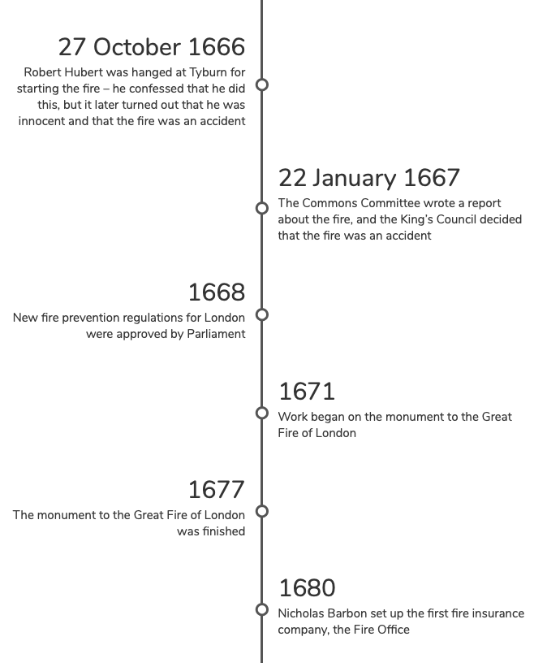
The Great Fire Timeline

Slide 9
Names to know:
Sir Christopher Wren (1632-1723) – Christopher Wren was a famous architect who designed St. Paul’s Cathedral. He had some ideas for how London could be rebuilt after the Great Fire, but the plans were rejected. Instead, he designed a monument to the Great Fire near where it began on Pudding Lane.
Samuel Pepys (1633-1703) – Samuel Pepys is most famous for keeping a diary for most of the 1660s, so he wrote a lot about the Great Fire in 1666. He also played an important part in helping to fight the fire by warning King Charles II that more needed to be done on the day the fire broke out (the King himself, and the Duke of York, took charge).
King Charles II (1630-1685) – King Charles II ruled from 1660-1685, and was king during the Great Fire of London. He helped the fire fighters, gave rewards to people who tried to stop the fire, and helped people who were hungry and homeless after the fire was over.
James, Duke of York (1633-1701) – The Lord High Admiral of England. Along with King Charles II, James took charge of the fire fighting efforts and helped to end the Great Fire. James’ guards acted as policemen to keep people and shops safe during the fire.
John Evelyn (1620-1706) – John Evelyn warned King Charles II in 1661 that the way houses in London were built would mean that a fire would be a disaster. When the Great Fire happened in 1666, he wrote about it in his diary – he walked around the city on 7 September and wrote about how people who had lost their homes were camping in the fields, and that the ground and charred wood was still so hot that holes burned in his shoes.
Thomas Faryner (1616-1670) – Thomas Faryner was a baker and owned the shop were the first fire broke out on 2 September 1666 that eventually led to most of London burning down. He was a baker to King Charles II

Slide 10
1666 and Beyond
Below are just some of the key events that have taken place in London, from The Great Fire to the Queen’s Diamond Jubilee.
1666 – The Great Fire
1863 - London introduced the world’s first underground railway
1888 – Jack the Ripper
1897 - Queen Victoria’s Diamond Jubilee
1907 - Suffragettes protested for women’s right to vote at the Houses of Parliament
1908 – London’s first Olympics Games
1940 - The Blitz (WWI)
1945 – WWII
1948 – London’s 2nd Olympic Games, British Nationality Act and HMT Empire Windrush
1965 - Sir Winston Churchill’s funeral
2005 – 7/7 bombings
2011 – Marriage of Prince William and Catherine Middleton
2012 – London’s 3rd Olympic Games and Queen Elizabeth II’s Diamond Jubilee
Use the helpful information slide at the end of the PowerPoint for links to create your own timeline of events.

Slide 11
Helpful information:
Watch “The Great Fire: In Real Time” Channel 5 documentary.
https://www.my5.tv/the-great-fire-in-real-time/season-1
Visit these websites for more information about the Great Fire.
http://www.fireoflondon.org.uk
https://www.bbc.co.uk/newsround/37222884
https://www.theschoolrun.com/homework-help/great-fire-london
https://www.bbc.co.uk/bitesize/topics/z7d7gwx/articles/zhgxcqt
Use these links to create your own timeline of key events from 1666 to 2020.
https://theculturetrip.com/europe/united-kingdom/england/london/articles/10-historical-events-that-shaped-london/
https://www.cityoflondon.gov.uk/things-to-do/visit-the-city/our-history/Pages/timeline.aspx

