Slide 1


TALKING TO YOUR CHILD ABOUT LIFE ONLINE

Slide 2


What are you most WORRIED about when your child is ONLINE?
Notes:
ASK: Find out what parents are currently worried about
TELL: Despite the positive finding that over seven in ten (72%) 8-17-year-olds who use messaging/social media sites or apps feel safe when using these apps/online sites, either all or most of the time, the online space is a risky environment for children.

Slide 3
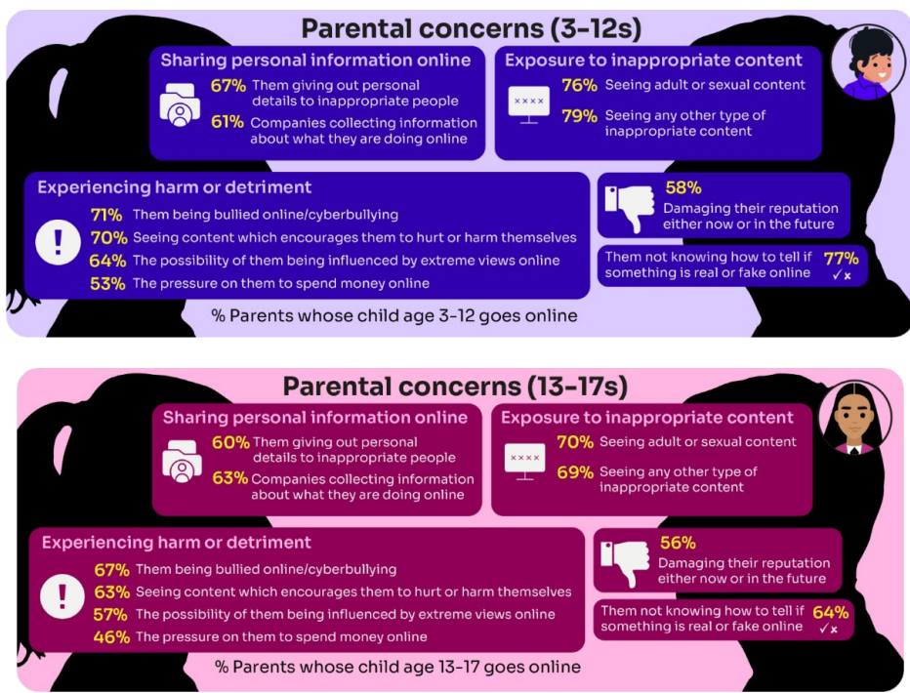
Summary of parental concerns (3 – 17 yr-olds)
Source: Children and parents: media use and attitudes report 2025
Notes:
Many parents indicate that they have concerns around various aspects of their children’s online activities.
The primary worry of all parents of online 3-17s continues to be potential exposure to age inappropriate content - three-quarters of parents said they were either fairly or very concerned about their child seeing content which is not appropriate for their age (76%) and the same proportion were concerned about them seeing ‘adult’ or sexual content (74%).
72% were concerned their child not knowing how to tell if something is real or fake online.
Seven in ten (69%) parents fear their child might be bullied online,
A similar proportion (68%) are worried about them seeing content that encourages them to hurt themselves.
61% of parents are concerned about their child being influenced by extreme views,
51% worry about the pressure to spend money online.
Unsurprisingly, there are many concerns which are more prominent among parents of younger (3- 12-year-old) children who go online.:
For example, a higher proportion of these parents compared to their counterparts (parents of teenagers) are concerned about their child being exposed to age inappropriate content (79% vs 69%), their child not being able to tell what is real or fake online (77% vs 64%), their child seeing content which encourages them to harm themselves (70% vs 63%), the 36 child giving out personal details to inappropriate people (67% vs 60%) and the possibility of their child being influenced by extreme views online (64% vs 57%).

Slide 4
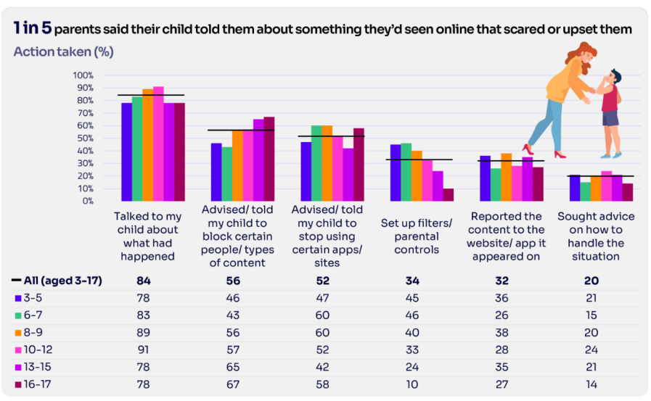
Are you CONFIDENT to TALK TO YOUR CHILD?
Is your child confident to TALK TO YOU?
WHAT WOULD YOU DO?
Are there any areas you would not feel confident or comfortable to discuss?
Younger children are more likely to tell a parent if they see something worrying or nasty online:
92% of 8-12-year-olds say that they would tell a parent
85% of 13-17s say that they would tell a parent
Source: Children and parents: media use and attitudes report 2025
Notes:
Almost all the parents in this group (99%) took some type of action in response to being told that their child had seen something that scared or upset them:
Over four in five parents in five (84%) had spoken to their child about what had happened.
Over half said they had advised their child to block a specific type of content or person (56%) and/or recommended that their child stop using certain apps or sites (52%).
Notably, there has been an increase this year in parents setting up filters or parental controls after an incident of this nature, up from 23% last year to 34% this year
However only about a third (32%) of parents had reported the content to the site or app on which it appeared
TELL:
You do not need to be an IT expert to help your child stay safe online. One of the best things you can do to protect your children is to talk regularly with them about their use of technology- just as you do with all other areas of parenting.
Having an open and honest approach is best - reacting, without involving them or talking to them, can often push behaviour underground, so it still happens, but you are less likely to know about it. This can increase risk to your child.

Slide 5



YOU don’t need to be an EXPERT … be a PARENT
It’s your choice – don’t let others dictate when the right time is to use tech.
Stay involved – make time to communicate, talk about what they are doing. What do they enjoy? What makes them laugh?
Don’t quiz them – have regular conversations. What's their favourite app? What is the best site to learn new things from?
Join in – watch them play a game and join in. Who are they playing with? Do they know the other players?
‘Show me how…’ – ask their advice to help you with your privacy settings, who you should add as a friend, are there any risks?
Lead by example – children learn as much from watching as they do from being told not to do something, so model good behaviour
Reassure them – tell them that they won't get in trouble and that you are always there to help
Notes:
ASK – What do you do that works well? Share good practice
REMIND - You do not need to be a tech expert to help your child with staying safe online. It’s ultimately about communication and being proactive.

Slide 6
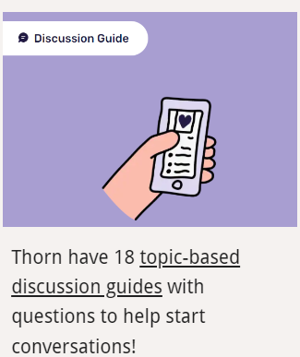
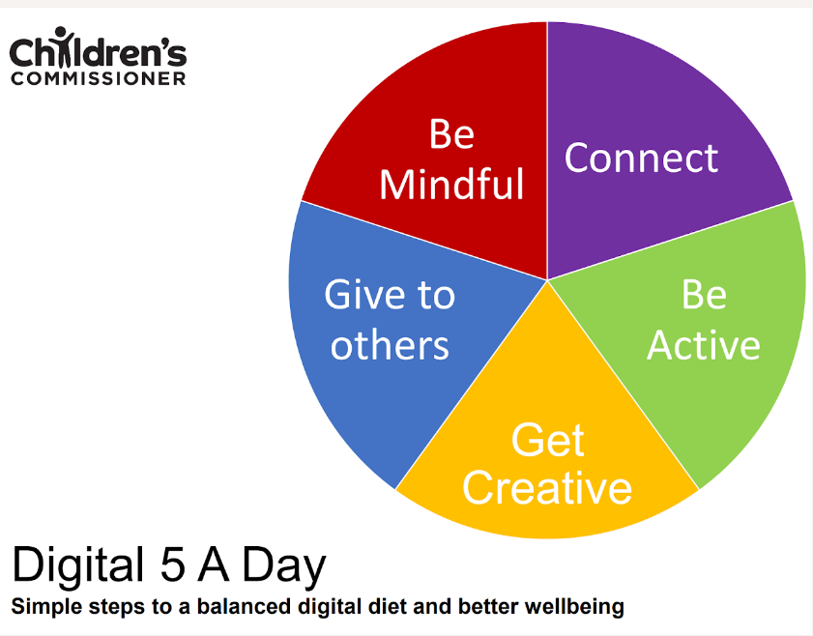




Find conversation starters, story time ideas and top tips to reinforce key safety messages at parentsafe.lgfl.net
Notes:
Feel free to point out some of these free resources for parents to reinforce safety messages and start those key online safety conversations:
TELL:
For younger children, it’s important to talk about boundaries, being kind to others and what they can do if they see or experience anything that worries or upsets them. Story time books e.g. ‘The Online Zoo’ and ‘#Goldilocks – a Fairytale for the Digital Age’ are great ways to discuss risk, consequences and positive strategies in a non-judgemental, age-appropriate way.
For older children, Thorn have 18 topic-based discussion guides with questions to help start conversations!

Slide 7
SUPERVISION AND PARENTAL CONTROLS

Slide 8
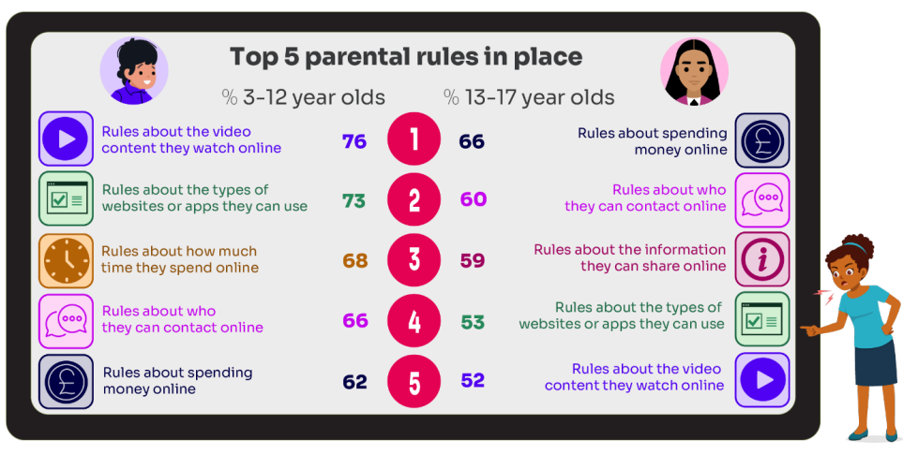
What RULES do YOU SET about being online?
What do you do that WORKS?
While parental concerns in some areas have increased considerably, their enforcement of rules appears to be diminishing, partly due to parents’ resignation about their ability to intervene in their children’s online lives.
Source: Children and parents: media use and attitudes report 2025
Notes:
ASK: What rules do you set for your children? How confident are you in implementing them?

Slide 9

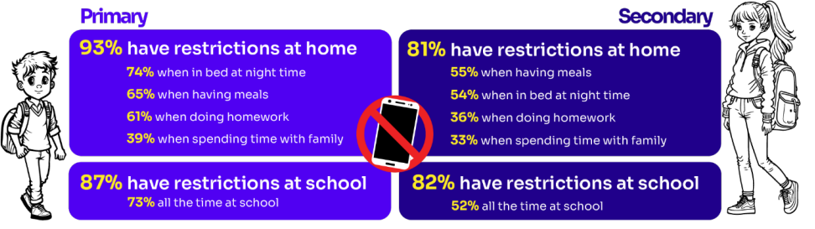
Do you RESTRICT their MOBILE PHONE USE?
If so, have you found it CHALLENGING?
Source: Children and parents: media use and attitudes report 2025
Notes:
ASK: What restrictions do you set for your children? How confident are you in implementing them?
More than eight in ten (83%) 8-17s in this group say there is at least one time when they cannot use their phones at home. Looking at specific restrictions when a child in this group is at home, nearly six in ten (58%) of 8-17s who go online via their phone say they are not allowed to use their phones when they are in bed at night, with a similar proportion (57%) reporting that they are not allowed to do so while having meals. Younger children in this group are more likely than older ones to report having each of these restrictions in place

Slide 10

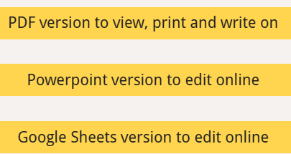
Why not have a family agreement to:
clarify what is allowed...or not
establish ground rules like no phones at the table or in the bedroom at night-time
agree shared expectations to reduce arguments and keep everyone safe & healthy
Download it at parentsafe.lgfl.net/digital-family-agreement
Notes:
TELL:
To help facilitate this, LGfL have created a free digital family agreement that parents could sit down and populate with all family members to agree what is and is not allowed within their family around tech use. This includes parents! WE as parents also need to role model good behaviour.

Slide 11
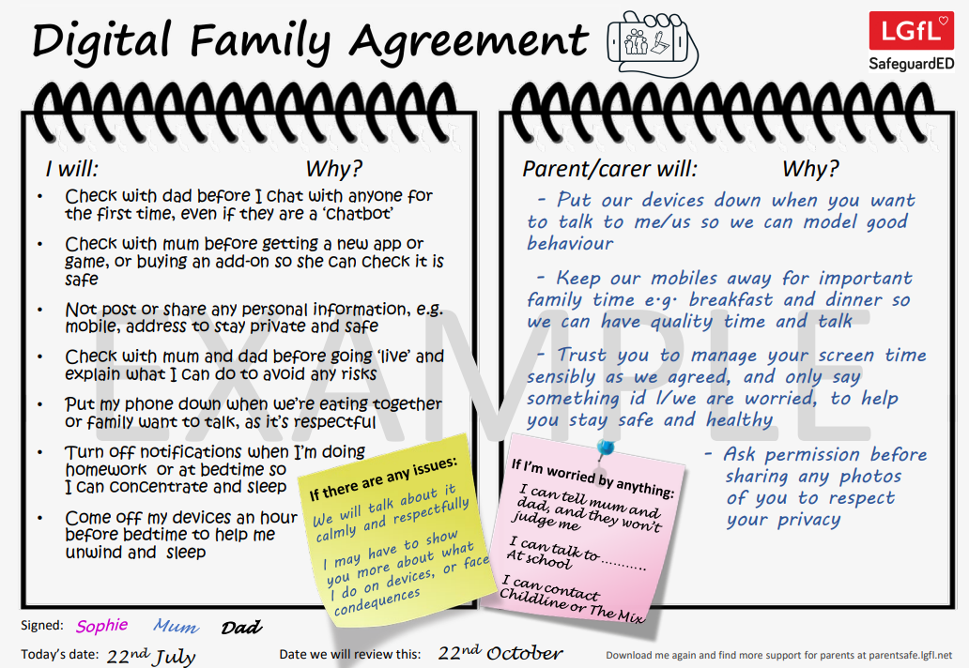
parentsafe.lgfl.net
Notes:
TELL - This is an example of a completed agreement – you may wish to take them through the sample statements to help them get started.
ASK – Have they heard of the term ‘Sharenting’?

Slide 12
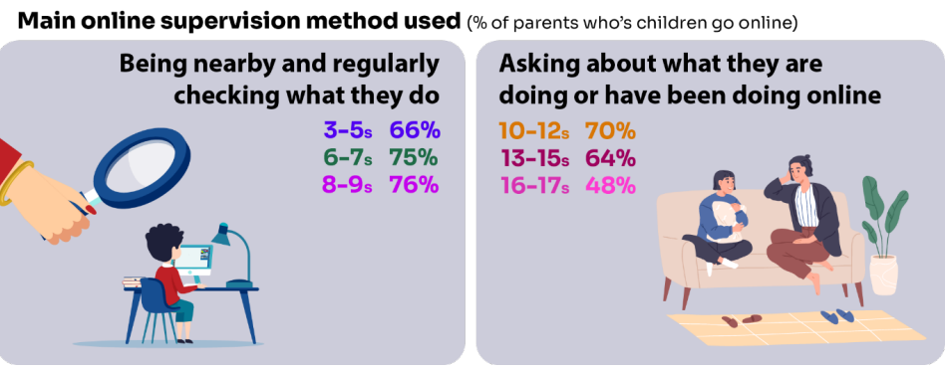
Do you SUPERVISE your child’s online activity? HOW?
Source: Children and parents: media use and attitudes report 2025
Notes:
TELL - The two most commonly-employed types of parental supervision among parents of 3-17s are to:
ask their child about what they are or have been doing online (59%), and
be nearby and regularly checking what their child does (55%).
Of course, this varies as the child gets older and more independent, as parents decreasingly monitor their child’s online life

Slide 13

Have you set up parental CONTROLS/PRIVACY SETTINGS for ALL DEVICES and NETWORKS?
Controls need to be set up on both the broadband connection AND each individual device
These do not come as standard so it’s worth checking
They are important because they allow you to:
Block and filter upsetting or inappropriate content or sites
Plan what time and how long your child can go online for
Notes:
TELL – it is important that these controls are set up on BOTH the broadband connection AND each individual device
About seven in ten (73%) parents of all 3-17-year-olds use at least one type of technical tool or control to manage their child’s access to online content; parents of 8-11-year-olds are more likely than those of older children to use at least one of these tools (84% vs 70% of parents of 12-15s and 54% of parents of 16-17s respectively). The most commonly-used technical tool used, across all parents of 3-17s, were parental controls built into the device by the manufacturer, e.g. Windows, Apple, Xbox, PlayStation etc. (32%). (Ofcom 2024)

Slide 14
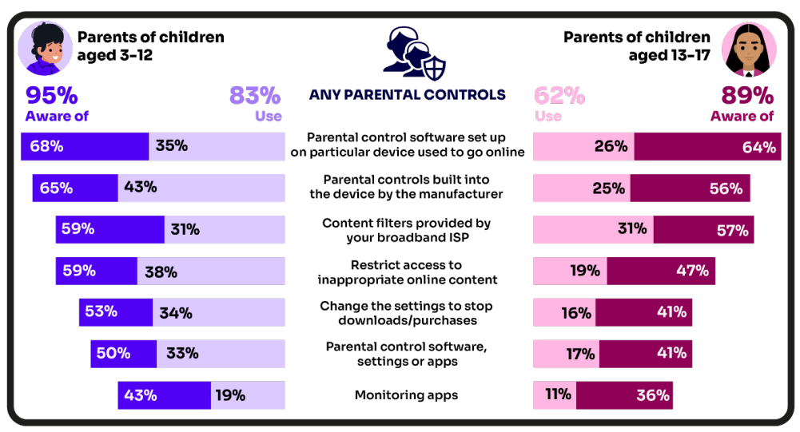
Are you AWARE of these PARENTAL CONTROL TOOLS?
Which ones have YOU USED?
‘I prefer to supervise my child’s online use by talking to them about setting rules’
(39%)
Source: Children and parents: media use and attitudes report 2025
Notes:
There is a high awareness of technical control tools among parents, BUT many are choosing not to use them
ASK – Why do you think this is the case?
TELL – it’s not as complicated or scary as you think. Let’s look at some top tips and resources to support you.
Parents of younger children are more likely than those with older children to use at least one type of technical tool or control to manage their child’s access to online content, with 83% of parents of 3-12s using at least one of these tools compared to 62% of parents of 13-17s.
Among all parents, the most frequently-used technical tool or control, out of the options presented to them, continues to be parental controls built into the device by manufacturers (such as Windows, Apple, Xbox, PlayStation etc.).
Parents of 6-7s in particular are more likely to use this type of control, with 50% of these parents saying they use these in 2024, compared to 36% in 2023.
Parents of 8-9- year-olds are more likely than last year to use apps installed on their child’s phone to monitor app usage. This year, 22% of these parents used such apps, up from 10% in 2023.

Slide 15
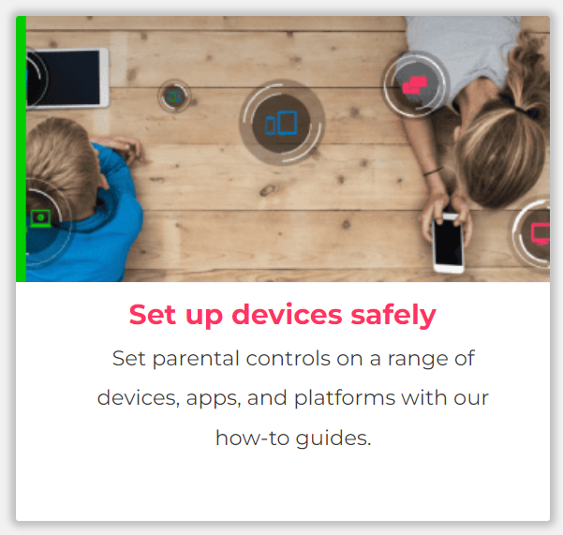
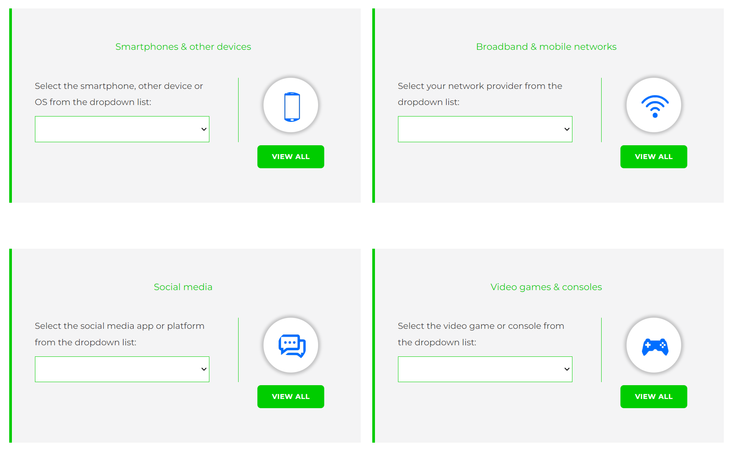
Visit internetmatters.org/parental-controls to find out how to set controls on devices:
Notes:
TELL – They can use this great page to find out how to set up controls on any smartphone, broadband, social media site/app and games console
REMIND - They need to set up parental controls on each of these individually

Slide 16
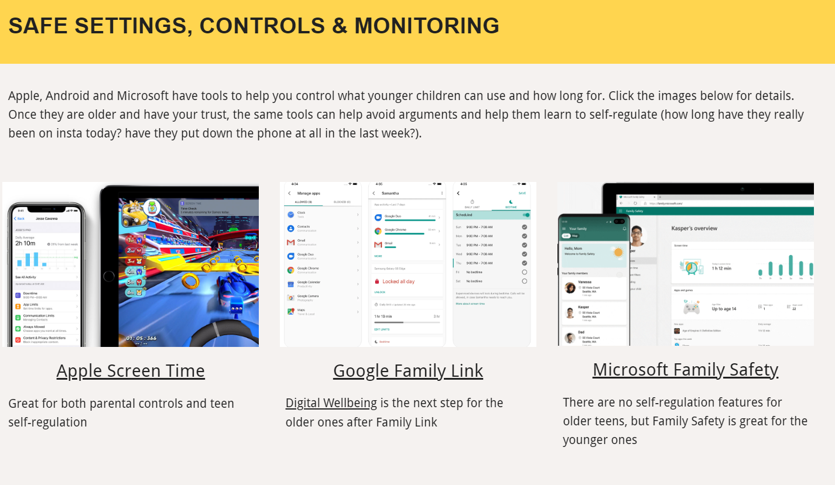
Parental control apps like Google Family Link, Screen Time and Microsoft Family can let you set limits across devices, apps and platforms
Visit parentsafe.lgfl.net/ for additional advice and tips on settings and controls for all devices
Notes:
EXPLAIN - As well as setting controls on your broadband, device, apps, games etc, Parental Control Apps like Google Family Link, Screen Time and Microsoft Family can further enhance safety by letting you set limits across devices, apps and platforms without needing to access these spaces separately. You can manage screen time, app access, inappropriate content restrictions and more.
Screen Time shows you how much time you spend on apps, websites and more. You can also set limits and restrictions for what you want to manage – on your own device or a child's device.
Family link can run on Android devices, e.g. Samsung… Parents can access and manage their child’s account and settings, and delete it if necessary
TIP – Why not run a ‘Bring your device and we’ll show you….’ pupil-led workshop to help parents with this at school?

Slide 17

REMEMBER
As children get older, restrictions and controls you use will change, but only at a pace you feel is appropriate for your child, not pressure from your child “because everyone else is allowed”
Content filters are never 100% effective, at some point your child may come across inappropriate or upsetting content, so make time to talk regularly

Slide 18
SOCIAL MEDIA AND GAMING

Slide 19
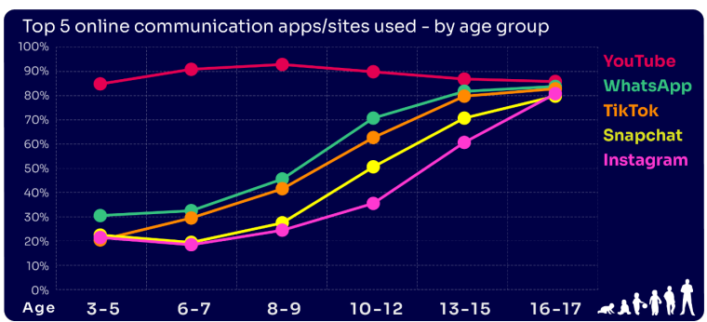
Are you FAMILIAR WITH THE APPS and GAMES your child is on?
YouTube is the most popular, but the appeal of many social media platforms varies by age
The two most popular apps for 3 – 7 yr-olds are WhatsApp (2 in 10) and Snapchat (3 in 10)
The proportion of 8-9s with an Instagram profile increased from 8% in 2023 to 14% in 2024
13-17s are most likely to have profiles on WhatsApp
(62%), Snapchat (62%) or TikTok (61%)
Go to apps.lgfl.net for guidance on apps and social media sites
Source: Children and parents: media use and attitudes report 2025
Notes:
YouTube continues to be universally popular, and the appeal of other social media platforms increases with age . nearly half (48%) of 16-17s use all of the top five apps/ sites that we asked about (YouTube, WhatsApp, TikTok, Snapchat and Instagram).
REMIND – your children need to be 13+ to use these platforms (See slide 39)

Slide 20
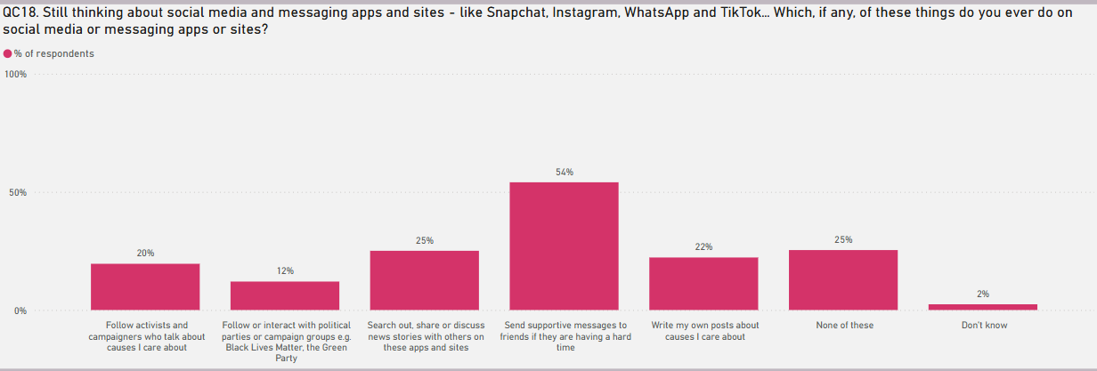
KNOW WHAT THEY DO on social media?
Eight in ten (81%) of all children aged 8-17 use at least one social media app/site for following friends, people and organisations, reading, liking or sharing content
TikTok was the most favoured platform to message and communicate with friends.
Source: Children and parents: media use and attitudes report 2025
Notes:
TELL - Motivations for using these types of app vary, but a key reason is the desire to connect with peers. Seven in ten (68%) 8-17-year-olds who use social media and/ or messaging sites or apps told us that using these types of sites or apps helped them feel closer to their friends, either all or most of the time.

Slide 21

WHY DOES THIS MATTER?
Young people can get around age restrictions on apps and websites, increasing the risk of them coming to harm online
Addictive algorithms can make it harder to take a break and maintain a healthy balance between time on and offline
Algorithms can also target content similar to what you’ve already selected/liked/shared
This can prevent you from finding new ideas and perspectives, create misinformation and reinforce stereotypes
Notes:
ASK – What kinds of risks do you think children could be exposed to? Can you give examples? (See slide 48 for a summary of related risks)

Slide 22
What might they NOT BE TELLING YOU?
Nearly six in ten (56%) 8-17s use multiple profiles on at least one social media platform:
(23%) said it was because one account was just for parents/family to see
15% said one account was for the ‘real me’ and another contained edited/filtered posts or photos
Source: Children and parents: media use and attitudes report 2025
Notes:
TELL - This demonstrates that at least some children feel the need to present distinct aspects of themselves on social media, depending on the audience.

Slide 23
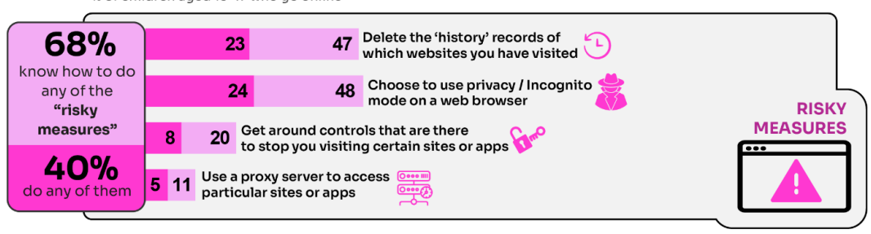
WHY is this ‘RISKY’?
40% had engaged in ‘risky’ behaviour!
Source: Children and parents: media use and attitudes report 2025
Notes:
TELL - This behaviour is considered ‘risky’ because they enable the child to conceal their online activity, preventing a parent or appropriate adult to ensure they are keeping safe online.

Slide 24
What about WHATSAPP?
Do you know the minimum age to use this? What are the risks?
Unwanted contact | to contact somebody on WhatsApp, all you need is their phone number, which could expose you to unwanted messages or calls
Inappropriate content | messages are end-to-end encrypted which means that the content cannot be monitored. This means that your child could see or hear harmful or upsetting content e.g. pornography or violence.
Location sharing | live location feature means that your child could reveal their current location to others
Cyberbullying | children could be bullied, feel left out or deliberately excluded or removed from groups
Oversharing | privacy features, such as disappearing and ‘view once’ messages, might mean that your child feels safe to reveal private or risky information or images. However, there is always a risk that this could be copied and shared
Notes:
TELL - WhatsApp let users send messages and content to contacts added to their account. To use the service in the UK, users must be 13-years-old or older (as of April 2024. The minimum age for WhatsApp used to be 16)

Slide 25

Notes:
PLAY – ‘What's Up on WhatsApp? Group Chats and Kicking’ video showing primary pupils talking about the realities of group chats and exclusion bullying - deliberately being left out to hurt someone's feelings.
https://youtu.be/BpT8vFn6_eA

Slide 26
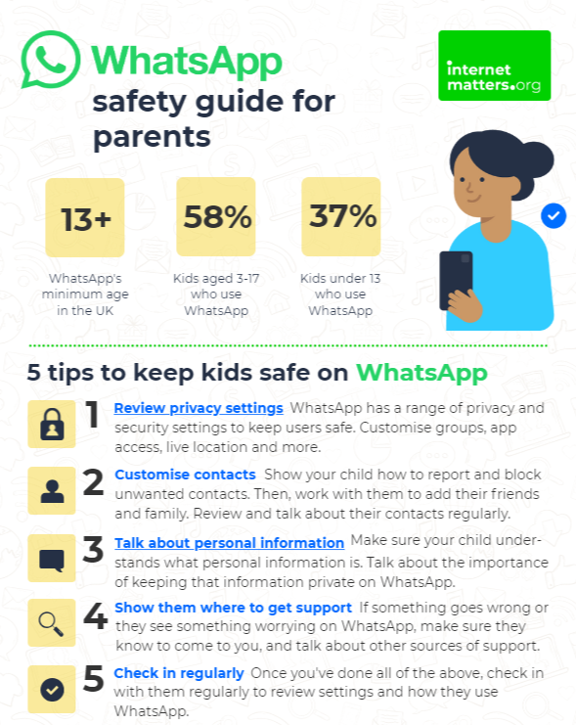
What can you do?
Visit https://www.internetmatters.org/resources/whatsapp-safety-a-how-to-guide-for-parents/#whatsapp-safety-tips for advice for parents
Notes:
SHARE – 5 top tips from the parent safety guide at https://www.internetmatters.org/resources/whatsapp-safety-a-how-to-guide-for-parents/#whatsapp-safety-tips
EXPLAIN – it’s useful to talk with children about etiquette when using group chats e.g.
how to communicate
what language to use/not use
recognition that others may see your messages if copied and shared
what to do if someone is unkind to them or others etc.

Slide 27



Find ratings and reviews for parents on apps, games and social media at commonsensemedia.org
Notes:
REMIND – they don’t need to be experts, but they can empower themselves by finding out about the suitability of the games/apps their child uses
SHOW – the Common Sense Media page and pick an app or game to show how easy it is to find a review

Slide 28
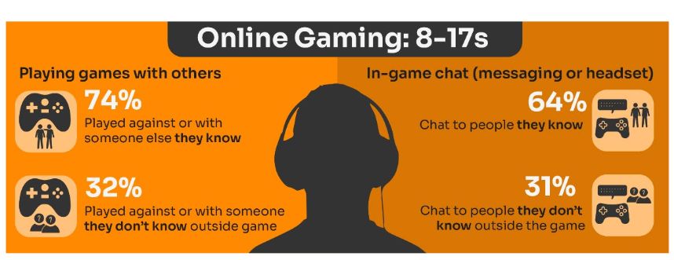
Do you know the DIFFERENCE between an ‘ONLINE’ FRIEND and a real one? How does this differ from your CHILD’S VIEW?
Are you familiar with who they are in contact with whilst playing games?
Have you asked about the chat facility?
Do you know the content and age restrictions for these games?
72%
63%
31%
31%
Visit gaming.lgfl.net for advice and activities
Source: Children and parents: media use and attitudes report 2025
Notes:
TELL:
Children often use online gaming as a tool to communicate with their peers, with 64% of 8-17s who game online chatting through the game with friends and/or people they know in real life.
However, 31% of children who game online, communicate with strangers as well.
A higher proportion of these children now play shooter games. This may raise concerns about how age appropriate the games favoured by some younger children actually are.
While communication via games is a valuable social tool for many children, it can sometimes leave them vulnerable to unwanted interactions. This year (12%) of all children aged 8-17 said someone had been nasty/hurtful to them through an online game

Slide 29
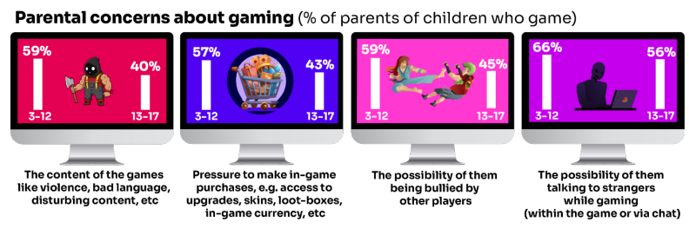
What are YOU most WORRIED about when it comes to GAMING?
Visit gaming.lgfl.net for advice and activities
Source: Children and parents: media use and attitudes report 2025
Notes:
TELL:
The most commonly cited concern among parents of 3-17s whose child games was the possibility of their child talking to strangers while gaming, either within the game or via the chat function (62%).
This was followed by the possibility of their child being bullied by other players (54%), the content of the games the child plays – i.e. violence, bad language, disturbing content etc. (52%), and the pressure on the child to make in-game purchases e.g. for things like access to upgrades, skins, loot-boxes, in-game currency or other rewards (52%).
Overall, parents of younger children are more likely than parents of teenage children (13-17s) to be concerned about these possibilities

Slide 30

Research finds children’s online spaces “saturated” with
GAMBLING-like content and advertising:
“They make it look like a game, it does not look like gambling.”
Risks are not understood by children due to the blurred lines between gambling and gambling-like activity such as loot boxes
Do you DISCUSS THIS when you talk about MONEY to your children and how gambling is made to LOOK ATTRACTIVE and likely that you would WIN?
https://www.gambleaware.org/media/hbcp3qgd/exploring-the-lived-experience-and-views-of-gambling-among-children-and-young-people_final_0.pdf
Notes:
TELL: The report found that gambling was understood to be a normal part of everyday life, and children described it as a part of their experience of growing up. Gambling content was seen with things such as horse racing, scratch cards and the National Lottery, while content that felt like gambling was seen in online games with gambling-like features such as loot boxes. The bright, loud and eye-catching nature of gambling adverts drew children and young people in, and many reported that gambling could look like gaming and vice versa, and the look and feel of the two worlds felt interchangeable.
EXPLAIN: Anyone who plays video games will probably have heard about loot boxes. They can contain useful items, in-game currency, new clothing or even characters that could change the way you play. 9 in 10 young people report that loot boxes are available in the games they play. A common practice if a game includes loot boxes is that the game is free. Typically, the game will make their money from selling tempting items in these boxes through a range of tactics –
ASK: Do you DISCUSS THIS when you talk about MONEY to your children and how gambling is made to LOOK ATTRACTIVE and likely that you would WIN?

Slide 31
How can YOU GET INVOLVED?
ASK what type of games your child enjoys – are they age-appropriate?
PLAY games together - keep the tech in shared spaces rather than bedrooms
TALK about who they are playing with - what information are they sharing?
EXPLAIN what is/isn’t appropriate to share, e.g. personal details to identify them/location
AGREE how they will spend their money online
DISCUSS what they would do if they were bullied online, and what steps to take
DECIDE how long is appropriate to play in one session - how many sessions a day
SETUP these restrictions in parental settings with your child
Visit gaming.lgfl.net for advice and activities to keep them safe

Slide 32
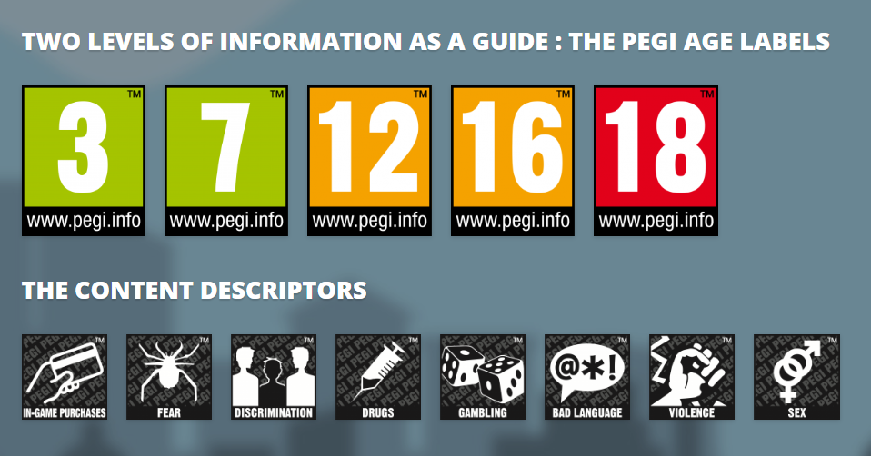
PEGI helps parents to make informed decisions when buying video games:
The age rating confirms that the game content is appropriate for players of certain age
It considers the age suitability of a game, not the level of difficulty
pegi.info
Notes:
UK uses the PEGI (Pan European Game Information) system to give games their age ratings to help people make informed decisions when buying video games or apps through the use of age recommendations and content descriptors. .You can find out more here: https://parentzone.org.uk/article/pegi-games-ratings#:~:text=The%20UK%20uses%20the%20PEGI,about%20how%20PEGI%20classifies%20games.

