Slide 1
Parents Evening Report
November 2024

Slide 3
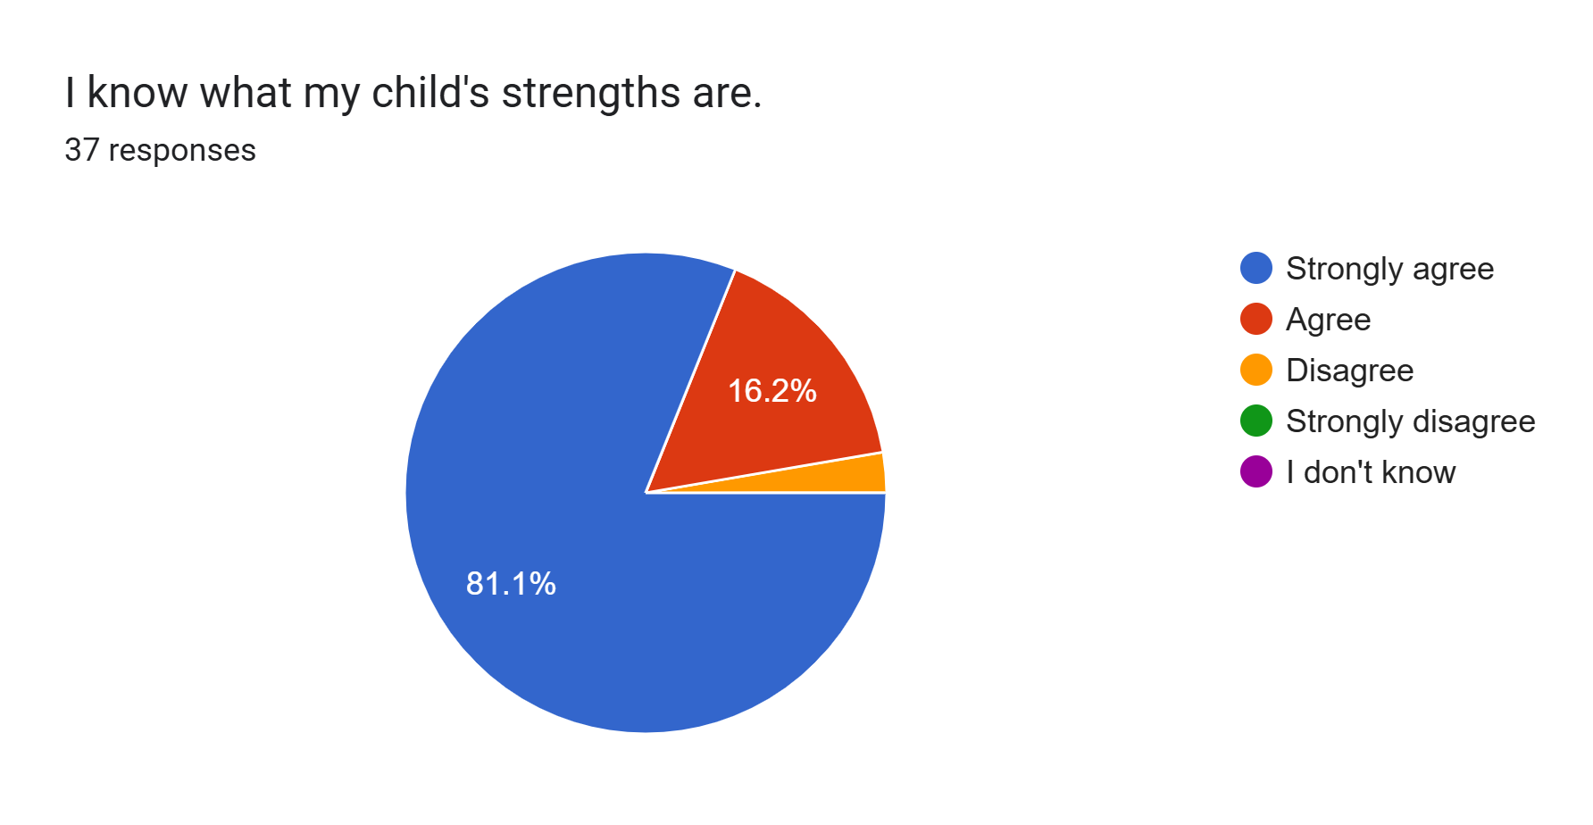
Additional comments or suggestions
Clear explanations from class teacher regarding targets and potential progress.
I felt the parents meeting focused on her weaknesses at the moment and didn't really feel I got much in the way of positives, i.e. something she does well or some nice comments about her character. I came away feeling very saddened, but I do understand that we needed to discuss things that she needs to improve on, that was made priority, I just felt it could have been softened with a few nice comments about her character.

Slide 4
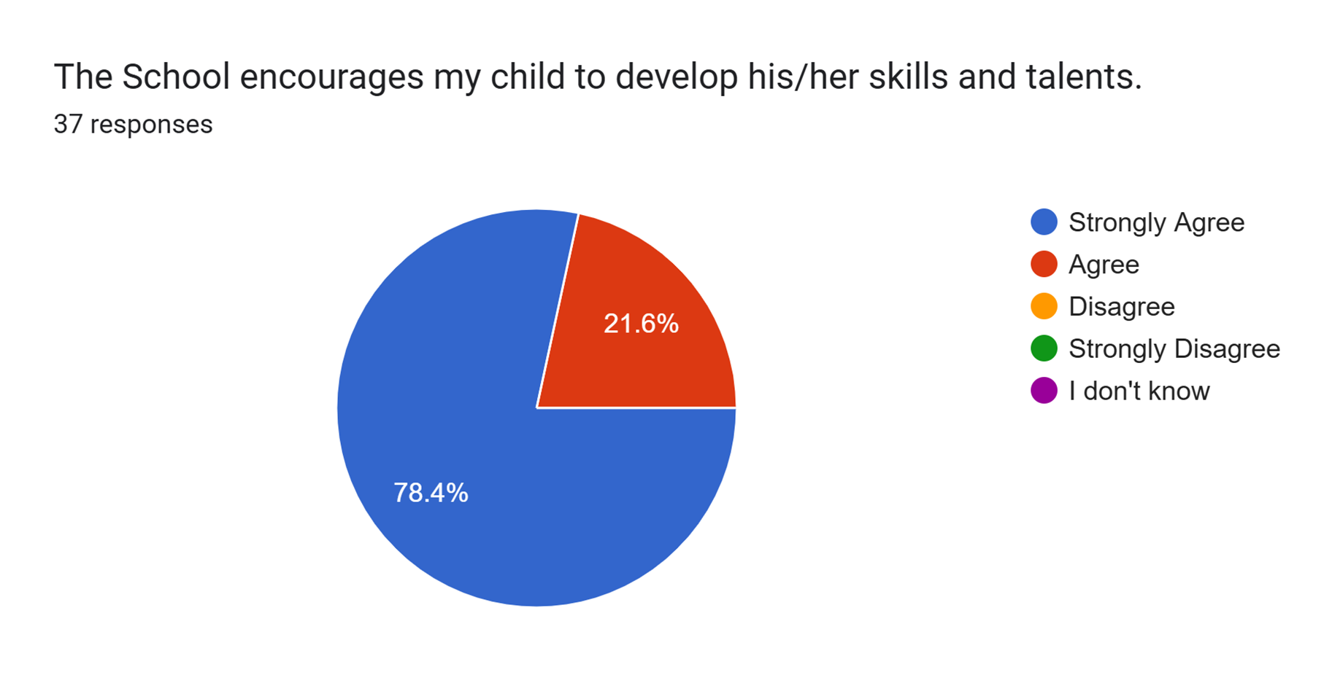
Additional comments or suggestions
Plenty of opportunities for children to explore talents and progress academically and creatively.

Slide 5
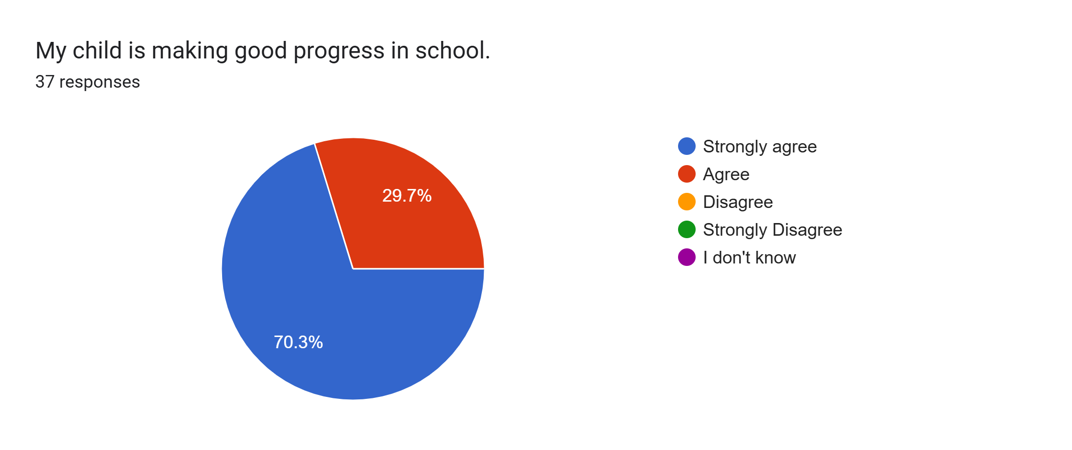
Additional comments or suggestions
Clear to see within books and scores from assessments.
I do feel she is progressing well, even if she doesn't have the confidence to show her abilities in school, she demonstrates this to us at home.
She seems to be making good progress academically but struggles massively with her emotions and the social side of school and this tends to all show at home and not wanting to go on the residential. Hopefully now this has been recognised and school are aware she can be supported in school with this. The small group course with Mrs Rice on confidence sounds like it will help her.

Slide 6
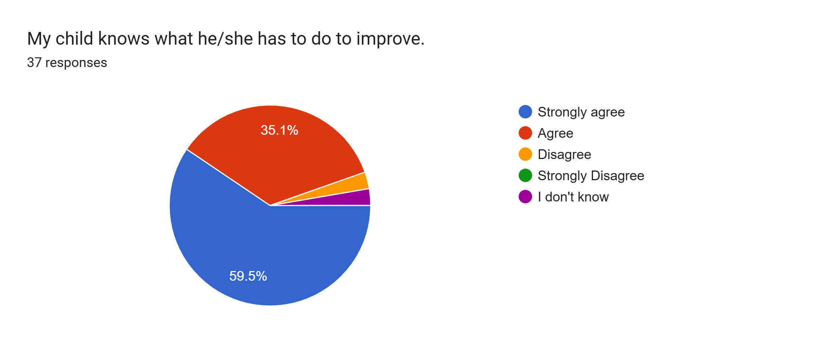
Additional comments or suggestions
Targets were made clear by staff teacher.
I feel school have been very helpful in aiding her progress and given me a clear idea of what needs improving.
She knows that she is looking at for finger spaces for her writing.
She knows she needs to read more at home and tries to give her best. That's all she can do.

Slide 7

Additional comments or suggestions
Suitable level and amount of homework for her to be challenged and revisit learning.
Mrs Sheridan was amazing sending work for him when I asked. He was able to keep up with his classmates despite an unexpected absence thanks to her.
An electronic copy of spellings would be useful as the paper sheet either doesn't make it home or gets lost. By email or link on the school app.
School have been very supportive, giving me time to have some one-to-one time with charlotte during school hours, which has had a really good impact on both myself and her. Thank you!
Good that homework is short and seems to be a recap of what they've done in class. She doesn't remember when homework is due in and needs reminders at home.

Slide 8
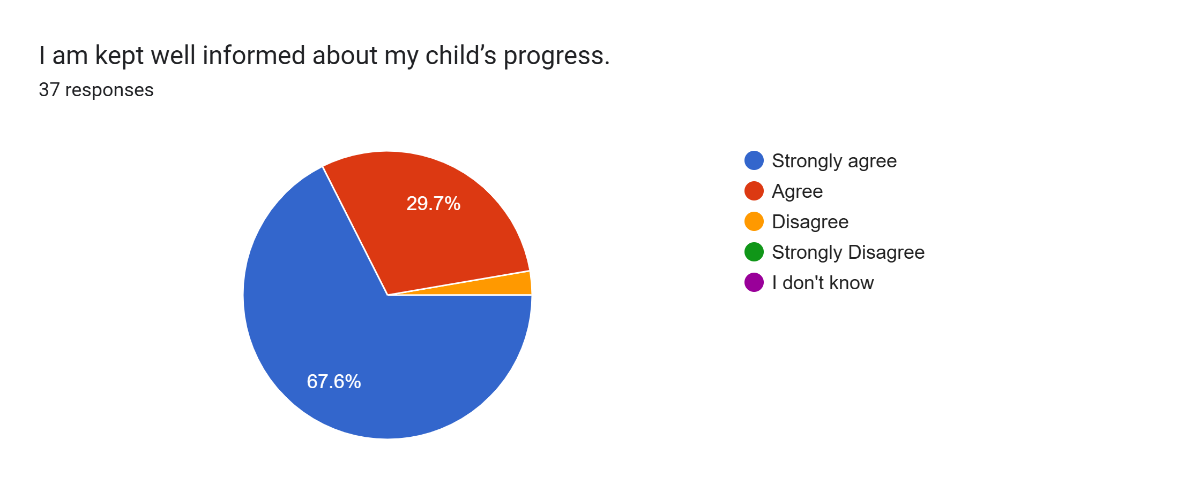
Additional comments or suggestions
Conversations with class teacher and lots online posts.
I was told she is doing well and giving 100% effort which is great and all we can ask. Not sure of any results from assessments but these are due soon and good that we can be told how she gets on with them and whether she will get more time/brain breaks for sats tests with having difficulties with ADHD diagnosis.

Slide 9
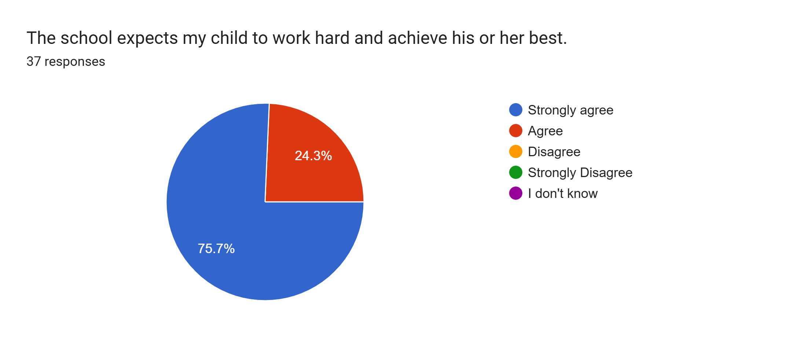

Slide 10
Please tell us any strengths about Parents Evening.
Very organised and good opportunity to look through child’s work. Decent amount of time to discuss child and never felt rushed in any years of attending.
Wonderful evening which was very well organised, informative and friendly.
Mrs Sheridan knows him really well despite him being at the school for such a short time. His academic capability came after a difficult settling in period, Mrs Sheridan managed his wellbeing amazing, and now he has settled is focusing on his strengths, things to work on and things we can support him with at home. Parents evening was well organised thanks so much.
Well organised.
Lovely welcome and always fab to get to chat to my children's teachers - as we don't get to do this on the door (breakfast club/after school club!)
Opportunity to speak to teacher regarding strengths and weaknesses.
It was well mapped out and welcoming.
Friendly and welcoming staff.
I love the opportunity to talk to the teacher just our family and them.
Well organised and welcoming.
Relaxed environment, it would be nice to have longer but understand the dilemma of time.
One to one with teacher to discuss strengths and weaknesses
Seems more positive and understanding of her. Good that her teacher seems to know her as an individual and felt the parents evening was individual to her.

Slide 11
Can you think of any ways Parents Evening can be improved?
Not at all. It’s always run seamlessly.
I thought it was stated, organised. Thanks.
As stated, I would just have liked to hear some positive feedback regarding her as well as what she needs to improve on "feedback sandwich" it would have just softened the blow a little for me as I did feel so upset after. I did totally understand it was something that needed to be discussed and I needed to know that she wasn't reaching her potential in this area during school, but I would have loved to have heard some personal comments about her character and things she does well.
No - you are all doing an exceptional job nurturing our children's love of learning and helping them to grow as individual learners with their own interests too. Thanks so much!
Make it easier to book appointments for siblings around a similar timeframe on the same evening
To share the topics of learning or significant events that the year/ school are working towards. Be clearer on how parents can support as a whole small and big asks.
Perhaps would have been good to see how she did with the start of year assessments. I'm not really sure how she is doing academically but glad to hear she is giving her best effort

