Slide 1
PARENTS EVENING FEEDBACK
March 2022

Slide 2
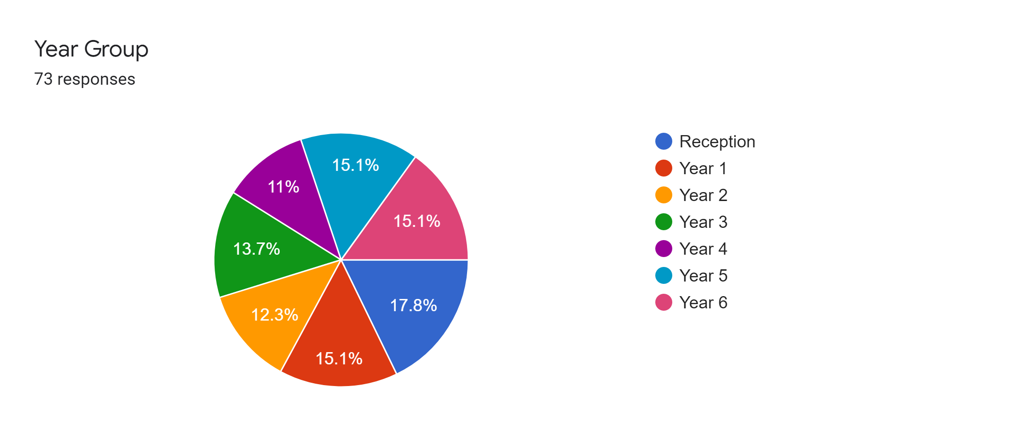

Slide 3
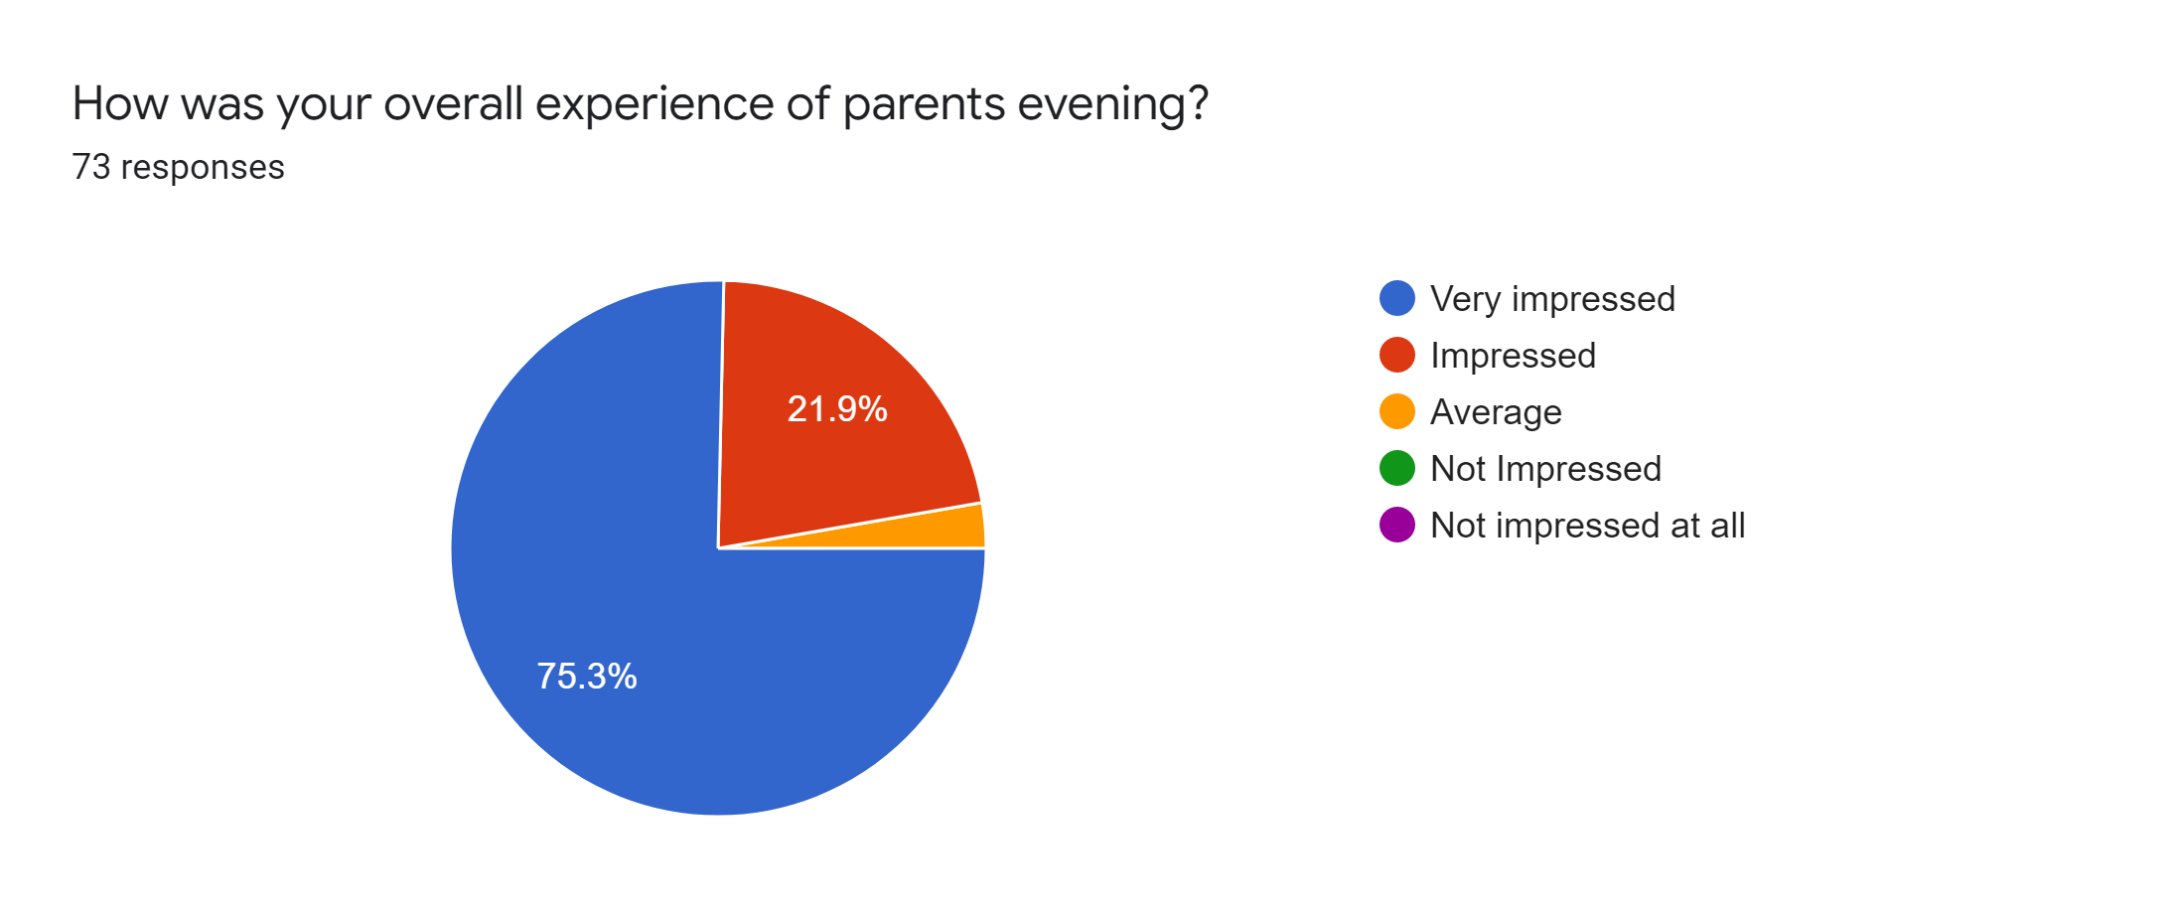

Slide 4
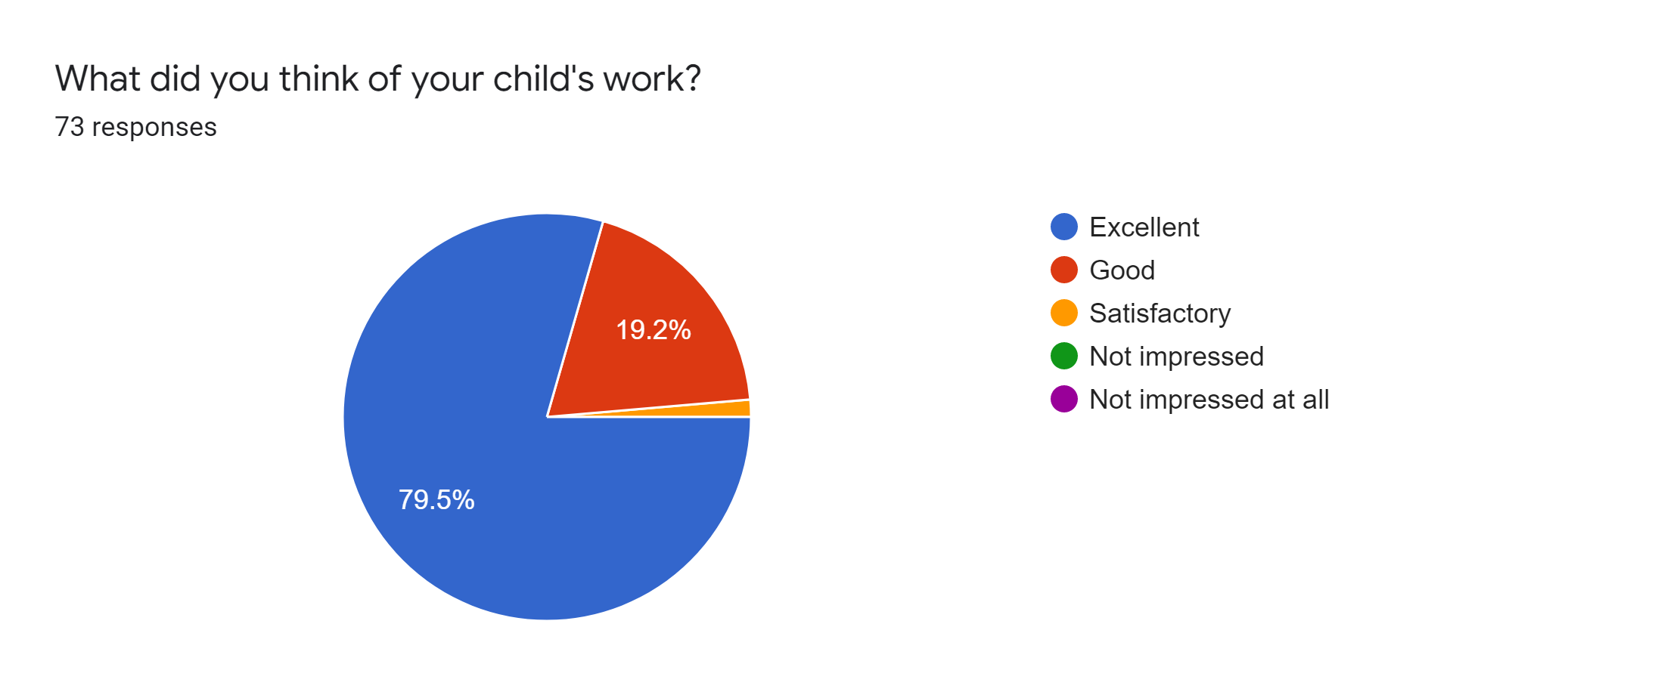

Slide 5
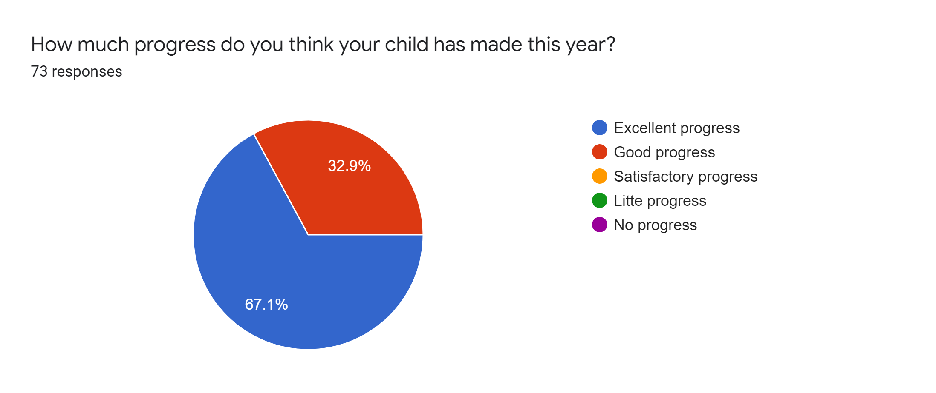

Slide 6
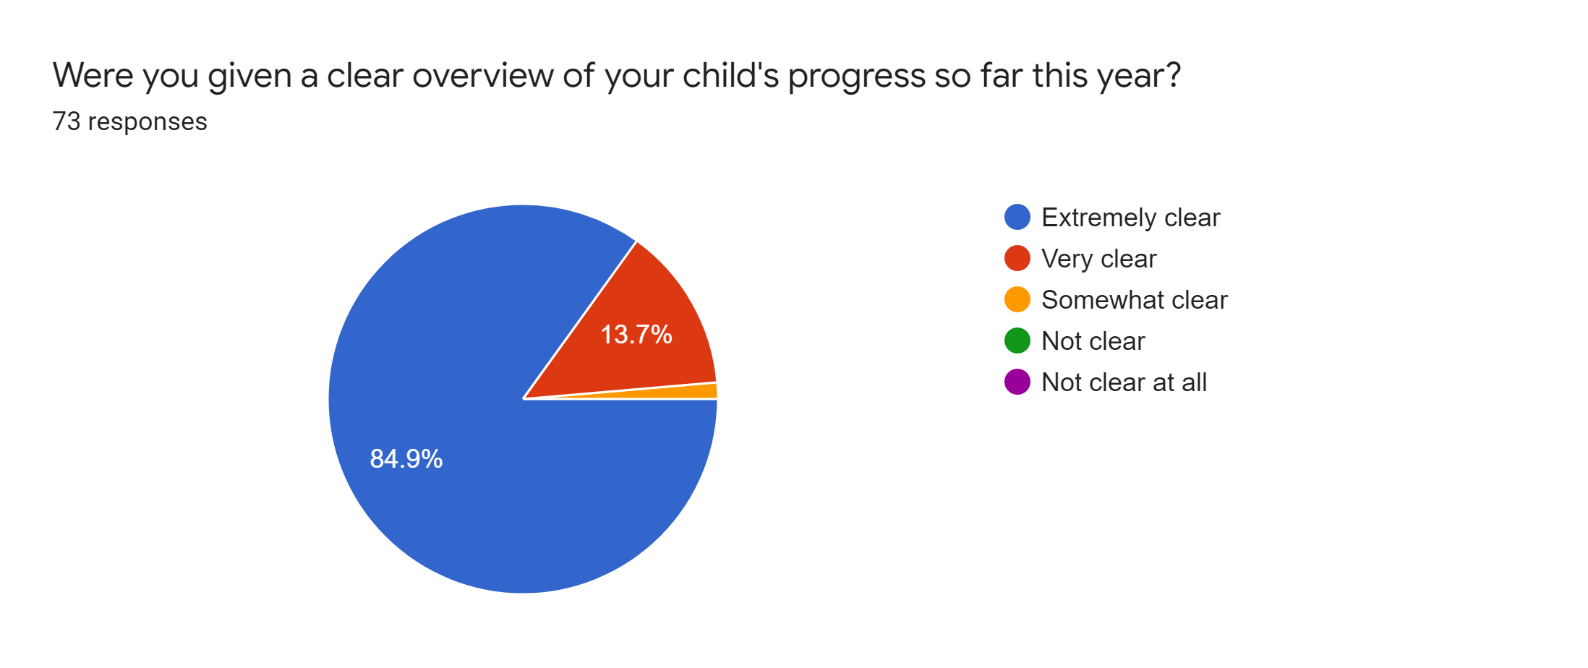

Slide 7
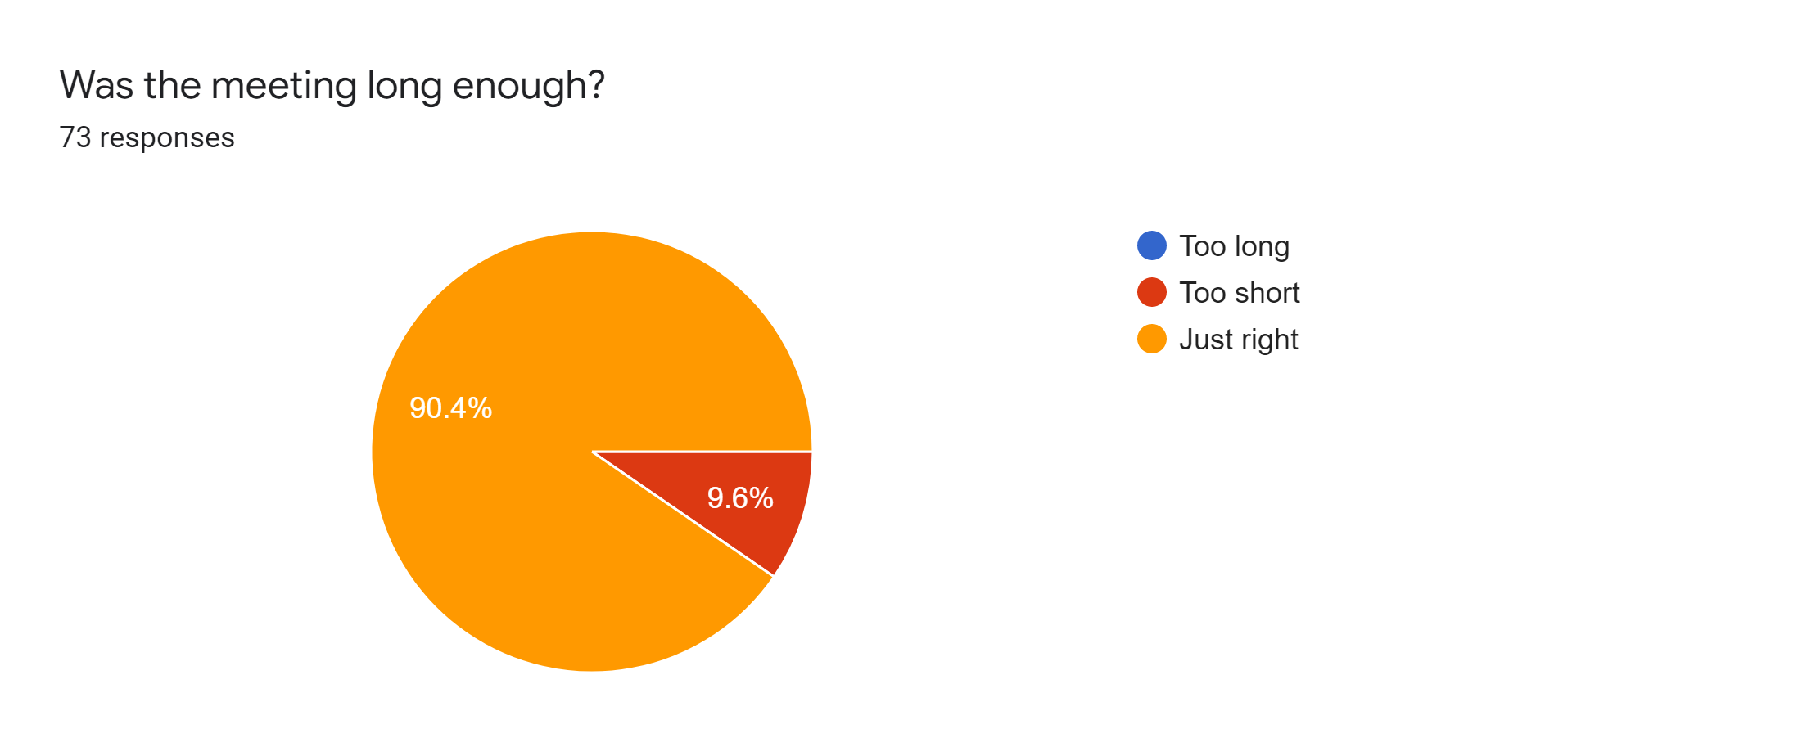

Slide 8
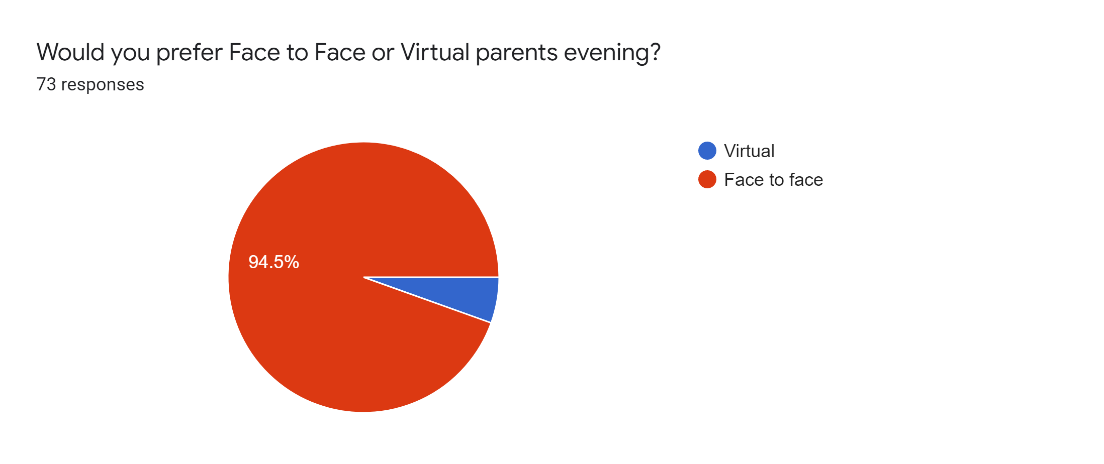

Slide 9
Please can you explain your reasons why?
Nice to speak in person
Get more of a feel of the teacher/ pupil relationship
Was great to be back in the school. Looking at her work, seeing work of the class in the classroom. Nice to be able to see the teacher and discuss progress.
Easier to fit in around work
Able to view child's work in school if face to face which you couldn’t do if a virtual meeting was held
Much more personal and it was lovely seeing the classroom and all the work being done
You get to see how your child is progressing in the year
The teacher gets to the point and is clear in his assessment. He creates progress reports and points out areas that need focussing on. I prefer face to face as I feel the video feels a little to distant.
I am extremely happy with how well my child is doing and I can’t thank the teacher enough for all the help she gives her
Easier to raise concerns
Feel it more personal
I find it more engaging being face to face and find it a better experience . We did have enough time to talk but that was because we went over the 5 mins. I think 10 mins is more reasonable.
No interruptions from other household members
Able to look at my child’s work
No internet problems
Better for my work hours

Slide 10
Body language and conversation better
I don't really mind, but it's nice to connect in person, especially in year 6 when you rarely see the teacher
More personal with less glitches
Can see more clearly what teacher to trying to say
Nice to see in person and see all the work
Communication better face to face
It was possible to have a look at the learning environment
It was good to be able to see their work books and how much progress they’ve made. Also nice to see the wall displays
Face to face meetings are much more personable
It's more personal
It's nice to talk to the teacher in person and to see my child's work books in her classroom.
Loved being able to look through her work again and seeing the progress she's made.
Happy with either
Virtual can be stressful if it cuts out all the time
Easier to discuss issues etc, sometimes virtual meetings have issues with sound, picture distortion and lag
Too short felt rushed
Nice to speak to the teacher
Opportunity to talk to the teacher face to face and see child's work.
It was really lovely to see the children's work and the displays
Much more personable than online. Nice to see the school and my child’s work too which we haven’t done for 2 years!
I like to see the children's work and classrooms as well as build a relationship with the teacher
Face to face allowed a clearer conversation and also allowed me to look at my child’s work books in the classroom
We loved the whole experience, seeing the classroom and work. Spending time face to face too is invaluable and allowed us to really be invested in my child’s overall progress

Slide 11
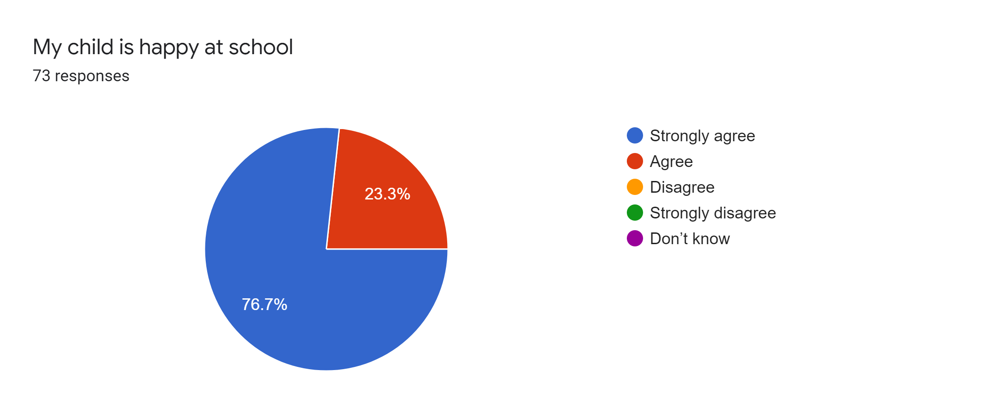

Slide 13
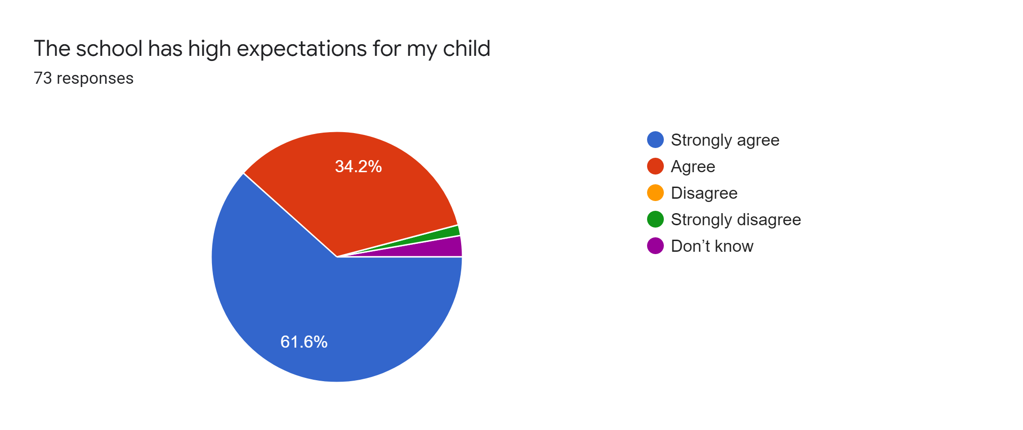

Slide 14
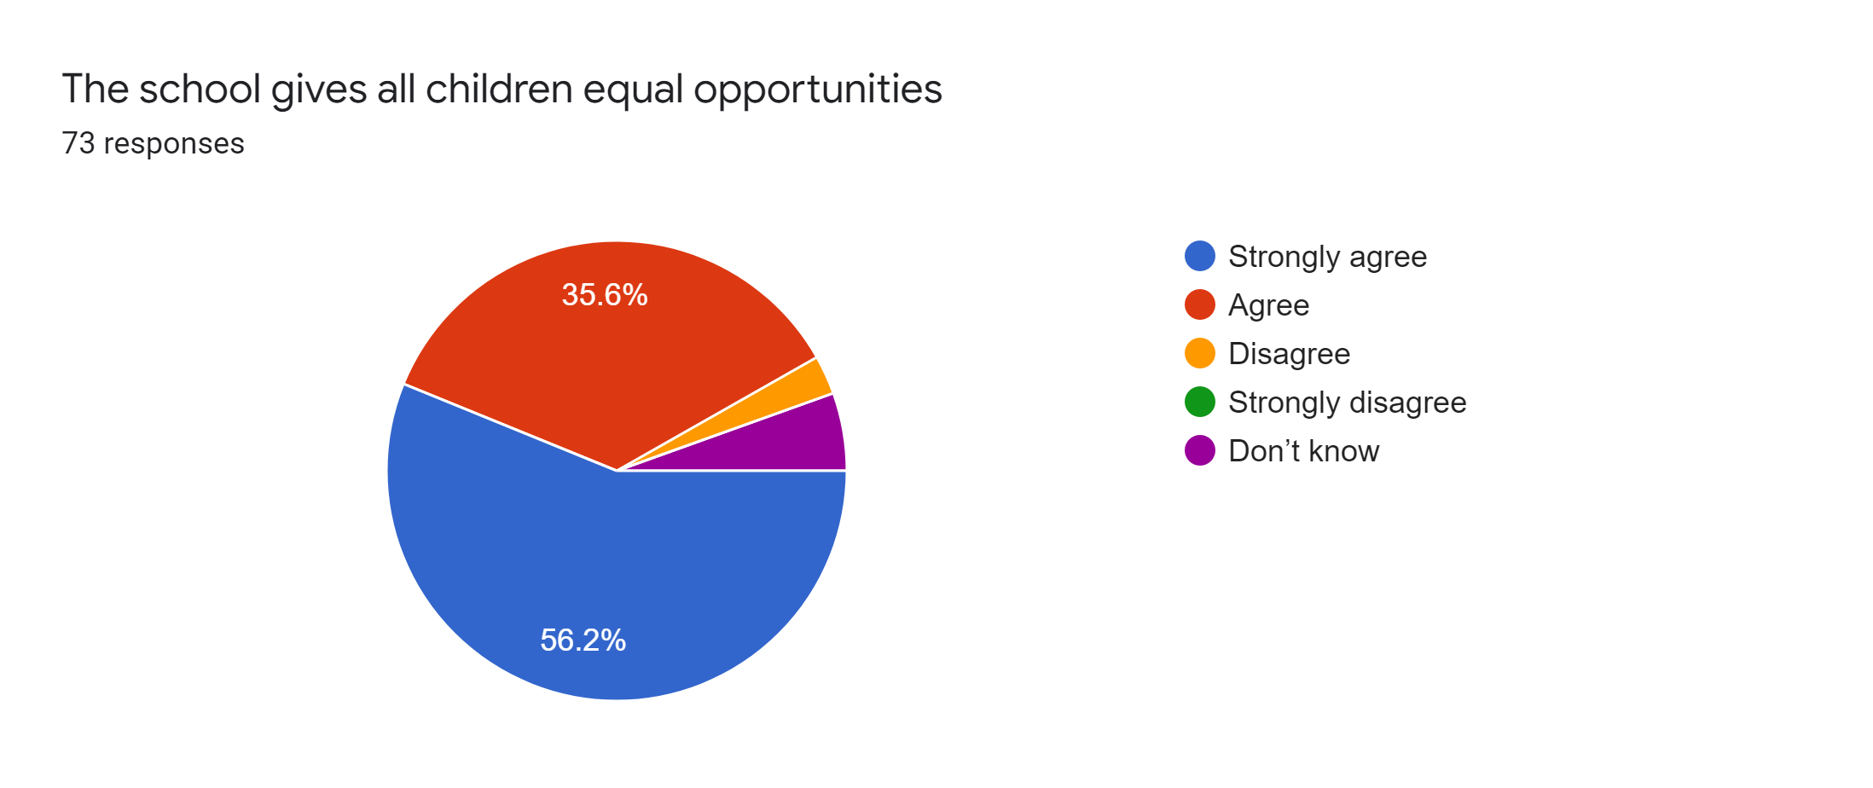

Slide 15
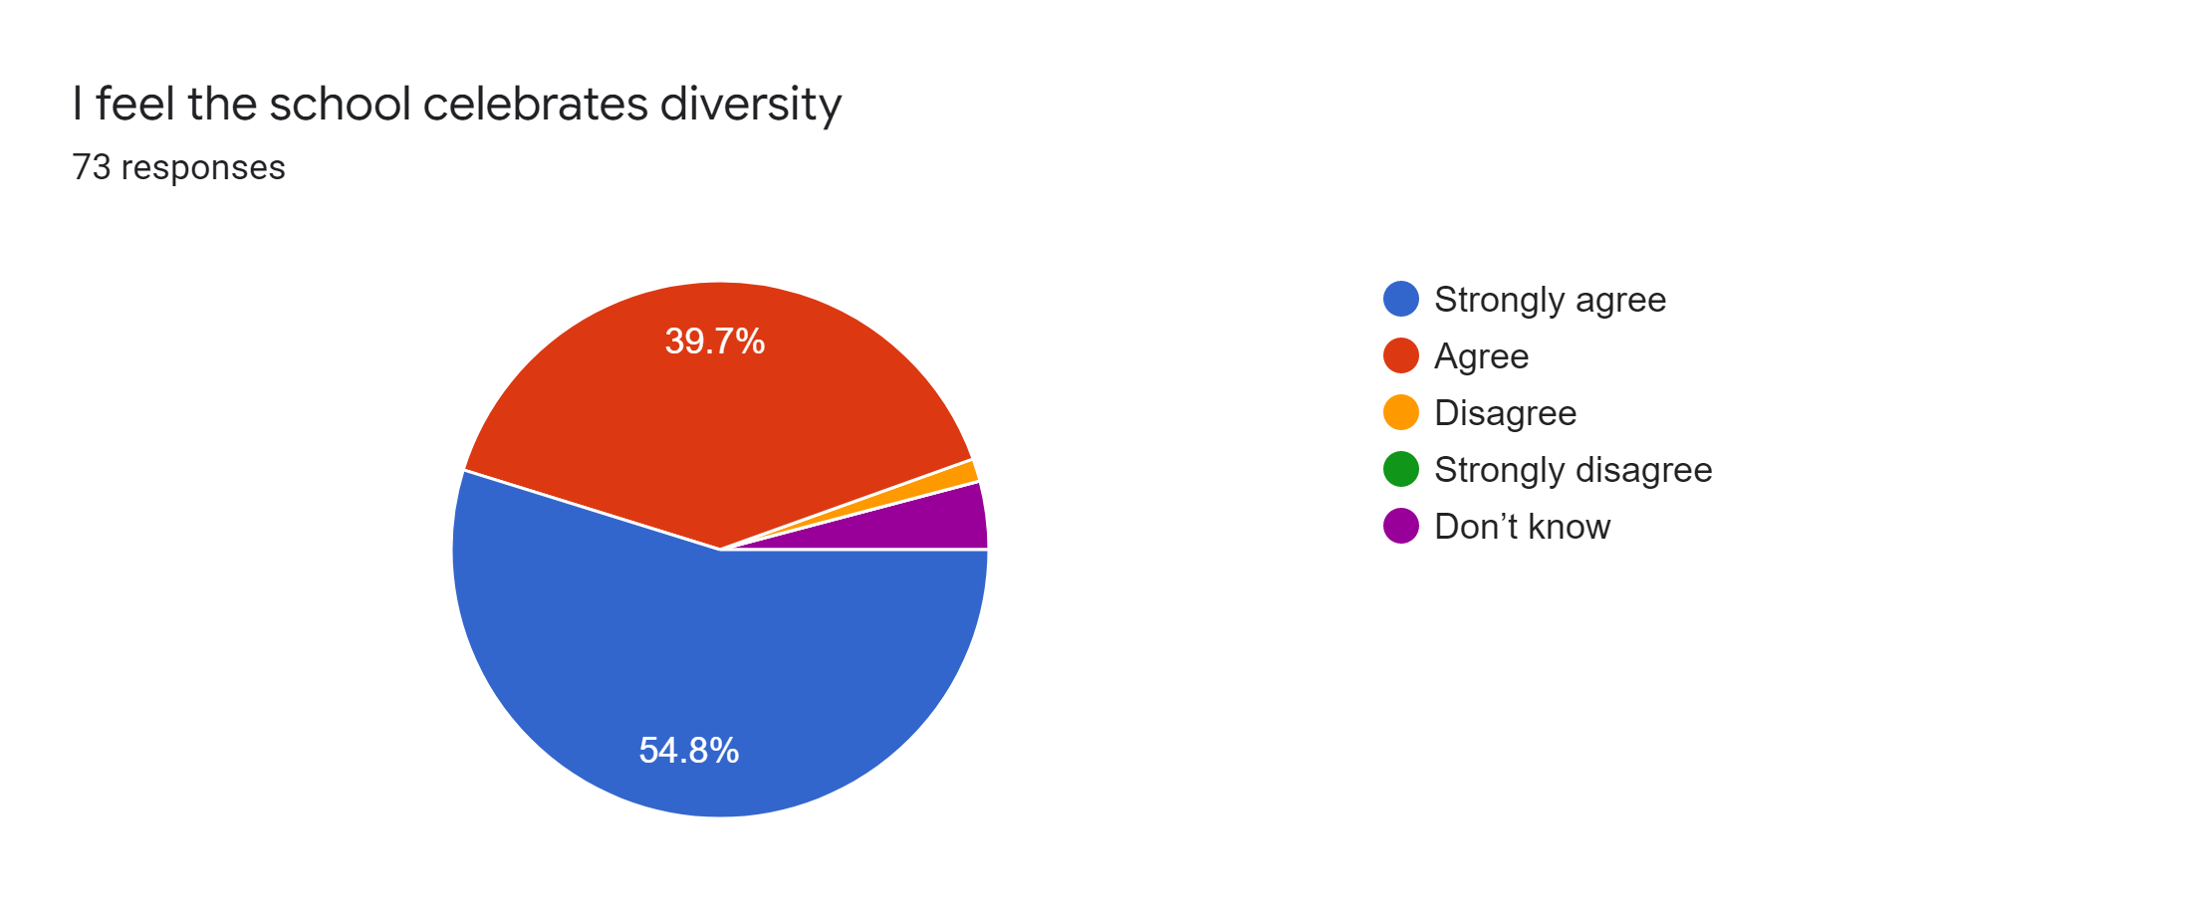

Slide 16
