Slide 1
Transition Questionnaire Feedback
March 2023

Slide 2
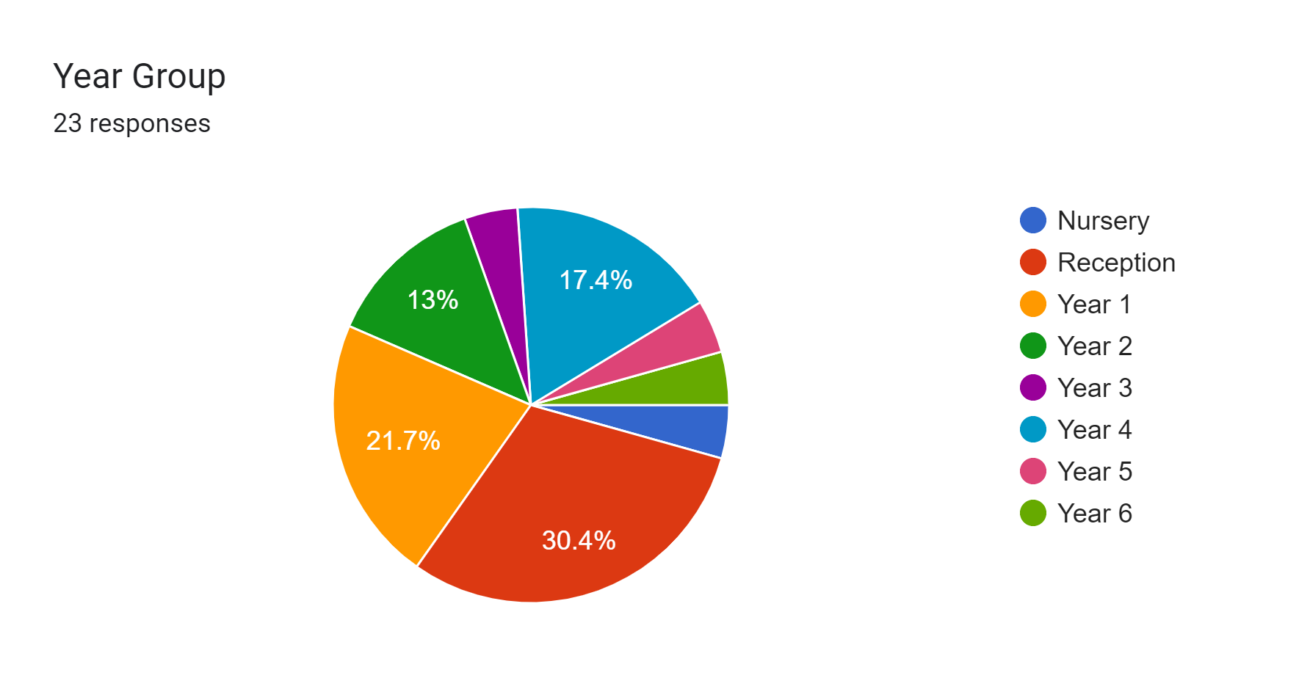

Slide 3
How do you feel your child settled into their current year group?
Found it challenging at beginning due to volume of work. Always tired.
Fairly well, she doesn’t easily separate from me and I think she has done as well as could be expected. I don’t think the school and in particular Mrs Beevers could a have done any more.
Really well he seems to be really enjoying school. I can tell he has fun and feels safe and comfortable at school.
Slow at first, but making lots of progress.
She seemed to settle into Year 4.
Really well although I think this was helped by her already knowing the teaching staff from nursery.
He has settled in very well.
She has settled in really well.
Really well she seems to be really settled and enjoying learning.
She fine, settled in well because with friends.
So well! She’s thriving and loves school, her teachers and her classmates.

Slide 4
How do you feel your child settled into their current year group?
Very well.
He is extremely settled.
Relatively well, adapted well to new routines.
She settled into her year group very well and adapted quickly to the new routines.
With ease due to calm welcoming environment.
It was a nice, easy transition for her coming from the nursery. She already knew most of the teachers and she loves them so I think she already felt quite comfortable. Every part of it felt very well supported by all members of the school.
He has settled well and has transitioned to the new year with its higher learning expectations and other developments in learning. He was ready for the new challenge and is excited by the new things he is learning.
Really well.
Still having a few problems, seems to be struggling with following routines/instructions, doesn't seem to want to participate in whole class activities, wants to be in control and do things on his terms.

Slide 5
What information and experiences did you receive prior to the transition that supported the transition?
My child had moving up sessions, some staff changes initially. Meet & greet/stay and play useful.
Meeting with teacher, stay and play days.
Not sure I received any.
Taster sessions, uniform sent to nursery.
Settling in sessions I think they worked really well. It made him very excited at the thought of starting school.
Class teacher, routine, expectations.
She met her most recent Year 4 teacher before she started full time by having her teach the class a few afternoons a week. This gave her a chance to get used to the new teacher. She looked forward to having Mrs Logie take over the class after Christmas.
Settling in sessions helped.
Information regarding moving up days and what work the children would be covering for the coming academic year.
Meet the teacher with Mrs Riley who explained what work was to be covered with the children and ways we could help the children with learning.
Met her teacher and had an overview of the learning.
2 day moving up.

Slide 6
What information and experiences did you receive prior to the transition that supported the transition?
Settling in days were brilliant and the glitter was such a lovely thing to do before starting. Also the lunch tasting was really helpful.
Excellent parents evening feedback
We looked round and got all paperwork needed.
Transition days in the new class and with the new teacher are invaluable.
Unsure
Meeting the teacher during the transition process (2 day introduction) was key to a smooth transition.
Information about him provided to school from nursery. Class teacher came to meet with him in nursery to slowly build trusting relationship. He was invited into school to visit reception class meet staff and pupils which was really helpful to build his understanding of school and his excitement about starting.
Who the teachers were going to be. We had days were parents were invited in which was nice and then a gradual start. I think she really benefitted from having her buddy. She talks about her all of the time and she has lots of fond memories and I think it was really helpful for her and helped her to feel good about going to school.
He was familiar with where his classroom would be and who would be teaching him. We felt happy with and confident in the transition process.

Slide 7
What information and experiences would have made this experience better for you and your child?
More talking points that she could bring home.
I wouldn't change anything as I feel he did settle at first and then the more he's got used to being in school he is trying to push the boundaries and be in control.
More transition days.
I feel it was handled perfectly, I have nothing to add to make it better.
A one-minute introduction to what the class is like that has been recorded by the children.
It would have been good to have met the new teacher when she took over from the previous one. Maybe a meet the teacher session or even an introduction letter sent home.
Further moving up days.
Support and partnership with teachers.
Maybe a timetable for the children and adults to look at together e.g. What is going to be taught and also what’s expected.
Really pleased with transition from nursery to school. Lots of exposure to school and staff helped. The teddy of bow for the children over the holidays was an extra special thought that helped children to feel excited and a part of school already.
I don't think there is anything in particular. It was all quite smooth.
Potentially, time allowing, an opportunity to meet the Year 1 teachers before the summer. However, I feel confident that had I requested this, the school would have done everything to facilitate accommodating this request.

Slide 8
What information would you like to receive prior to the move to the next year group to support the transition?
Think it is available on your website.
Difference between juniors and infants.
When transition days are, how they're going to support him in the transition, how Year 1 is different to reception and what the expectations are.
Introduction from new teacher/ classroom staff. What exciting things the kids can look forward to. What clubs might be available to them. Information that makes them excited about coming to school and entering a new academic year.
Any key dates, information. Names of staff.
Key Curriculum objectives, and topics of learning throughout the year. I understand Mrs Riley loves music and brings this into the classroom. He loves music and would really thrive from this.
Potential trips, wider opportunities.
Might be useful to see a timetable, pe days etc.
Who the teaching staff will be, which classroom, what they will be learning.
Practical information regarding subjects to be covered and meet the teacher days.
Style of learning to aid with homework.

Slide 9
What information would you like to receive prior to the move to the next year group to support the transition?
2/3 days morning
How day to day differs in KS1 to reception.
Just the same kind of information we got for reception.
Details on who his teacher will be.
Pre-visit to the school, an example of a typical daily routine, tips for organisation and time management.
As above a timetable of events, what the children will be learning about.
Possible a brief breakdown of what a standard day looks like to help child understand at home what they can expect.
What we can do to prepare him ahead of transition over summer. what differences there might be to the school day/learning styles to begin to familiarise him ahead of new year.

Slide 10
What experiences do you think would benefit you and your child prior to moving to the next year group?
Book suggestions to enjoy with our child that may help them in preparation for the next academic year. Reception did the pick and mix project homework which may be nice over the holidays. Think these should be optional though so we avoid putting undue pressure on parents/carers.
Meeting with the teacher to discuss his needs, more opportunities for him to spend time with the teacher in the classroom to get used to the environment and for him to know the expectations.
Spending time with new teacher and support staff for more than just a day. Making some lovely memories together.
Time spent getting to know her teacher. Multiple meetings before.
Taster session possibly with or without parents. Maybe Mrs Riley teaching the reception class for a couple of hours a week towards the end of July to get the children use to a new teacher, but not sure in reality that could be accommodated though.
Chat with the Year 5 pupils.
Meet the teacher session and hope the class will have one teacher for the whole year.
Settling in sessions.
Chance for her to get to know the Year 1 staff and environment and the different expectations of KS1.
Transition days, to meet the teacher and be in his new class environment.
Pre-visit and taster day at the school
A meet the new teacher for both the children and parents event.
Meet the teachers/visit the new classroom

Slide 11
Any other comments to improve our transition between year groups?
Maybe some insight into what will change in the next year group, what's expected, what can parents do to help the transition.
It seems good.
He loves school and has never struggled with new teachers/transitions so you must be doing all the right things to support him, in my opinion!
Nothing further to add. We are immensely grateful for all that staff members do to support and nurture them. exceptional care, individual support for child's needs. Thank you for building a beautiful community at BVPS.

