Slide 1
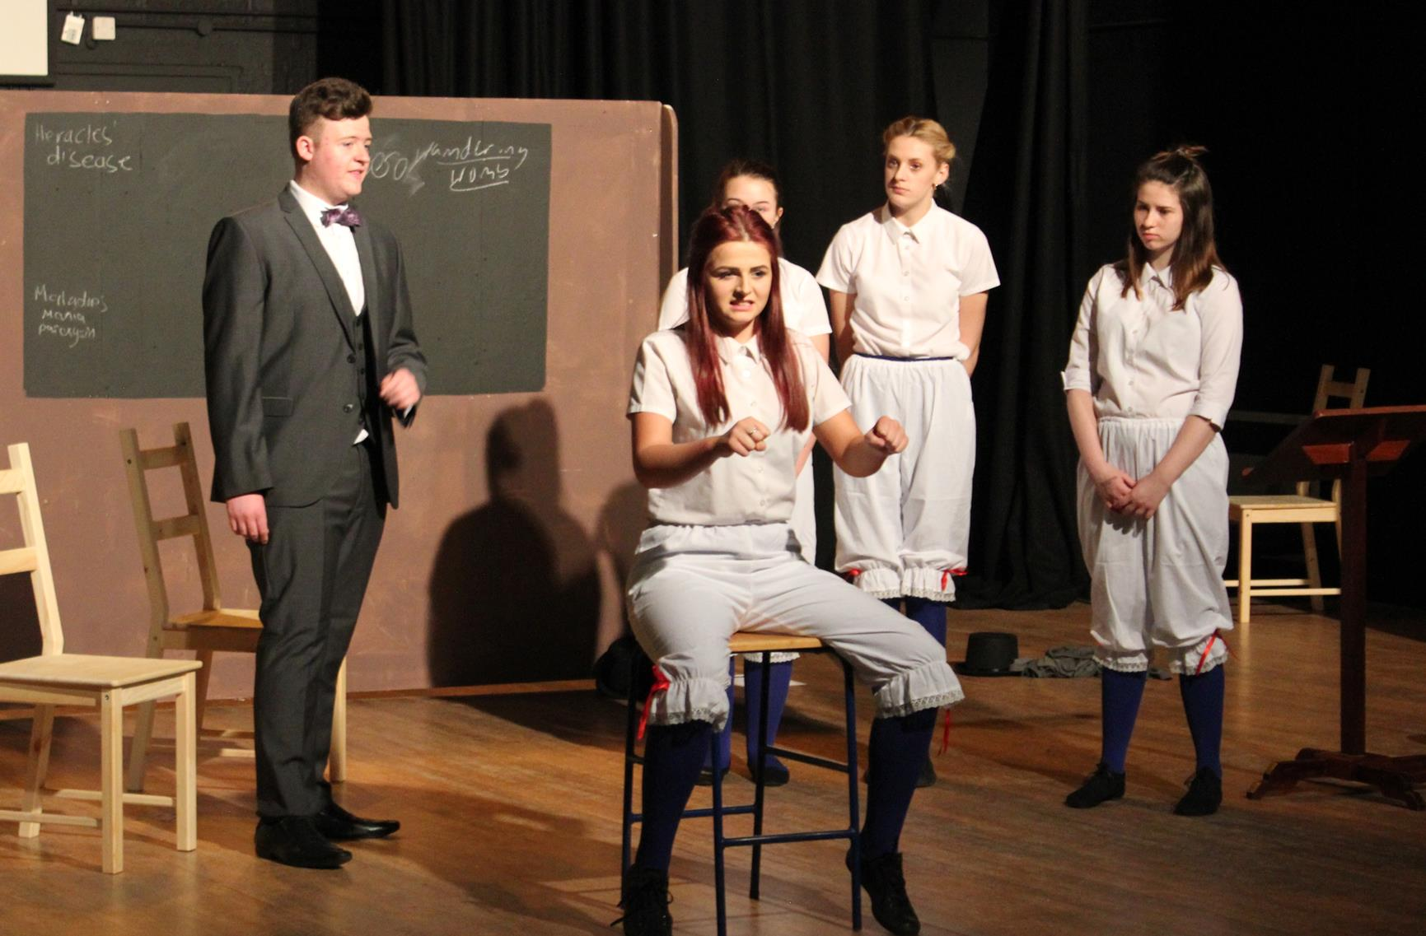
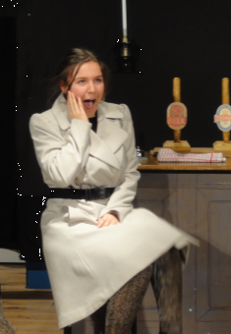
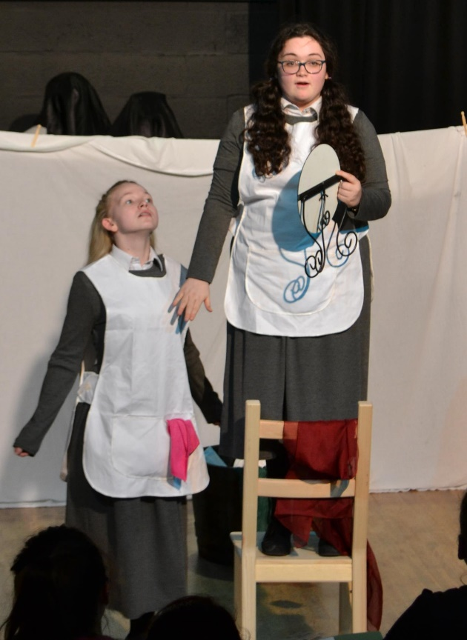
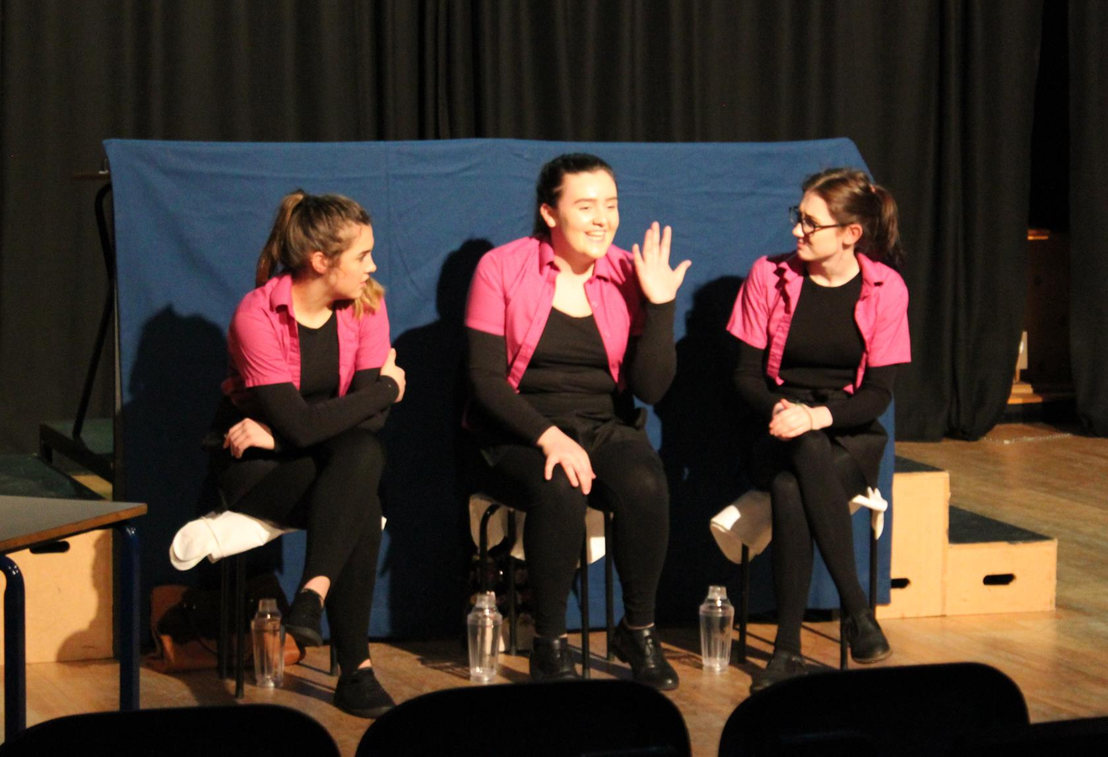
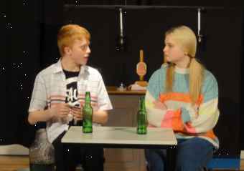
GCSE DRAMA

Slide 2
How can GCSE Drama help me with a future career?
Yes, GCSE Drama can help you towards a professional career in the Arts but it can also help you develop many different skills for many careers outside of the Arts sector
Skills Drama will help you develop:
Confidence
Problem Solving
Leadership
Empathy
Public Speaking
Analysis and Evaluation
Presentation skills
Team work
And there are many more…
GCSE drama could be the starting point to a range of careers and college courses to take you further…
Social work
Public services
Business
Retail
Actor/Actress
Various jobs within the arts industry
Working within the NHS
Teaching
Personal training

Slide 3
Who should consider taking GCSE Drama?
If you can work in a group with other people
You enjoy performing
You like performing in front of different audiences
You like working and rehearsing independently and can do this effectively and do not loose focus
If you like being creative
You are happy to learn lines
You don’t mind attending after school rehearsals
You like the written work that comes with drama – analysing and evaluating you own performances and writing theatre reviews.

Slide 4
WHAT WILL I BE STUDYING FOR GCSE DRAMA?
Structure of the course
Component 1- 40% Devising (Coursework marked in school)
Creating you own piece of drama based on a chosen stimulus. Performed to an audience. 10% - Performance mark
Portfolio to accompany performance – How did you create and develop your performance and a self-evaluation of your final piece. 30% Portfolio mark
Component 2– 20% Practical (Marked by a visiting examiner)
Perform in two scripted extracts to an audience and examiner. This could be a monologue, duologue or a group performance.
Component 3– 40% Exam (written examination 1hr 45 minutes)
Theatre Makers in Practice- looking at how performance skills (acting) and design elements (set, costume, lighting etc) are brought together to create theatre, split into:
Section A– Set Text- ‘The Crucible’ by Arthur Miller
Section B– Live theatre Evaluation- we visit the theatre to watch a live performance help to complete this section.

Slide 5
If you have any questions or want to know more about the course please speak to Mrs Burgess-Clift or
Miss Granfield

