Slide 1



EARLY HELP AT BURTON BOROUGH SCHOOL

Slide 2
Early Help
At Burton Borough School we understand that family life can sometimes be difficult and challenging. From time to time there may be situations where you feel you need more help and support. At these times we are able to offer you what is known as the Early Help Offer.
Providing early help to our children and families, means we can be more effective in preventing problems, from affecting children’s ability to thrive and learn. Early help means providing support as soon as a concern emerges, at any point of a child’s life.
You may want help due to concerns about your child’s mental health or anxiety, behaviour or additional needs. Or you may have concerns about your housing situation or finances.
Please see the information below for details of the range of ways in which can help you to find the support that you need.
Please contact us by telephone or email if you feel you need support. We may also be able to offer bilingual support.

Slide 3
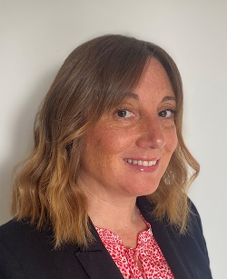
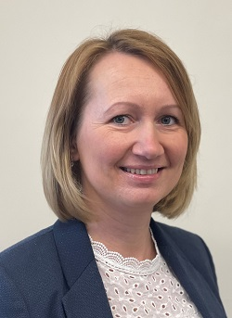
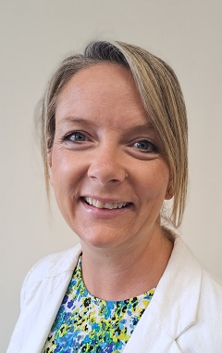
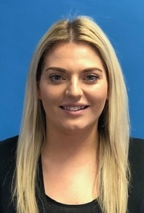
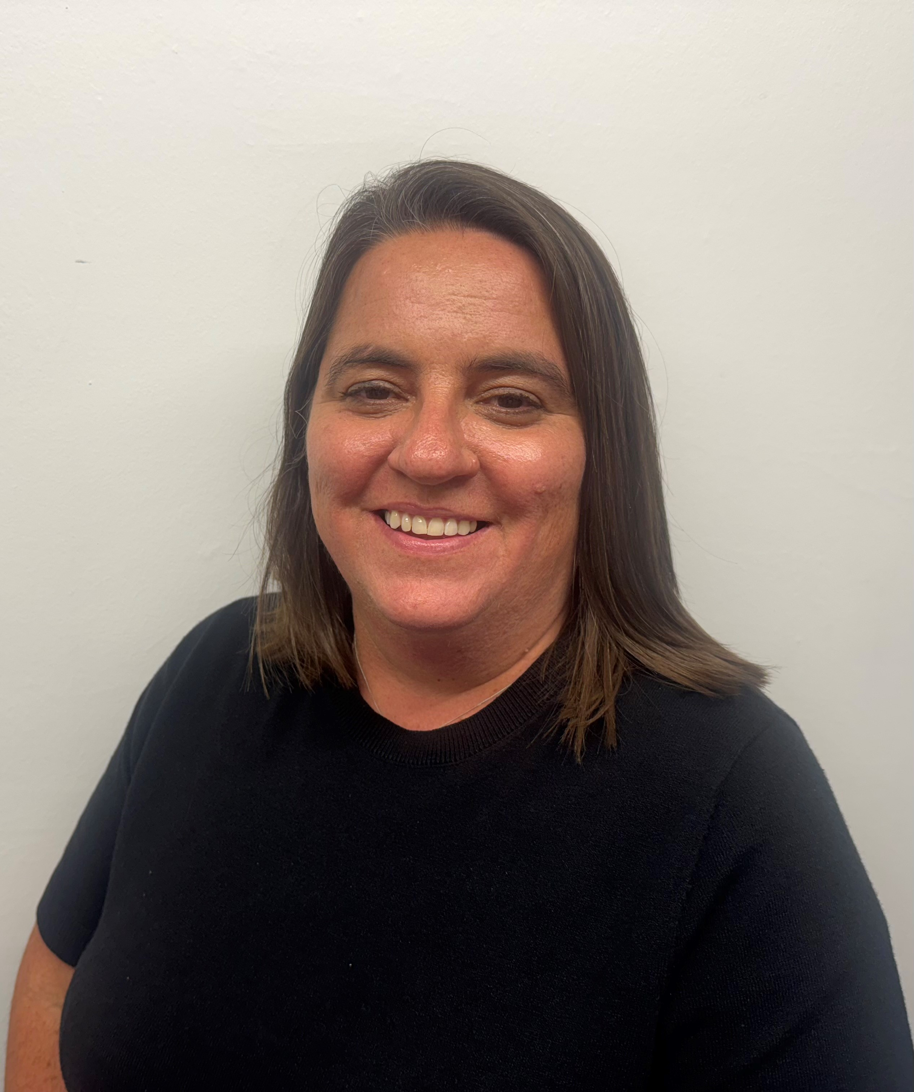
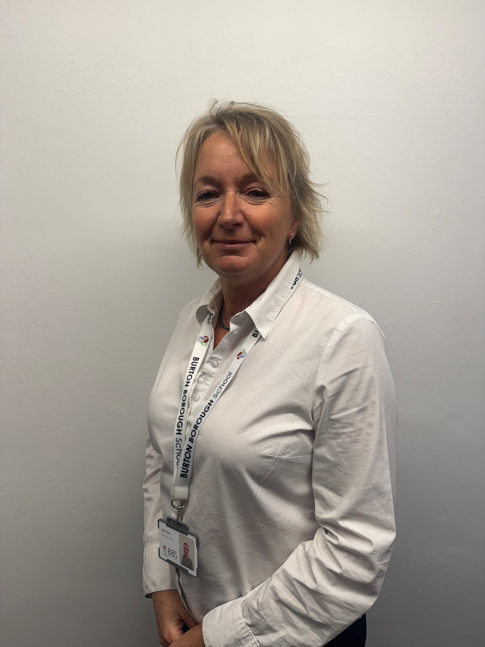
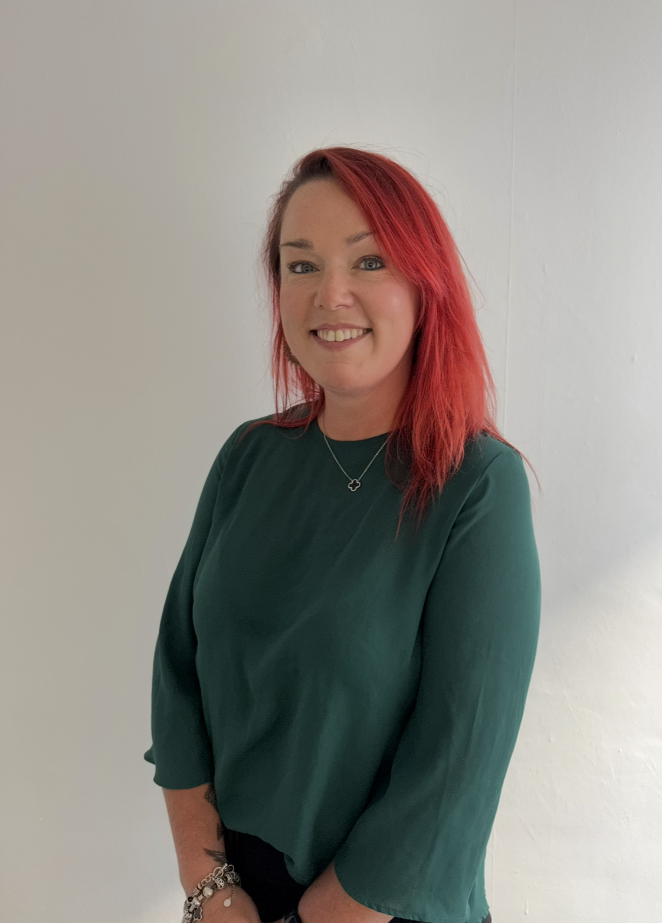
Staff involved with delivering Early Help
Emma Edge | Basia Sigiel | Ginny Wright | Paige Jervis | Gina Baughurst | Sue Sims | Ellie Delaney

Slide 4
School attendance
If you need support with your child’s attendance or are facing any barriers in getting your child to school, we can support you. Please contact the school and ask to meet with our Education Welfare Officers (EWO) who will be happy to meet with you at home or at school.
Should I keep my child off school checklist poster Should I keep my child off school checklist poster (publishing.service.gov.uk)

Slide 5
Emotional Literacy Support Assistant (ELSA)
If your child has anxiety regarding school or any aspect of their wider life. We have 3 qualified Emotional Literacy Support Assistants, who work with individuals and small groups of children to support them with managing feelings and emotions. https://www.elsanetwork.org/
We have well-being mentors.

Slide 6
School Counsellor
Our school counsellor is Lin McNamara. She supports children with a range of needs. Lin is highly experienced in her role and delivers exceptional outcomes. Lin is in school 2 days a week and sees students on a 1:1 basis.
Lin has experience in working with Social Services and CAFCASS. Lin is trained in working with families, adults and young children.

Slide 7
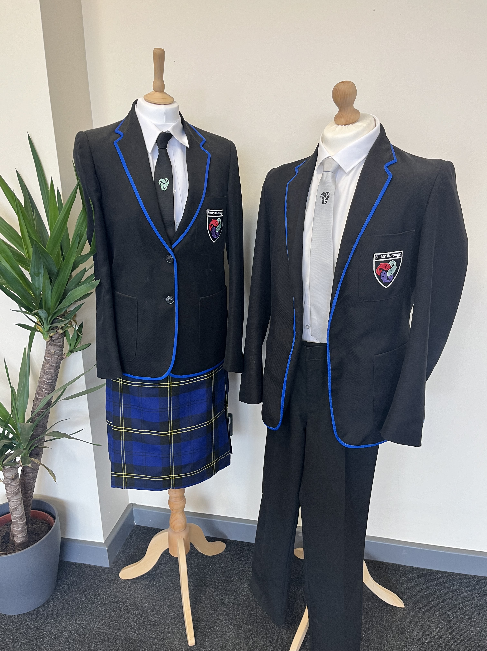
Uniform
Do you need support with uniform?
Our uniform at burton borough school
Uniform is available from Baker & Son, Wellington and Mary’s Tots and Teens, Newport
At Burton Borough School we have second hand uniform available to borrow. Please speak to a member of the Pastoral Team.
We have a Hardship fund for our Free School Meals students. This fund may be able to support with uniform. Speak to your child's Head of Year or Mrs Griffiths (Assistant Headteachers) for more information. Additionally, you may be able to get Winter Coats and Shoes, please speak to the Assistant Head of Year for your child.
If you can’t find what you need, please speak to the office and they will support you with what you might need.

Slide 8

Young carerS
Is your child a young carer? Are we aware? If so we can support with a range of clubs and activities to complement the work of the Young Carers Association.
Telford and Wrekin All Age Carers Centre – Information, advice and guidance around every part of their caring role (telfordcarers.org.uk)
We can offer a whole range of support. Our Heads of Year can refer them to T&W Young Carers or you can call 01952 240209 and ask for Young Carers.

Slide 9

Sleep
Routines, boundaries, sleep, listening , co-parenting, anxiety...
Do you need some tips or support with parenting? Place2be have developed a range of short videos to help parents navigate the world of being a parent! Click on the Place2Be Parenting Smart link to explore the videos.
https://parentingsmart.place2be.org.uk/
Does your child find it hard to settle at bedtime, or won't go to sleep without you, or wakes in the night? Supported by Beam and The Children's Society, we have put together some top tips to help with sleep. Click here to view our 'Sleep' information.

Slide 10





Housing
Click on the links below for support with housing and the cost of living
https://www.telford.gov.uk/costofliving
https://www.telford.gov.uk/info/20667/tenant
https://www.telford.gov.uk/info/20667/tenant_support/6580/damp_and_mould
https://www.telford.gov.uk/info/20806/affordable_warmth
https://www.telford.gov.uk/info/20667/tenant_support/6577/useful_telephone_numbers_and_links

Slide 11
Does your child have additional needs?
Strengthening Families - SEND - Local offer (telfordsend.org.uk)
The most useful children and family support is that which helps families to stabilise and improve their own situation through primary prevention approaches at the earliest time. Strengthening Families provide local services for families with children aged 0-19 through children and family centres, in a planned approach to ensure resources are targeted where they are most effective.
Home - PODS (podstelford.org)
PARENTS OPENING DOORS (PODS)
We work across the whole range of services including health, education, social care, and alongside our voluntary sector partners – at a local, regional and national level.
Telford SENDIASS | SENDIASS Telford – (telfordsendiass.org.uk)
Listen to your concerns and provide information and advice on the 'phone or in person
Work with you to explore your options
Help you prepare for meetings
Help to explain reports written by professionals
Give you information in relation to SEND law to enable you to participate and make informed decisions regarding your child's education
Signpost you to other sources of information and support
Work in partnership with schools and the local authority to develop positive relationships and outcomes
Telford Autism Hub – (telfordautismnhub.org.uk)
Available to children aged 0-18 and their families who have a formal diagnosis.
Giving advice, information and signposting
Providing workshops where young people and families can receive support in a group setting
Supporting parents to plan and implement strategies within the ASD care plan

Slide 12
Practical support
Speakout to report bullying concerns
Wellbeing Mentors
Mental Health Lead
School Counsellor
Pastoral Head Of Year
SEND Team
ELSA Programme
EWO
Family Support Worker
Family Liaison Officer
School Nurse
Future Focus
After school clubs
Year 6 Transition Team
Mental Health First Aider

Slide 13
Parent workshops
EHCP Information Evening
Year 6 SEN Transition Evening
Year 6 EHCP student lunch
Family Forum – Sessions such as How to revise, Meet the examiner, How to support your child with exam stress, The importance of good attendance
Telford College – Offering A-Levels and T-Levels in a variety of courses. Open days are held regularly.
Stafford College – Offering A-Levels, A+ Programmes, T-Levels, Vocational Courses and Progression Pathways

Slide 14
Sign posting to other agencies
Family Connect – Some families may need some extra help and support for a variety of reasons – Telephone 01952 385385 Monday – Friday 9am – 5pm or familyconnect@telford.gov.uk
School Nurse – Drop-in Sessions on Thursday lunchtime or we can refer your child
Mental health support – BEAM
Crisis Support Telford – Help with information on Foodbank’s, Uniform, Telford Energy Advice and more
Newport Food Bank and Newport Food, Save and Share
Health Visitor
Strengthening Families - There are 3 different areas: Hadley Castle, Lakeside South, The Wrekin
Citizen’s Advice – The Guildhall, Newport - 01952 567193
Housing – Telford and Wrekin Housing Solutions and Homelessness Advice – 01952 381925
Domestic Abuse support – Cranstoun in partnership with West Mercia Women’s Aid – 0800 840 3747
PRISM – Community Bereavement Support Service – 01952 872858

Slide 15
The ways we listen
We can be a professional friend and offer support:
Offering a helping hand
Maintain a supportive relationship
Friendly advice
Judgement free listening ear
How we gather views and are alert to potential issues:
Parent/carer questionnaires
Pupil voice – student council
Safeguarding team
Help with filling out forms or reading documents
Support at appointments to get specialist help

Slide 16
Financial Support - extra
Pupil Premium – Please contact the School to see what help we can offer.
Free School Meals – If you are on a low income and receive a qualifying benefit you may be able to claim Free School Meals. More information is on the Telford and Wrekin website.
Food Bank –Please see information on (Telford Foodbank – Telford Crisis Support)
CAP (Christians against Poverty)
Thrive – A group of organisations that work together to provide support (insprire2thrive.co.uk/access-support)
Women’s Aid – Domestic Abuse - helpline@womensaid.org.uk
Citizens Advice – Thursday’s at The Guildhall, Newport. Telephone 01952 567193.

