Slide 1
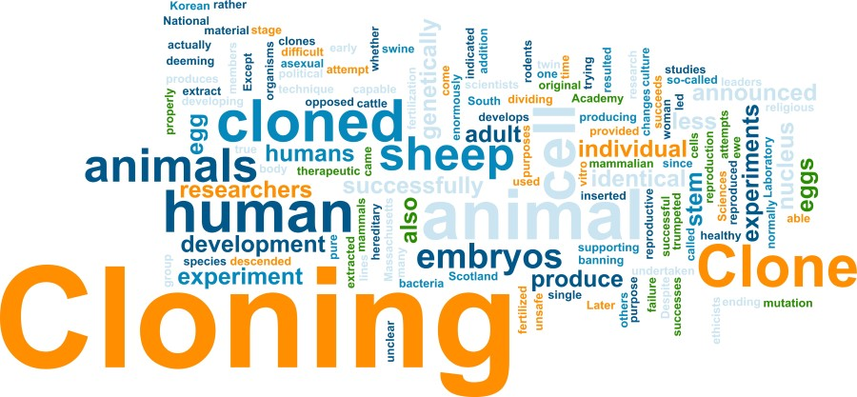

Slide 2
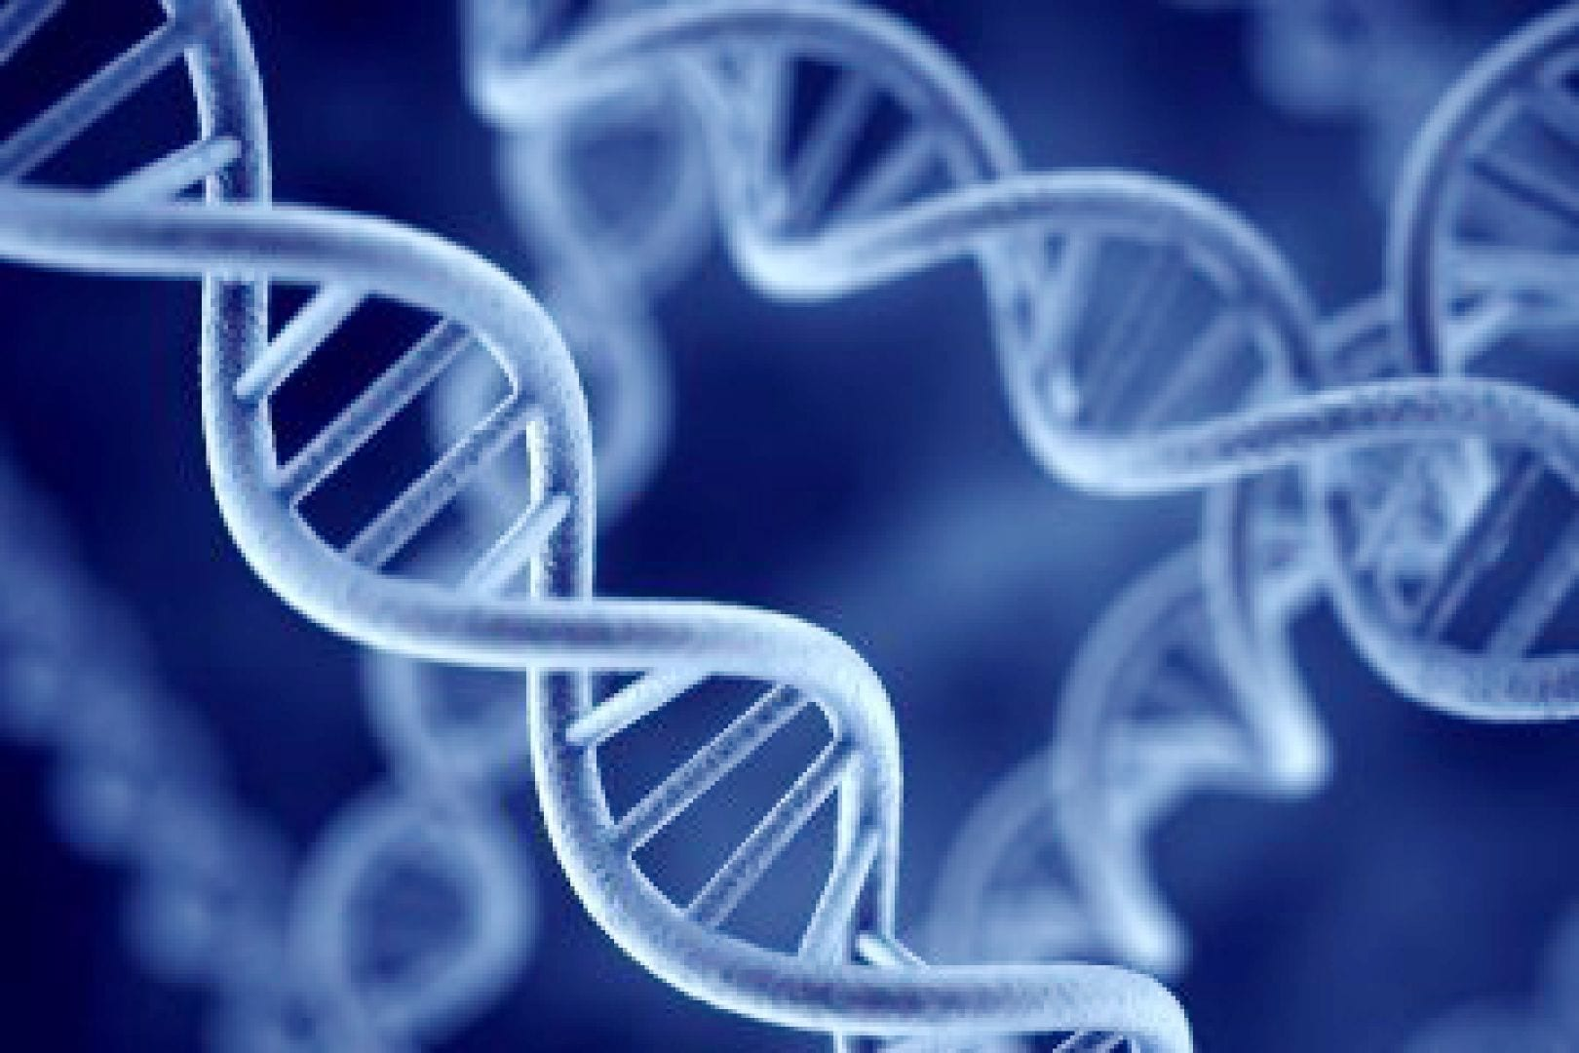
Is it OK to clone a human being?
Big Think – due first Friday back after the summer.

Slide 3
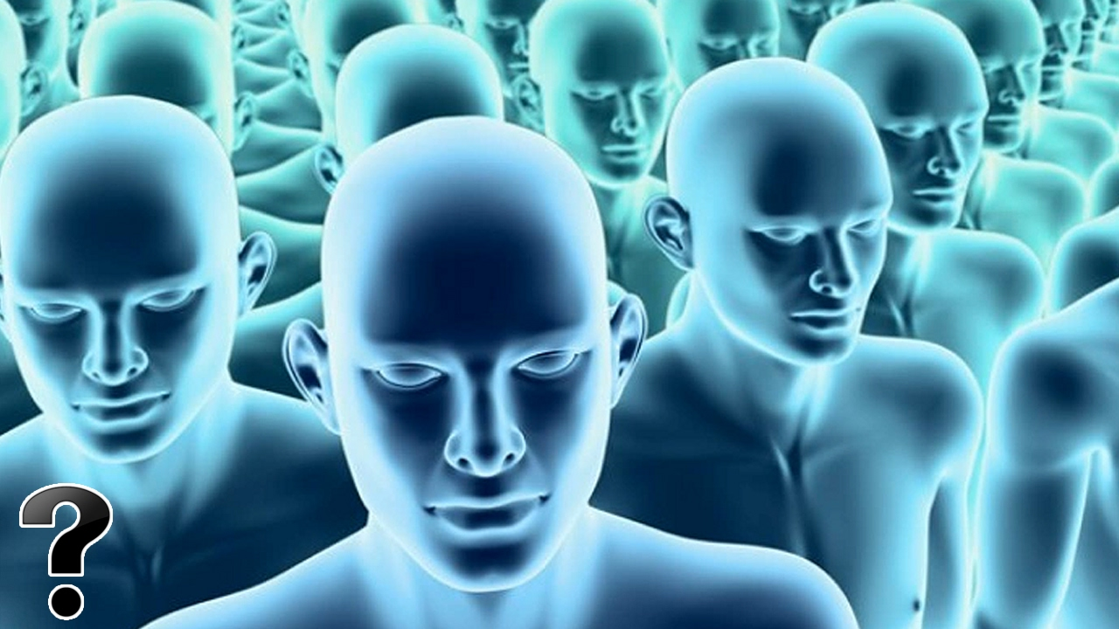
What do we mean by ‘cloning’?
Human cloning is the creation of a genetically identical copy (or clone) of a human.
The term is also often used to refer to the reproduction of human cells and tissue.

Slide 4
3 ways cloning might help us:
Growing new body parts with no fear of rejection
Giving people children
Improving the human race ‘still you, just the best of you.’
Your possible future - Gattaca movie clip

Slide 5
Why should you care? Cloning is happening now. All over the world.
Therapeutic cloning uses stem cells (the basic building blocks of plants and animals) to help cure serious diseases, as the cells would be able to grow and replace damaged parts of our bodies.
When you think of cloning you probably think of a copied creature. But there’s much more to cloning than giving you that identical twin you’ve always wanted - most of the work that's being done is less about copying ourselves whole and more about copying bits of us.
What might it help with?
Degenerative brain diseases
Spinal cord injuries
Heart disease
Missing teeth
Diabetes
HIV/Aids
Growing new organs
Replacing cancer cells

Slide 6
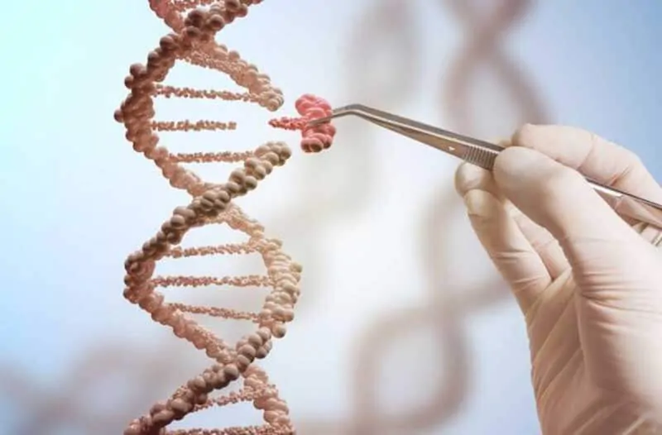
What’s to stop us?
In 2005, the UN adopted the declaration on human cloning, which prohibited any forms of human cloning, as it was considered to go against the idea of human dignity and the protection of human life.
Some people also argue that we shouldn’t try to ‘play God’ and mess with a human life (in the form of embryos) if that person can’t give you permission.
Questions to discuss:
If you are a clone, is there a chance you could be treated differently to someone who is born ‘naturally’?
If you are a clone, wouldn’t you have an unfair advantage over your original?
If there are superior clones, wouldn’t that create an elite group who would look down on the ‘normal’ versions for their weaknesses?

Slide 7
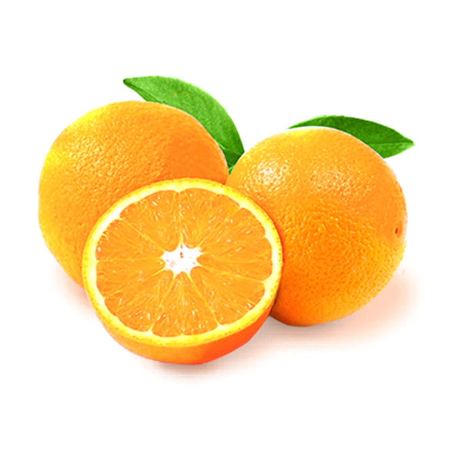
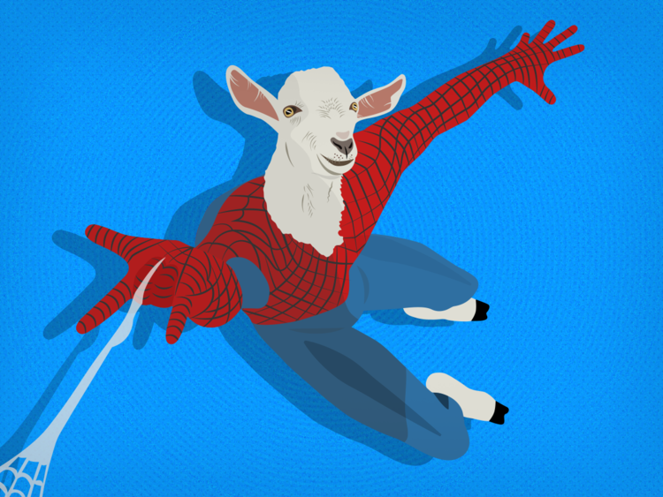
Weird and wonderful facts about cloning
Where in the world can you have your pet cloned (for £60,000)?
The US
Switzerland
South Korea
What fruits are all clones of one another?
Navel oranges
Pineapples
Watermelons
A biotech company in Canada created a substance called Biosteel by cloning which animal?
Goat
Rabbit
Monkey

Slide 8
Is it OK to clone a human being? Big think position papers to Mr Allen after the summer
Start by setting out what you think before doing any research. Show you understand the questions and give your initial opinion.
Do some research, perhaps using the OXPLORE website. Write up the most interesting details you find out and what your opinions are on those details.
Conclude by stating what you think after the research. Do you feel the same? Has your mind changed? If it has, what changed your mind? Was it something you didn’t know or do you now think about it differently? If you did not change your mind, what new evidence did you find that was most compelling?
I look forward to reading your position papers!

