Slide 1
Burton Borough Y10 Induction Evening
Ben Morgan
8/9/2022

Slide 2
Key staff
Latest information for Y10
Core subjects
Approach to learning
Platinum status
Examinations
Work experience
Mindfulness
Top Tips

Slide 3
Key Stage 4 Introductions
Pastoral Support and Behaviour – Ben Morgan
Head of English – Christine Owen
Head of Maths – Julia Pickering
Head of Science – Rob Court
Examination Officer – Lisa Richardson
SENDCO – Kim Stephens
Work experience/ Career Guidance – Lisa Kane

Slide 4
Work Experience – 10th -20th July 2023
Students will be in school on 21st July for a debrief session

Slide 5
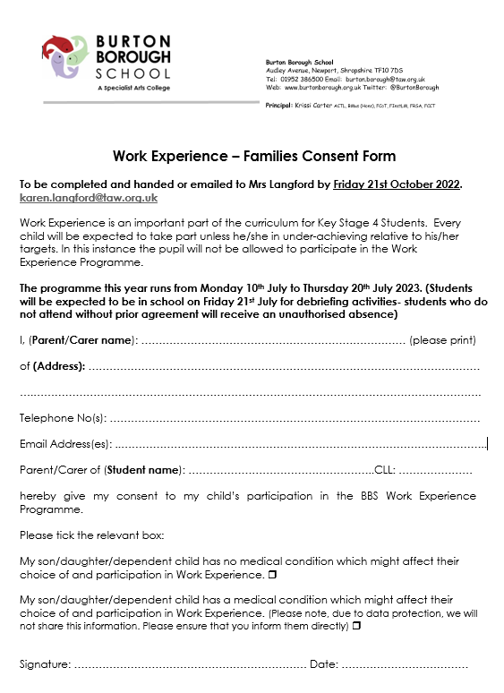
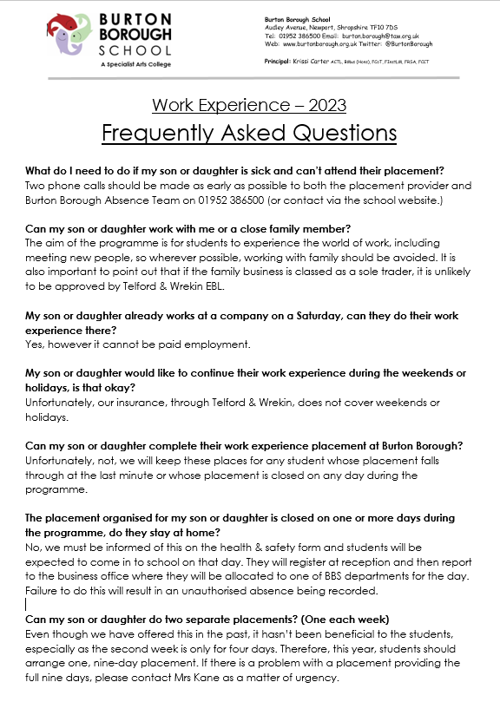
Paperwork
Deadlines:
Consent form – Friday 21st October
Health & Safety form (out of area) – 16th December
Health & Safety (local) – 17th February

Slide 6
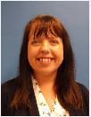
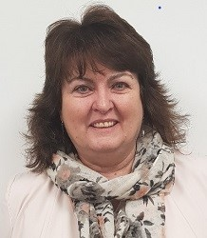
Work Experience Team
Mrs Kane
Mrs Langford
Based in the Business Office
lisa.kane@taw.org.uk
karen.langford@taw.org.uk

Slide 8
Rewarding Businesses and Students

Slide 9
What do we know
For examinations 2024 there are no changes (As yet!).
Marking this year will be a lot more stringent- Aiming towards 2019
No compensation is going to be given for missed learning time
Anyone who has left any school in the past 3 years, anywhere in the country would say get ahead of the game
Y10 Mock exams will start in April

Slide 10
The best bit of advice for you:
Get ahead of the game through hard work and good habits, both in school, and at home.
Standard pass
Strong pass
Centre Assessed Grades
If the school was to close tomorrow, what evidence would your teachers have to give you the correct grade. It is a grade based on evidence NOT potential

Slide 11
Changes ….
Up to 30 examinations in 4 weeks
Traditional’ subjects
No more early entry
Less controlled assessment, less coursework and more emphasis on exams
BTEC examinations
Potentially 5+ hours per day

Slide 12
English
KS4 Team:
Miss Owen – Head of Department
Mrs Griffiths – 2nd in Dept
Mrs Heins
Mr Allen
Miss Beaver
Miss Jones
Mrs Steadman
Miss Lee
Mr Dunbar
English Intent Statement: Becoming confident communicators and critical thinkers

Slide 13
The Qualifications: no tiers
English Language GCSE
Two examinations – one fiction, one non-fiction, testing reading/appreciation of writer’s craft - and writing skills.
English Literature GCSE
Two examinations – Macbeth, A Christmas Carol, An Inspector Calls, Conflict Poetry, Unseen Poetry

Slide 14
Boosting chances for success
Best effort, always – every lesson - every homework;
Pay close attention to accuracy and proofread;
Know set texts in-depth and access the wider reading – QR codes on every English door. This gives different ways of interpreting;
Take feedback on-board and be able to articulate ways to improve;
Access revision podcasts;
Invited intervention students – access everything offered;
Access Seneca/Massolit.

Slide 15
Supporting your child – promoting ambition
Homework – please encourage your child to put quiet time aside;
Keep in touch with your child’s class teacher;
Discuss careers and aspirations – post-16 offers; future life and careers. English is key to opening doors. Not just to get into college, but for later in life.
English Dept podcasts – Miss Owen has created podcasts for English Language. These can be accessed when your child is focusing on that aspect of their revision.
Buy set texts – they can be accessed at home and re-read.

Slide 16
Revision Guides
All are available through the school for Literature on the portal.
We only recommend revision guides written by Beverley Emm for Language. Also available through the school.

Slide 17
Y10 Mathematics
Juliapickering@taw.org.uk

Slide 18
The Mathematics Department
Miss J Pickering – Head of Maths julia.pickering@taw.org.uk
Miss M Darby – Second in Maths
Mr D Au
Mrs L Breen
Mr D Buick
Miss S Featherstone
Mr A Kerry
Mrs E Ordidge
Mrs A Slater
Mr F Yeboah

Slide 19
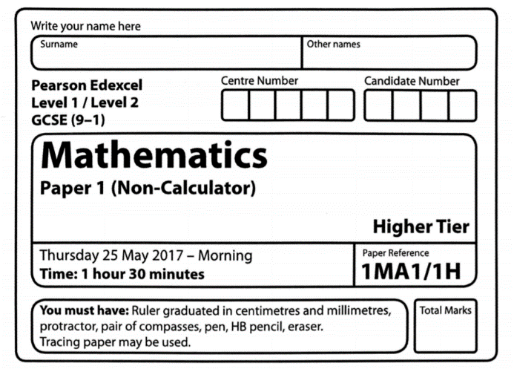
GCSE Mathematics
Overview
Exam Board - Edexcel
33.3% non calculator (Paper 1)
66.7% calculator (Paper 2 and 3)
Each paper is 1hr 30 minutes, and worth 80 marks (240 total)
Foundation Tier 1 – 5
Higher Tier 4 – 9
Mix of question styles, single mark to multi-step
Mathematical demand increases through the paper

Slide 20
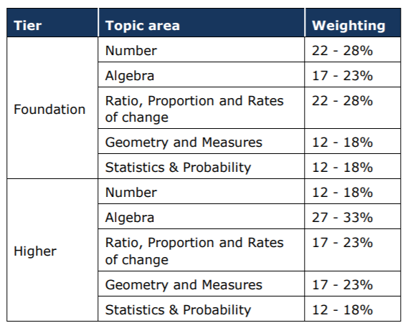
GCSE Mathematics

Slide 21
Year 10 Mathematics
Lessons
10 lessons per fortnight –
at least 1 of which is dedicated to recap and recall
Every lesson counts
Focus and hard work
Concentration and effort
Act on all feedback given
Recap and recall
Regular topic and mixed assessments, and mock papers periodically
New Sparx Maths homework
Current topics & recall, individually personalised
Expectation of 100% completion
Note taking and working out compulsory (homework books provided)

Slide 22
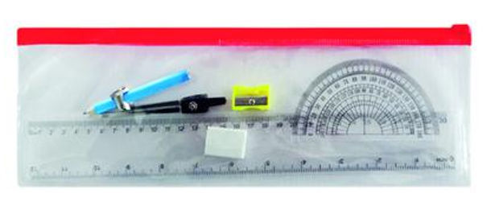
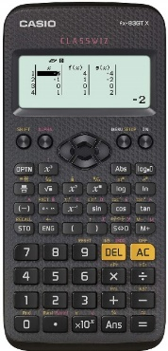
Year 10 Mathematics
Essential Equipment
Be prepared – have all your equipment, every lesson
Scientific calculator (fx-83GTx, cost price via parent pay)
Geometry set – compass and protractor
Revision guide/ workbook (cost price, via parent pay)

Slide 23
Year 10 Mathematics
Make or buy Revision Cards
Revision Regular practice
Work through practice papers, and mark them
Get yourself organised
Buy a Revision Guide and USE IT!
Create a revision timetable – and include relaxation
Ask for help when you need it
Watch video tutorials and make notes
Do a little every day –
CorbettMaths 5 a Day, MemRi,
Fix Up 5
Identify your own target topic areas and work on them
Use HegartyMaths to consolidate current learning and recall key skills
Find a quiet work space
Study with a friend – quiz each other
Review
class notes
Have regular breaks
Google it… or use YouTube
or TikTok

Slide 24
Additional Mathematics Resources
Past and practice papers – available on the Maths padlet, or ask your class teacher padlet.com/BBS_Maths/n9h11a2qxzev
Collins Revision guide and workbook in one
CorbettMaths revision cards
CGP Revision bundle
GCSE Maths Edexcel Revision Guide
GCSE Maths Edexcel Exam Practice Workbook
GCSE Maths Edexcel Revision Question Cards

Slide 25
Online Mathematics Resources
Sparx Maths – sparxmaths.com video tutorials and quizzes
CorbettMaths – corbettmaths.com 5 a day and video tutorials
JustMaths – online.justmaths.co.uk individual question level analysis and reworked questions for mock papers
MathsWatch – vle.mathswatch.co.uk video tutorials and questions
BBS Maths Padlet - padlet.com/BBS_Maths/n9h11a2qxzev an online notice board full of resources

Slide 26
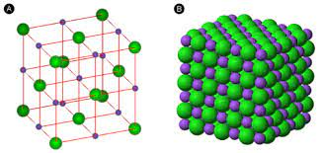
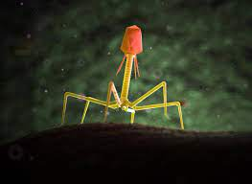
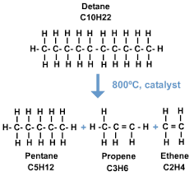
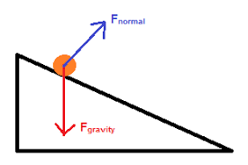
Science
Igniting curiosity and respect for the Natural World

Slide 27
Dr Court – Head of Science (Biology)
Mr Phillips – KS4 lead (Physics)
Ms Yates – KS3 lead (Biology)
Mrs Cooper – maternity leave(Biology)
Mr Robinson (Biology)
Mrs Stephens – Vice Principal (Biology)
Mr Trevor-Biddle (Biology)
Mr Bennion (Chemistry)
Mrs Felstead –Aqualate Aspiration Lead (Chemistry)
Mrs Turner (Chemistry)
Mr Evans (Physics)

Slide 28
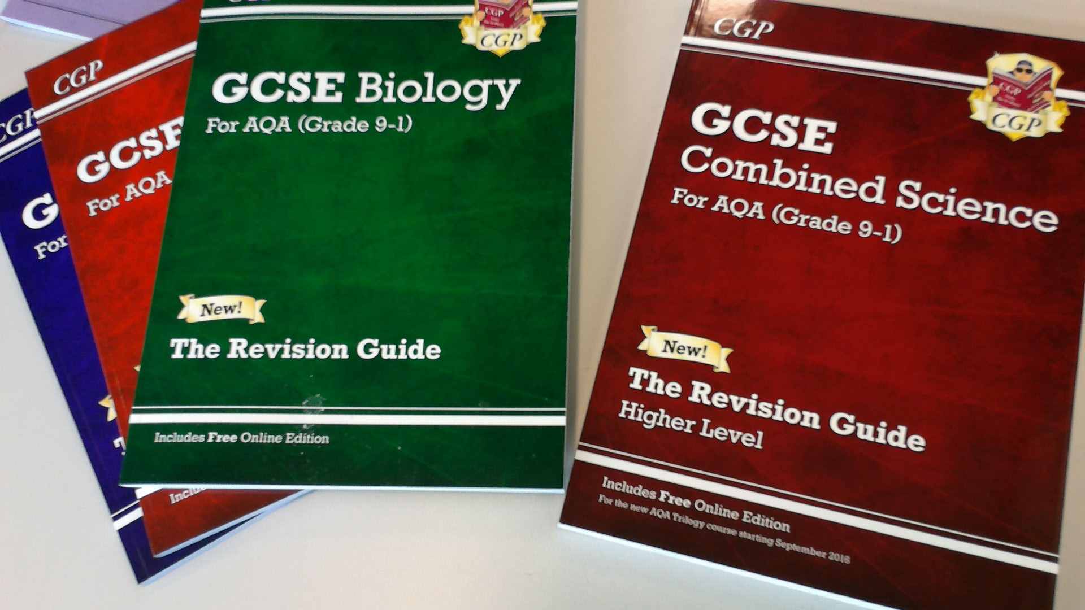
Year 9 -
GCSE content
Year 10 onwards – combined or triple science courses.
Available in School
Combined Science Revision Guide - £6.50 (2 GCSEs)
Triple Science revision guides-£10 for set of 3 (3GCSEs)

Slide 29
Combined Science: Trilogy
9,9
9,8
8,8
8,7
7,7
7,6
6,6
6,5
5,5
5,4
4,4
4,3
3,3
3,2
2,2
6 exams (2 Biology, 2 Chemistry, 2 Physics) at the end of year 11.
70 minutes long (70 marks)
Marks from each are combined to give a mark out of 420
A double grade (eg 5,4) will be awarded based on this combined mark

Slide 30
Triple Science (Option groups)
2 Biology exams at the end of year 11.
1 hour and 45 minutes (100 marks)
Marks from each are combined to give a score out of 200
A GCSE Biology grade will be awarded based on the combined score.
The same is true for Physics and Chemistry.

Slide 31
Foundation and Higher Tiers
Foundation: grade 1-5
Higher: grade 4 -9 (if you do not attain a 4 you get a U)
We review tiers throughout the year

Slide 32
Assessment for this year
Fortnight beginning 5th December
3 separate assessments (Bio, Chem, Phys) focussing on content covered so far in year 10 (but including year 9 content)
Fortnight beginning 24th April
Combined Science – 3x 70 minute exam papers (Biology paper 1, Chemistry paper 2, Physics paper 1)
Triple Science – 3x 1 hour 45 minute exam papers (Biology paper 1, Chemistry paper 2, Physics paper 1)

Slide 33
What should students do now?
Learn key terms and content as we go along (40% of the exam is recall)
Purchase a revision guide
Bring revision guide to lessons
Bring scientific calculator to lessons (same as Maths)
Know and use the AQA specification when revising
Use Educake for recall questions
Speak to their teachers to identify areas for development and create an action plan
Access and use resources on Science area of Sharepoint (knowledge organisers, revision mats, specification, past paper question packs, mark schemes)

Slide 34
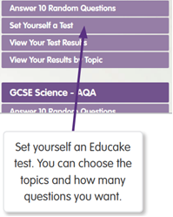
What should students do now?
Learn key terms and content as we go along (40% of the exam is recall)
Educake - Self-marking retrieval practice

Slide 35
What can I do to support my child?
Support your child to do everything on the previous slides.
Help them with their recall – revision cards, revision diagrams. Test your child throughout the next two years.
Practise past papers and questions – Science Sharepoint, revision workbooks.

Slide 36
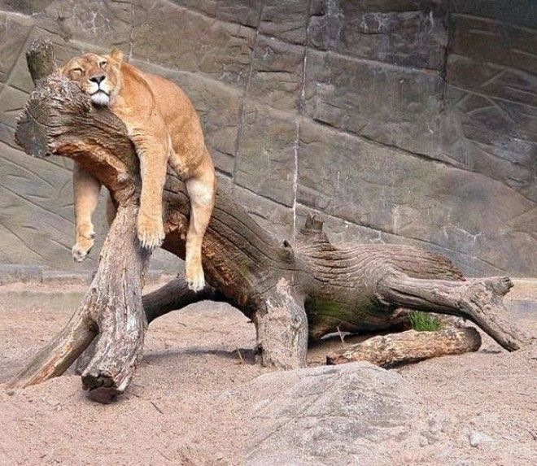
The Burton Borough start of KS4 learner spectrum range
Get ahead of the game now! You cannot wait.
Take the opportunities the school offers

Slide 37
Platinum Status at BBS

Slide 38
Examinations

Slide 39
Exam equipment that you must bring with you.
Black Pen
Ruler, Pencil, Eraser, Compasses, Protractor
Cannot use Tippex/gel pens/highlighters in your answers
Calculator unless you are told otherwise but remove cover and instructions
Equipment for sale from school
Access Arrangements: Extra time/ reader/ scribe
The school has to prove that this is normal working practice
You have to be proving this now
Any questions on this please contact your Keyworker/SENDCO

Slide 40
Homework
Expectancies in lessons
Level of challenge
Expectancies as young adults
Speed
Intensity

Slide 42
Mindfulness
Remember to look after yourself
Meditation/ yoga/ exercise/ diet
Positive re-adjustment
Good habits
Listen to advice
Speak up- We have a team of professionals!

Slide 43
What can I do as a student
Start now!
Get ahead of the game.
What evidence does your classroom teacher have to give you a grade? What would the school write on a reference for a post-16 provider if they had to write it now?
Find your preferred revision tool in each subject
Practice recall techniques
Write to time
Create a work/revision timetable
Remember every lesson counts

Slide 44
What can I do as a parent?
Get on the various subject sites posted on here so that you can see how they work
Familiarize yourself with the exam board websites particularly regarding past papers
Get involved in the recall techniques.
Purchase set texts and revision guides
Encourage mindfulness
Attend parents evening
Push, drag, kick
Celebrate
Cuddle

