Slide 1
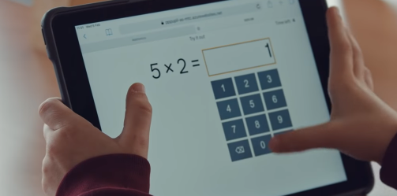
Year 4 Multiplication Tables Check
Presentation for Parents, Carers & Guardians
2025

Slide 2
What is the purpose of the multiplication tables check?
To determine whether year 4 pupils can fluently recall their multiplication tables.
To help schools to identify pupils who require additional support.
There is no ‘pass’ rate or threshold.
The DfE will create a report on overall results across all schools in England to measure improvements.
Notes:
The check is not intended as a diagnostic tool.
Unlike the KS1 Phonics Screening check, children will not be expected to re-sit the check if they do not meet a set threshold.
Times tables are used in so many areas of UKS2 maths, it is fantastic knowledge to have and by knowing them it will set the children up really well going into year 5 and 6.
We’re not just learning for a test- it’s for life.

Slide 3
When the multiplication tables check will be carried out
There will be 3-week window in June for the administration of the check.
There is no set day to administer the check.
Children are not expected to take the check at the same time.
All eligible* year 4 pupils England will be required to take the check.
*If a pupil is not entered for the check, the school should inform the pupil’s parents.
Notes:
It is up to individual schools to decide how the check is administered – some schools will administer individually while others will take small groups out or administer to the whole class.
I prefer to test individually, and the children have already completed a mock so are used to the layout of the test.

Slide 4
How the multiplication tables check is carried out
The check will be fully digital and take place on screen.
Children will be able to use laptops, desktops and tablets.
Answers will be entered using a keyboard or by pressing digits using a mouse or touchscreen using an on-screen number pad.
Notes:
There is no written element to the test, it is completely digital.
We used iPads to test the children, the children practise using these.

Slide 5
How the multiplication tables check is carried out
Under standard administration* the multiplication check will take less than 5 minutes per pupil.
Children will get 6 seconds from the time the question appears to input their answer.
There will be 25 questions with a 3 second pause in-between questions.
*Some pupils will be eligible for specific arrangements.
Notes:
6 seconds per answer means that children must be able to read, recall and enter their response within that time.
3 second break in between answers
Whatever is written in the answer box at the end of 6 seconds will be counted as the answer i.e. if the student intends to write 144 and only 14 is typed when the timer ends, their recorded answer is 14.
It is important that the children know their times tables as fluently as possible as there is little time to work out the answers.

Slide 6
The questions
Each pupil will be randomly assigned a set of questions.
There will be repeated questions across different checks each year, but no more than 30% of questions will be repeated in any two checks.
Children will only face multiplication statements in the check (not related division facts).
Pupils will not see their individual results when they complete the check.
Notes:
The check will not have any repeated questions and will be entirely multiplication facts not division. I know on TT Rockstars the children sometimes complete division facts but not in this test.
We don’t see the results straight away, the results are taken and a national average is calculate.
The results will be sent to the schools when all the checks have been completed but it is then up to the school if they report the results or not.

Slide 7
During the check
There will always be questions from the 3, 4, 5, 6, 7, 8, 9, 11 and 12 multiplication tables in each check.
There will be no questions from the 1 times table (i.e 1 x 8 or 8 x 1).
The 6, 7, 8, 9 and 12 times tables are more likely to be asked.
There will only be a maximum of 7 questions from the 2, 5 and 10 times tables.
Reversal of questions will not feature in the same check.
Notes:
The STA state that there is a focus on the 6, 7, 8, 9 and 12 times tables as they are the ‘most difficult’ multiplication tables.
The test is carefully programmed so no one can get lucky and have lots of easy questions.
Reversal questions = 8 x 6 and 6 x 8

Slide 8
Questions more likely to appear
The following 11 multiplication questions are more likely to be asked:
  6 x 6, 6 x 7, 6 x 8, 6 x 9, 6 x 12
  7 x 8, 7 x 9, 7 x 12
  8 x 9, 8 x 12
  12 x 12
Notes:
Not each set of questions will feature all of these facts, and other questions will be asked, but it is likely that a good proportion of the above will be present in each set of questions.

Slide 9
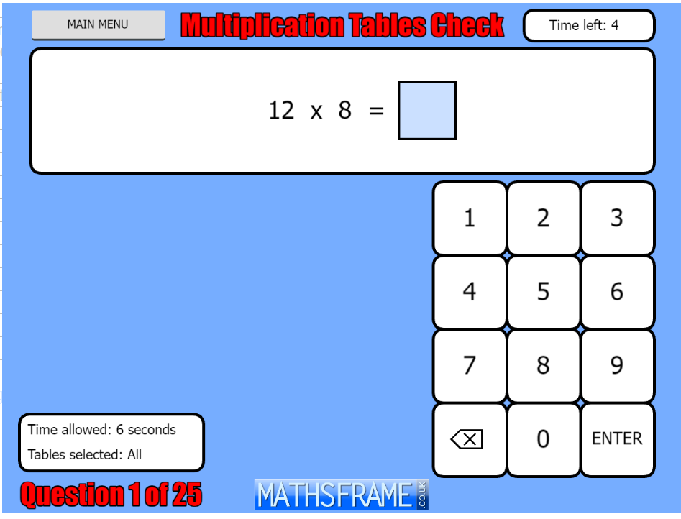
Example multiplication table check
This website will give you an idea of the speed at which children will be asked questions.
https://mathsframe.co.uk/en/resources/resource/477/Multiplication-Tables-Check
Soundcheck on TT Rockstars is also in a similar format to the check.
Notes:
This is a great example to practise on: it gives 6 seconds for a question and 3 seconds in between.
I am encouraging the children to type their answer, check their answer and then press enter if there’s time. If they don’t press enter, their answer will still be counted.

Slide 10
How can I support my child in preparing for their multiplication tables check?
Firstly, a positive attitude goes a long way – so as much encouragement and support as possible (but we don’t need to tell you that)!
Some further tips:
Make times tables fun;
  Climb stairs counting in multiples
  Play verbal times tables games
  Listen to and learn times tables songs
  Take it in turns to say different times tables in funny voices (i.e. say 2 x 3 = 6 in a lion’s voice)
  Make up rhymes
  Play online maths games
TT Rockstars
Maths Frame
CompleteMaths
Notes:
Firstly, a huge thank you for all your help and support in getting children to practise their times tables, I know there was a lot of resistance around TT Rockstars at the start but hopefully the encouragement from us and you and a bit of friendly competition is encouraging them to practise.
I’ve seen a huge increase in their retention of times tables so thank you. We have been practising times table songs, which the children really seem to enjoy, and lots are retaining these.
Repetition is key, practising on the way to school repeating them in the car.
Positive attitude so there is no stress in the build up to the test.
We play times tables bingo, times tables nought and crosses.
Grab a pack of cards turn two over and multiply the numbers together, fastest wins keeps the cards.
TT Rockstars is brilliant to help with the time restraint.
Times tables are essential for all aspects of learning, especially in maths, so it is important that all children are actively practicing their times tables.

Slide 11
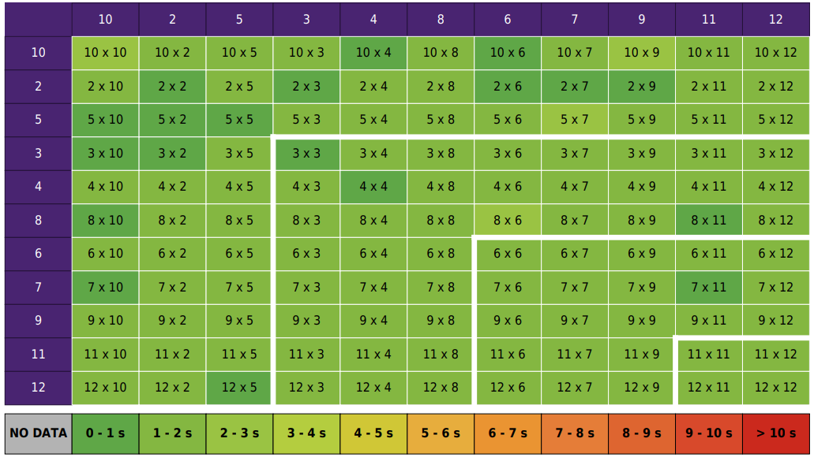
Notes:
The heatmaps on TTRockStars are really useful – not only for the children, but for us as teachers too.
The ideal heatmap would be filled in green.
Sometimes, certain times tables will not be open for the children yet. These will appear grey.
The differing colours allows us as teachers to see what gaps there might be – it allows us to provide targeted intervention to prepare the children for the MTC.

Slide 12
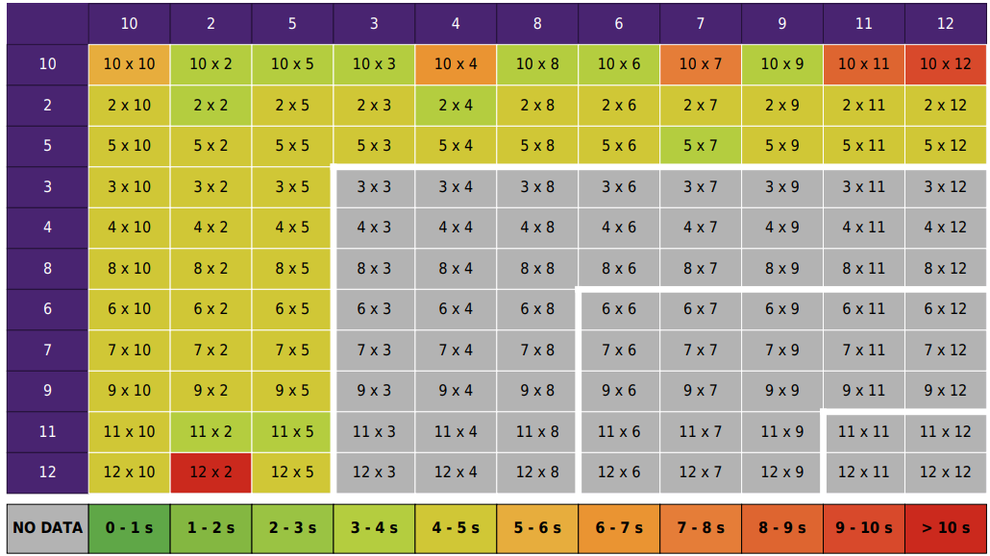
Notes:
The heatmaps on TTRockStars are really useful – not only for the children, but for us as teachers too.
The ideal heatmap would be filled in green.
Sometimes, certain times tables will not be open for the children yet. These will appear grey.
The differing colours allows us as teachers to see what gaps there might be – it allows us to provide targeted intervention to prepare the children for the MTC.

Slide 13
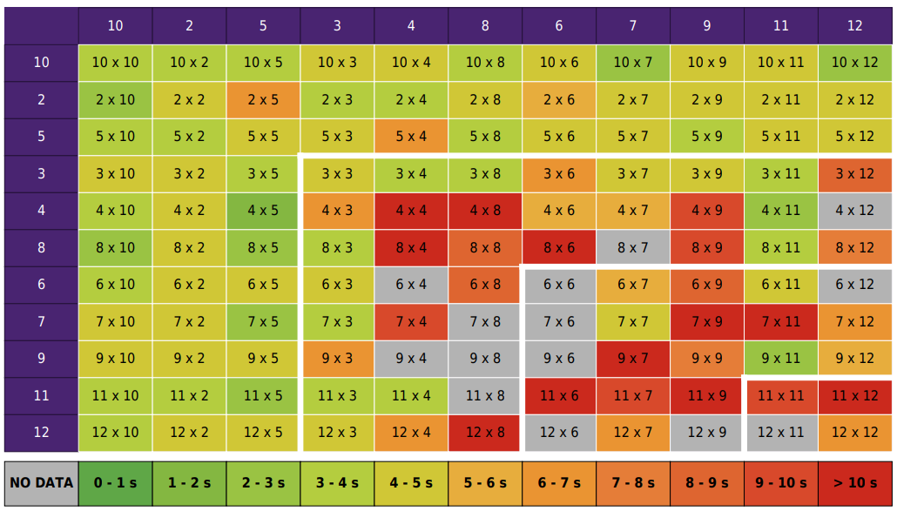
Notes:
The heatmaps on TTRockStars are really useful – not only for the children, but for us as teachers too.
The ideal heatmap would be filled in green.
Sometimes, certain times tables will not be open for the children yet. These will appear grey.
The differing colours allows us as teachers to see what gaps there might be – it allows us to provide targeted intervention to prepare the children for the MTC.

Slide 14
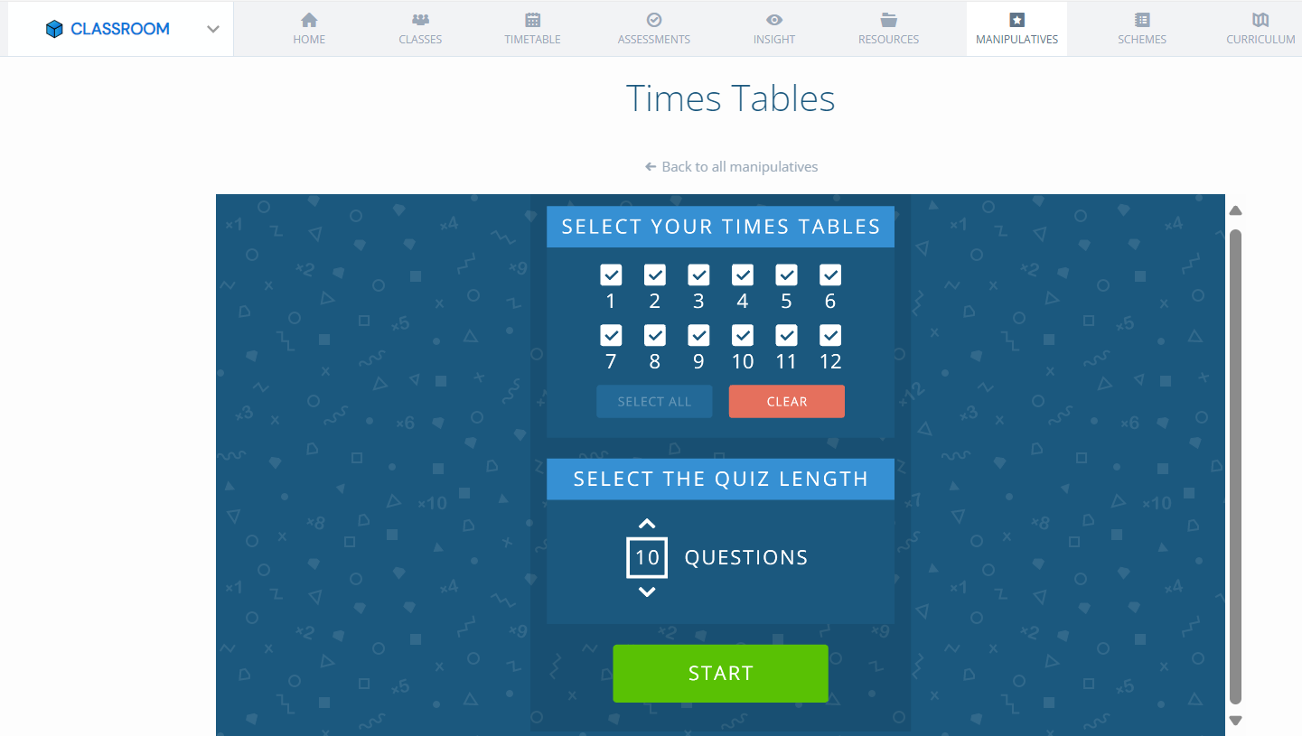
Notes:
The ‘classroom’ element of Complete Maths can also help to practise times tables in another way. It is not as quick as TTRS, but can be a good alternative when first starting out.

Slide 15
