Slide 1
Extended code and
Phonics screening check.

Slide 2
Year 1 housekeeping.
Please send reading books to school everyday.
One of the year 1 team will read with your child each week.
Reading books are changed on Mondays and Thursdays.
Please encourage your child to complete Numbots for 30 minutes.
Please send spelling folders in on Fridays. Incorrect spellings are highlighted.
Please name all the cardigans and jumpers!

Slide 3
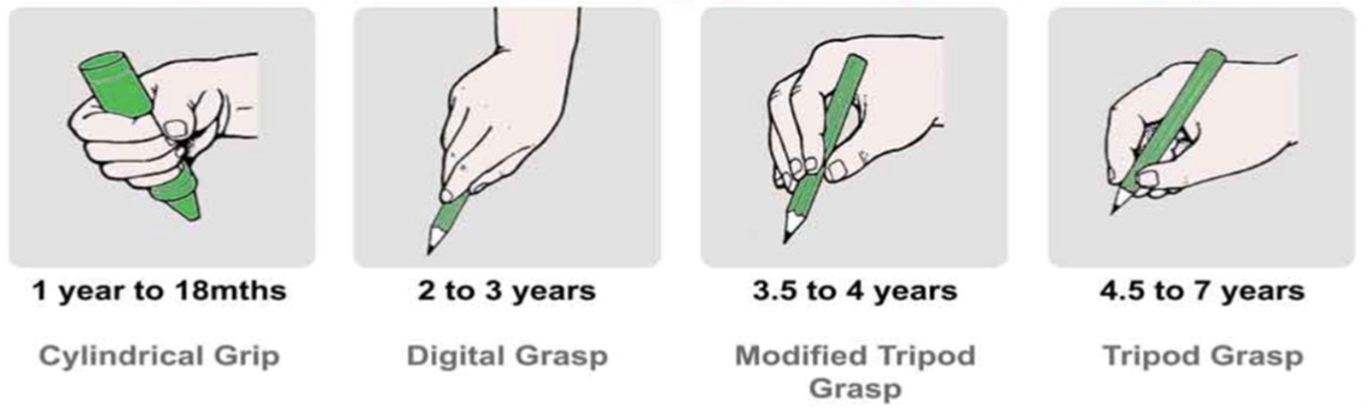

Slide 4

Bury School reading scheme works alongside..

Slide 5
* Instructional Method
* Start in Foundation
* Systematic, structured, cumulative and sequential
* Explicit code-orientated programme
* DfE validation

Slide 6
Phonic skills –
Blending
Segmenting
Phoneme manipulation
(ability to modify, change, or move the individual sounds in a word.)

Slide 7
Phonics concepts
Letters are symbols that represent sounds - phonemes.
Phonemes can be spelled using 1,2,3 or 4 letters
(a ay igh eigh)
The same sound can be spelling in different ways
The same spelling can represent different sounds (wind, lead)

Slide 8
Extended code – Year 1
ai family includes ay a ey ea
ar family includes al a
ee family includes ie e ea ey y
ou family includes ow
oy family includes oi
oo family includes ue ew u
oa family includes oe ow o
or family includes au ore aw augh ough our oor
ur family includes ir er or ear
igh family includes ie y i
This list is not exhaustive, just an example of the sounds the children learn.

Slide 9
Phonics language
Vowels are aeiou All the other letters are consonants
Graphemes when written, phonemes when said – a single sound a, b, c
Digraphs - two letters together, that make a single sound ai ck or
Two letters, one sound.
Trigraphs – three letters that make a single sound igh ear air
Three letters, one sound.
Tetragraphs – four letters that make a single sound ough eigh
Four letters, one sound.
Split digraphs (eg cake, tube) - not on the Sounds-write scheme.

Slide 10
More clarification on split digraphs -
Previously – Now -
a-e as in cake The long a sound and ke as a digraph
e-e as in these The long e sound and se as a digraph
i-e as in nice The long i sound and ce as a digraph
o-e as in phone The long o sound and ne as a digraph
u-e as in huge The long u sound and ge as a digraph
The digraphs now match other words such as mouse, nerve and axle

Slide 11
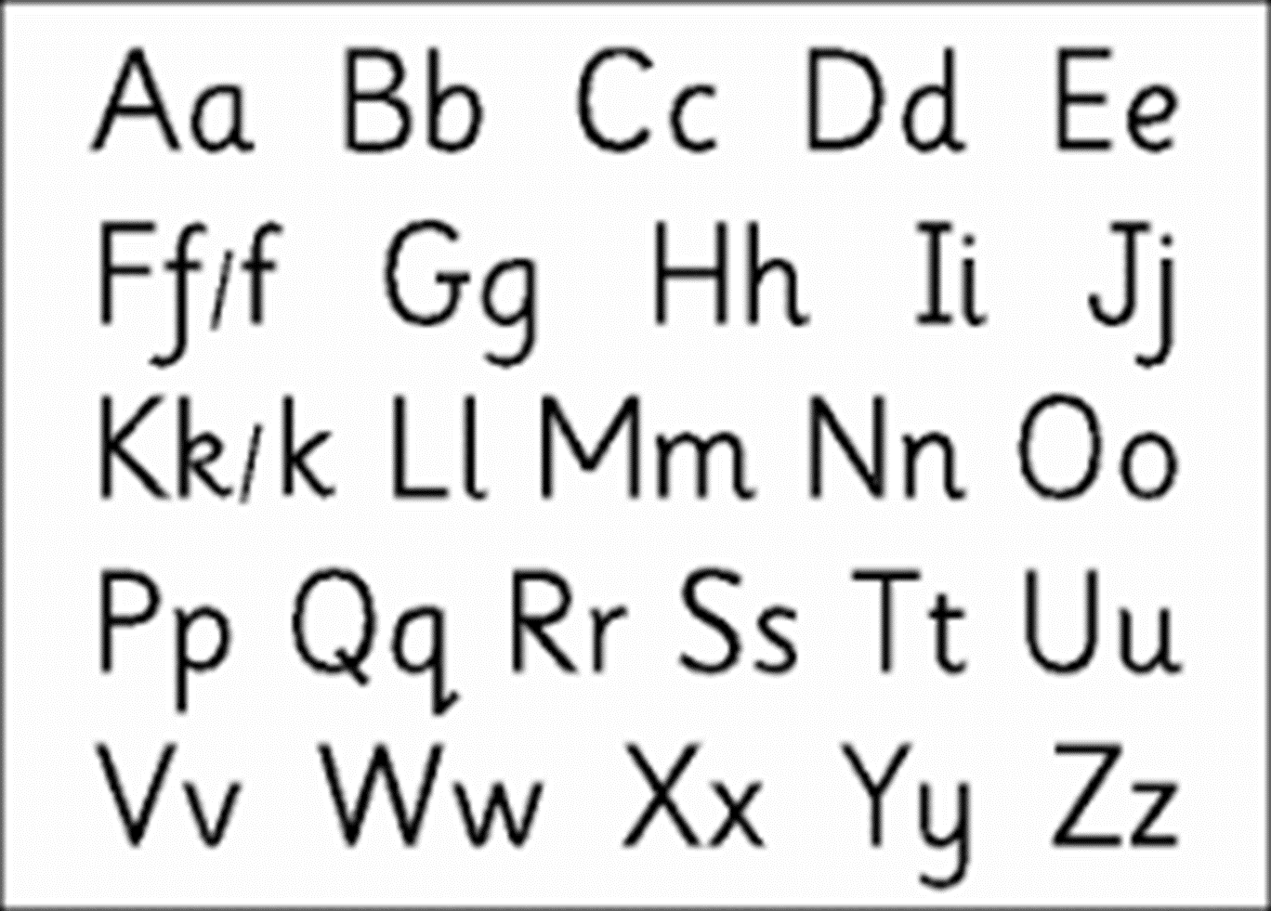

How to pronounce the sounds without schwas

Slide 12
Information about the phonics screening
Usually at the start of June.
The children have as long as they need.
On a 1:1 basis in a quiet place.
They are allowed to write on the sheet to help them decode.
There are 20 real words and 20 nonsense words.
Nonsense words have an alien next to them.
There are no clues, no reading round the word or using the picture. They simply have to use their phonic knowledge.
Previous years, the pass mark has been around 33/40
If they don’t pass, they retake in year 2.

Slide 13




Real and nonsense words
There are 20 real words, starting with a few sounds, getting longer and more complex. (eg Phonics screening 2013)
thin cheek moist toy fuel strike reaching
There are 20 nonsense words, marked by an alien each time, again starting with a few sounds and getting longer and more complex.
elp veen voisk herks zale strabe

Slide 14
Top tips to help…
Prompt your child to use the ‘bed’ rule to help distinguish between b and d.
We talk about where the sounds are usually found in a word. This helps them work out where the sound is in the word for spelling. English breaks rules all over the place so we do not teach a ‘spelling rule’.
Phonics can be split into families. We ask the children when writing to use their ‘best bet’ based on where the sound is in the word, and which sound it usually is, as
Phonicsplay.co.uk is a free resource where you can focus on specific sounds. Start with a sound from phase 3, that your child recognises. As the year moves on, we will cover all the phase 3 and phase 5 sounds, but we do not label them as phases at school.

Slide 15
More top tips to help…
Your child needs to read their school reading book every day, for at least 10 minutes.
Your child need to practise their spellings every day. I know these are a challenge to the children. Little and often will help. Look, cover, write and check method. The spellings mirror the sounds currently being taught in school.
3. Continue to read and enjoy other books with your child, including higher level books that you will read to them.
4. Read to your child every night to improve your child's knowledge, language and understanding of the world.

Slide 16
The biggest tips!
Slow down.
Say the sounds and read the word.

