Slide 1

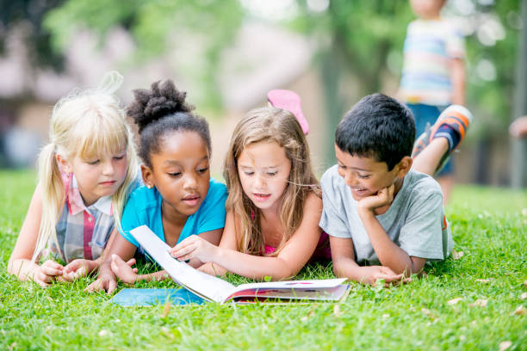
Welcome
Bury School
Reading Morning
September 2026

Slide 2
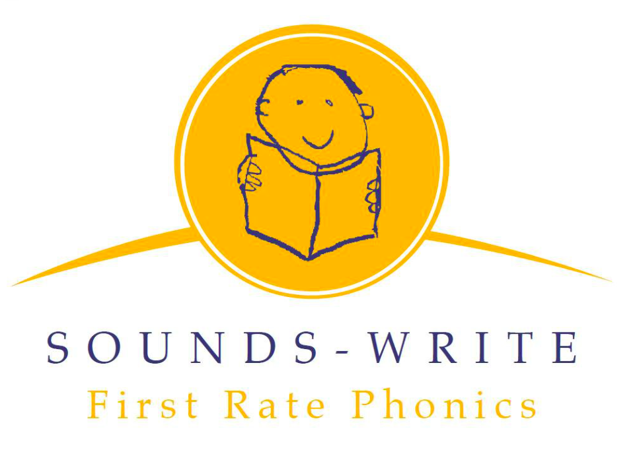
Bury School reading scheme works alongside…

Slide 3
Sounds-Write explained….
Instructional method.
Systematic, structured, cumulative approach.
Teaches the letters and combinations of letters which make the sounds of our language.
DfE validated.

Slide 4
Phonics concepts
Letters are symbols representing sounds.
Phonemes
Each sound we hear in a word is a phoneme. (A phoneme can be more than one letter)
‘dog’ has 3 phonemes /d/ /o/ /g/
Each phoneme is represented by 1 letter
‘ship’ also has 3 phonemes /sh/ /i/ /p/
We have 3 sounds but the word has 4 letters

Slide 5
Graphemes (spellings)
These are the symbols used to represent the phonemes (sounds). It is a letter or group of letters representing one sound.
‘team’ contains the 2-letter grapheme ‘ea’, which represents the sound /ee/.
‘eight’ contains the 4 letter grapheme ‘eigh’, which represents the sound /ae/.

Slide 6
What do I say to my child about words which do not follow the phonics rules?
'the’
‘was’
‘do’
At this stage in our child’s learning, keep it simple.
Say something like, ‘when you see this word, just say ‘iz’.
Words that include phonemes that have not been taught yet, can be explained in this way too.

Slide 7
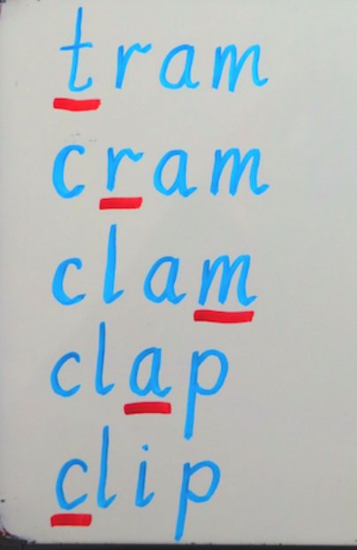
Skills to master
Blending
Segmenting
Phoneme manipulation
(ability to modify, change, or move the individual sounds in a word.)

Slide 8
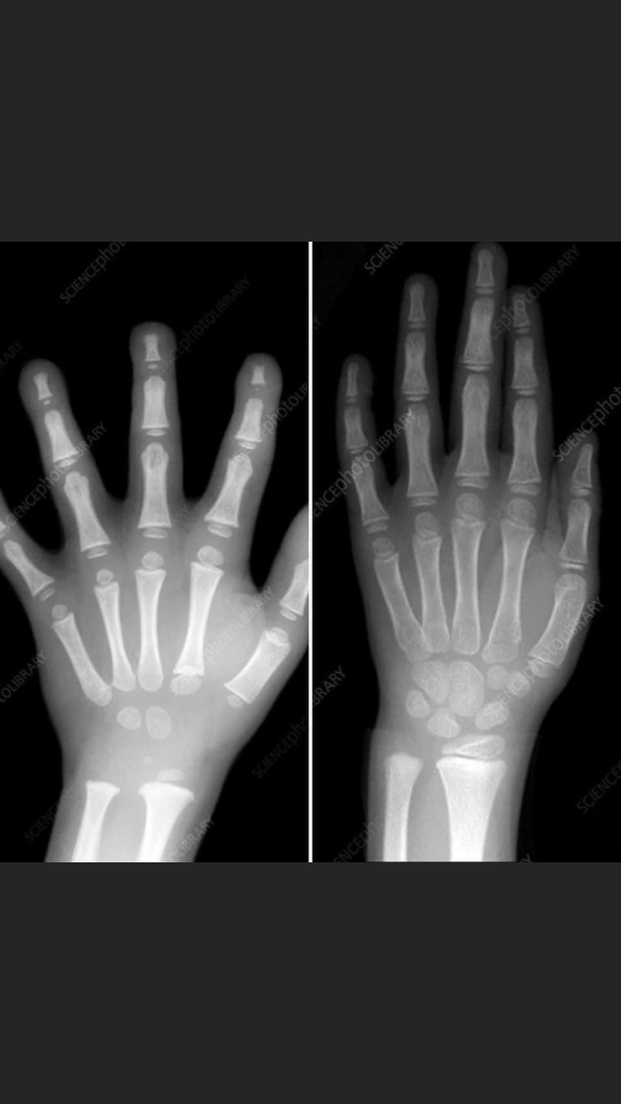
Skills develop over time – when they are ready.
Don’t worry about your
child’s mark making or
writing.
They are working on it
internally!

Slide 9
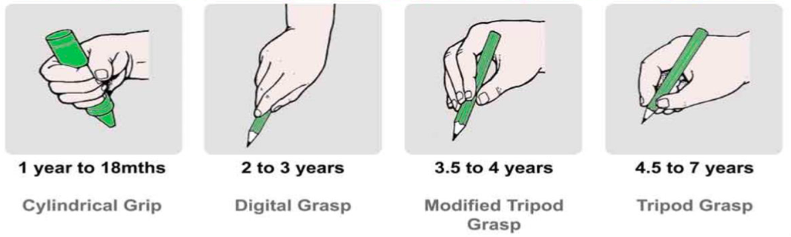
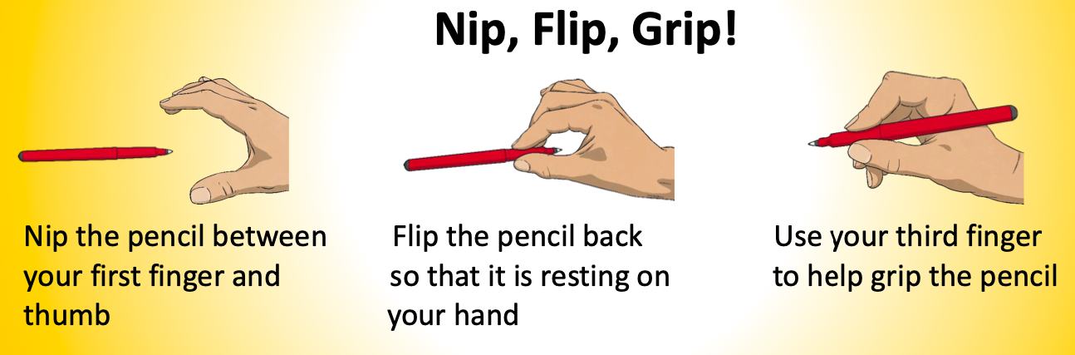
We teach correct pencil grip.
Helping at home

Slide 10
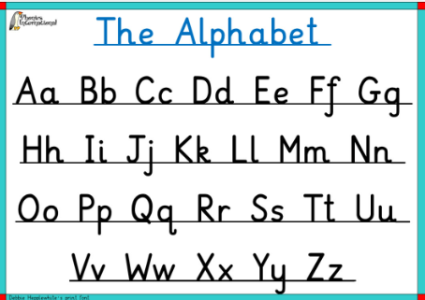
Helping at home - correct letter formation.
Debbie Hepplewhite.

Slide 11
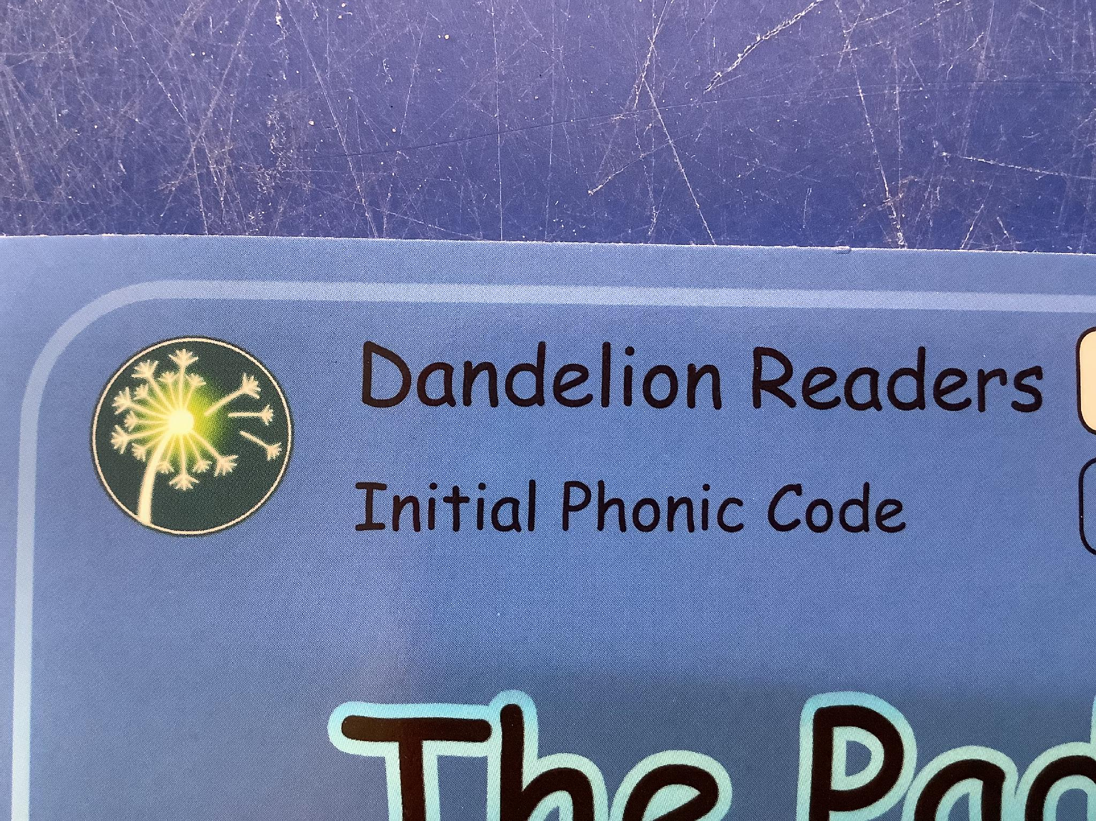
School Schemes
Why should my child read phonics based reading books?
The books consolidate the phonics taught in the classroom. With step-by-step progression, the child succeeds at each level while learning the phonics needed to become a fluent reader.
This approach develops confident readers with reliable reading strategies.
Notes:
ORT – main scheme used but have others to supplement.
Follow through a progression of books-to independent readers.
Show green reading record books
individual sheets..
Children will change books initially twice a week - usually read 1-1. Sometimes we will have read the book with them and this will be commented on in their green book or signed on sheet.
Not a race!!

Slide 12
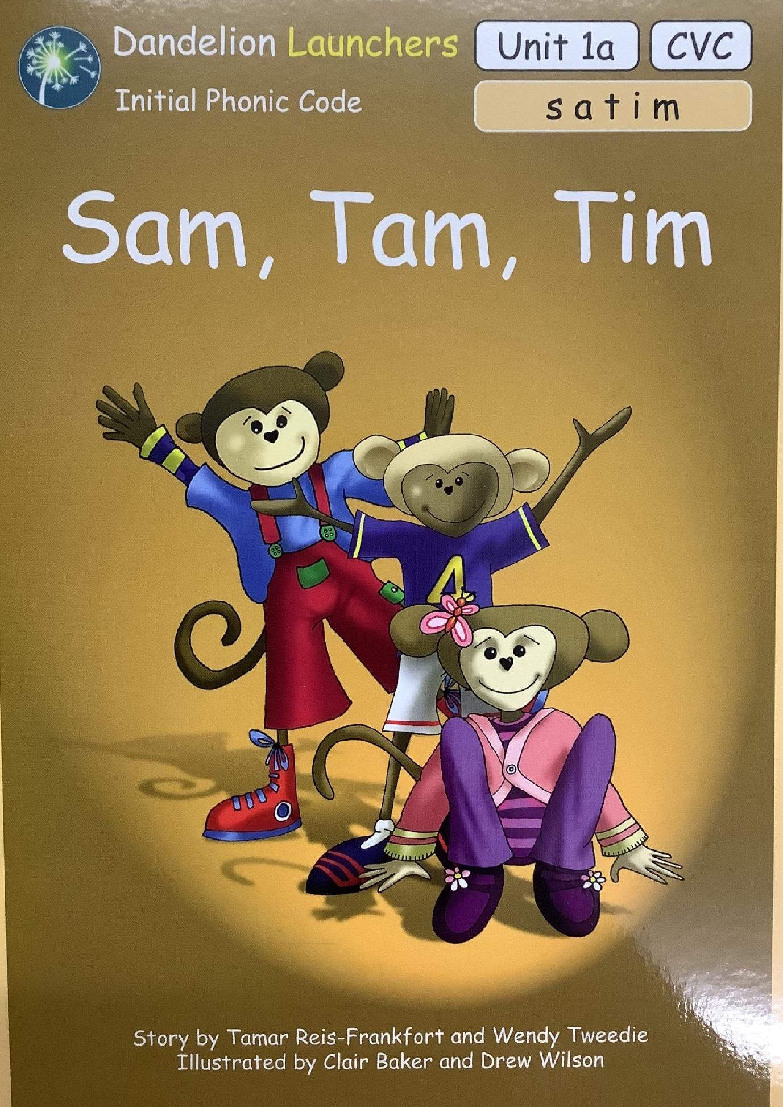
Reading scheme books

Slide 13
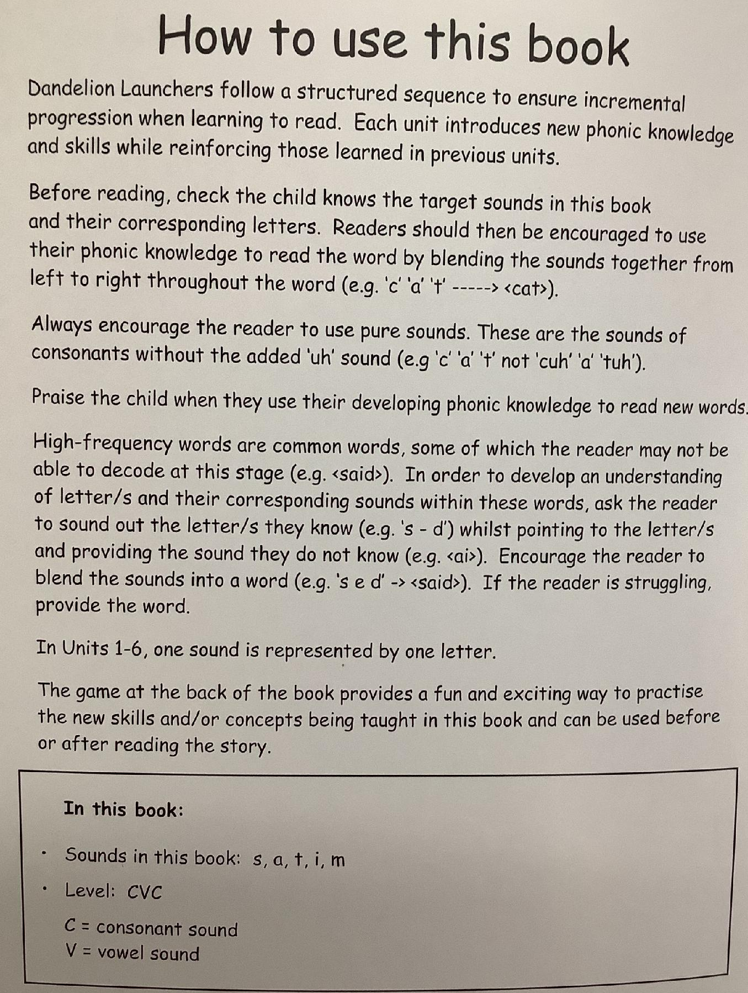
Reading scheme books

Slide 14
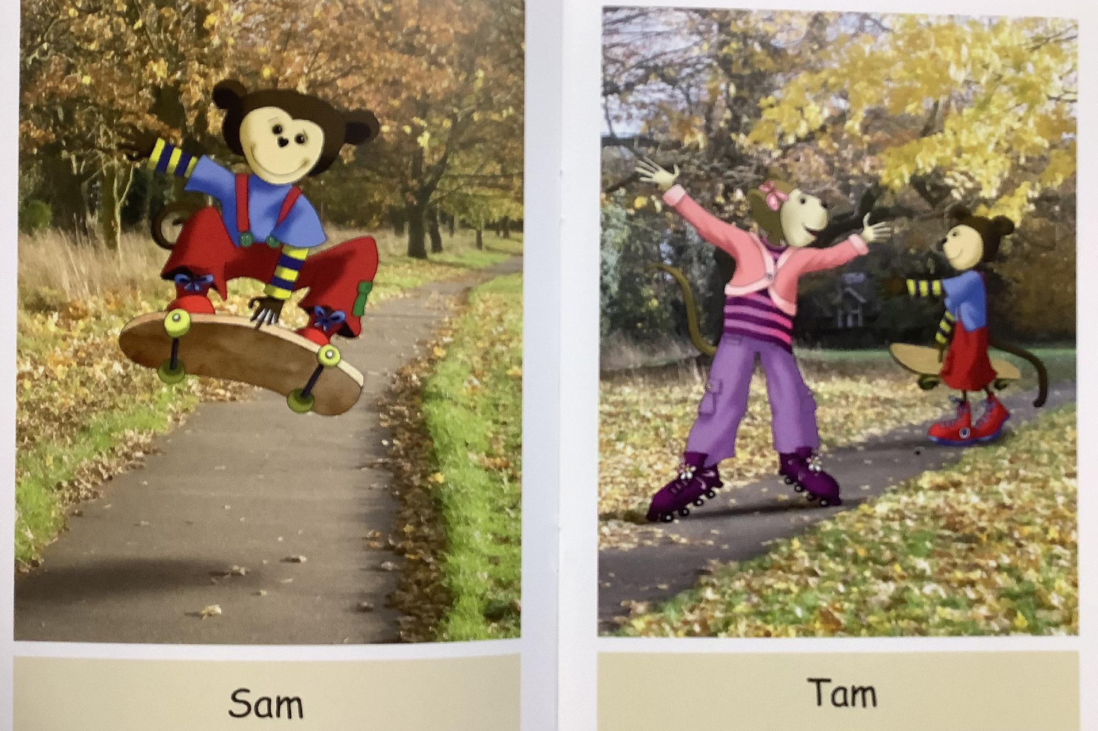
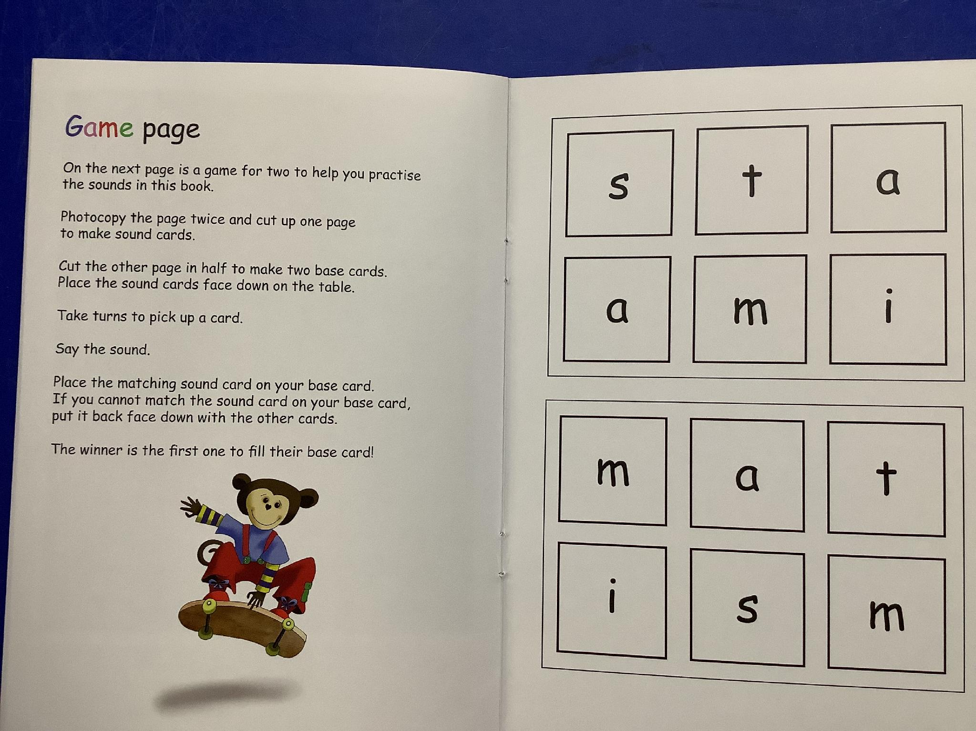

Slide 15
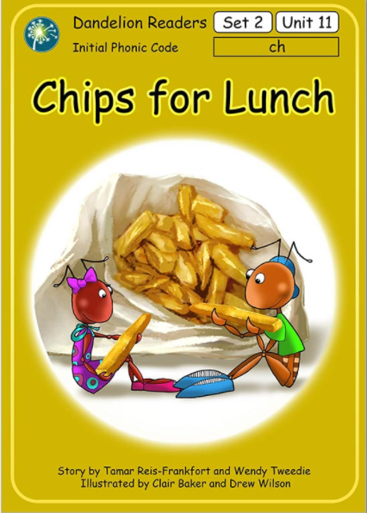
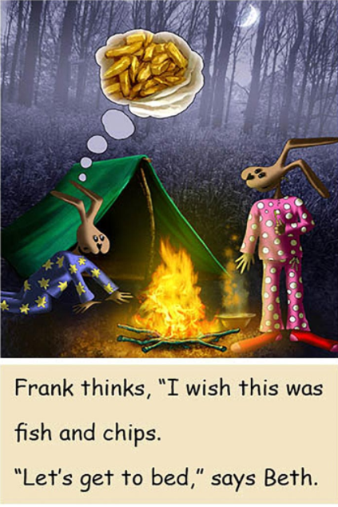
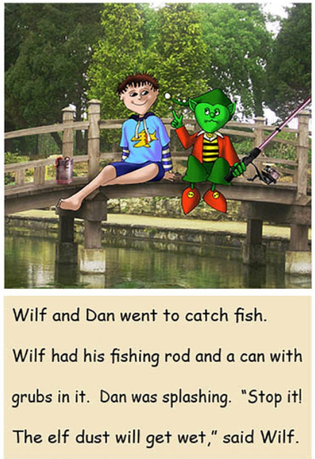

Slide 16
The Reading Record
We view these as a valuable part of our home-school relationship. The reading record is helpful for us to communicate about your child’s reading progress. It is quick and easy to use as you read with your child.

Slide 17
Home reading should happen every day for approximately 10 mins, as this will aid your child’s progress. This can include you reading a book to your child.
We will send the same book home if the record has not been filled in, so please try to indicate to us when you are ready for the next book.
Your child's book will be changed twice a week, usually Mondays and Thursdays. Your child will move up a level when ready or repeat a level if they need more practise. Please remember it is not a race to get to the end of the reading scheme first.

Slide 18
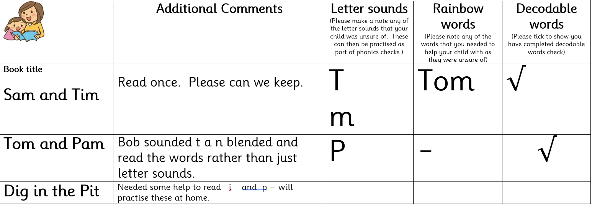
The reading record

Slide 19
What to do when your child gets stuck.
- Give them time to think about it first without jumping in. (This is really hard to do as adults!)
- Ask them which part of the word they are finding tricky. It might only be one letter.
- See if the picture could help them work out the word. This also helps to show if your child has understood what they have already read.
- It’s fine to simply tell your child the word if they are becoming flustered. We all want happy readers!

Slide 20
Some Tips
- Help your child to learn their sounds, not letter names.
- Enjoy and share your child’s reading book. Sometimes you will want to read with your child, sometimes listen to your child and sometimes talk about the story and look at the pictures.
- Continue to read and enjoy other books with your child, including a daily bedtime story, higher level and non-fiction books that you will read to them. Children love to have their favourite books read over and over.
- Visit the library. It’s free, you can borrow up to 12 books at a time and have access to ebooks via the app.

