Slide 1
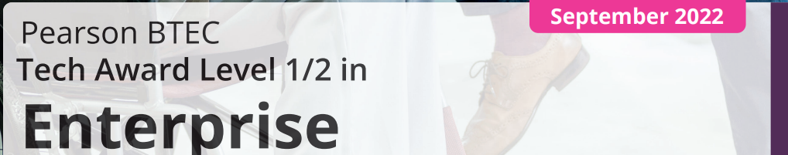
Notes:
You will start thinking about and deciding, if you would like to study Health and Social Care, as an option subject over the next few weeks, before a September start

Slide 2

Qualification Content
The BTEC Level 1/2 Tech Award is equivalent to a GCSE over a two year qualification.
The Pearson BTEC Level 1/Level 2 Tech Award in Enterprise (603/7063/4) is for learners who want to acquire sector-specific applied knowledge and practices through vocational contexts by studying enterprises, entrepreneurs, customers, competitors, the external environment, business planning and presenting, marketing and finance as part of their Key Stage 4 learning.
Notes:
Health & Social Care is about working with people, this is a good subject to help you understand about different people.

Slide 3


Teaching hours
Students will be taught three different units, called ‘Components’ in Years 10 and 11, but this is planned and organised.
They will have 2 hours a week of teacher contact time in lesson with Mr Pearson and students will also be expected to complete homework, weekly.
Notes:
Each week their will be homework…. Which you will be expected to do… but the more you know, the better you will do ☺

Slide 4
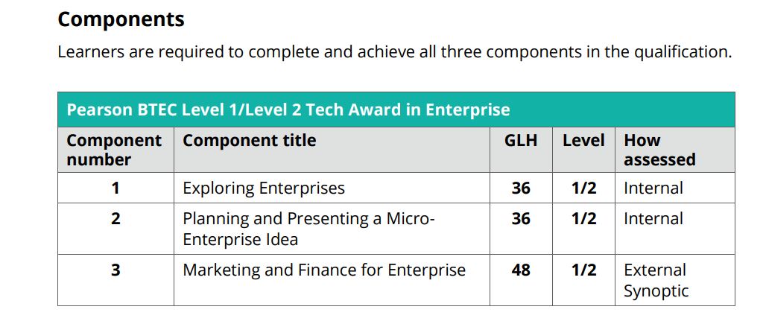
Qualification Structure
There are THREE units that students will be covering, two coursework units in Year 10/11 and one exam in Year 11. These are;

Slide 5
Your Qualification Grade
Component 1
Assignment
30%
Component 2
Assignment
30%
Component 3
Assignment
40%
Year 1
Year 10/11
Year 2
Year 11
Notes:
Your Year 10 work will be 60% of your end grade and your Year 11 40%. This is different to your other GCSE’s as you’re working for the end grade in Year 10

Slide 6
There are two internally assessed units, course work units, completed at school Year 10 Component 1 delivered and assessed.
Year 10 Component 2 delivered and is then assessed in Year 11
Students will be taught the subject content, carry out tasks and make notes that will all be written or printed and placed in their folders.
Students will be able to refer to their notes in their assessment, so it is important that students are writing down as much information as possible.
Course Work Units
Notes:
Your teacher will help and guide you to be organised but you must develop time management skills and independent organisation and study

Slide 7
All students will be aiming for a Pass, Merit or Distinction in their assessments.
We will assess classwork and homework, giving feedback via Microsoft teams, so students need to be accessing and completing their homework on this forum.
This is why it is important that students must meet the deadlines for homework and keep up to date with classwork.
If a student is absent for any lessons, they will need to catch up on any work missed. All work is placed on TEAMS.
Course Work Units
Notes:
You will get an opportunity to improve your assessment however, it’s always best to get it right, first time. Don’t rely on second chances.

Slide 8
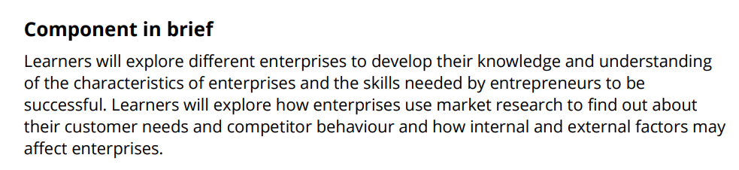
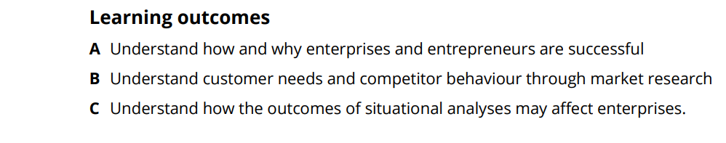
Year 10; Component 1
Component 1:Exploring Enterprises
Students complete 5 tasks, marked out of 12, totalling 60 marks available. This makes up 30% of their overall mark, so each task is worth 6%. This is assessed in year 10 only.
Notes:
Remember a Component is actually a Unit. This unit is a Pass, Merit or Distinction and Component 2 is also worth 30% of the end qualification grade

Slide 9
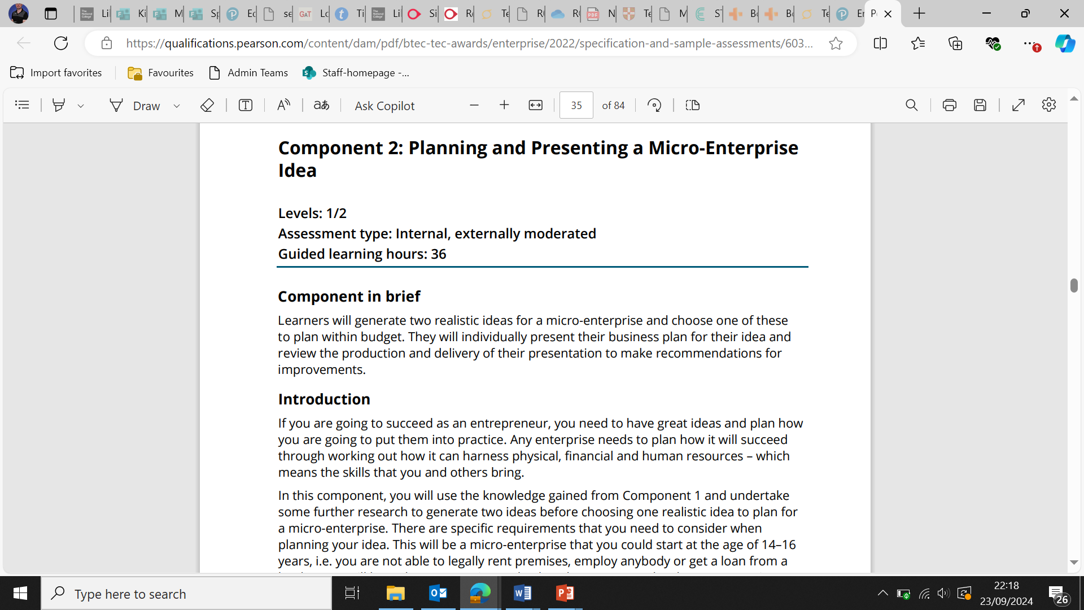
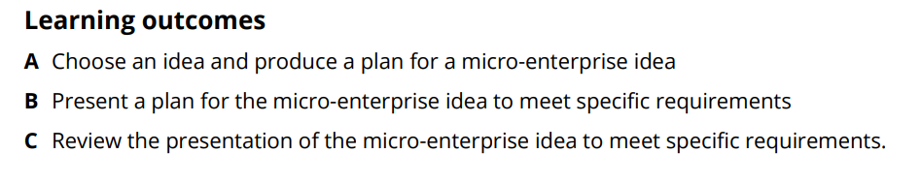
Year 10/11; Component 2
Component 2:Planning and Presenting a Micro-Enterprise Idea
This will be assessed in year 11 and submitted by December. It makes up 30% and is internal marked and externally moderated. 5 tasks again, worth 12 marks each and totalling 60 marks.
Notes:
This unit is a Pass, Merit or Distinction and Component 2 is also worth 30% of the end qualification grade

Slide 10
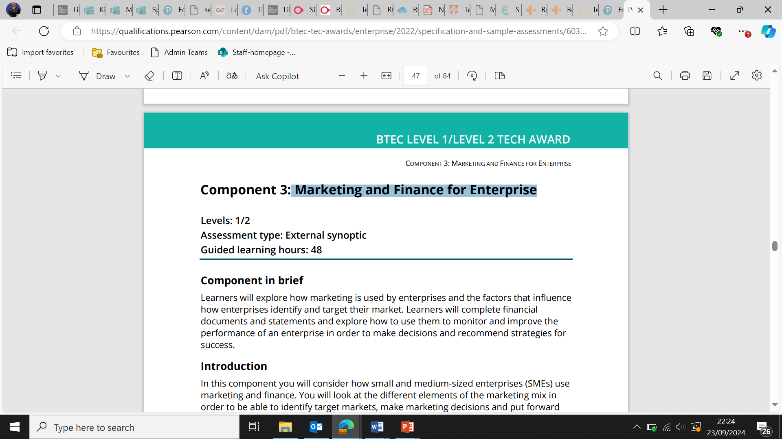
Year 11; Component 3
Component 3: Marketing and Finance for Enterprise
AO1 Demonstrate knowledge of facts, terms and issues in relation to enterprise
AO2 Demonstrate an understanding of facts, terms and issues in relation to enterprise
AO3 Apply an understanding of facts, terms and issues in relation to enterprise
AO4 Make connections with concepts, issues and terms in enterprise
AO5 Carry out calculations to complete financial documents, carry out calculations using formulae and ratios, and construct and interpret break-even charts
Notes:
Your exam result is marked as a Pass, Merit or Distinction and Component 3 is also worth 40% of the end qualification grade

Slide 11
Mock exams
A mock exam will take place in February, we will use this exam to clear up any misconceptions and gaps in learning.
The Comp 3 exam will be in exam conditions with external invigilators. The exam will then be sent away to be marked by the Pearson’s exam markers. With results available in August.

Slide 12

Key Dates
Jan.–May
Component 1 Assessment (Y10)
Sep.–Dec.
Component 2 Assessment (Y11)
February
A Mock Exam (Y11) will take place in February
beginning of May
The Component 3 Exam (Y11) will take place at the beginning of May
Notes:
Your exam result is marked as a Pass, Merit or Distinction and Component 3 is also worth 40% of the end qualification grade

Slide 13
