Slide 1

Sport
Join us on our journey….

Slide 2

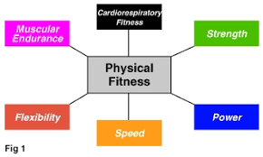

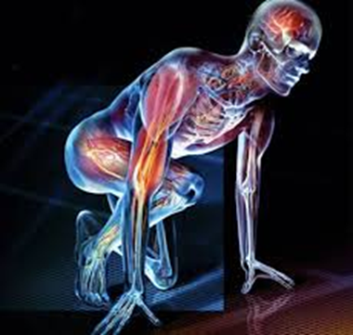
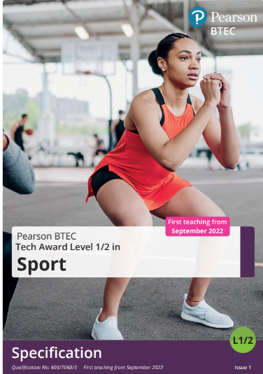
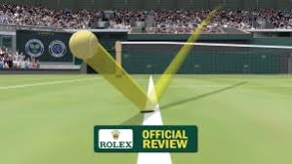
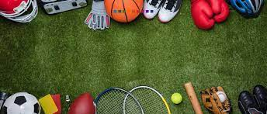
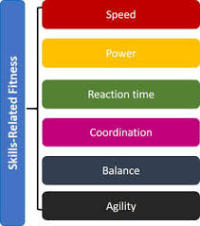
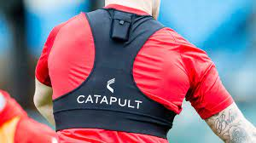
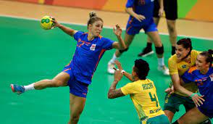
2 ASSIGNMENTS
1 EXAM

Slide 3
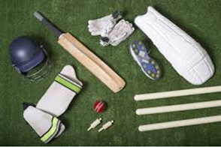
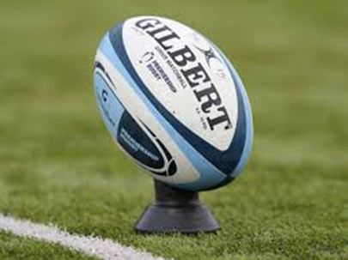
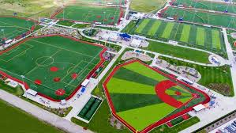
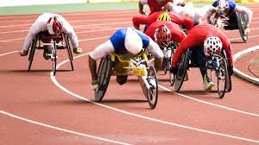
30%
COMPONENT 1
PREPARING PARTICIPANTS TO TAKE PART IN SPORT AND PHYSICAL ACTIVITY
Learning outcomes:
Explore types and provision of sport and physical activity for different types of participant
Examine equipment and technology required for participants to use when taking part in sport and physical activity
Be able to prepare participants to take part in sport and physical activity.
ASSIGNMENT
BASED

Slide 4
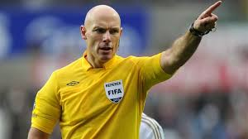
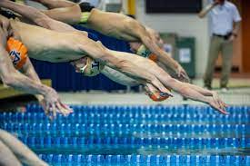
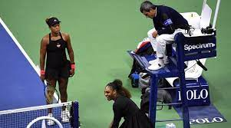
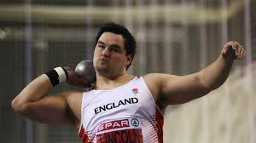
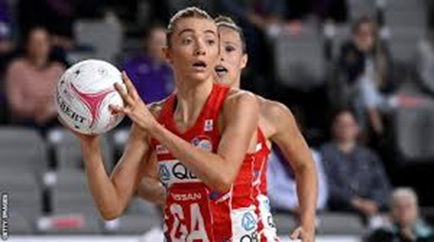
30%
ASSIGNMENT
BASED
COMPONENT 2
TAKING PART AND IMPROVING OTHER PARTICIPANTS SPORTING PERFORMANCE
Learning outcomes
Understand how different components of fitness are used in different physical activities
Be able to participate in sport and understand the roles and responsibilities of officials
Demonstrate ways to improve participants sporting techniques

Slide 5
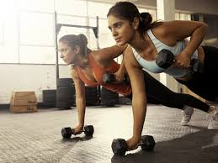
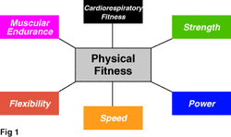
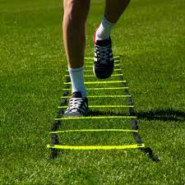
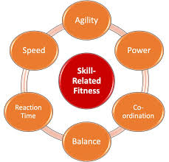
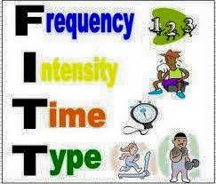
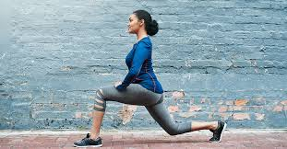
Component 3
FITNESS FOR SPORT AND EXERCISE
Demonstrate knowledge and understanding of the following:
Physical components of fitness,
Skill components of fitness,
Fitness testing,
Training methods,
Principles of training
Explain how the above will work together to improve performance, participation and enjoyment in sport and physical activity
40%
EXAM
BASED

Slide 6
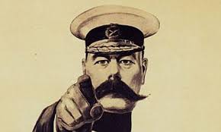

SPORT BTEC LEVEL 2
Is this course for you?
Have an interest in sport and physical activity
Wants to learn more about the fitness, training and preparation required to be a successful sports performer
Is willing to work hard and be part of a team
Participate in at least one sport or activity outside of school
Enjoy keeping fit and healthy
Can work independently
Has competent ICT skills

Slide 7
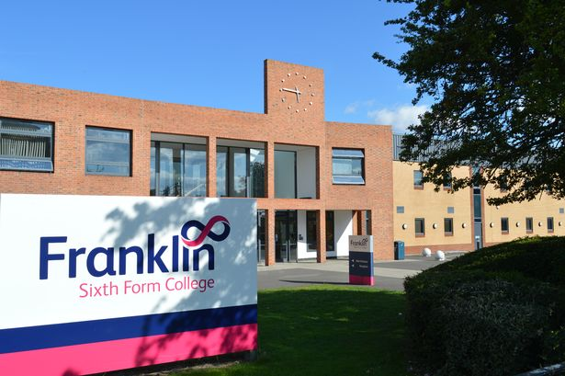

Further education in SPORT
Sport level 2
BTEC level 3/ A Level
University
Work within industry

Slide 8
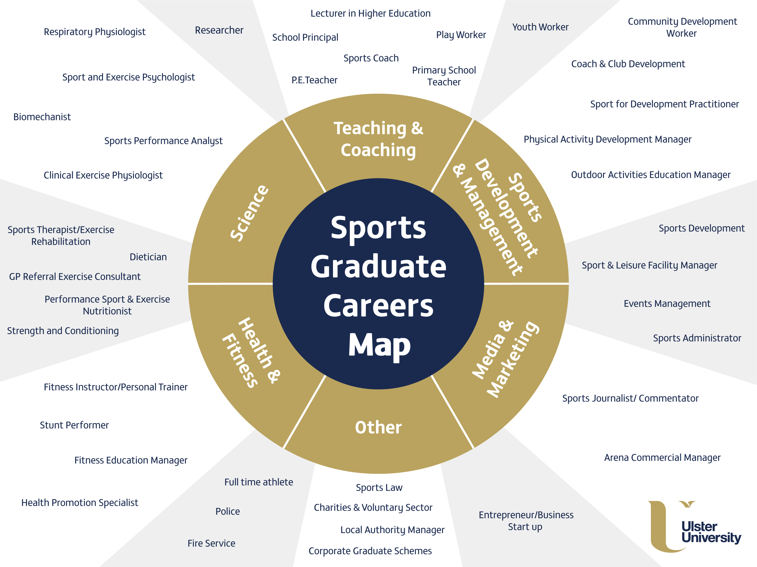

Slide 9
Any Questions ?

