Slide 1
BTEC Level 1/2 Tech Award in Travel & Tourism
What will my child study over the next two years and how will they be assessed?

Slide 2

An Overview
Students complete 2 Internally Assessed components and 1 Externally Assessed component (Exam)
Components cover a variety of themes across the Travel & Tourism sector including meeting needs of Tourists, how companies work together and the need for Tourism to become more sustainable
The Course is graded from a Level 1 Pass all the way up to a Level 2 Distinction*. A Level 2 Pass is the equivalent of a Grade 4 and a Distinction is the equivalent of a Grade 7.
The Academy uses the Pearson Edexcel Exam Board

Slide 3

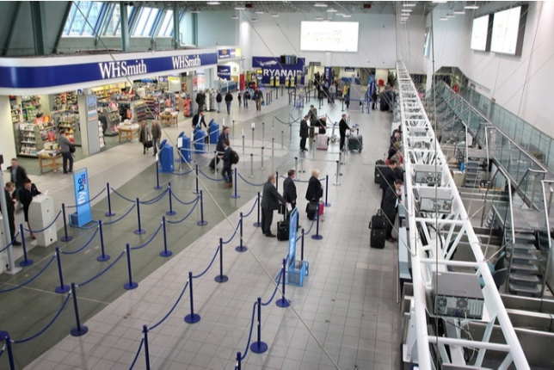
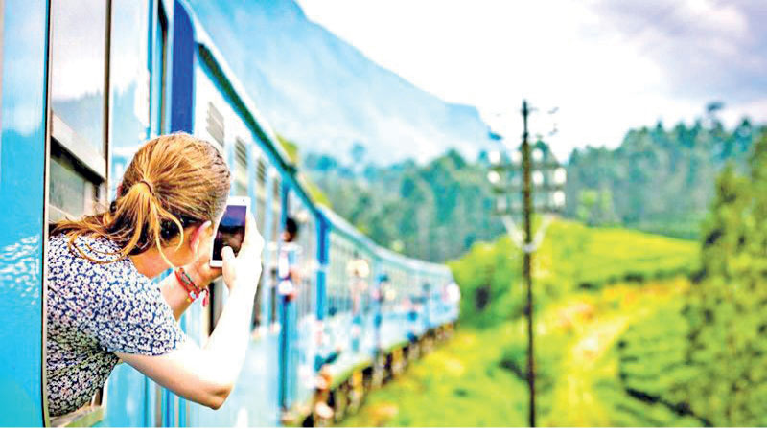
Course Content
Over the two year course, students study a set of key Geographical Themes. These are:
Component 1: Travel & Tourism organisations & destinations
This Theme looks at:
Travel & Tourism organisations in the UK
Ownership, aims, key products & services of these organisations
The role of consumer technologies within the industry
Features of and routes to popular tourist destinations
Component 2: Customer Needs in Travel and Tourism
This Theme looks at:
How organisations use market research
Travel and Tourism trends and customer needs
How specific needs are met by organisations
How travel planning meets customer needs & preferences
Component 3: Influences on Global Travel and Tourism
This Theme looks at:
Factors influencing global Travel & Tourism
How organisations & destinations respond to factors
Impacts of Tourism in Global destinations
Managing and controlling the impacts of Tourism

Slide 4
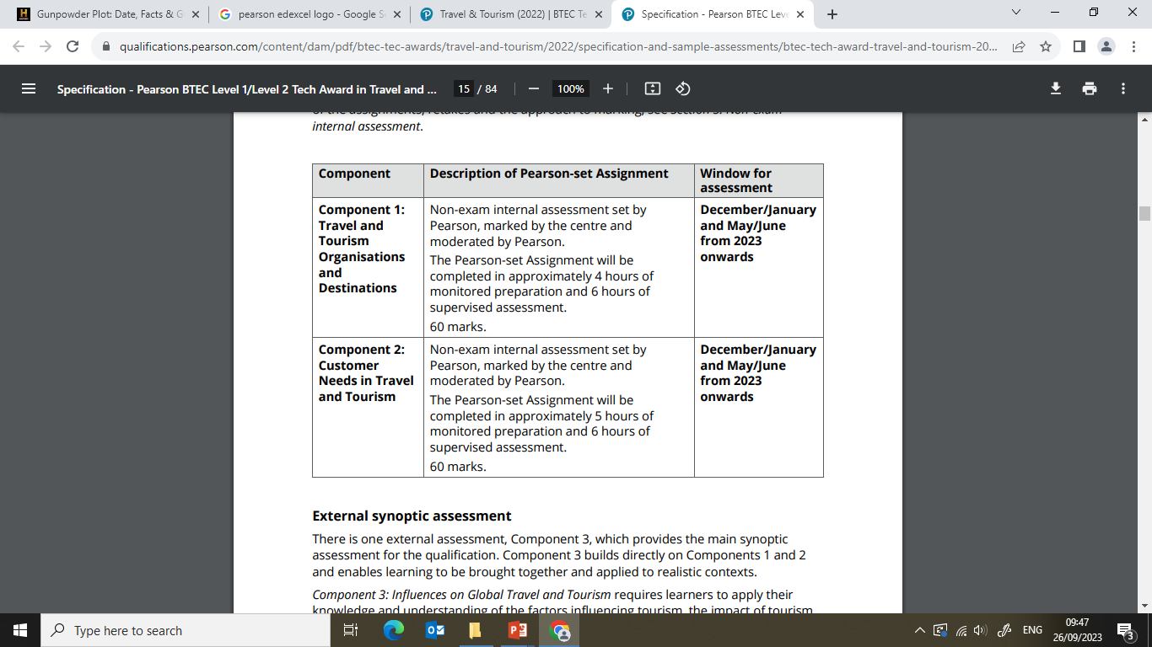
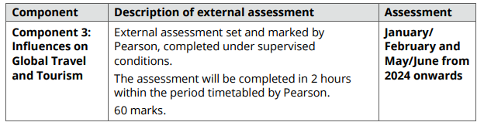
Assessment
Over the two years students completed three assessed pieces of work which count towards their grade.
Components 1 & 2 are Internal assessments completed over a set number of hours.
Component 3 is a 2 hour assessment, marked externally

Slide 5
How will we support your child in Travel and Tourism?
- Planned and structured lessons which use a variety of resources to engage students and ensure understanding and progress including the use of Homework to embed knowledge
- In-depth knowledge of exam requirements to develop exam technique and improve grades
- Regular assessment to check progress and understanding
- Students will complete a mock internal assessment and receive feedback and improvements on this, before completing the Pearson Set Assignment (PSA).
- Communication and additional support materials through Microsoft Teams
- Revision materials for the externally examined component

Slide 6
How can I support my child in Travel and Tourism?
- Encourage your child to watch the news and TV documentaries about the travel and tourism sector
- Encourage them to develop their own revision materials such as Knowledge organisers, Mind Maps and Flash Cards of important Case Study locations and Events
- Encourage them to complete research around areas of the travel and tourism industry (they will need to do some of this for their case study homework themselves)
- Discuss current affairs with your child – this will help them develop a viewpoint. Discuss planning and booking holidays or local trips and visits so they see the different people and businesses involved in the process

Slide 7
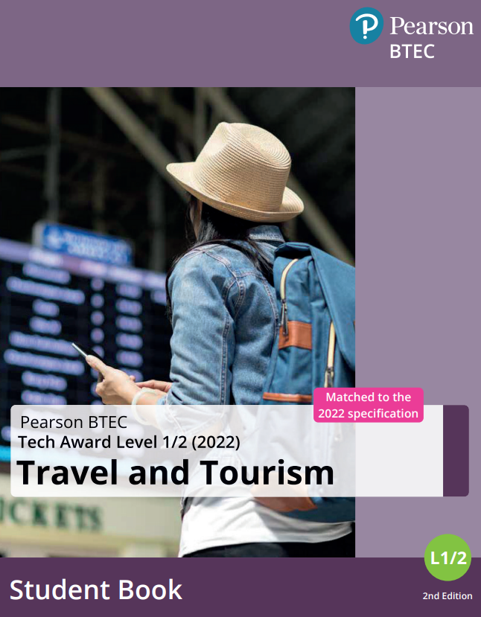
Revision Materials Available

Slide 8




We’re here to help…
If you have any questions or issues you would like to discuss about the course, resources available and supporting your child, please contact:
Ellie.Mulligan@cyac.org.uk

