Slide 1

BTEC Tech Award in Travel & Tourism

Slide 2
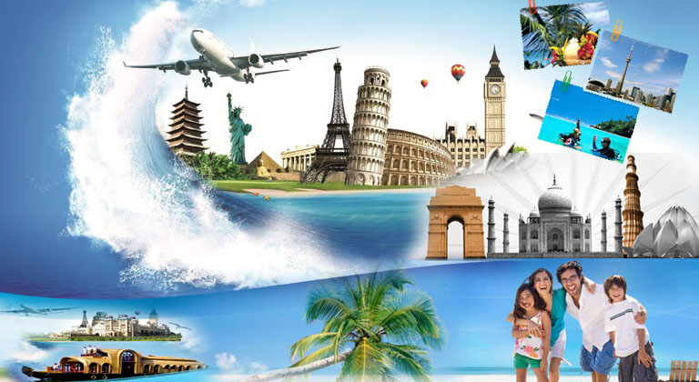
“For learners interested in taking a hands-on course alongside their GCSEs that will offer them a practical introduction to life and work in the dynamic travel and tourism industry, allowing them to make an informed decision about their future learning and career”
Travel & Tourism
Tech Award qualifications will
Explore what it’s like to work in the sector and gain the underpinning knowledge and skills required to work in it.
Develop key knowledge, skills and behaviours, and learn about essential tools, techniques, and equipment.
Apply their learning to real-life contexts and vocational scenarios in both learning and assessment

Slide 3
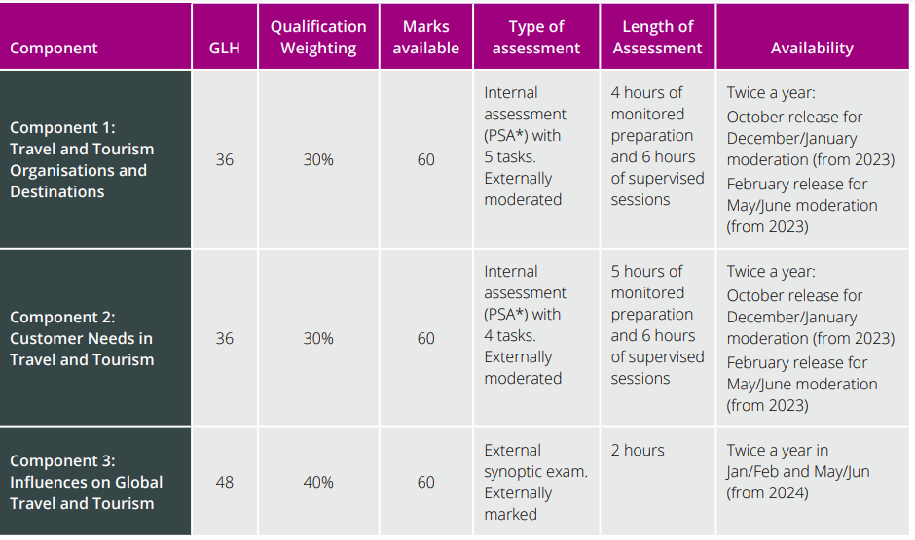
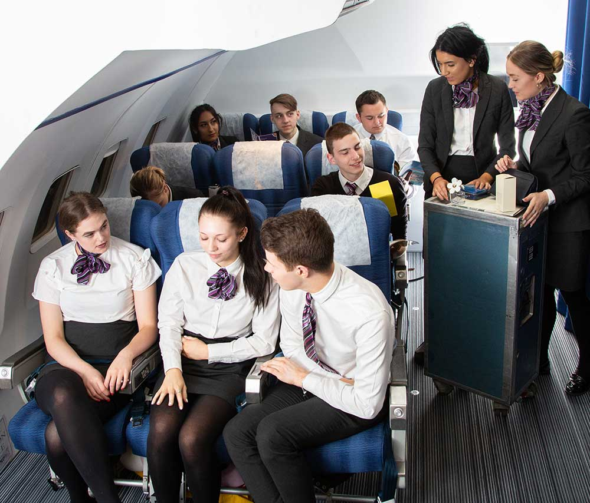
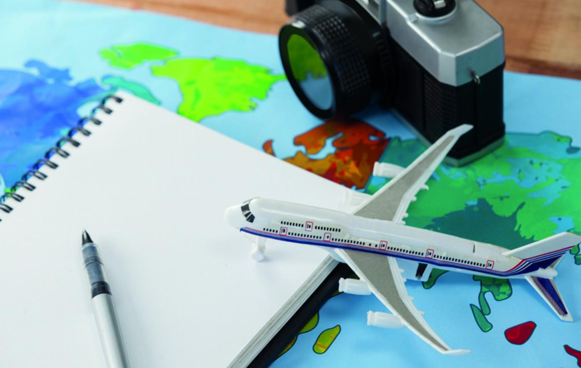
Assessment Overview

Slide 4
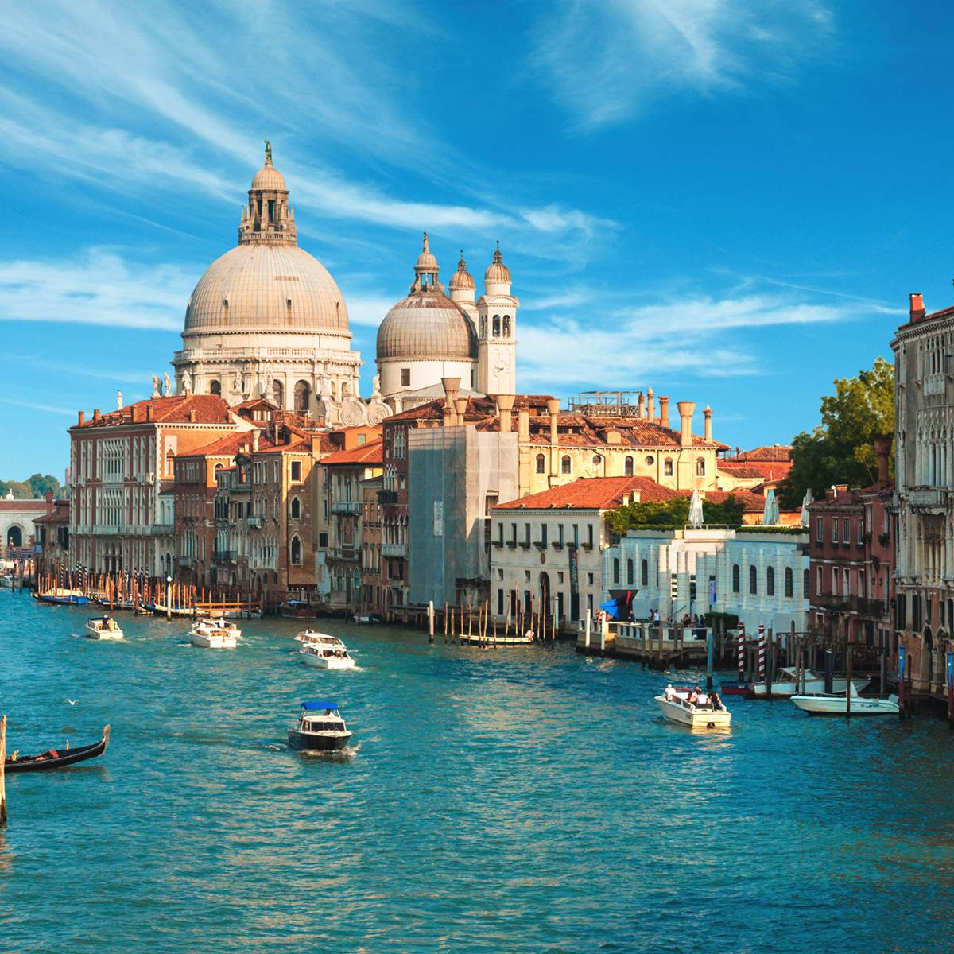
Component 1 - Travel and Tourism Organisations and Destinations
Learners will investigate travel and tourism organisations in the UK, their ownership, aims, key products and services, and how they work together. They will explore the role of different consumer technologies within the travel and tourism industry. Learners will understand the different types of tourism and different types of visitor and will investigate the features of and routes to popular tourist destinations
The Key Focus will be on:
Accommodation providers
Transport providers
Visitor Attractions
Tour Operators
Travel Agents
Marketing
You will research specific travel companies and how they are owned, structured and how they operate
You will also look at the role of technology in helping customers access Travel companies
You will also match different types of tourists to destinations & attractions

Slide 5


Component 2: Customer Needs in Travel and Tourism
Learners will investigate how organisations use market research to identify travel and tourism trends and identify customer needs and preferences. They will apply their understanding by exploring how specific needs are met by organisations and how travel planning meets customer needs and preferences.
The Key Focus will be on:
The role of market research
Using market research to identify customer needs & preferences
Using research to identify travel & tourism trends
How the needs of customers can be met
You will develop an understanding of the different reasons people travel
You will plan a trip/visit for a specific group of customers including travel, accommodation, activities, attractions & excursions

Slide 6
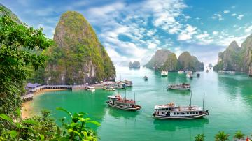
Component 3: Influences on Global Travel and Tourism
Learners will explore the different factors that may influence global travel and tourism, and how travel and tourism organisations and destinations respond to these factors. Learners will examine the potential impacts of tourism at global destinations and how destinations can manage the impacts of tourism and control tourism development to achieve sustainable tourism.
The Key Focus will be on:
Factors which influence the Global tourist industry – e.g. prices, exchange rates, safety of destinations, health factors
How Travel & Tourism organisations inform customers of these factors
The impacts of travel & tourism on sustainability – Economic, Social and Environmental Impacts of Tourism
How destinations are managed to help protect local environments, benefit local people and protect local cultures & traditions
The role of different organisations in managing global tourism

Slide 7
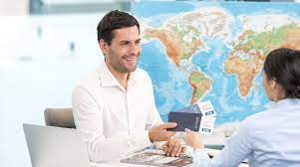
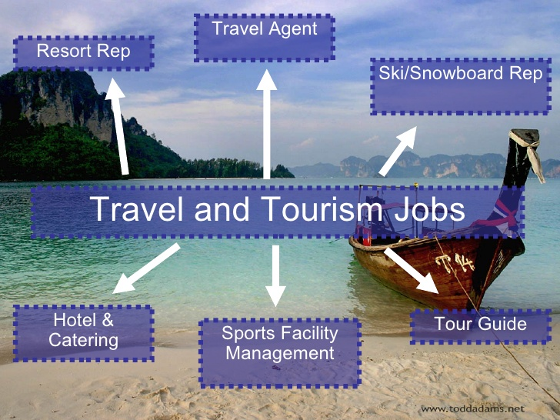
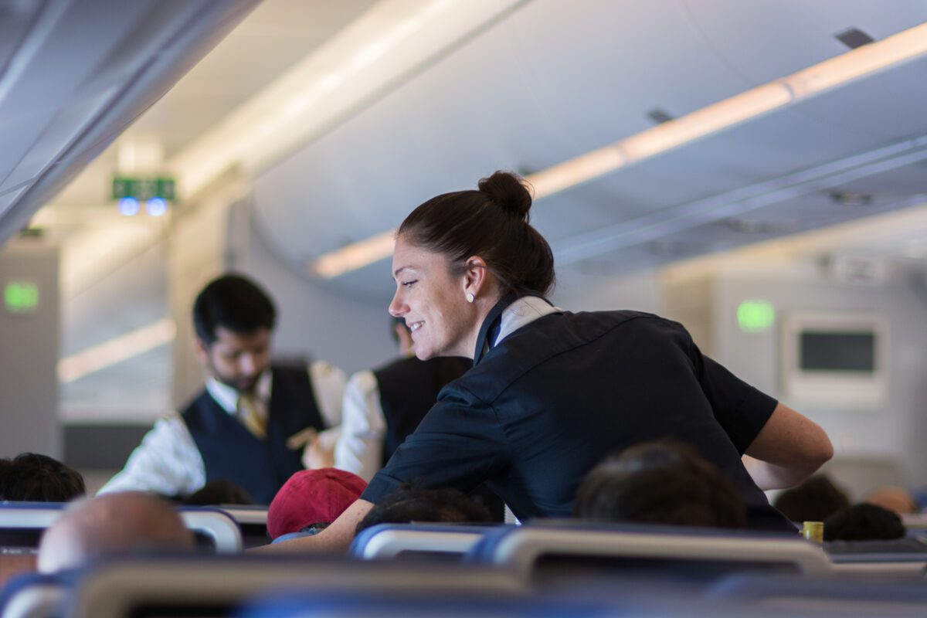
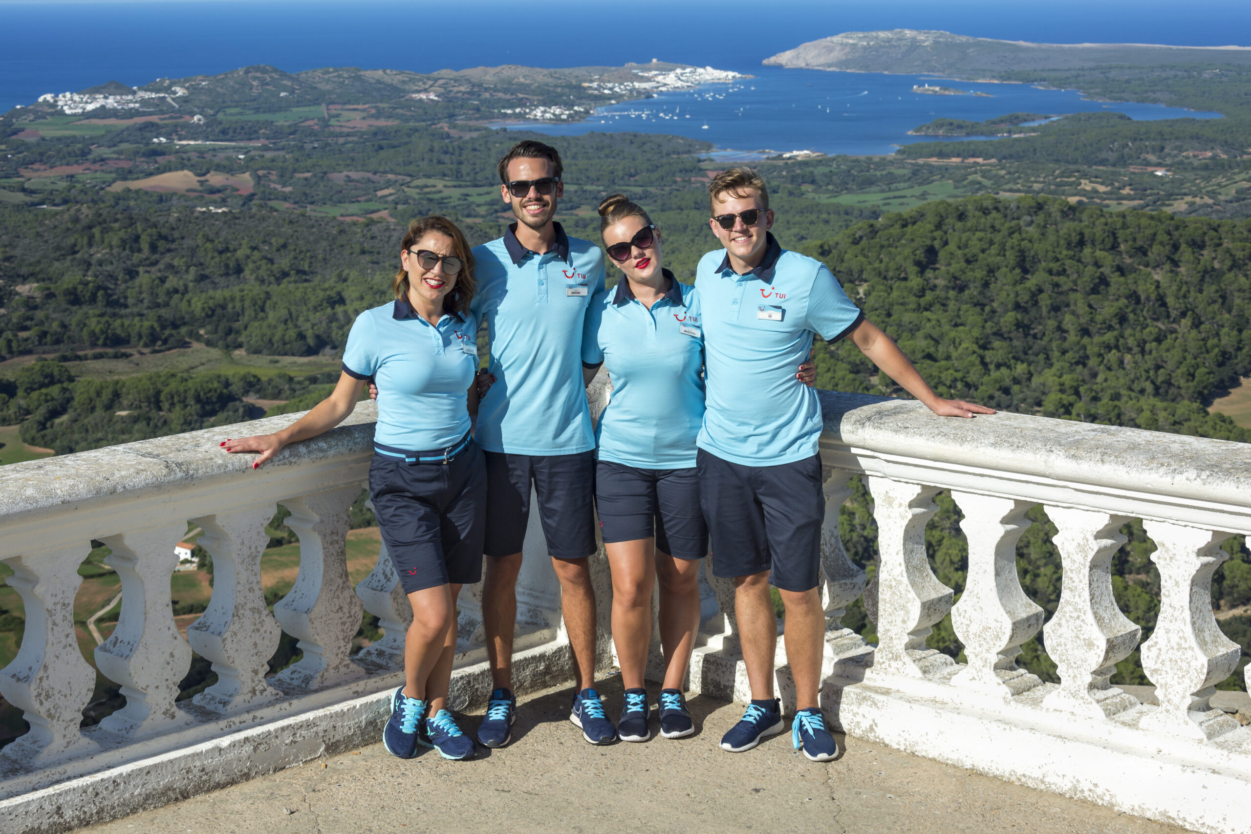
Next Steps
Following successful completion of this qualification, you can progress onto A Levels, or to a vocational qualification at Level 3, such as a BTEC National in Travel & Tourism.
This then allows you enter employment or apprenticeships, or to move on to higher education by studying a degree in the tourism sector.

