Slide 1

Revising GCSE
English Language and
Literature
Join us on our journey….

Slide 2


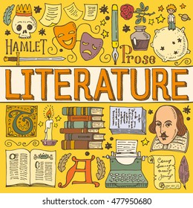
English Language Component 1
1 hour 45 minute exam
English Language Component 2
2 hour exam
English Literature Component 1
2 hour exam
English Literature Component 2
2 hours 30 minute exam

Slide 3
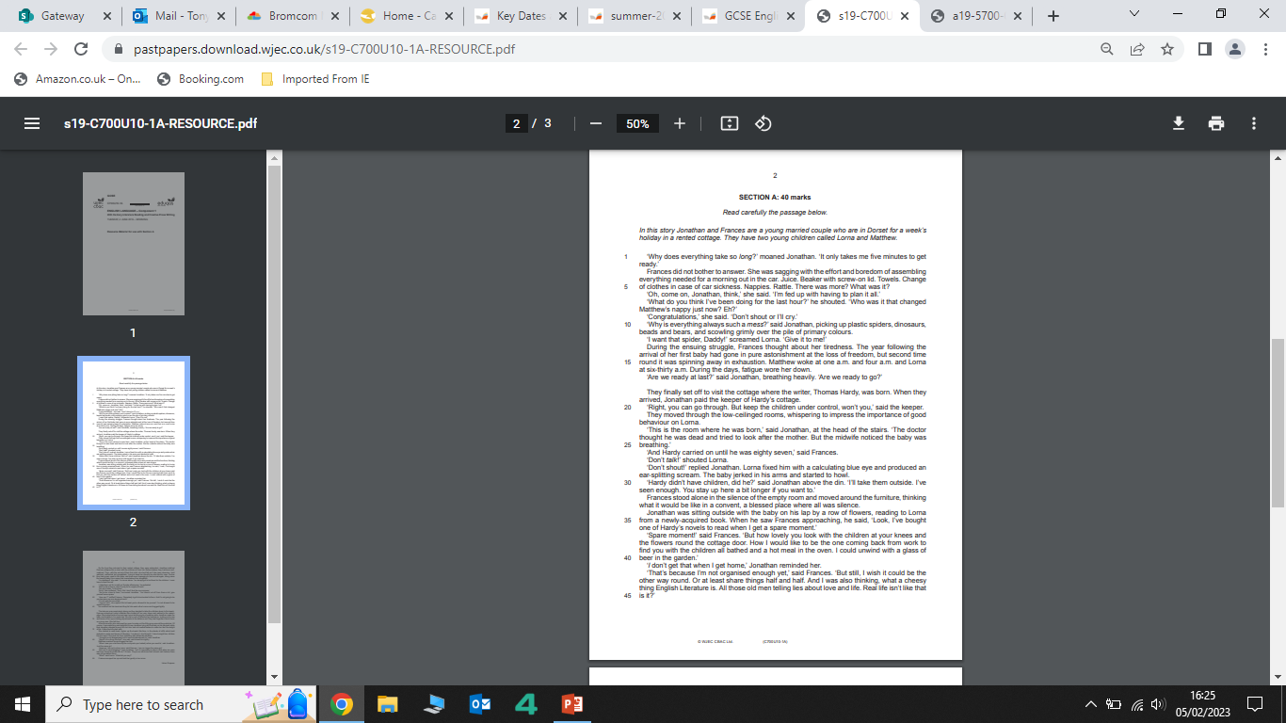
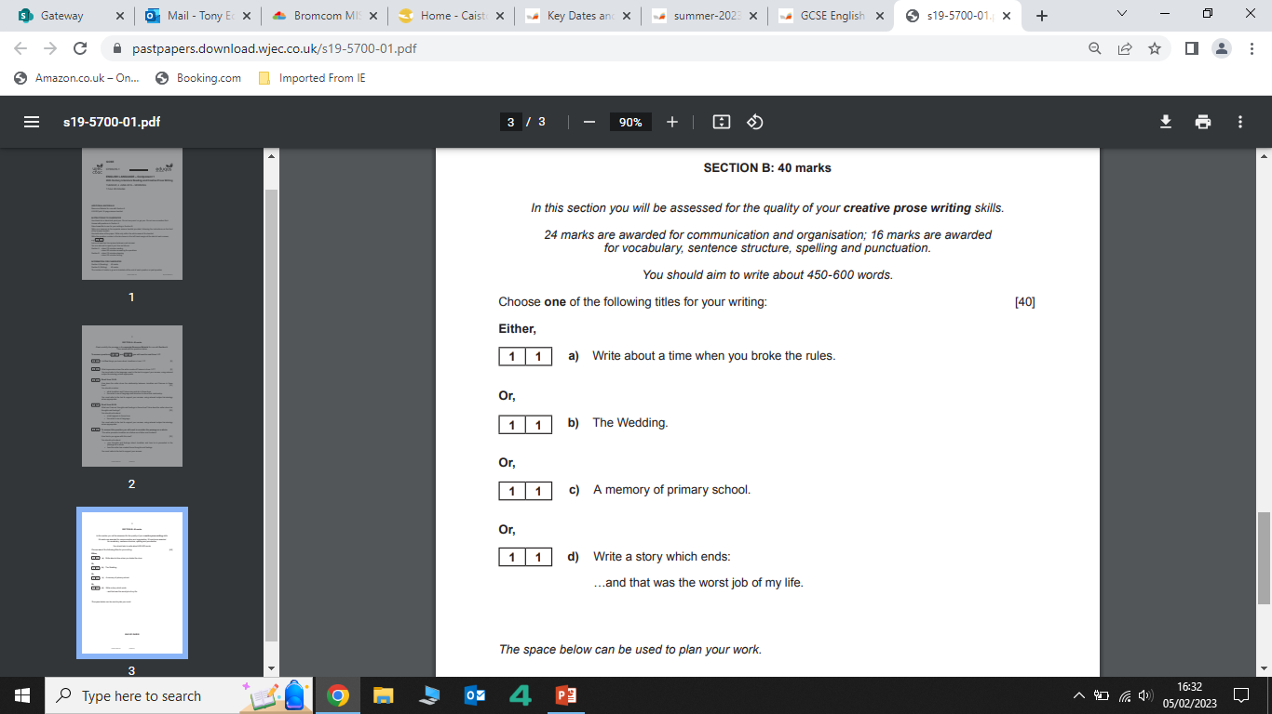
English Language Component 1
Q1: Retrieval
Q2 Impressions
Q3 Lang & Structure
Section B
Section A
Q4: Language
Q5: Evaluation
Q6: Write a Narrative!

Slide 4
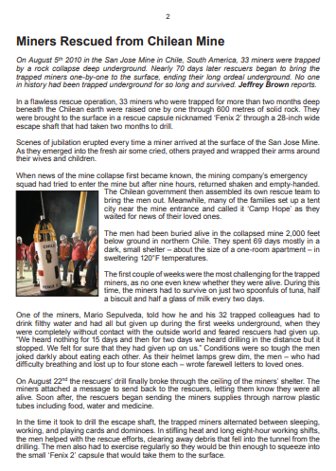
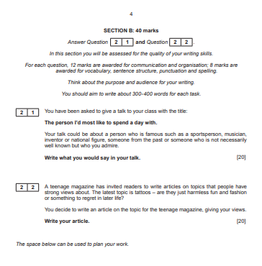
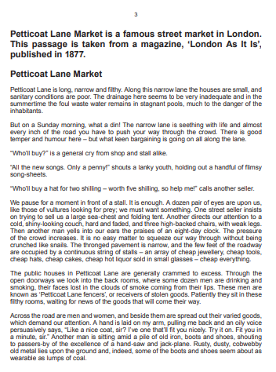
English Language Component 2
Q1.1: Retrieval
Q1.2: Language
Section A
Q1.3: Retrieval
Section B
Q1.4: Evaluation
Q1.5: Brief Explanation
Q1.6: Comparison
Transactional Writing

Slide 5
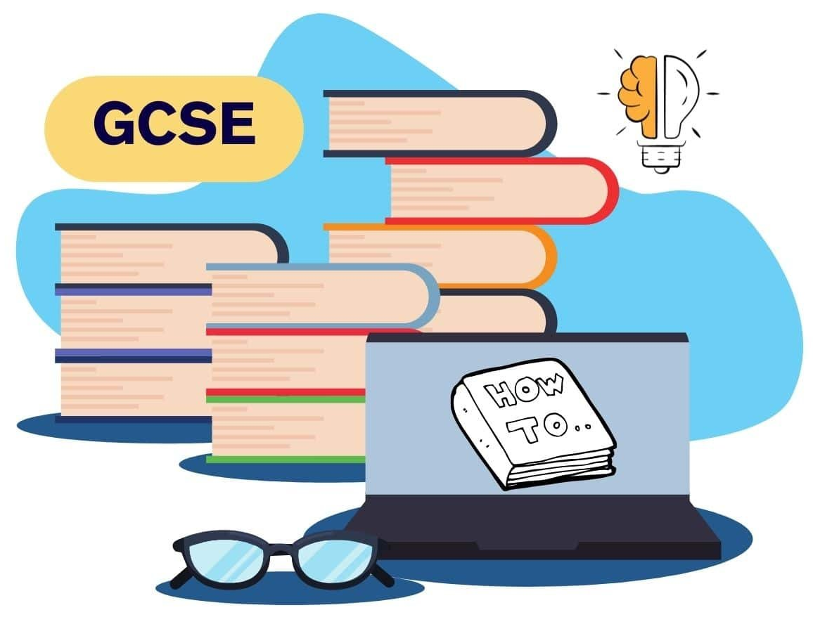
REVISING GCSE ENGLISH LANGUAGE
Use past exam papers to practice under timed conditions.
Break revision into manageable chunks with specific goals.
Create flashcards for key vocabulary and language techniques.
Annotate texts to highlight important ideas and techniques.
Write short practice answers and get feedback.
Read a variety of texts to improve understanding and vocabulary.
Use mind maps to organize ideas and themes.
Teach someone else what you’ve learned to reinforce knowledge.
Take regular breaks to stay focused and avoid burnout.
Review spelling, punctuation, and grammar regularly
Remember, revision that takes place daily will enable you to independently build the skills you need for the linear exams!

Slide 6
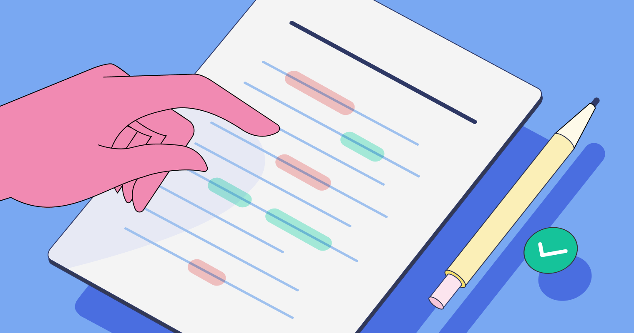

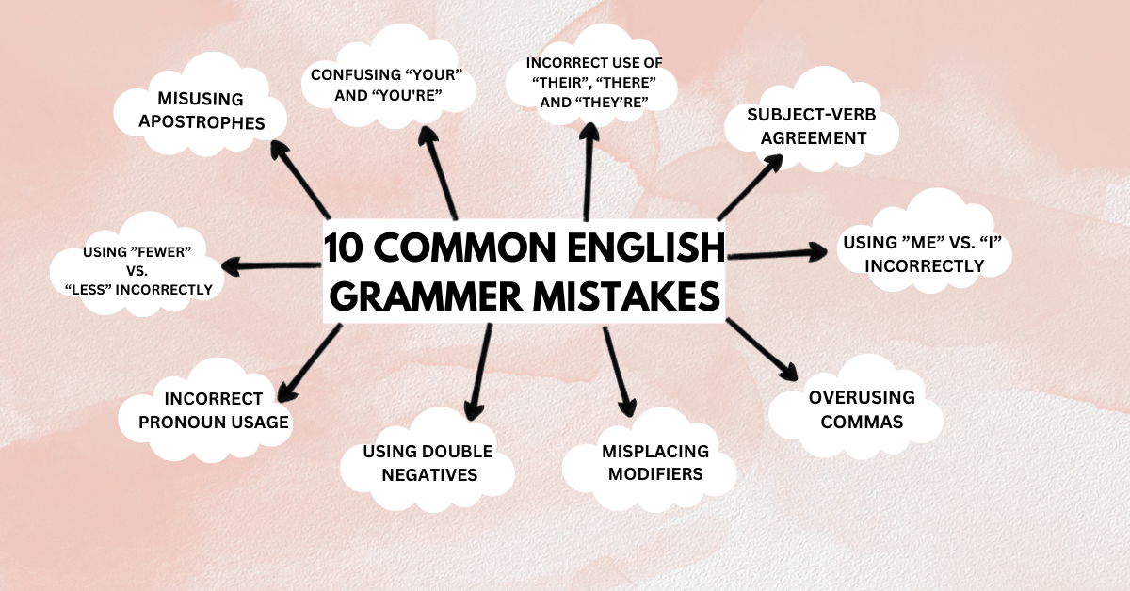
English Language: Writing Skills

Slide 7
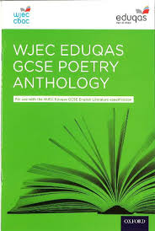

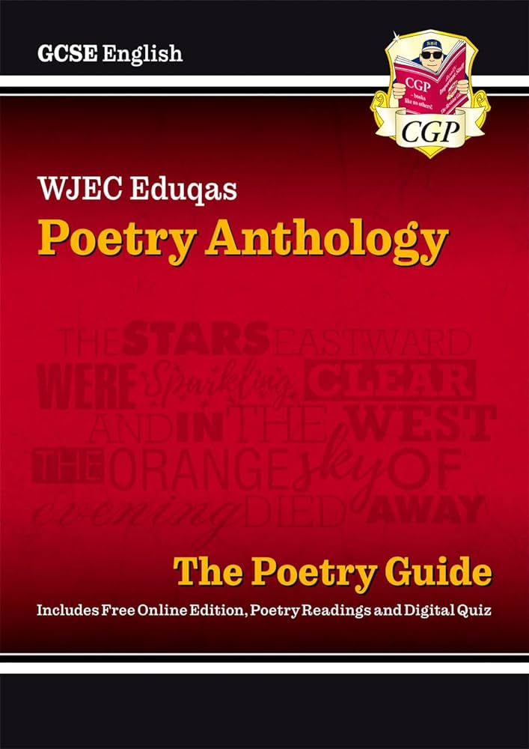
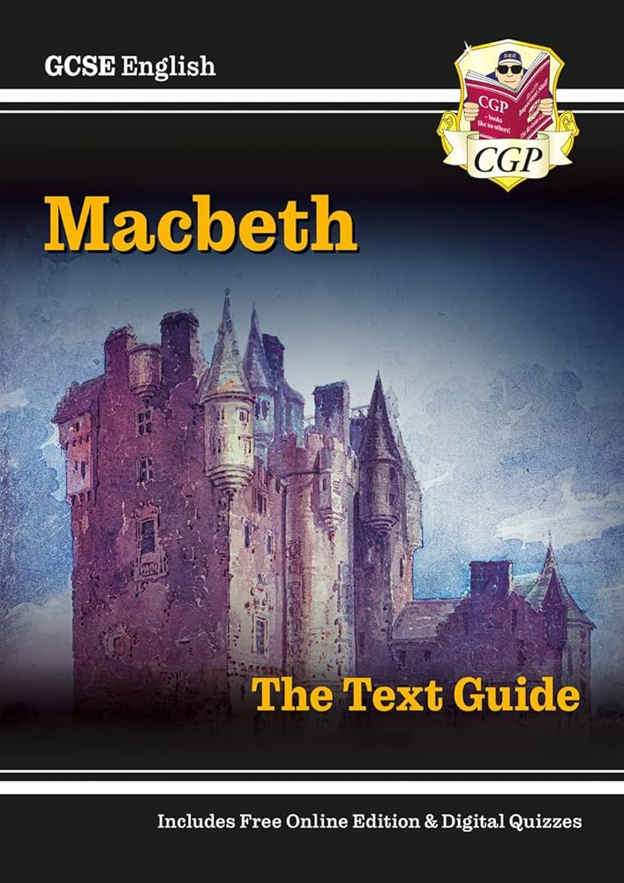
English Literature Component 1
Poetry Anthology
Macbeth

Slide 8

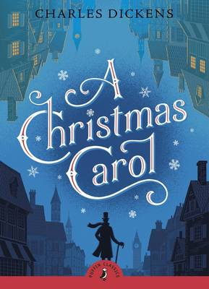

English Literature Component 2
An Inspector Calls
A Christmas Carol
Unseen Poetry

Slide 9

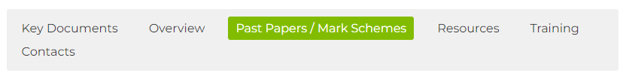
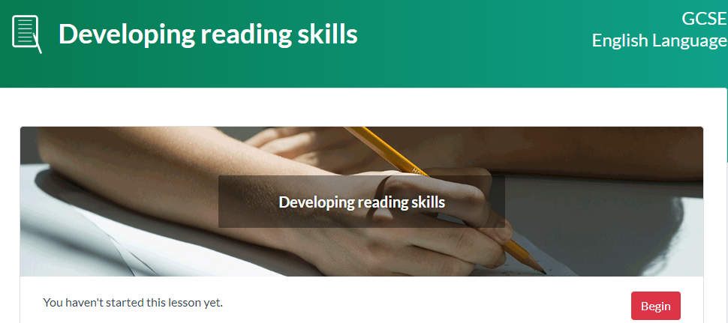

The most effective way to revise & Prepare?
A full range of past papers and mark schemes are readily available
There are a full range of blended learning revision materials available via the Eduqas website. The English team will provide full details and hyperlinks on Microsoft Teams.

Slide 10
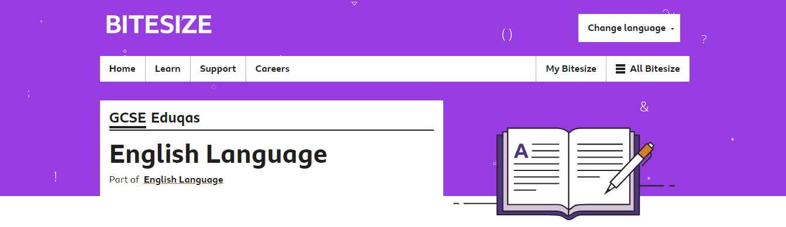
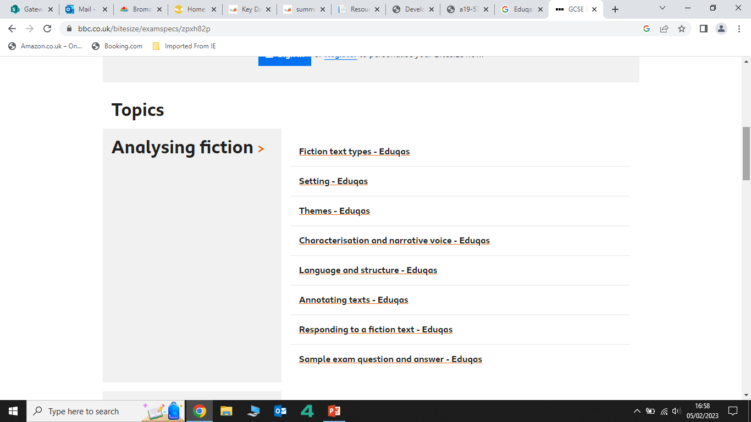
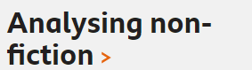
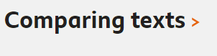
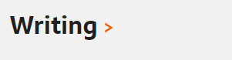
The most effective way to revise & Prepare?

Slide 11


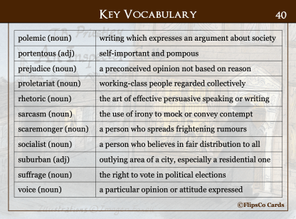
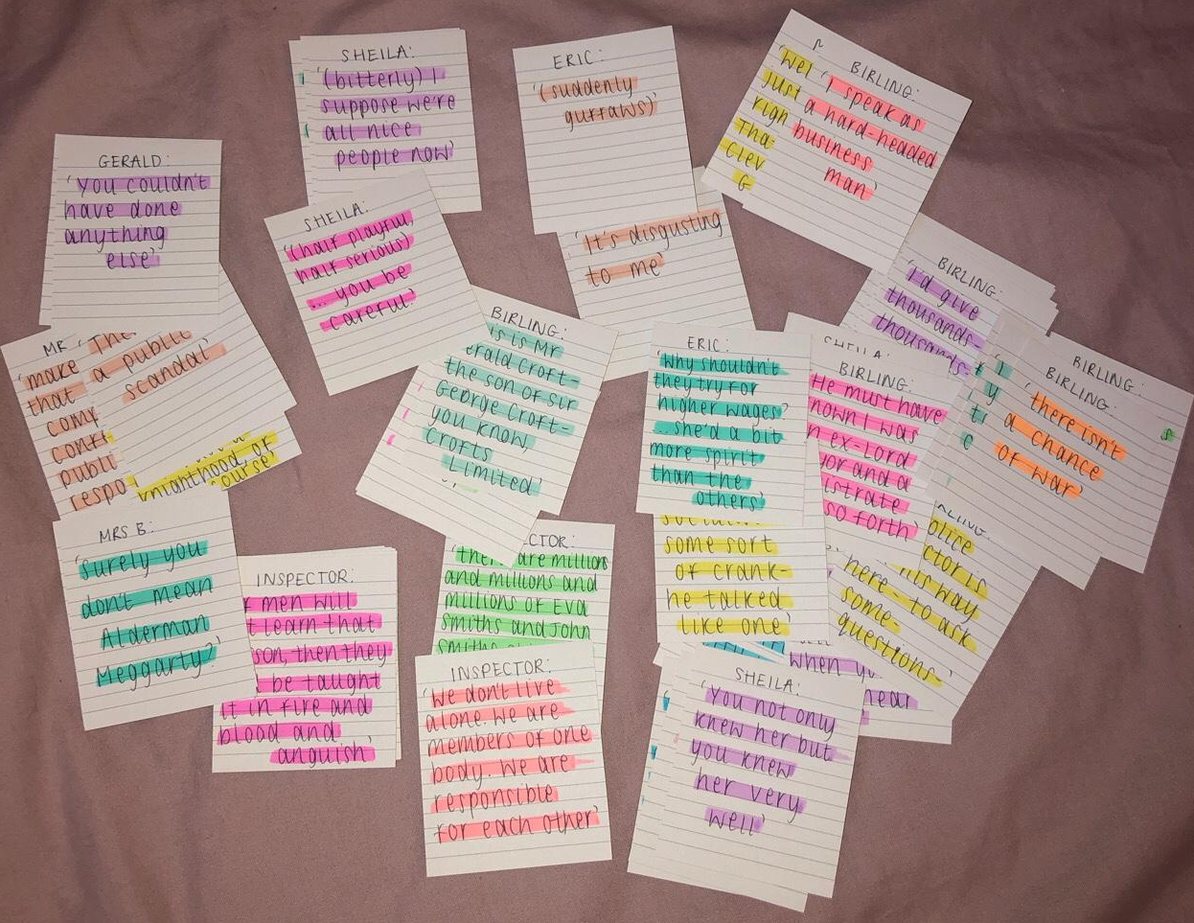
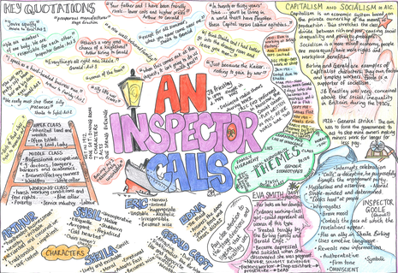


Building your understanding of literature

Slide 12

Contact Details:
Tony.Edmondson@cyac.org.uk

