Slide 1
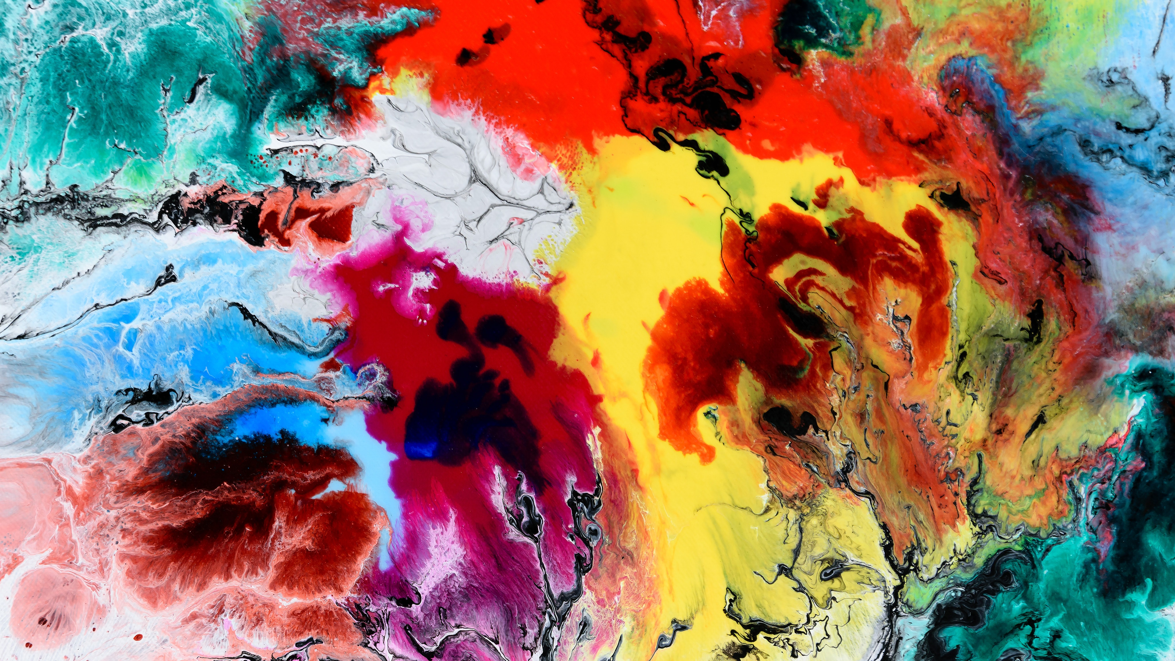
GCSE
ART & DESIGN

Slide 2
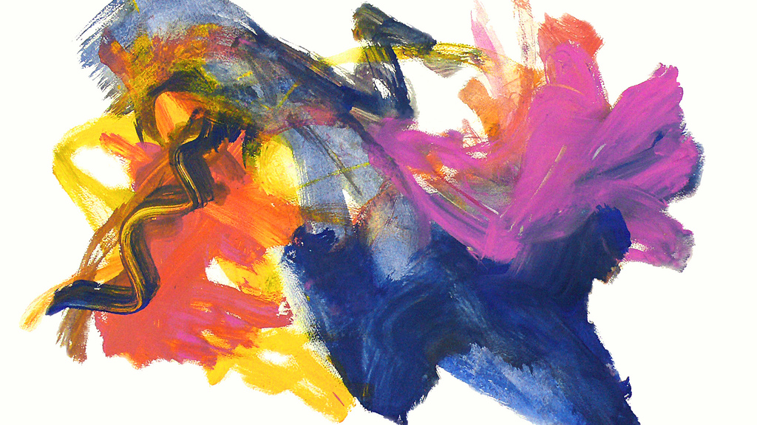
art¹
ɑːt/
noun
noun: art; plural noun: arts; plural noun: the arts
1.
the expression or application of human creative skill and imagination, typically in a visual form such as painting or sculpture, producing works to be appreciated primarily for their beauty or emotional power.

Slide 3

What skills do children gain from Art?
develop eye-hand coordination
develop their small muscle skills
planning, designing and constructing an idea
experimenting with form, line, movement, shapes and spatial relationships
learn skills as you manipulate materials

Slide 4

Art & Design progression opportunities
Exhibition designer
Fine artist
Illustrator
Museum/gallery curator
Printmaker
Architect
Museum Curator
Set and Exhibit Designers
Interior Designer
Art direction

Slide 5

Expectations
Attend all lessons wherever possible – even one missed lesson puts them behind!
To complete at least 1 hour of portfolio work at home each week
Give and receive feedback critically and constructively
Focus in lessons and ensure all work is presented to a high standard
Use their imagination!
Be committed to the course
Trust each other and be team players

Slide 6
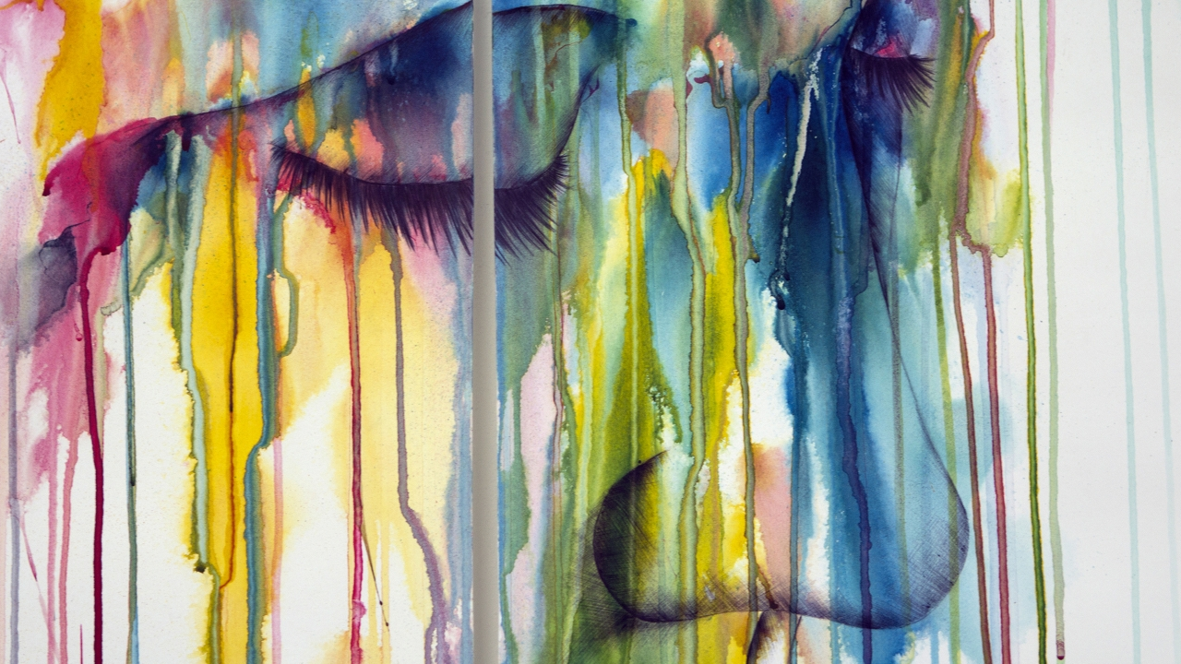
Specification at a Glance
GCSE Art & Design

Slide 7
How you will be assessed:
Component 1: Portfolio
What's assessed A portfolio that in total shows explicit coverage of the four assessment objectives. It must include a sustained project evidencing the journey from initial engagement to the realisation of intentions and a selection of further work undertaken during the student’s course of study.
How it's assessed No time limit 96 marks 60% of GCSE
Component 2: Externally set assignment
What's assessed Students respond to their chosen starting point from an externally set assignment paper relating to their subject title, evidencing coverage of all four assessment objectives.
How it's assessed Preparatory period followed by 10 hours of supervised time 96 marks 40% of GCSE

Slide 8
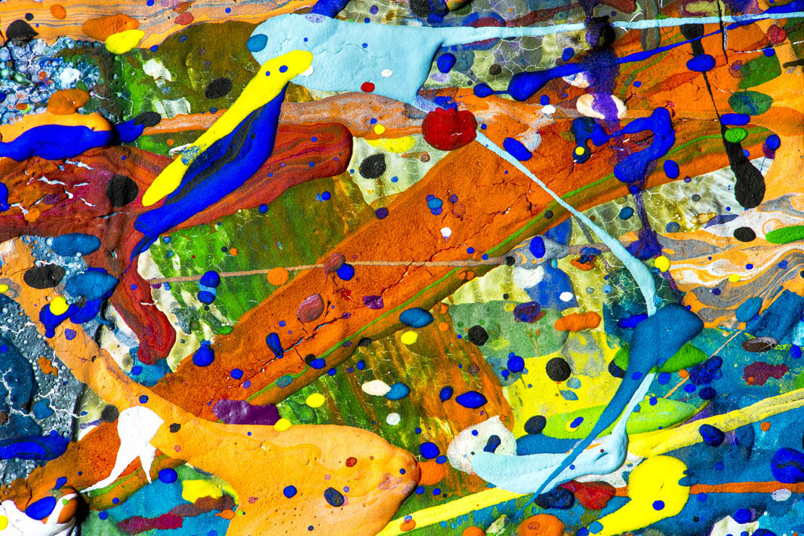
The exams and non-exam assessment will measure how students have achieved the following assessment objectives.
AO1: Develop ideas through investigations, demonstrating critical understanding of sources.
AO2: Refine work by exploring ideas, selecting and experimenting with appropriate media, materials, techniques and processes.
AO3: Record ideas, observations and insights relevant to intentions as work progresses.
AO4: Present a personal and meaningful response that realises intentions and demonstrates understanding of visual language.

