Slide 1
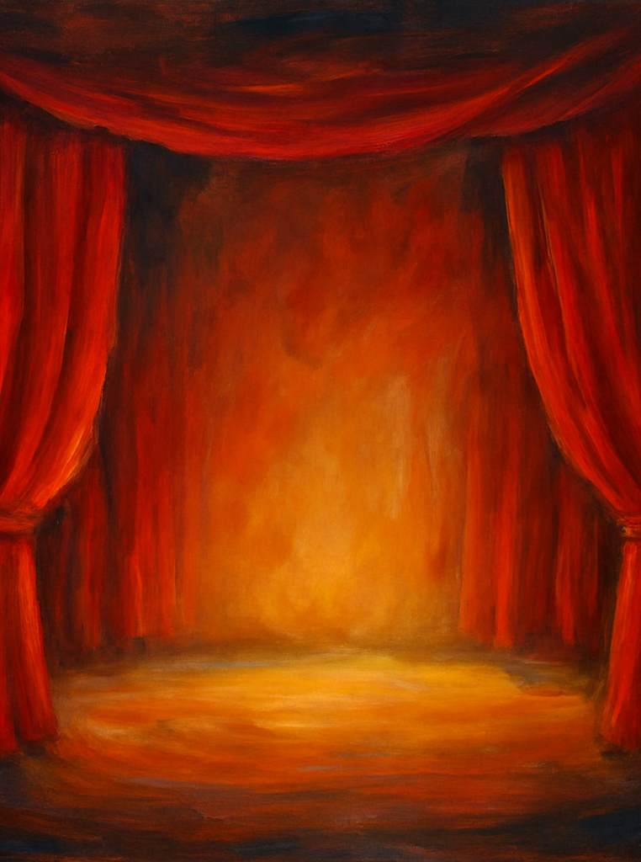
Eduqas GCSE Drama Specification Introduction for Students and parents/guardians
August 2025

Slide 2
Performing arts
Performing Arts: ACTING
Team work
Build confidence
Performing
Communication
Creative
Have fun
Vocal skills
Acting

Slide 3




Aims & Objectives
Apply knowledge and understanding in making, performing and responding to drama
Explore performance texts and their social, cultural and historical contexts
Develop skills in both acting and design through collaborative practice
Reflect critically on your own work and that of others
Knowledge
Texts & Context
Collaboration
Reflection
[1][2]

Slide 4
Course Structure & Assessment
Component 1 – Devising Theatre Create and perform a devised piece based on a stimulus using a practitioner or genre. Includes a portfolio and evaluation.
Component 2 – Performing from a Text Study two extracts from a performance text and perform a piece using sections from both extracts. Externally assessed.
Component 3 – Interpreting Theatre
Written exam: answer questions on a set text and review a live theatre production.
[1][2][3][4]

Slide 5
COMPONENT 1 – DEVISING (40% OF GCSE)
Create a piece using techniques of a practitioner/characteristics of a genre
Stimulus provided by WJEC (choice of 4)
Internally assessed; externally moderated
Work submitted by end of March (Y11)
Groups consist of 2-5 acting candidates
Up to 4 additional design candidates
Performance (Recorded)
2 actors: 5-10 minutes
3 actors: 7-12 minutes
4 actors: 9-14 minutes
5 actors: 11-16 minutes
AO1 Create and develop ideas to communicate meaning for performance. (30 marks)
Ideas created in response to stimulus
Use of practitioner/genre techniques
Individual contribution to process
Development of character/mood and atmosphere
Selection of performance techniques
Use of space
AO2 Apply theatrical skills to realise artistic intentions in live performance
(15 marks)
Application of performance skills
Interpretation of character/scene
Individual contribution to performance
AO4 Analyse and Evaluate their own work
(15 marks)
Their application of performance skills
Their interpretation of character/scene
Their individual contribution
Evaluation
Supervised conditions – 1 hour 30 minutes.
Must complete 3 sections:
An analysis and evaluation of interpretation of character in performance
An analysis and evaluation of how their skills contributed to effectiveness of performance
An analysis and evaluation of their individual contribution to final performance, indicating how effectively they fulfilled their initial aims and objectives
Learners have access to 2 sides of A4 in bullet point notes when writing evaluation.
Portfolio (750-900 words)
Compiled during the process.
Focus on 3 moments where work has changed in a significant way. Explain how:
1. Ideas have been researched/created/developed in response to stimulus
Ideas from chosen practitioner/drama have been applied to create meaning
Ideas have been developed, amended and refined
250-300 words for each section

Slide 6
COMP 2 – PERFORMING FROM A TEXT (20%)
COMP 3 – INTERPRETING THEATRE (40%)
Externally assessed
Performance of two extracts (10 minutes) from same text
2-4 actors per group, up to 2 additional design candidates
Don’t need to perform the full 20 minutes studied
The text must contrast in playwright, time period and theme to text chosen for Comp 3
All learners submit 150 word paragraph to examiner stating artistic intentions (not assessed)
Performers assessed on:
Physical skills
Vocal skills
Interaction with other performers
Interpretation of character
Communication with audience
Contribution to performance in realising artistic intentions.
40% of GCSE
Written exam – 60 marks
1 hour 30 minutes
Section A: Set Text – 45 marks
A series of questions on one set text. Assessed on ability to explore:
Acting
Designing
Directing
Section B: Live Theatre Review – 15 marks
One question from choice of two
Designers assessed on:
Application of design skills
Creation of mood and atmosphere
Changes in design to compliment performance
Interpretation of text
Communication of meaning
Contribution to performance in realising artistic intentions
Texts (2024 onwards):
Macbeth – William Shakespeare
An Inspector Calls – J.B Priestley
Find Me – Olwen Wymark
Noughts & Crosses – Malorie Blackman
Refugee Boy – Benjamin Zephaniah
I Love You Mum – I Promise I Won’t Die – Mark Wheeler
The IT – Vivienne Franzmann
Groups of 2 actors: 5-10 minutes
Groups of 3 actors – 7-12 minutes
Groups of 4 actors – 9-14 minutes

Slide 7
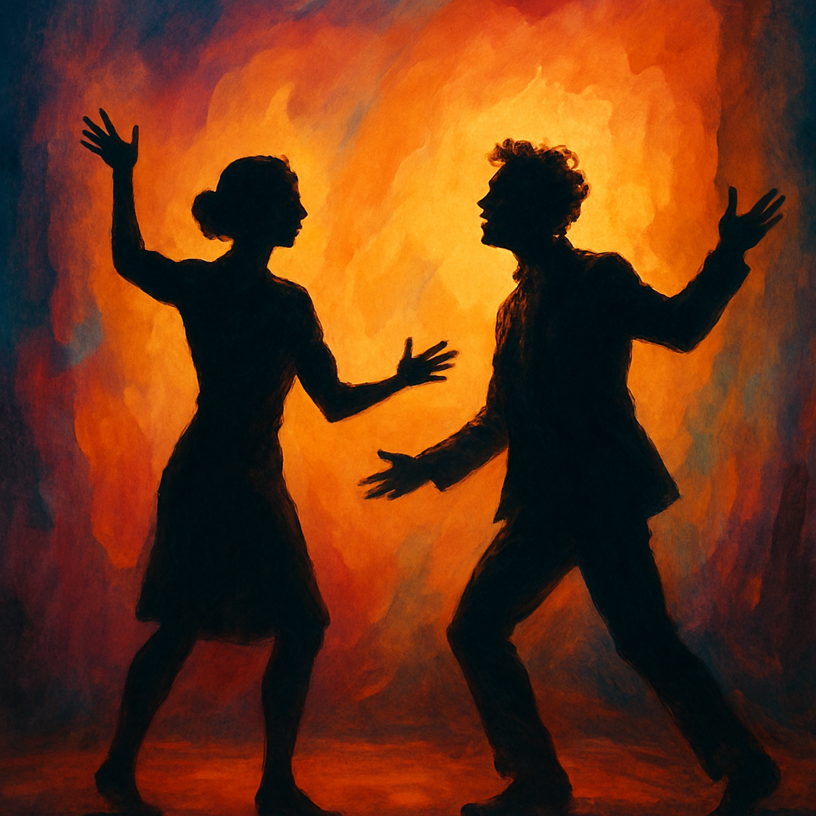
Component 1: Devising Theatre
Overview
Non‑exam assessment worth 40% of the qualification – 60 marks
Create and perform a devised piece using a practitioner or genre in response to a stimulus set by Eduqas
Produce a portfolio and written evaluation
Practical tasks – Acting
Brainstorm stimuli to generate themes, characters and narrative
Devise scenes through improvisation and script‑writing exercises
Rehearse with peers focusing on voice, movement and characterisation
Practical tasks – Design
Develop a set, costume or lighting concept inspired by your stimulus
Create a mood board and scale model to communicate your vision
Collaborate with performers to refine technical elements and produce cues
[1]

Slide 8

Component 2: Performing from a Text
Overview
Externally assessed by visiting examiner (20% of qualification – 60 marks)
Study two 10 minute extracts from one performance text
Perform a piece using sections from both extracts
Acting tasks
Analyse characters and context in the chosen play
Rehearse selected scenes focusing on movement and voice
Collaborate with peers to refine ensemble work
Design tasks
Research period and style to inform design choices
Draft set, costume or lighting plans for the scenes
Collaborate with actors to integrate designs into performance
[1]

Slide 9

Component 3: Interpreting Theatre
Overview
1 hour 30 minutes written examination (40% of qualification – 60 marks)
This years is 8th May
Section A: questions on a set text
Section B: review of a live theatre production
Set Texts
An Inspector Calls
Find Me
I Love You, Mum – I Promise I Won't Die
Macbeth
Noughts & Crosses
Refugee Boy
The IT
Preparation tips – Acting
Read and annotate your chosen set text, exploring character motivations
Watch live or recorded productions to analyse directorial choices
Practise answering exam questions with timed responses
Preparation tips – Design
Develop a concept design for set, costume or lighting that communicates themes
Justify your design ideas by referencing the script and contextual research
Attend live performances to observe how design enhances storytelling
[1][2]

Slide 10
Skills & Development
Creativity & Imagination Generate original ideas and bring them to life on stage.
Teamwork & Communication Collaborate effectively and communicate your vision with others.
Critical Thinking Analyse plays and performances to make informed creative decisions.
Resilience & Self‑Reflection Embrace feedback and refine your work through evaluation.
[1]

Slide 11
Expectations
Students must:
Attend all required rehearsals
Know all their lines at least 2 weeks before assessment
Have all their design plans finished at least 2 weeks before assessment
Give and receive feedback
Focus in lessons and rehearsals (students are marked on their conduct in every lesson)
Use their imagination! It is their performance!
Be committed to the course.
Trust each other and work with everyone

Slide 12

Conclusion & Next Steps
Summary
The Eduqas GCSE Drama course offers a balanced blend of practical and written work. Whether your focus is acting or design, you will develop creative, analytical and collaborative skills that extend far beyond the studio.
Next Steps
Engage enthusiastically with all practical tasks – rehearsal is essential
Attend and review live theatre to broaden your understanding
Keep a reflective journal documenting your progress and ideas
Make use of design portfolios and rehearsals to communicate your vision
Ask questions and collaborate – your teacher and peers are vital resources
[1]

Slide 13
“There are no small parts there are only small actors!”
Students CAN get a GCSE grade 7/8 if their character only has a few lines
They can and SHOULD show their skills through alternative acting techniques

