Slide 1
GCSE AQA Fine Art
Year 9 Options Assembly
What You Need to Know

Slide 2
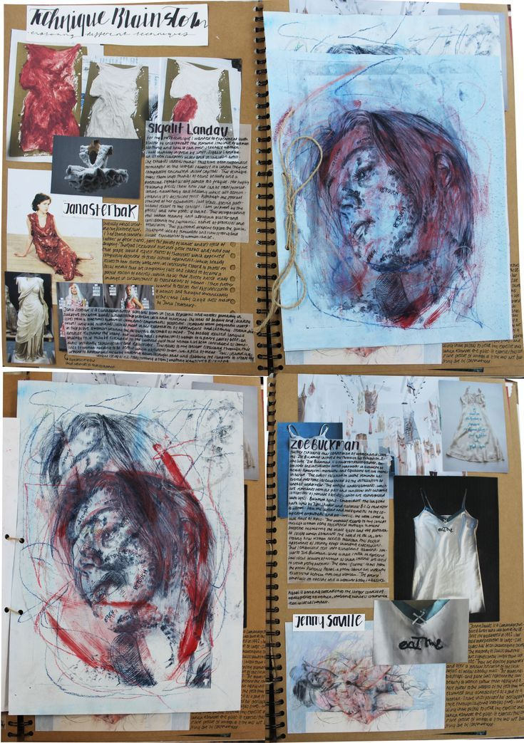
What is GCSE Fine Art?
A creative subject focused on drawing, painting, sculpture, photography, and mixed media.
You develop ideas through investigation, practice, and personal projects.

Slide 3
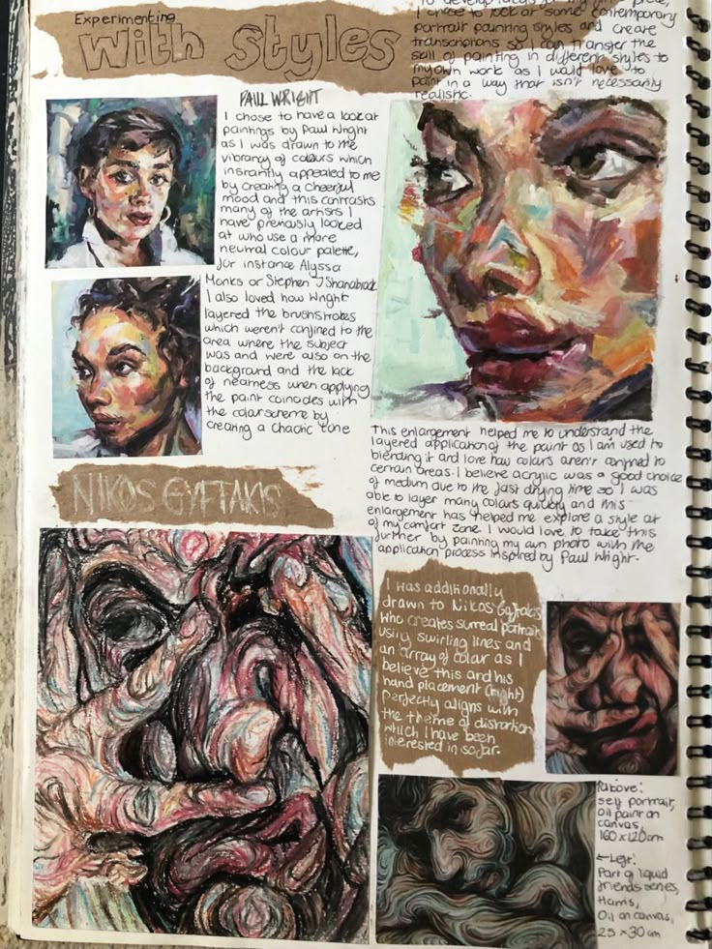
Course Structure (AQA)
Component 1: Portfolio (60%)
Ongoing coursework over 2 years.
Component 2: Externally Set Assignment (40%)
10-hour final exam project.

Slide 4
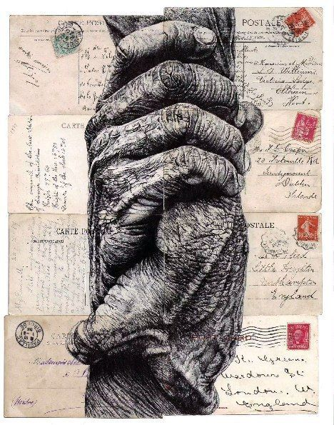
AQA Assessment Objectives
AO1: Develop ideas and research
AO2: Experiment with materials
AO3: Record observations (mainly drawing)
AO4: Present a personal response

Slide 5
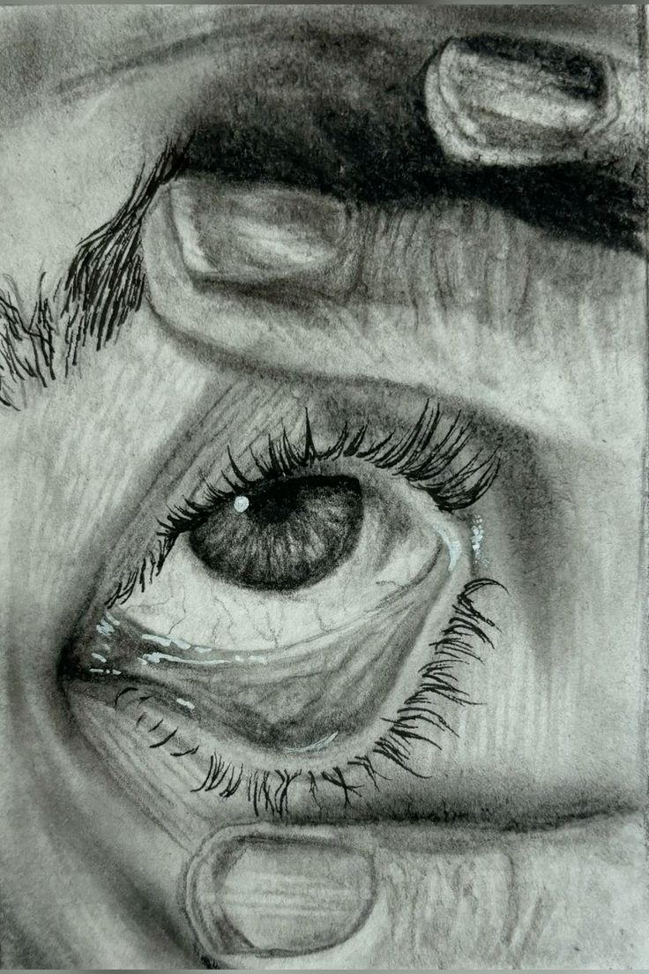
How Much Drawing is Involved?
Drawing is essential and continuous.
You will:
- Draw every week
- Keep a detailed sketchbook
- Do observational drawing
- Practise technical skills
If you dislike drawing, this subject is not recommended.

Slide 6
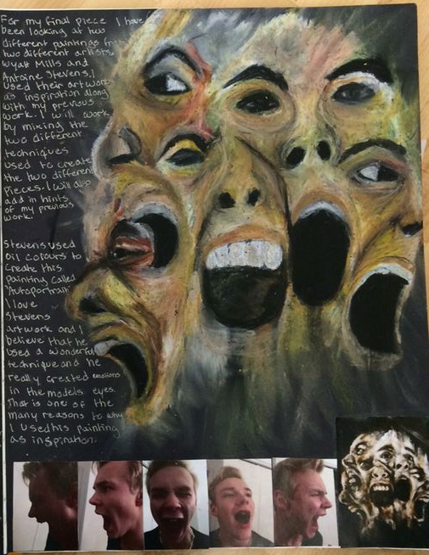
Written Annotation
Written work is required in every project.
You must:
- Explain your ideas
- Analyse artists
- Evaluate your work
- Reflect on improvements
Expect regular written tasks.

Slide 7
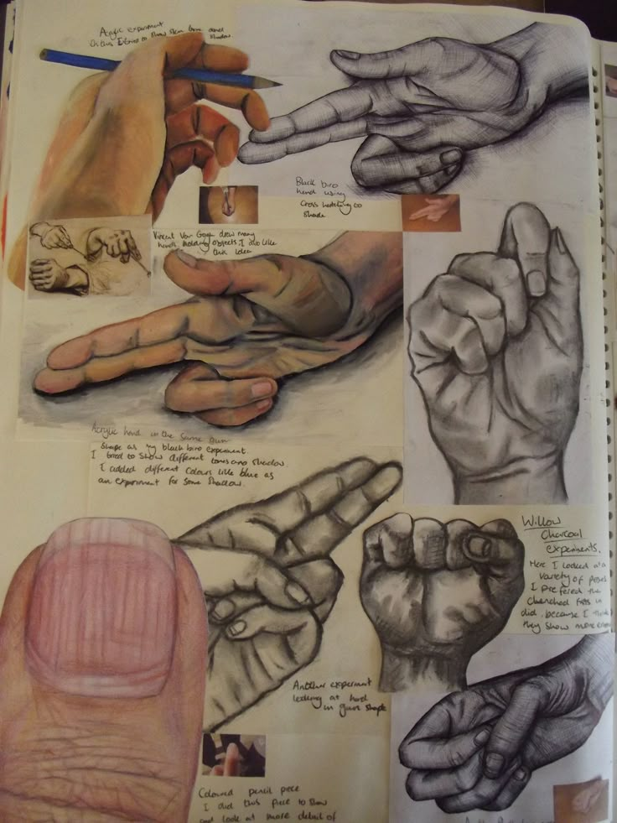
Essential Skills for Success
- Strong drawing ability
- Good organisation
- Creativity and imagination
- Time management
- Willingness to practise
- Independence

Slide 8
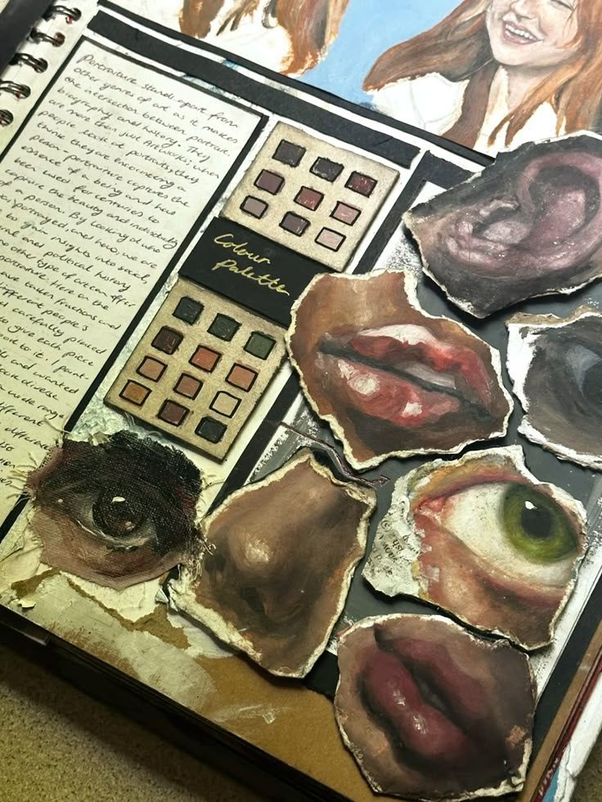
Workload and Commitment
This is a demanding subject.
You will:
- Complete homework weekly
- Work on projects at home
- Meet strict deadlines
- Manage long-term coursework

Slide 9
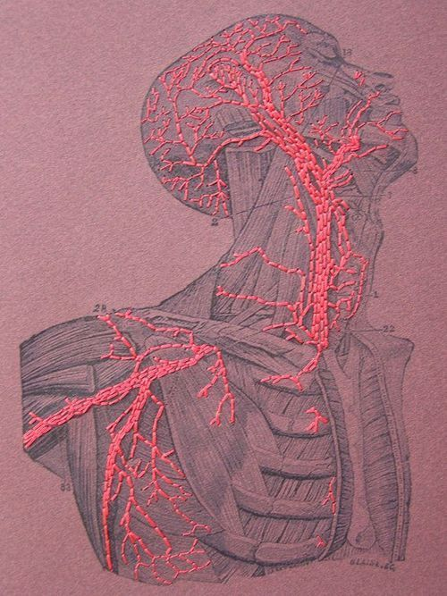
Who Should Choose Fine Art?
Choose this subject if you:
- Enjoy drawing regularly
- Like creating artwork
- Are self-motivated
- Are prepared to practise
Not suitable for last-minute workers.

Slide 10
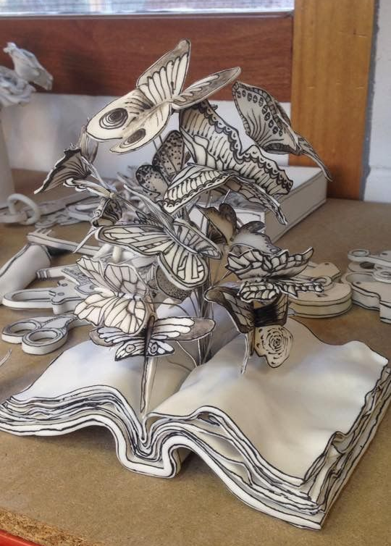
Important Warning
If you struggle with drawing or dislike creative work:
- You may find this course stressful
- Grades depend heavily on practical skill
- Progress is slow without practice

Slide 11
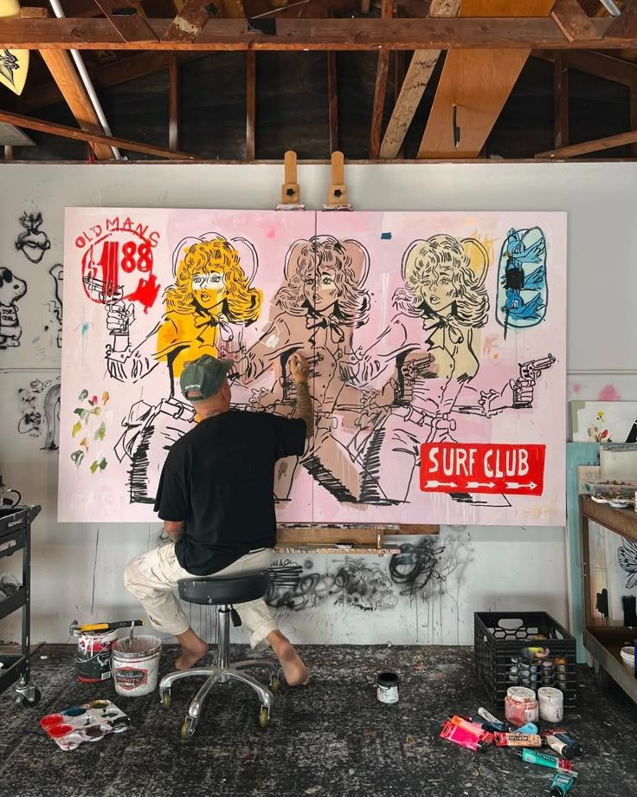
Career Pathways
- Graphic Designer
- Illustrator
- Animator
- Fine Artist
- Fashion Designer
- Architect
- Interior Designer
- Art Teacher
- Game Designer

Slide 12
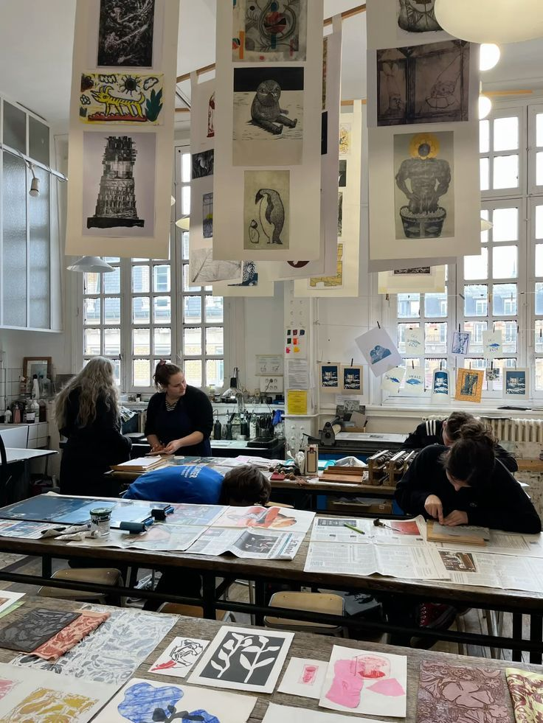
Further Study Routes
GCSE Fine Art → A-Level Art → University → Creative Careers
Also useful for:
- Media Studies
- Design Technology
- Photography

Slide 13
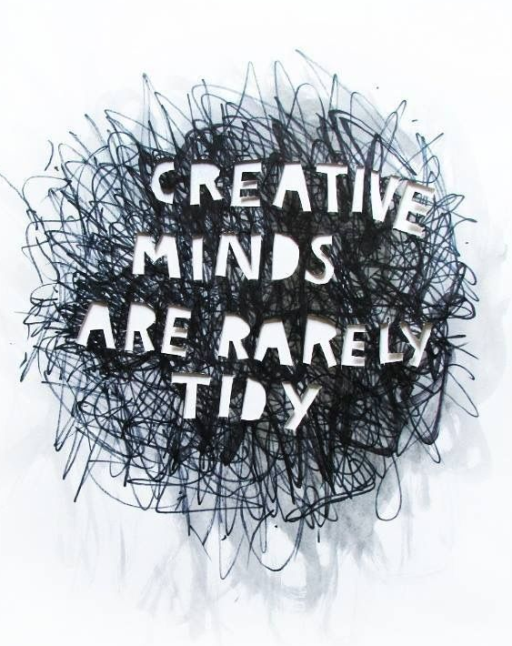
Final Advice
Choose Fine Art if:
- You enjoy drawing
- You accept heavy coursework
- You are committed to improving your skills
It is challenging but rewarding!

