Slide 1

OCR
GRAPHIC COMMUNICATION GCSE

Slide 2
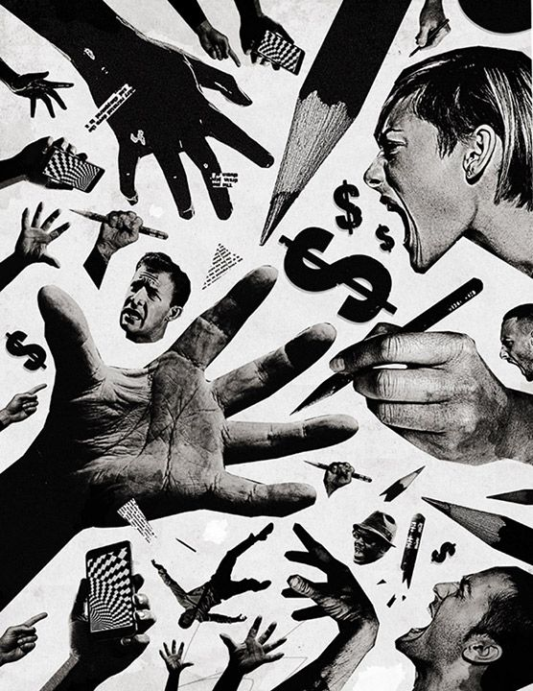
What is Graphic Communication?
Graphic communication is the process of conveying information, ideas, and emotions using visual materials such as drawings, photographs, text, and digital tools.
It involves designing and producing visual content, including branding, packaging and advertisements. The goal is to create engaging and impactful messages that resonate with an audience by leveraging a wide range of media and design principles.

Slide 3
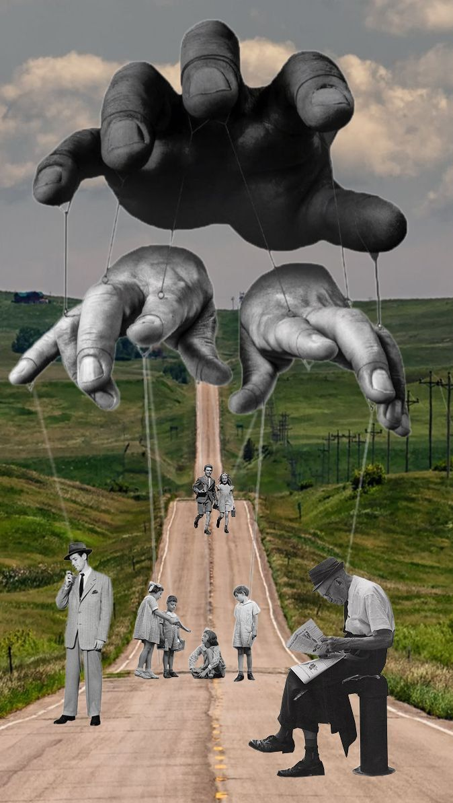
Progression Opportunities
UX/UI Designer:Focuses on user experience, ensuring products, apps, and websites are intuitive and accessible.
Brand Strategist:Develops visual and strategic brand identities.
Illustrator/Typographer:Creates artwork for various media or focuses on the art of typography.
Animator/VFX Artist:Creates moving images for film, television, and other digital platforms.
Web Designer:Designs and develops visual layouts for websites.
Creative Director:Oversees creative projects and teams.
Art Director:Guides artistic and design elements of a project.
Studio Manager/Project Manager:Manages the workflow and resources within a design agency.
Freelance Graphic Designer:Offers design services independently to various clients.
Advertising & Marketing:Applies design skills to create campaigns for companies.
Media & Publishing:Designs for magazines, books, and other media outlets.
Fashion & Film:Works in visual design for these creative industries.

Slide 4

How is the course structured?
Y10 – The Honey Project: Students will be required to create a brand identity for a company, packaging designs and advertisements. Within this project they will look at marketing, typography, packaging design and illustration.
Y10/11 - Festival: Students are required to re-brand a popular music festival. They will need to produce a logo, print promotional items and merchandise. In this project they will explore digital editing, illustration, photography and design for print.
Y11 – Exam Unit: the students will choose one of seven starting points and develop their own personal project. The themes change each year, but in the past have been 'movies', 'dining room', 'hair', to name a few!

Slide 5
How the pupils will be assessed:
Component 1: Portfolio
What's assessed A portfolio that in total shows explicit coverage of the four assessment objectives. It must include a sustained project evidencing the journey from initial engagement to the realisation of intentions and a selection of further work undertaken during the student’s course of study.
How it's assessed No time limit 96 marks 60% of GCSE
Component 2: Externally set assignment
What's assessed Students respond to their chosen starting point from an externally set assignment paper relating to their subject title, evidencing coverage of all four assessment objectives.
How it's assessed Preparatory period followed by 10 hours of supervised time 96 marks 40% of GCSE

Slide 6

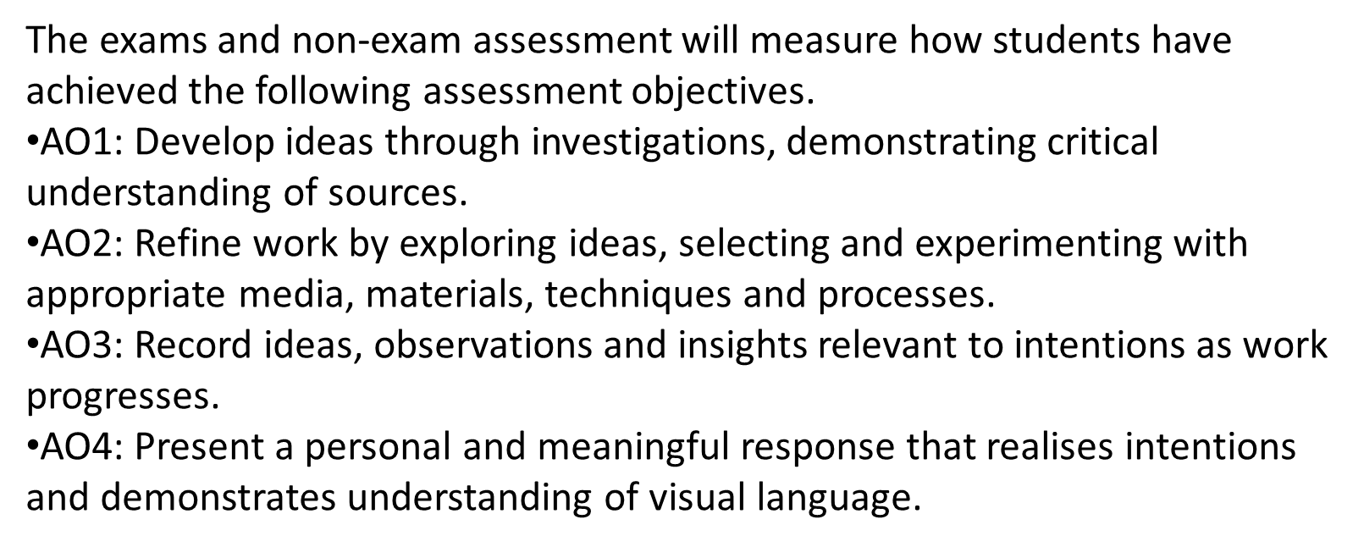
The Assessment Objectives

Slide 7
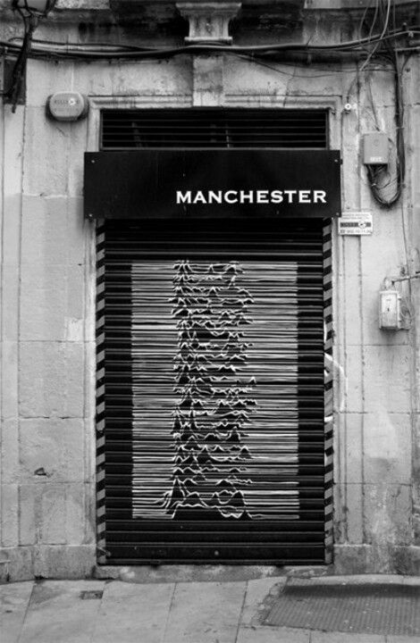
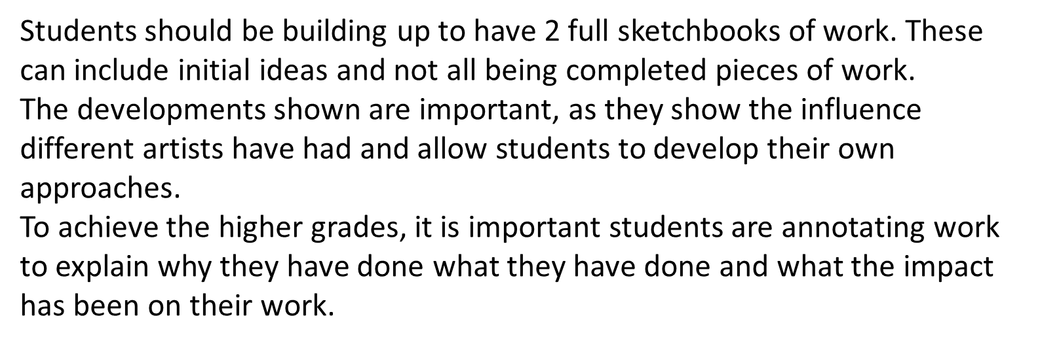
Expectations
There is an emphasis on recording ideas and this will be through writing, drawing and taking photographs.
STUDENTS WILL NEED TO WORK AT HOME!

