Slide 1
OCR GCSE Graphic Communication
Year 9 Options Assembly
What You Need to Know

Slide 2
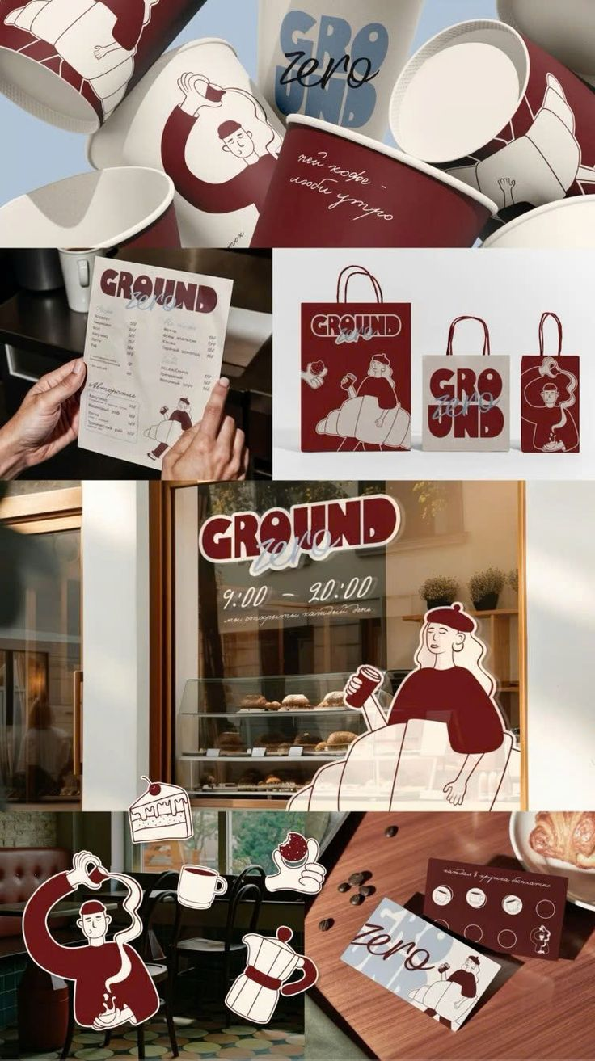
What is GCSE Graphic Communication?
A creative subject focused on visual communication.
You design posters, logos, packaging, branding, and merchandise.

Slide 3
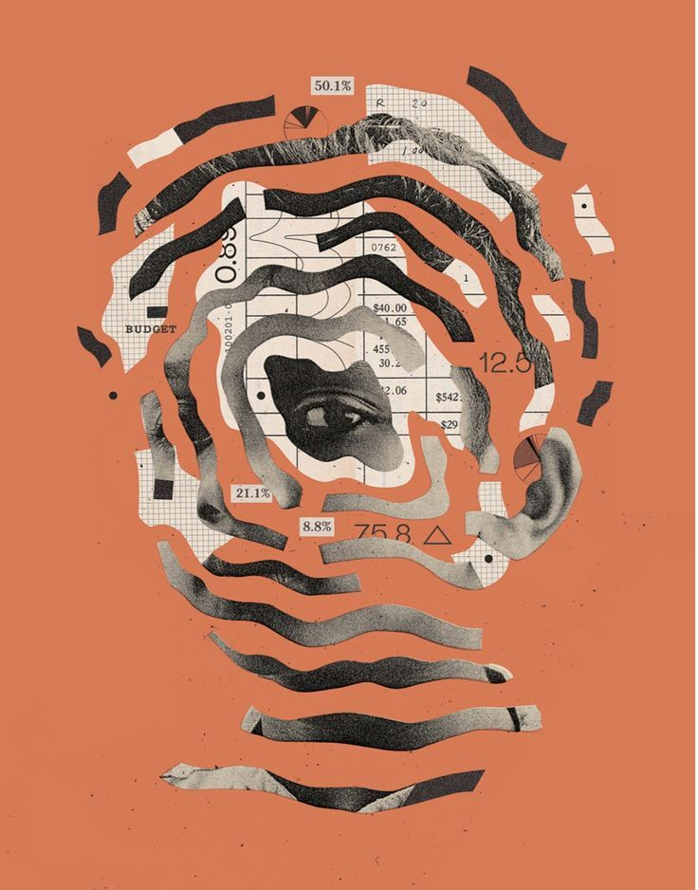
Course Structure (OCR)
Component 1: Portfolio (60%)
Coursework over 2 years: HONEY & FESTIVAL!
Component 2: Externally Set Task (40%)
10-hour controlled assessment.

Slide 4
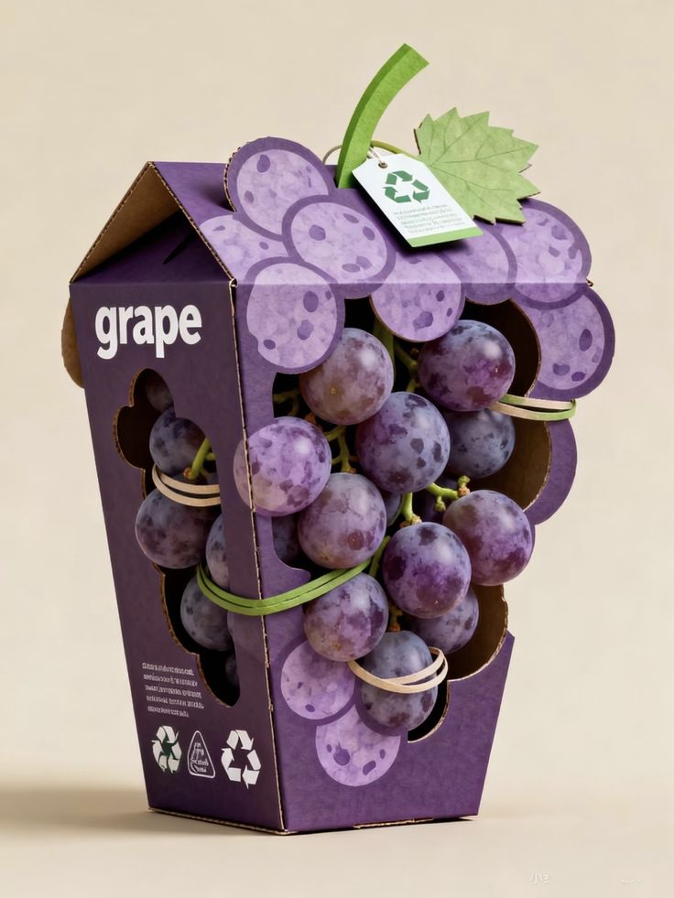
OCR Assessment Objectives
AO1: Develop ideas and research
AO2: Experiment with materials and digital tools
AO3: Record ideas through drawing and design
AO4: Present a personal response

Slide 5

The Importance of Drawing
Drawing is essential.
You will:
- Sketch design ideas
- Develop layouts
- Plan typography
- Create visual concepts
Weak drawing skills limit progress.

Slide 6

Creativity is Essential
You must be highly creative.
You will:
- Generate original ideas
- Solve design problems
- Take creative risks
- Develop personal style
Basic ideas will not achieve high grades.

Slide 7
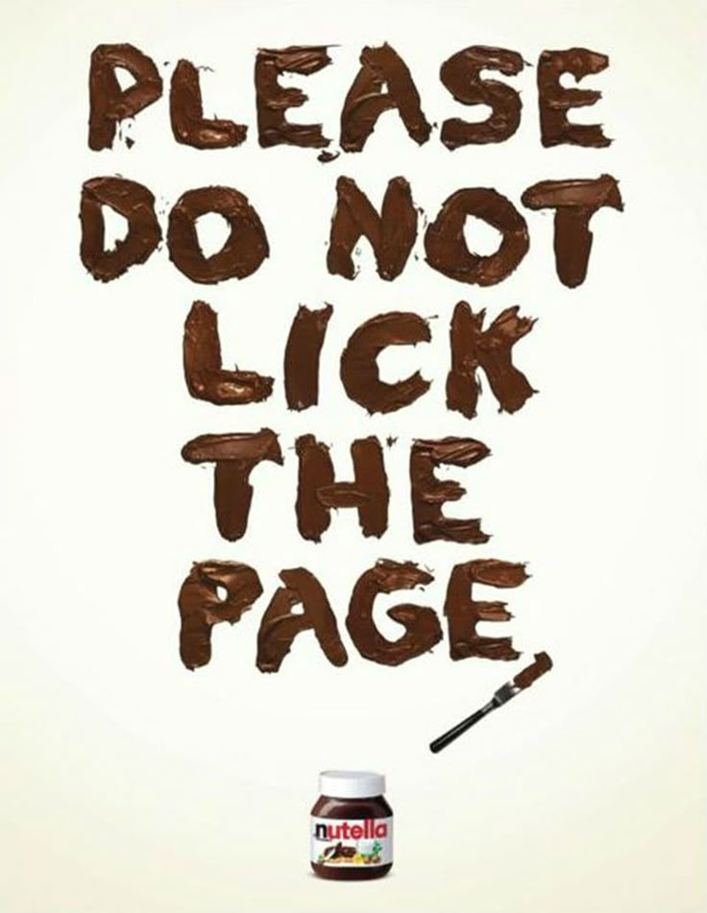
Written Analysis and Evaluation
Extended writing is required.
You must:
- Analyse designers
- Explain design choices
- Evaluate your own work
- Use specialist vocabulary
Strong writing skills are vital.

Slide 8
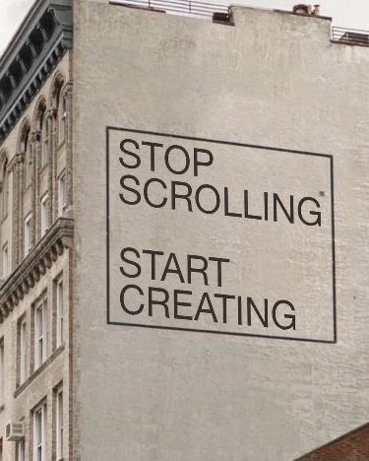
Essential Skills for Success
- Strong drawing ability
- High creativity
- Confident writing skills
- Digital design skills
- Organisation
- Independence

Slide 9

Workload and Commitment
This is demanding.
You will:
- Meet frequent deadlines
- Complete work at home
- Write detailed evaluations
- Manage long-term projects

Slide 10
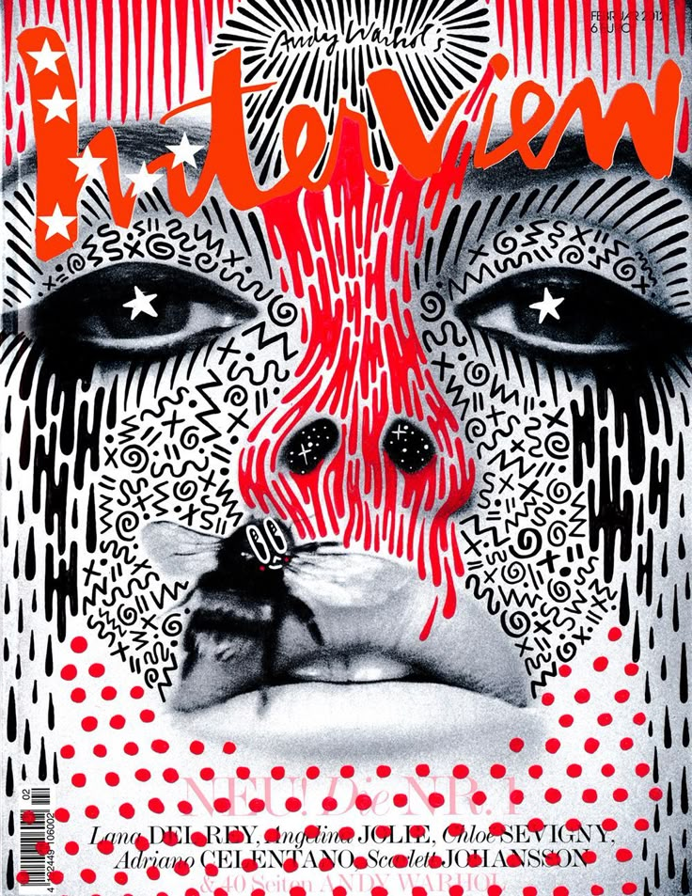
Who Should Choose This Subject?
Choose if you:
- Enjoy drawing and designing
- Are very creative
- Can write in detail
- Work independently
Not suitable for low effort.

Slide 11
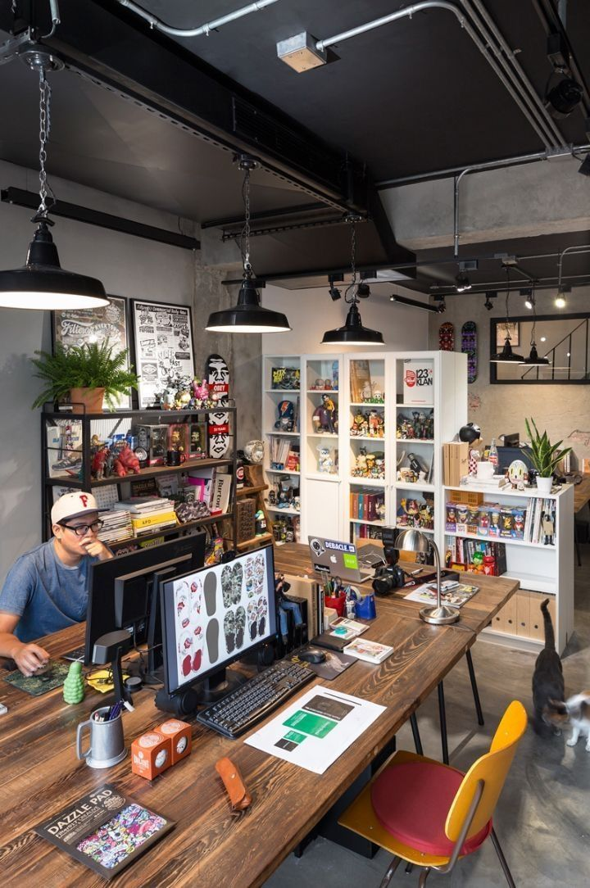
Career Pathways
- Graphic Designer
- Brand Designer
- Illustrator
- Advertising Creative
- Web Designer
- UI/UX Designer
- Digital Artist

Slide 12
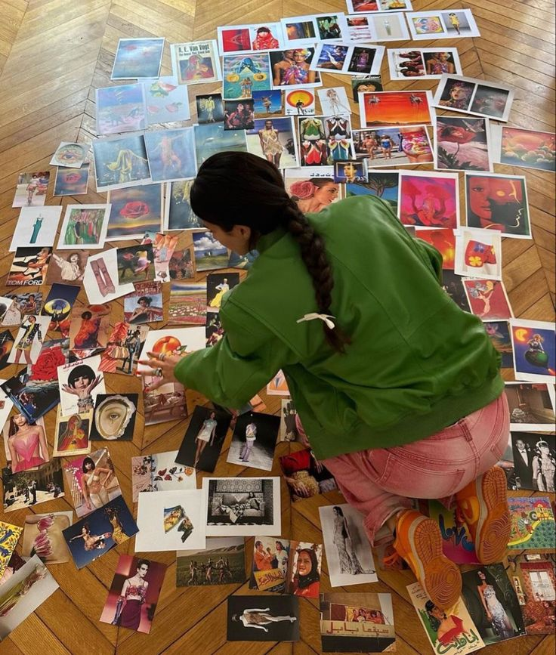
Further Study Routes
GCSE → A-Level → University → Creative Careers
Also useful for:
- Media Studies
- Business
- Photography

Slide 13
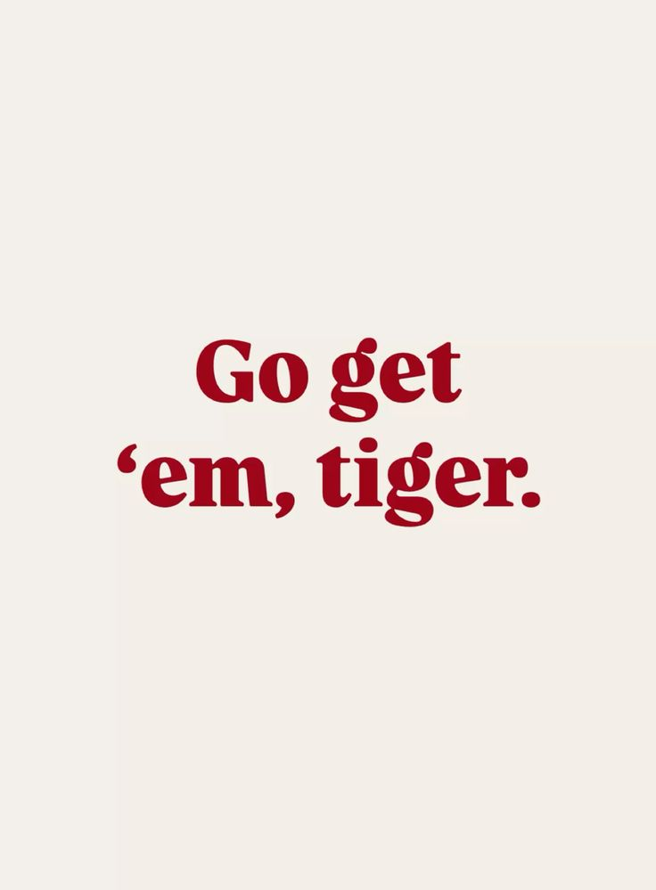
Final Advice
Choose this subject only if:
- You enjoy drawing
- You are very creative
- You can write in detail
- You are committed
Hard work brings success!

