Slide 1
GCSE History
What will my child study over the next two years and how will they be assessed?

Slide 2

An Overview
Students complete 3 Exams at the end of the 2 year course
The exams cover 4 key periods of History – The Tudor reign of Henry VIII, The American West 1835-1895 and Conflict and Tension in the USA (Civil Rights) – as well a Thematic study focusing on Medicine in Britain 1250-present including the Western Front 1914-1918
The Course is graded from 9-1, 4 is a pass/5 is a good pass
The Academy uses the Pearson Edexcel GCSE History Course

Slide 3
Course Content
Over the two year course, students study four key periods of History. These are
Period 1 - Medicine in Britain, c1250–present and The British sector of the Western Front, 1914–1918: injuries, treatment and the trenches
This period looks at:
- Medicine in Medieval England
- The Medical Renaissance in England
- Medicine in 18th & 19th Century Britain
- Medicine in Modern Britain
- The challenges associated with medicine on the Western Front
Period 2 – Henry VIII & his Ministers, 1509-1540
This period looks at:
- England in 1509 – its government & society
- Henry VIII’s rise to power
- The role of Thomas Wolsey and Thomas Cromwell as Henry’s ministers
- Key domestic and international events
- England’s relationship with France & Spain
- The Break with Rome & The Reformation
Period 3 – The American West – 1835-1895
This period looks at:
- The beliefs and society of the Plains Indians
- Migration of Settlers to the West Coast
- The challenges of settling on the Great Plains
- The issue of Law & Order in the American West
- Relations between the US Government & Plains Indians
- The end of the Plains Indian’s way of life
Period 4 – The USA, 1954–75: conflict at home and abroad
This period looks at:
- The Civil Rights movement
- Key Civil Rights leaders such as MLK and Malcolm X
- The Vietnam War
- Protests and opposition to the Vietnam War

Slide 4
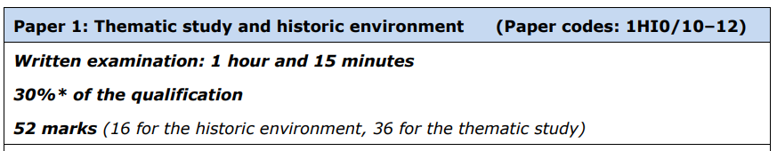
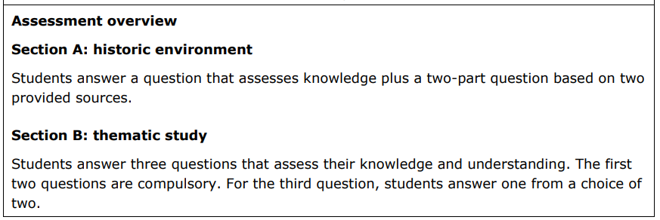
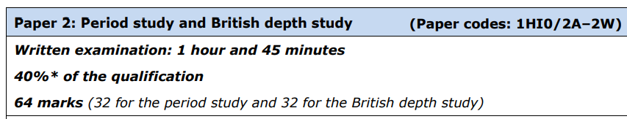
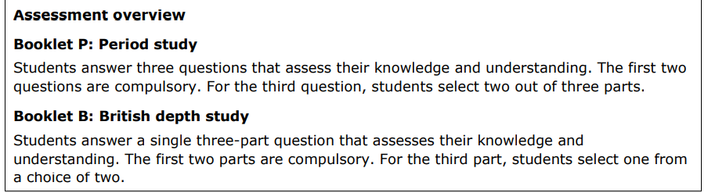
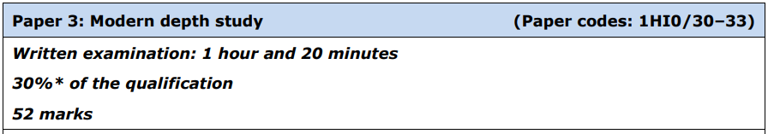
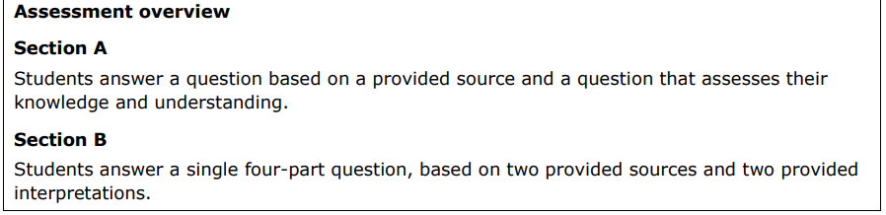
Examinations
At the end of the course, students will sit 3 exams which are designed to test their knowledge of the four periods as well as their historical skills around source analysis and interpretation and the ability to justify analyse and evaluate:

Slide 5
How will we support your child in History?
- Planned and structured lessons which use a variety of resources to engage students and ensure understanding and progress
- In-depth knowledge of exam requirements to develop exam technique and improve grades – staff utilise Edexcel training resources and examiner reports to build knowledge of exam paper requirements
- Regular assessment to check progress and understanding
- School holiday revision sessions and intervention sessions at lunchtimes and after school.
- Communication and additional support materials through Microsoft Teams, including comprehensive revision guide videos
- Revision materials for each of the Historical Periods of the course

Slide 6
How can I support my child in History?
- Encourage your child to watch the news and TV documentaries on the Themes of the course –use BBC iPlayer, The History Channel, Discovery, etc. to further understand key ideas and concepts
- Encourage them to develop their own revision materials such as Knowledge organisers, Mind Maps and Flash Cards of important Case Study locations and Events
- Encourage them to develop their own key word and key date list of term and events for each Theme. Test them on their knowledge of key words and their definitions
- Discuss current affairs with your child – this will help them develop a viewpoint. Recent examination topics have been natural disasters, deprivation in coastal towns, extreme sports, climate change. Challenge your child’s opinion on historical aspects of the course to help them explain the importance or relevance of a person or decision or event
- Direct your child towards GCSEPod if they claim they have no homework. They can even get it on their phone or tablet and can check their understanding through the quizzes.

Slide 7

Homework
Homework is set every single week for KS4 this will primarily be set on Educake our online homework system - students have already been given their logins for this.
Students are required to complete their Educake homework by the Friday of every week.
There will be occasions where additional homework is set, which could be exam answer practice or worksheets.

Slide 8
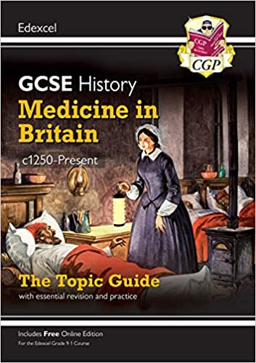
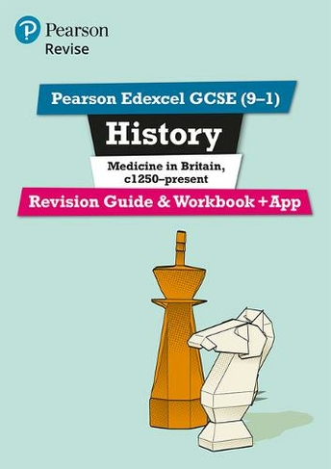
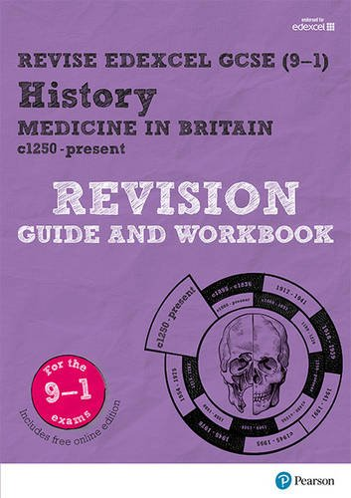


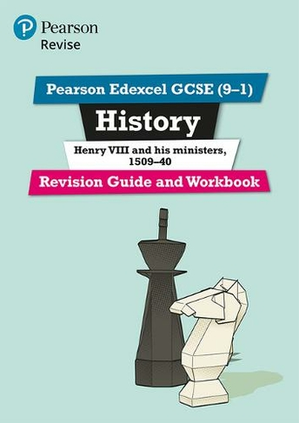

Revision Materials Available

Slide 9
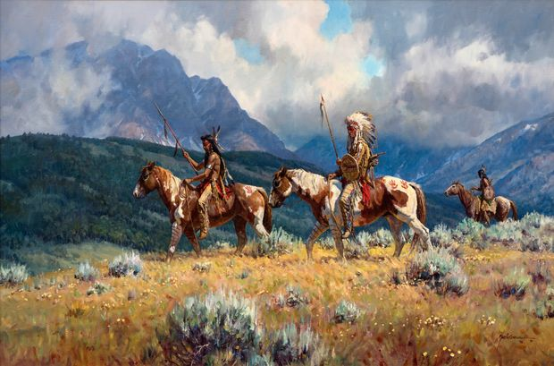
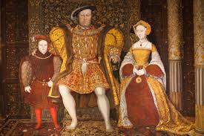
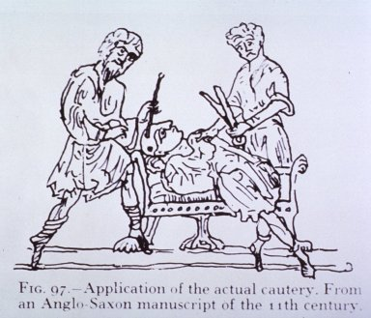
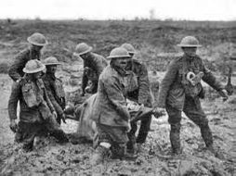
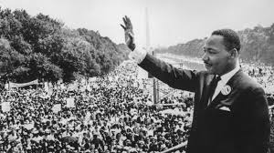
We’re here to help…
If you have any questions or issues you would like to discuss about the course, resources available and supporting your child, please contact:
Francessa.Contegiacomo@cyac.org.uk

