Slide 1
GCSE History
Why choose GCSE History?

Slide 2
If you are someone who …
Can analyse information and weigh up the importance of evidence…
Enjoys independent and guided research…
Can write extended answers to a question …
Can communicate in both written and verbally to form a convincing argument …
Enjoys problem-solving …
Arguing with evidence and proving a point …
Is interested in society, politics or culture …
Is interested in how the past has shaped the present …
You might be someone who also enjoys English literature, law, politics, philosophy, sociology …
Finds interest in the unknown and seeking answers to a question …

Slide 3
Why study GCSE History?
History isn’t just reciting lists of dates or knowing when the Battle of Hastings took place. It’s about understanding why those events mattered in both national and international contexts.
People who study history are fearless explorers of the past. They investigate past politics, societies, cultures, languages , health, art, education, money, conflicts and more, look at how things have developed over time and connect the dots to understand how we got where we are today.

Slide 4
Why study GCSE History?
I have often heard people say “well what would I do with a History qualification” turns out there is a lot!
Politician
Journalist
Archaeologist
Archivist
Game consultant
Teacher
Costume Designer
Social Media Manager
Law
Author/Writer
Librarian
Historian
Heritage Manager
Living Historian
Underwater Archaeologist

Slide 5
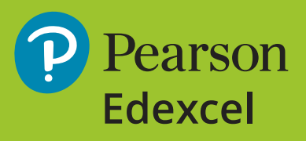
An Overview Of The Course
You complete 3 Exams at the end of the 2 year course
The exams cover 4 key periods of History – The Tudor reign of Henry VIII, The American West 1835-1895 and USA Conflict at Home and Abroad – as well a Thematic study focusing on Medicine in Britain 1250-present including the Western Front 1914-1918
The Course is graded from 9-1, 4 is a pass/5 is a good pass
The Academy uses the Pearson Edexcel GCSE History Course

Slide 6
Course Content
Over the two year course, students study four key periods of History. These are
Period 1 - Medicine in Britain, c1250–present and The British sector of the Western Front, 1914–1918: injuries, treatment and the trenches
This period looks at:
- Medicine in Medieval England
- The Medical Renaissance in England
- Medicine in 18th & 19th Century Britain
- Medicine in Modern Britain
- The challenges associated with medicine on the Western Front
Period 2 – Henry VIII & his Ministers, 1509-1540
This period looks at:
- England in 1509 – its government & society
- Henry VIII’s rise to power
- The role of Thomas Wolsey and Thomas Cromwell as Henry’s ministers
- Key domestic and international events
- England’s relationship with France & Spain
- The Break with Rome & The Reformation
Period 3 – The American West – 1835-1895
This period looks at:
- The beliefs and society of the Plains Indians
- Migration of Settlers to the West Coast
- The challenges of settling on the Great Plains
- The issue of Law & Order in the American West
- Relations between the US Government & Plains Indians
- The end of the Plains Indian’s way of life
Period 4 – Civil Rights
This period looks at:
- Martin Luther King and Malcom X
Civil Rights in the USA
Protests against Civil Rights
The Vietnam War
Protests against the Vietnam War

Slide 7
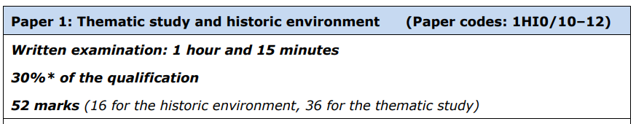
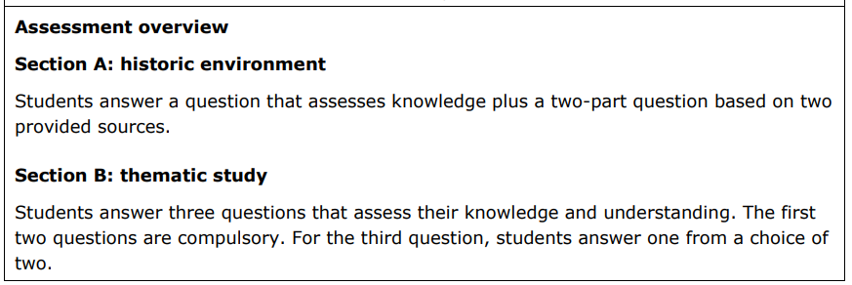
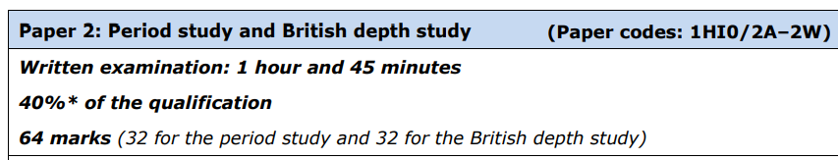
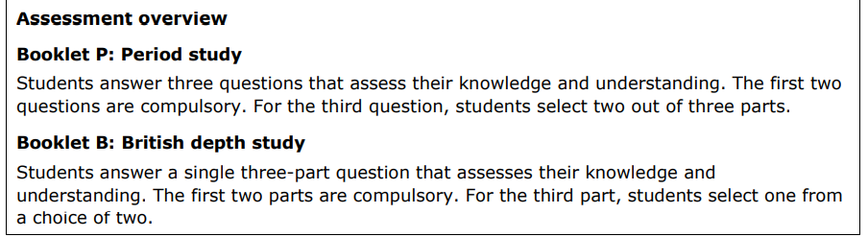
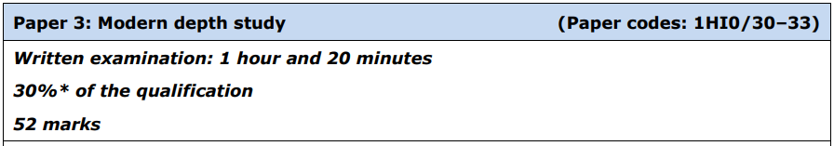
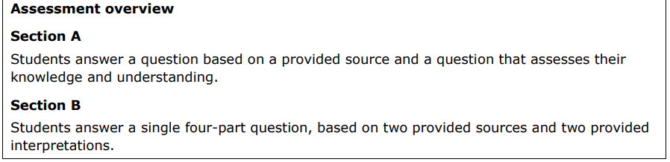
Examinations
At the end of the course, you will sit 3 exams which are designed to test their knowledge of the four periods as well as your historical skills around source analysis and interpretation and the ability to justify analyse and evaluate:

Slide 8
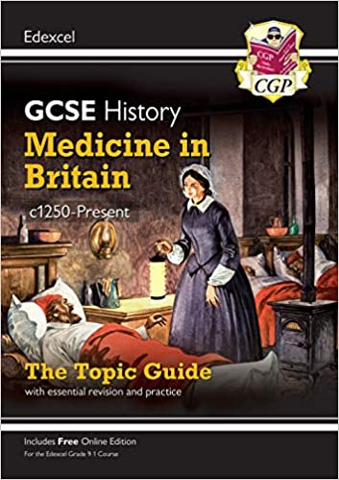
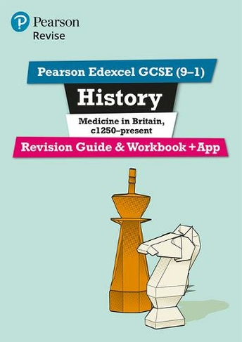
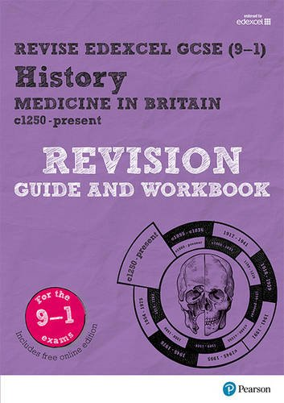
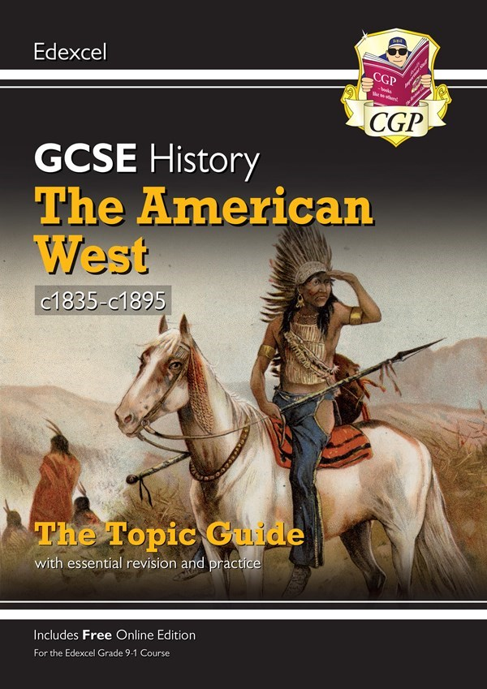
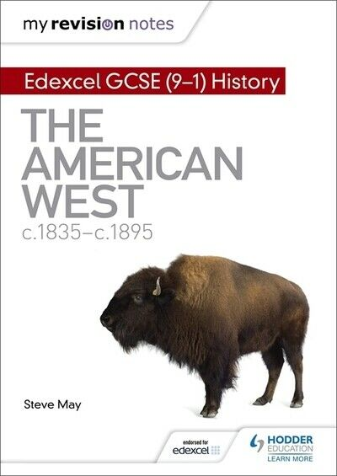
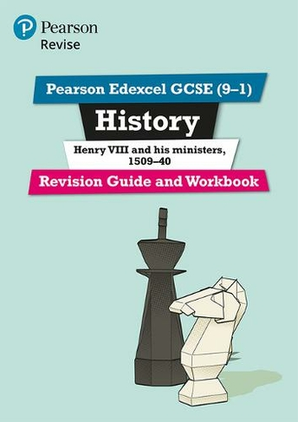
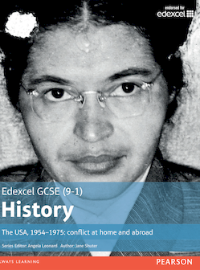
Revision Materials Available

Slide 9
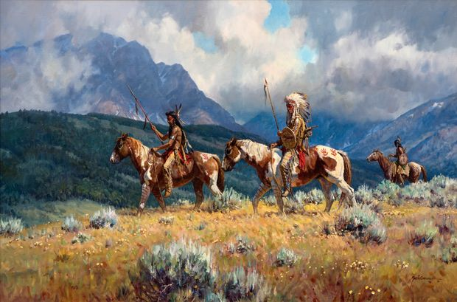
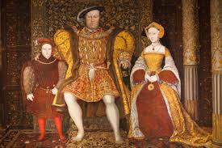
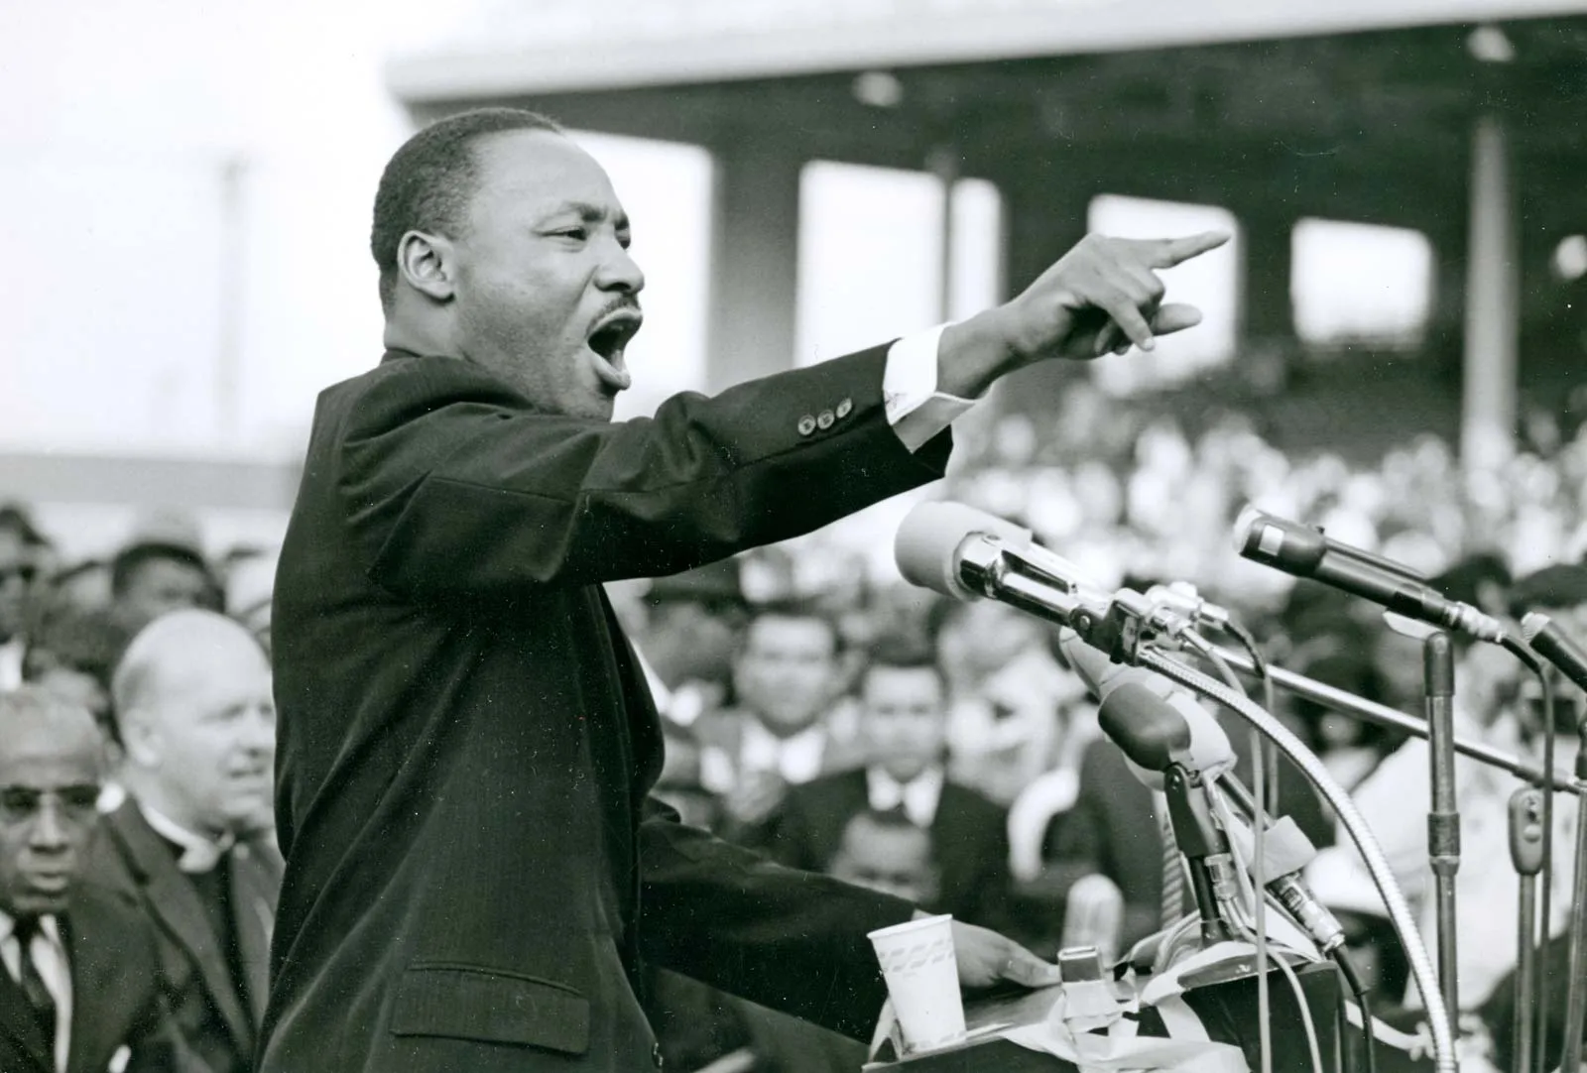
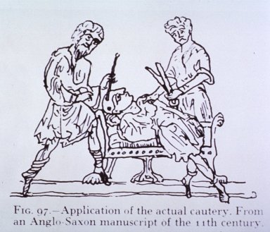
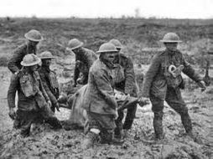
We’re here to help…
If you have any questions or issues you would like to discuss about the course, resources available and supporting your child, please contact:
Ben.Curtis@cyac.org.uk
Francessa.contegiacomo@cyac.org.uk

