Slide 1
GCSE AQA Photography
Year 9 Options Assembly
What You Need to Know

Slide 2
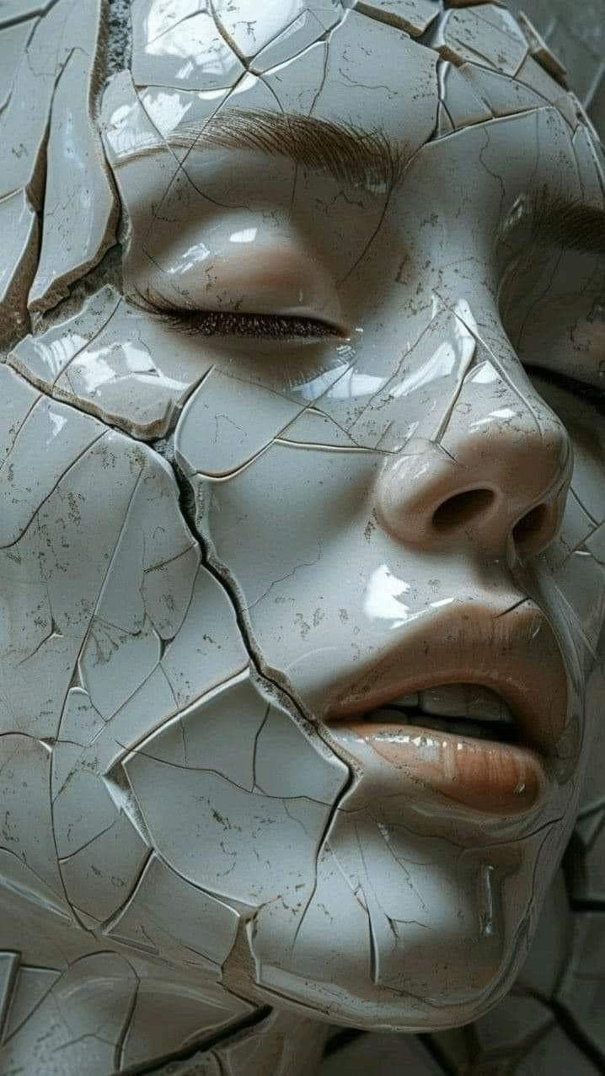
What is GCSE Photography?
A creative subject focused on digital and traditional photography.
You explore lighting, composition, editing, and visual storytelling.

Slide 3
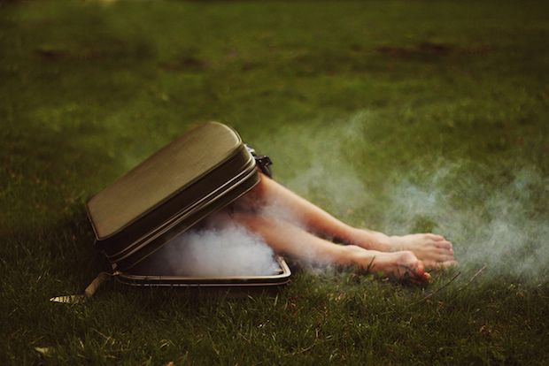
Course Structure (AQA)
Component 1: Portfolio (60%)
Ongoing coursework over 2 years.
Component 2: Externally Set Assignment (40%)
10-hour controlled assessment.

Slide 4
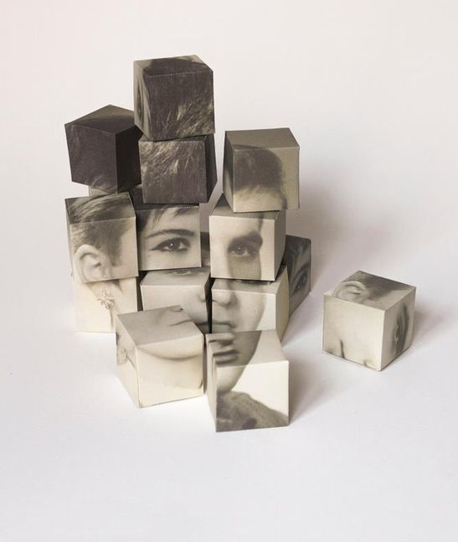
AQA Assessment Objectives
AO1: Develop ideas and research
AO2: Experiment with techniques and processes
AO3: Record ideas (photography and drawing)
AO4: Present a personal response

Slide 5
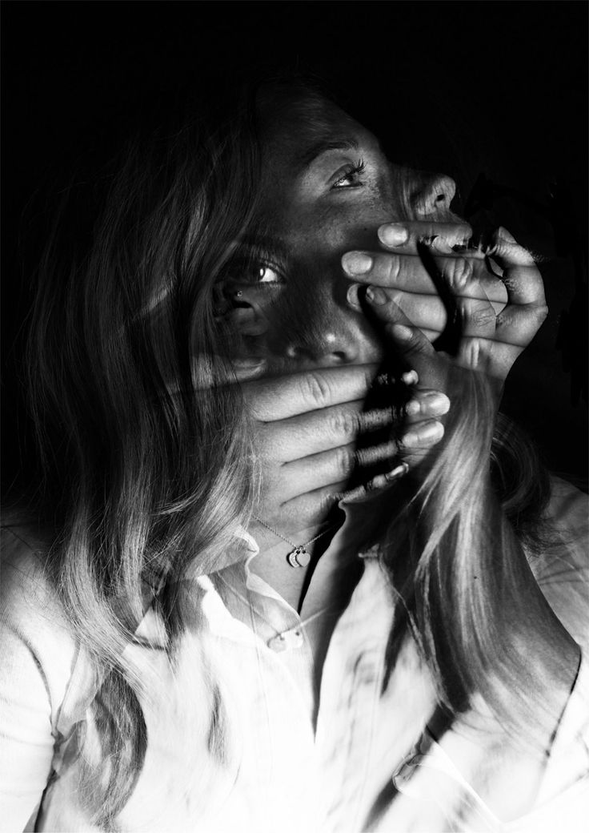
Drawing for Photography
Drawing is essential for planning shoots.
You will:
- Create shoot plans
- Sketch compositions
- Plan lighting and angles
- Design layouts
If you dislike drawing, this course may be difficult.

Slide 6
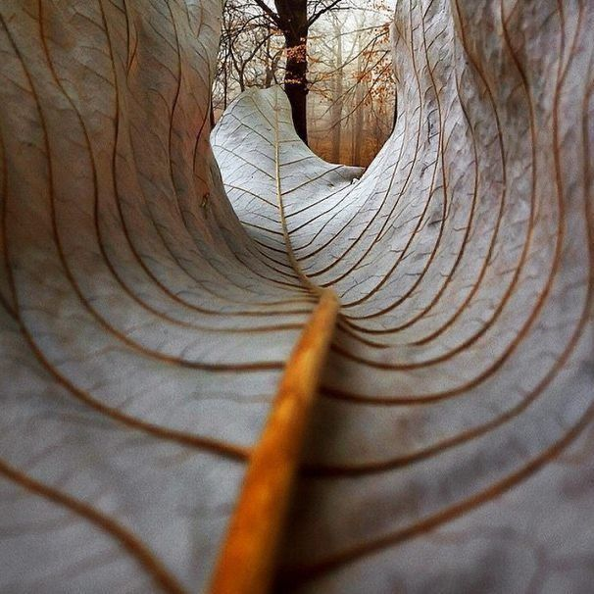
Written Analysis and Evaluation
Extended writing is required in every project.
You must:
- Analyse photographers
- Explain creative choices
- Evaluate your own work
- Use specialist vocabulary
Strong writing skills are essential.

Slide 7
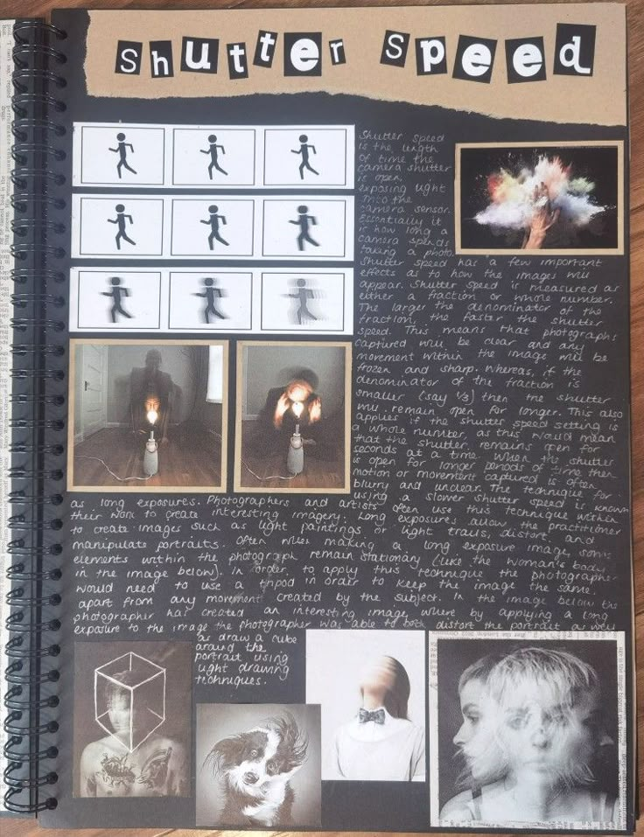
How Much Writing is Involved?
You will regularly complete:
- Detailed artist analysis
- Project evaluations
- Exam reflections
- Development commentary
Expect long written responses.

Slide 8
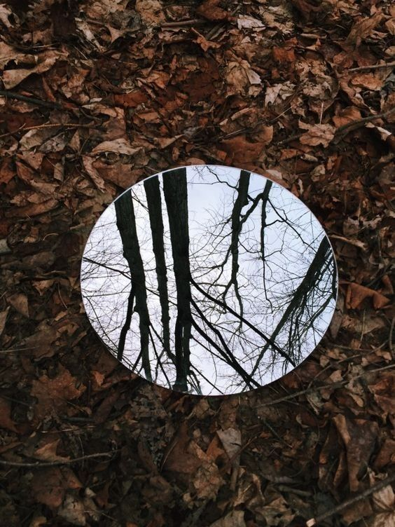
Essential Skills for Success
- Good drawing for planning
- Strong written communication
- Technical camera skills
- Organisation
- Creativity
- Independence

Slide 9
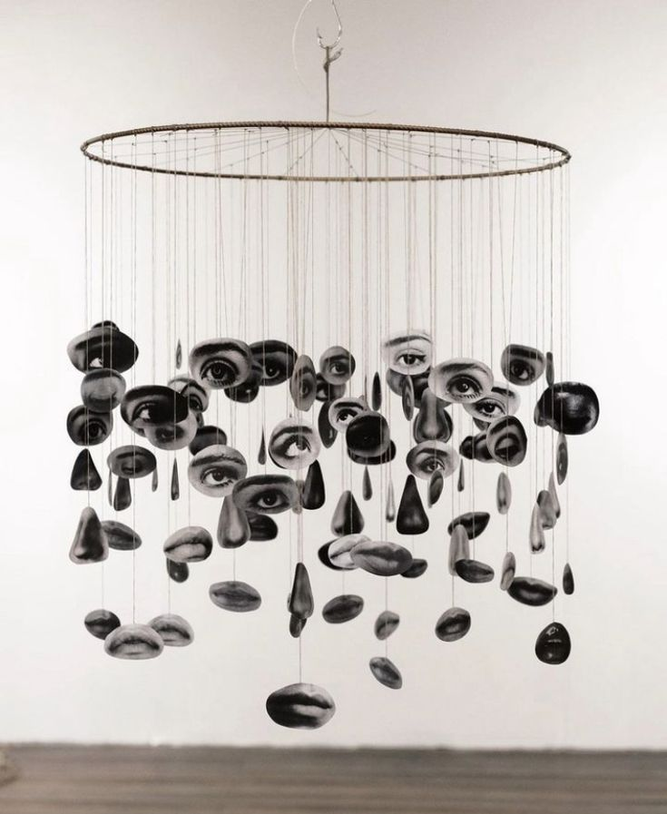
Workload and Commitment
This is a demanding subject.
You will:
- Meet regular deadlines
- Edit work at home
- Complete written tasks
- Manage long-term projects

Slide 10
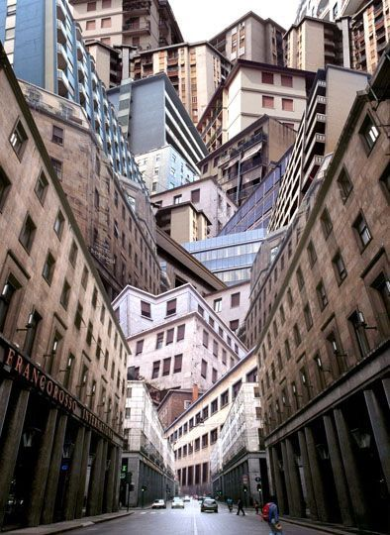
Who Should Choose Photography?
Choose this subject if you:
- Enjoy creative subjects
- Can draw and communicate with plans
- Are confident with writing
- Like working independently
Not suitable for minimal effort.

Slide 11
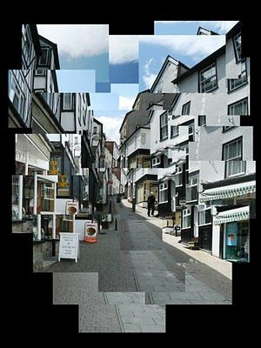
Important Warning
If you struggle with drawing or extended writing:
- You may find this course challenging
- Grades depend on analysis and planning
- Poor organisation affects results

Slide 12
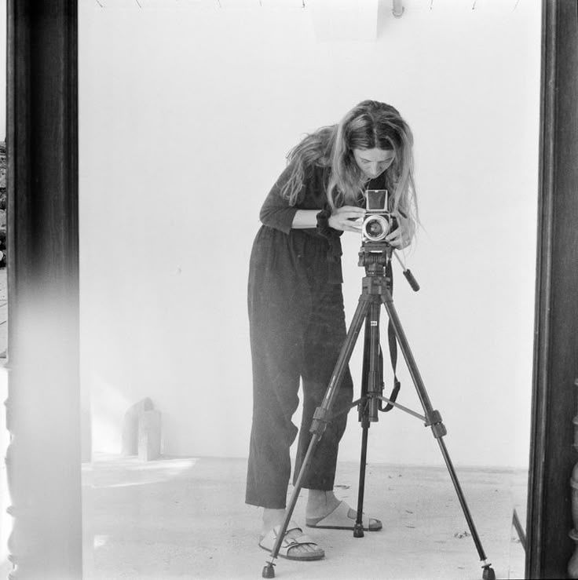
Career Pathways
- Photographer
- Photojournalist
- Graphic Designer
- Media Editor
- Marketing Designer
- Fashion Photographer
- Advertising Creative
- Film and Media Producer

Slide 13
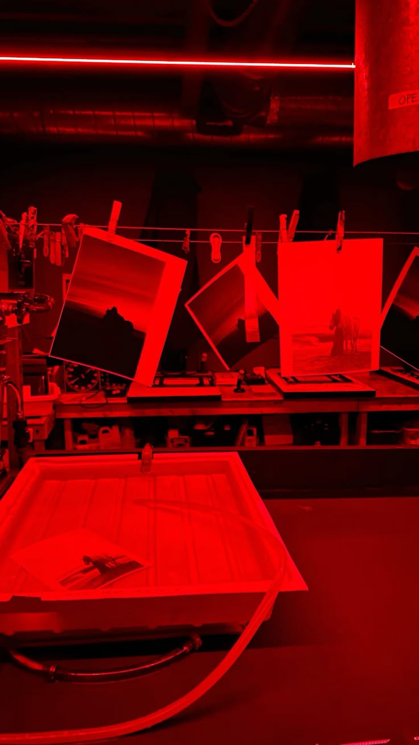
Further Study Routes
GCSE Photography → A-Level Photography/Art → University → Creative Careers
Also useful for:
- Media Studies
- Design Technology
- Film Studies

Slide 14
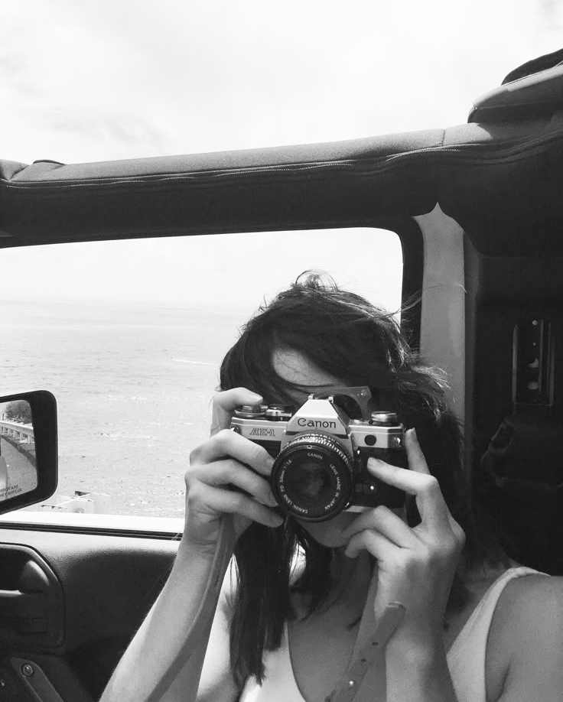
Equipment You Will Need
YOU DO NOT NEED TO OWN A CAMERA!
Must have a smartphone with decent camera
Everything else is provided

Slide 15
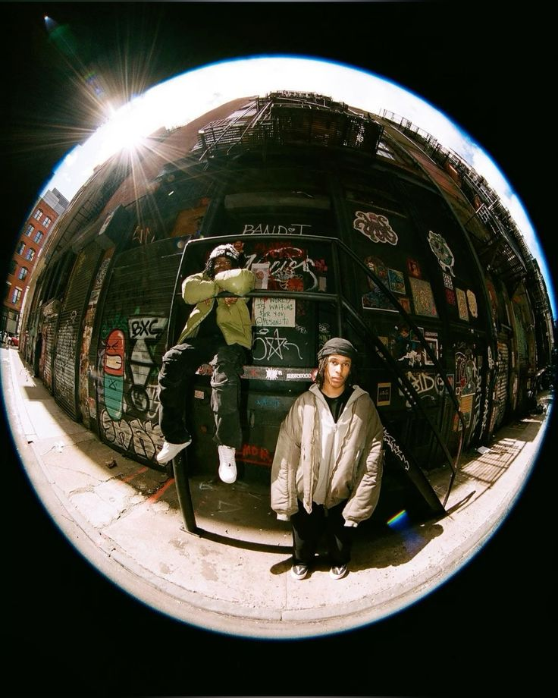
Final Advice
Choose Photography if:
- You can plan using drawing effectively
- You enjoy extended writing
- You are organised
- You are committed
Hard work leads to strong results!

