Slide 1



Y9 OPTIONS
GCSE Spanish
Join us on our journey….

Slide 2

Why GCSE Spanish?
Studying any language is a vital asset in the modern world.
Every industry is desperate for graduates who have the skills and qualities that learning a language grants you.
74% of employers are looking for school-leavers with language skills. (Most employers do not require complete fluency. They want conversational ability, which will give a good impression, help to build relationships and make new contacts).
Having a second language will set you apart from other job seekers, as well as potentially increasing your salary by up to 20%!!
Join us on our journey….

Slide 3
Why GCSE Spanish?
Our planet has over 6 billion people who speak between 6000 and 7000 different languages.
Only 6% of the world’s population are native English speakers.
75% of the world’s population speak no English at all!
As well as learning the language itself you will learn about the wider Spanish-speaking cultures and nuances to enable you to increase your understanding of the world we live in.
Join us on our journey….

Slide 4
Why GCSE Spanish?
Some universities now require a language GCSE for certain degree courses e.g English, History and Law
A GCSE in a language will help you get into university
You will need a GCSE in a language to be awarded the English Baccalaureate (Ebacc)
Join us on our journey….

Slide 5
What is involved in GCSE Spanish?
The content of Spanish GCSE is split across 3 key themes:
Theme 1 - Identity and Culture
Theme 2 - Local, International and Global Areas of interest
Theme 3 - Current and future study and employment
All three of these themes directly build and relate to what you have been studying so far over the last three years.
Join us on our journey….

Slide 6
GCSE Spanish
Theme 1 – Identity and Culture
Topic 1: Me, my family and friends - Relationships with family and friends - Marriage/partnership
Topic 2: Technology in everyday life - Social media - Mobile technology
Topic 3: Free-time activities - Music - Food and eating out - Cinema and TV – Sport
Topic 4: Customs and festivals in Spanish speaking countries/communities
Join us on our journey….

Slide 7
GCSE Spanish
Theme 2 – Local, national, international and
global areas of interest
Topic 1: Home, town, neighbourhood and region
Topic 2: Social issues - Charity/voluntary work - Healthy/unhealthy living
Topic 3: Global issues - The environment - Poverty/homelessness
Topic 4: Travel and tourism
Join us on our journey….

Slide 8
GCSE Spanish
Theme 3 – Current and future study and employment
Topic 1: My studies
Topic 2: Life at school/college
Topic 3: Education post-16
Topic 4: Jobs, career choices and ambitions
Join us on our journey….

Slide 9
Who this course will suit:
Those who are curious and like to learn new words and learn about new cultures (21 countries have Spanish as an official language and around 450 million people speak it!)
You will need to be independent, as you will need to learn vocabulary each week and develop your language skills outside of the classroom!
Remember Spanish is the 2nd most spoken language in the world, after Mandarin Chinese.
Join us on our journey….

Slide 10
How you will be assessed:
Language GCSEs have tiered entry - this means there are two different exams. One is called Foundation and the other is called Higher.
The Foundation exam is easier, but the highest grade you can achieve is a 5.
The Higher exam is more difficult, but you can achieve up to a 9.
Decisions on which tier students should take will occur during the early part of Year 11.
There are 4 different papers to take (each worth 25% of your grade), all exams take place during Year 11:
Paper 1 - Listening
Paper 2 - Speaking (takes place during April-May of Year 11) 1:1 with teacher
Paper 3 - Reading
Paper 4 - Writing
Join us on our journey….

Slide 11
Assessment: Foundation Tier (Grades 1-5)
Higher Tier (Grades 4-9)
Listening (25%) Written exam
30/40 mins + 5 mins reading time
40/50 marks
Section A Listening Tasks
Section B Dictation
Join us on our journey….

Slide 12
Assessment: Foundation Tier (Grades 1-5)
Higher Tier (Grades 4-9)
Speaking (25%) Oral exam
7-9/10-12 mins + 12 mins preparation time
60 marks
Part 1 – Read Aloud
Part 2 – Role Play
Part 3 – Picture Task with General Conversation
Join us on our journey….

Slide 13
Assessment: Foundation Tier (Grades 1-5)
Higher Tier (Grades 4-9)
Reading (25%) Written exam
45/60 mins
60 marks
Section A Reading and Understanding
Section B Translation into English
Join us on our journey….

Slide 14
Assessment: Foundation Tier (Grades 1-5)
Writing (25%) 1 hour
50 marks
  Question 1 Produce 4 sentences in response to a photo
  (8 marks)
  Question 2 Write approx. 40 words in response to 4 bullet points
  (16 marks)
  Question 3 Translation from English to Spanish (min. 35 words)
  (10 marks)
  Question 4 Write approx. 90 words in response to 4 bullet points, choice of 2 (16 marks)
Join us on our journey….

Slide 15
Assessment: Higher Tier (Grades 4-9)
Writing (25%) 1 hour 15 mins
60 marks
  Question 1 Write approx. 90 words in response to 4 bullet points, choice of 2 (16 marks)
  Question 2 Write approx. 150 words in response to 2 bullet points, choice of 2 (32 marks)
  Question 3 Translation from English to Spanish (min. 50 words) (12
Join us on our journey….

Slide 16
Careers:
A language is beneficial to any career, however these are some of the most common careers language graduates go into:
Translation (for governments, businesses, publishers & more!
Journalism & The media
Marketing
Law
The Police (especially detective work)
Sales executives
Engineering
Tourism
Transport & Logistics industries
Teaching
Hospitality & catering industries.
Join us on our journey….

Slide 17
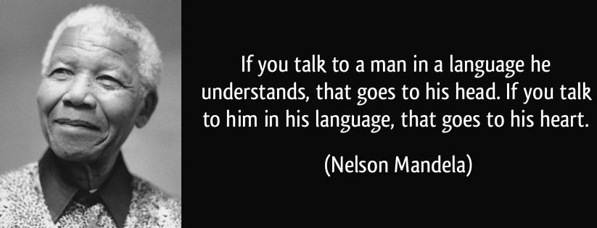
Join us on our journey….

Slide 18

https://www.youtube.com/watch?v=c0MlOuOPjfU&safe=active
Join us on our journey….

