Slide 1

Geography at Caistor Yarborough Academy Supporting Your Child with GCSE Revision.
Join us on our journey….

Slide 2


Purpose of this Guide
This leaflet supports parents and carers in helping their child prepare effectively for GCSEs in Geography. It outlines key content, exam structures, and practical revision approaches that make a difference at home.
Exam Board: Eduqas GCSE Geography A
Join us on our journey….

Slide 3
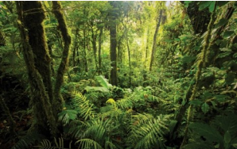
Key Themes
• Landscapes & Physical Processes – Rivers, coasts,
flooding and management.
• Rural–Urban Links – Population change, retailing,
global cities, urbanisation.
• Weather, Climate & Ecosystems – Climate change,
weather hazards, ecosystems.
• Development & Resource Issues – Global inequalities and water management.
• Coastal Hazards & Management – UK coastlines,
vulnerability and sustainability.
• Social Development Issues—Healthcare, Disease &
Migration
Join us on our journey….

Slide 4
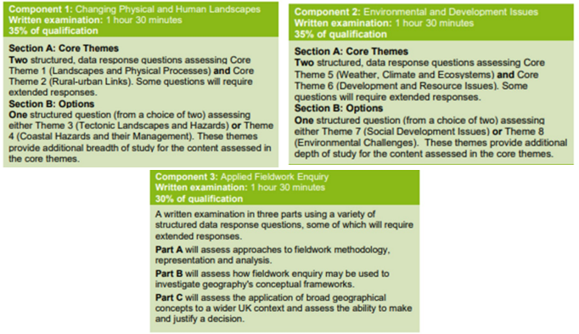
The Exam Element
Join us on our journey….

Slide 5
Examples of Effective Revision Tools
Flashcards:
• Landform creation – Waterfalls, Meanders, Headlands, Bays, Spits.
• River processes – Erosion, Transportation, Deposition.
• Climate factors – Latitude, Altitude, Distance from Sea.
• Global circulation and storm formation.
• Migration push and pull factors.
• Development indicators – GNI, GDP, HDI.
Flow Diagrams:
• Hydrological Cycle – Evaporation → Condensation → Precipitation → Run-off.
• Carbon & Nutrient Cycles – showing stores and transfers.
Mind Maps:
• Coastal Management Strategies – Hard vs. Soft Engineering (advantages, disadvantages, stakeholder views).
• Global Cities – London and Lagos: challenges and sustainable solutions.
• Ecosystem Management – Rainforest conservation, ecotourism, biosphere reserves.
• Flood Management – Comparing approaches and community impacts.
• Retail Change – Causes, impacts and strategies to revitalise high streets.
Join us on our journey….

Slide 6
How Parents Can Help
• Encourage regular short revision sessions using Educake (Homework platform), BBC Bitesize, GCSEPod, and YouTube (e.g. “Time for Geography”).
• Review flashcards together to test definitions and key terms.
• Discuss real-world examples such as flooding, coastal erosion, or urban growth.
• Support completion of past papers and use exam mark schemes to check progress – Use Free AI platforms to produce model answers to help students develop exam technique
• Use Free AI platforms to create Multiple Choice Quizzes on the Course Key Themes
Join us on our journey….

Slide 7
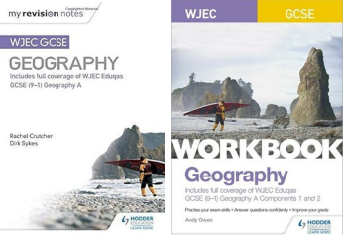
Useful Revision Guides
Official Eduqas Spec A—My Revision Notes:
WJEC GCSE Geography Second Edition
WJEC GCSE Geography workbook
Gcse Geography Revision Guide –
Not course specific but useful for general Geography revision
Join us on our journey….

