Slide 1

History at Caistor Yarborough Academy Supporting Your Child with GCSE Revision.
Join us on our journey….

Slide 2

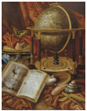
Purpose of this Guide
This leaflet supports parents and carers in helping their child prepare effectively for GCSEs in History. It outlines key content, exam structures, and practical revision approaches that make a difference at home.
Exam Board: Edexcel
Join us on our journey….

Slide 3
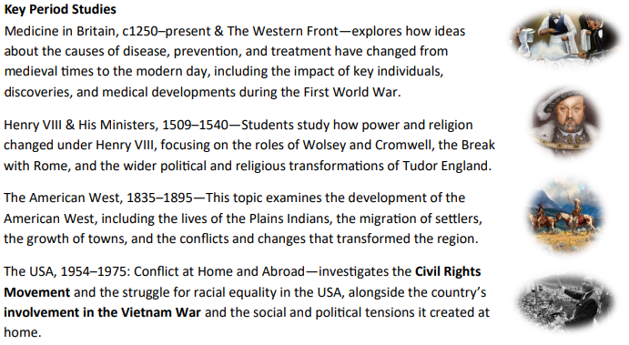
Key Period Studies
Join us on our journey….

Slide 4
The Exam Element
Paper 1—Thematic Study and Historic Environment (1 hour 15 mins) Medicine in Britain, c1250–
present & The Western Front – testing how medicine has developed over time and how medical care
was delivered during World War I.
Paper 2—Period Study and British Depth Study (1 hour 45 mins) - Henry VIII and His Ministers, 1509–
1540 – assessed in Paper 2 (part 1), focusing on Henry VIII’s government, religion and the roles of
Wolsey and Cromwell.
The American West, 1835–1895 – assessed in Paper 2 (part 2), examining the settlement and
development of the West, including conflict and change.
Paper 3—Modern Depth Study (1 hour 20) - The USA, 1954–1975: Conflict at Home and Abroad –
testing understanding of the Civil Rights Movement and America’s involvement in the Vietnam War
through source and interpretation analysis.
Join us on our journey….

Slide 5
Examples of Revision Tools
Flashcards:
• Medicine in Britain – Key individuals (Jenner, Pasteur, Fleming), medical breakthroughs, and key
dates.
• Henry VIII & His Ministers – Wolsey’s reforms, Cromwell’s role, and the Reformation.
• The American West – Plains Indian culture, Homestead Act, key figures (Joseph McCoy, John Iliff).
• Conflict in the USA – Civil Rights leaders (Martin Luther King Jr., Malcolm X), key acts (Civil Rights Act
1964), and Vietnam events.
Mind Maps:
• Medicine Through Time – Causes of disease, treatments, public health, and changing medical
knowledge.
• The American West – Migration, settlement, conflict, law and order.
• Henry VIII & His Ministers – Political power, religion, and key events (Break with Rome).
• Conflict in the USA – Civil Rights vs. Vietnam War, protest movements, and public opinion.
Timelines:
• Medicine in Britain: Medieval → Renaissance → Industrial → Modern eras.
• The American West: 1835 (Plains Indian lifestyle) → 1862 (Homestead Act) → 1890 (Wounded
Knee).
• Henry VIII: 1509 (Accession) → 1529 (Fall of Wolsey) → 1534 (Act of Supremacy) → 1540 (Execution
of Cromwell).
• Conflict in the USA: 1954 (Brown v Board) → 1963 (March on Washington) → 1968 (Tet Offensive &
Civil Rights Act).
Join us on our journey….

Slide 6
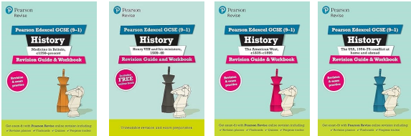
How Parents Can Help
• Ask your child to “teach back” key events — this strengthens memory.
• Encourage timed past paper practice using Edexcel materials.
• Support use of examiner reports for model answers.
• Reinforce chronological understanding using timelines and mind maps.
• Direct students to Educake (Homework platform), BBC Bitesize, GCSEPod, and reliable YouTube
channels like Revise GCSE History and Mr Swift History.
• Make use of Free AI platforms to help students create model answers for past questions &
identify where marks have been awarded
Join us on our journey….

