Slide 1

Mathematics at Caistor Yarborough Academy
Join us on our journey….

Slide 2

Staff
Mrs Marshallsay (Head of Mathematics)
Mrs Mirmolavi/ Mr Frame (2nd Department)
Mr Mill
Mrs Hickson
Mr Taylor
Mrs Chisnall (department LSA)
Join us on our journey….

Slide 3
GCSE Mathematics:
Graded from 9-1
All linear exams – 100% external assessment
Pearson Edexcel exam board
2 tiers Higher (grades 4 - 9)
Foundation (grades 1 – 5)
Join us on our journey….

Slide 4
Exam Papers
3 exams in May/June – Paper 1: NON CALCULATOR
Paper 2: CALCULATOR
Paper 3: CALCULATOR
All exams are 1 hour 30 minutes/ 80 marks
Each exam is worth 33 1/3 of the final grade (equal weighting)
Join us on our journey….

Slide 5
Assessing skills in Mathematics
Each exam will assess the 6 core strands of Mathematics
Number
Algebra
Ratio, proportion and rates of change
Geometry and measures
Probability
Statistics
2025 results 4+ 77% 5+ 54% N.A. 4+ 72% 5+ 53%
Join us on our journey….

Slide 6
Ways to help yourself
And how we help you:
There is a lot of formulae to be learned
Join us on our journey….

Slide 7
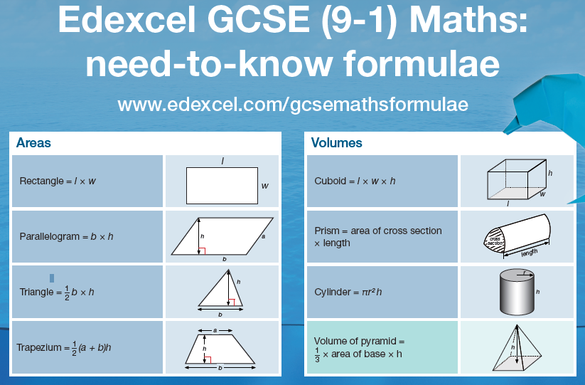

Make sure that you learn all the formulae
We will give you Flashcards to help
You will also get time in form periods to practice
Use this time wisely!!!
Join us on our journey….

Slide 8
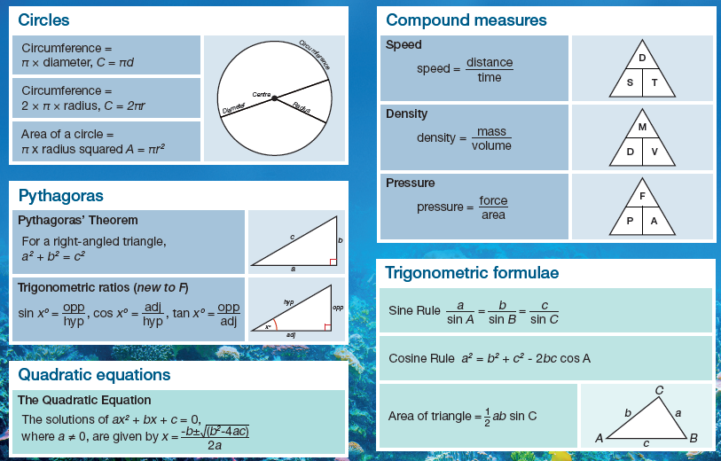
Make sure that you learn all the formulae
We will give you Flashcards to help
You will also get time in form periods to practice
Use this time wisely!!!
Join us on our journey….

Slide 9

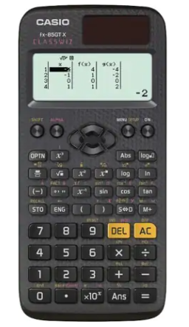
Calculator:
Remember, 2 of the 3 exams are calculator papers.
Get yourself the same calculator we use in school. We can then teach you how to use it effectively.
You will need it for homework and revision
Casio Fx 83 GTCW or Casio Fx 85 GTCW
Join us on our journey….

Slide 10

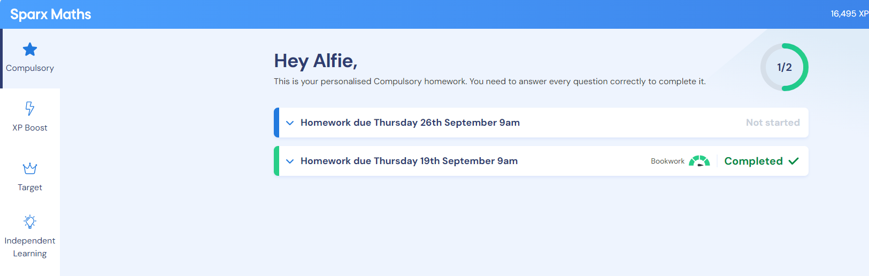
You will be given ;
*Access to SPARX Maths
Dashboard - Teacher View | Sparx Maths
Join us on our journey….

Slide 11
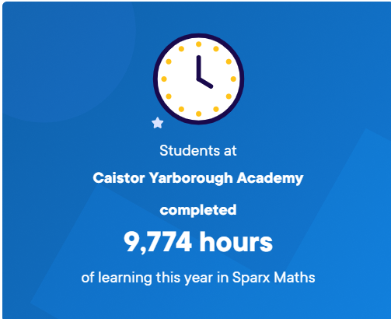

Constant recap of learning and filling in gaps in knowledge throughout the year makes a huge difference to outcomes
Join us on our journey….

Slide 12
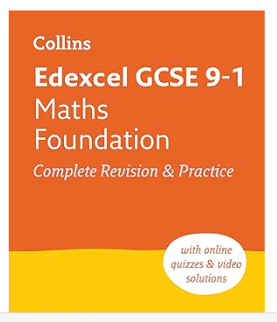
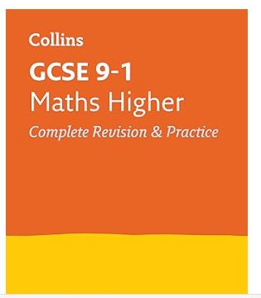
The best way to LEARN Mathematics is to DO Mathematics ;
*SPARX Maths
*Corbett Maths … Videos, Practice exercises and Exam questions
Edexcel Higher Checklist 2022 (corbettmaths.com)
*A set of flashcards to help you learn the formulae needed
*Revision and Intervention materials
Join us on our journey….

Slide 13
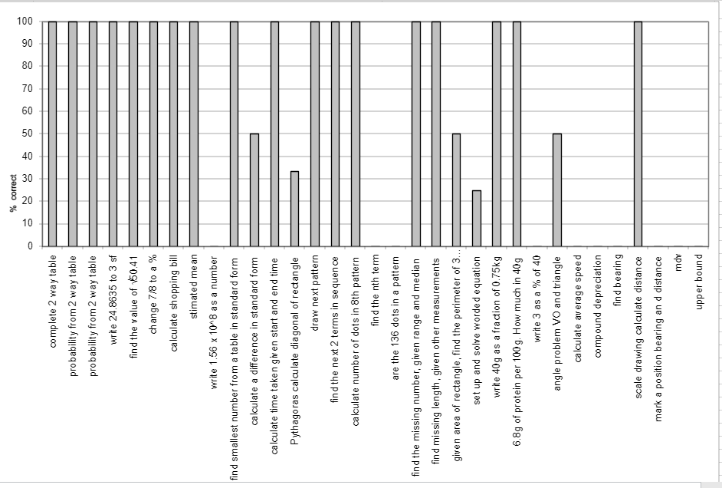
The best way to LEARN Mathematics is to DO Mathematics;
*Personalised assessment grid following exams
Join us on our journey….

Slide 14
Contact us: with any questions
Cheryl.Marshallsay@cyac.org.uk (Head of Faculty)
Claire.mirmolavi@cyac.org.uk (Second in Faculty)
George.frame@cayac.org.uk (Second in Faculty)
Gemma.Chisnall@cyac.org.uk
Join us on our journey….

